Slide 1


CORONAVIRUS TWEET SENTIMENT ANALYSIS
CAPSTONE PROJECT - III
MADE BY: SANKET CHOURIYA
PROJECT MADE BY:
SANKET CHOURIYA
Participants : Ruchitha Kanakaiah Bijja & Dinesh Bhuyan

Slide 2

TABLE OF CONTENT
Introduction
About Dataset
Exploratory Analysis
Text Preprocessing
Model Implementation
Model Comparison
Conclusion

Slide 3
INTRODUCTION
INTRODUCTION
During the recent COVID-19 outbreak, public opinion analytics provided useful information for determining the best public health response. At the same time, the dissemination of misinformation, aided by social media and other digital platforms, has proven to be a greater threat to global public health than the virus itself, as the COVID-19 pandemic has shown. The public's feelings on social distancing can be discovered by analyzing articulated messages from Twitter.
This challenge asks you to build a classification model to predict the sentiment of COVID-19 tweets. The tweets have been pulled from Twitter and manual tagging has been done then. The automated method of recognizing and classifying subjective information in text data is known as sentiment analysis. Basically, the engine works as follows: after user has provided with tweet, the engine cleans the data and tries to classify the tweet as positive, negative or neutral.

Slide 4

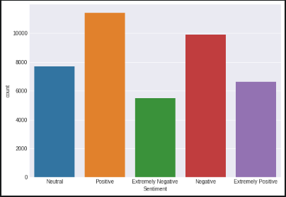
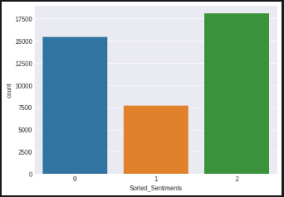
SENTIMENT DISTRIBUTION
Out of 41157 tweets, There are 11422 Positive tweets, 9917 Negative Tweets, Neutral Tweets, 6624 Extremely Positive and 5481 Extremely Negative. This are the original 5 classes in the Target label aka Sentiment Column in Dataframe.
As this classification is MultiClass. Thus, to make it simple, The original classes has been merged down to 3 classes now i.e. Positive (18046), Negative (15398) and Neutral (7713) to make the classification much easier.

Slide 5
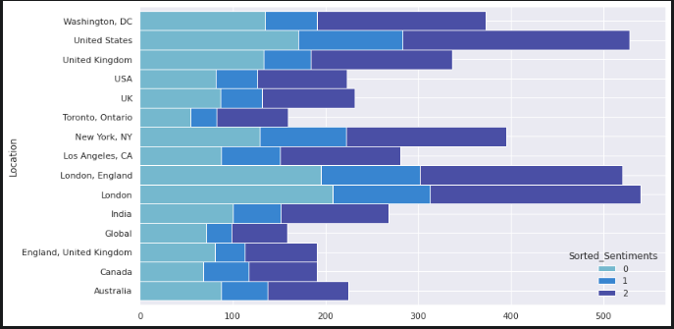
LOCATIONS WITH MOST OF THE TWEETS
Seems, like London had most no of tweets made during the 2020. Both Most of number of Negative and positive tweets has been made from London itself while Americans were on second place for there presence in Twitter.

Slide 6
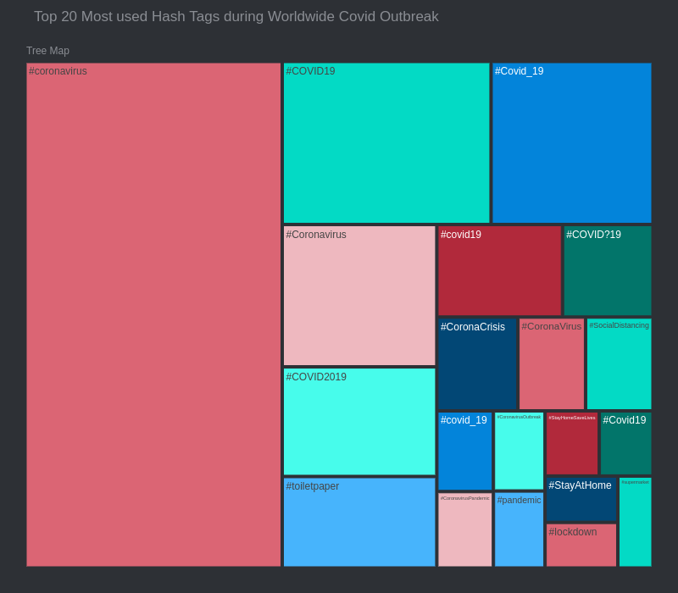
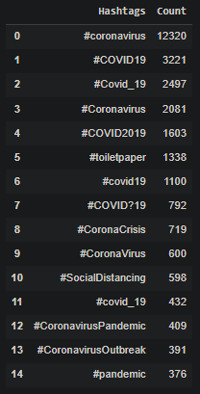
MOST USED HASH TAGS

Slide 7
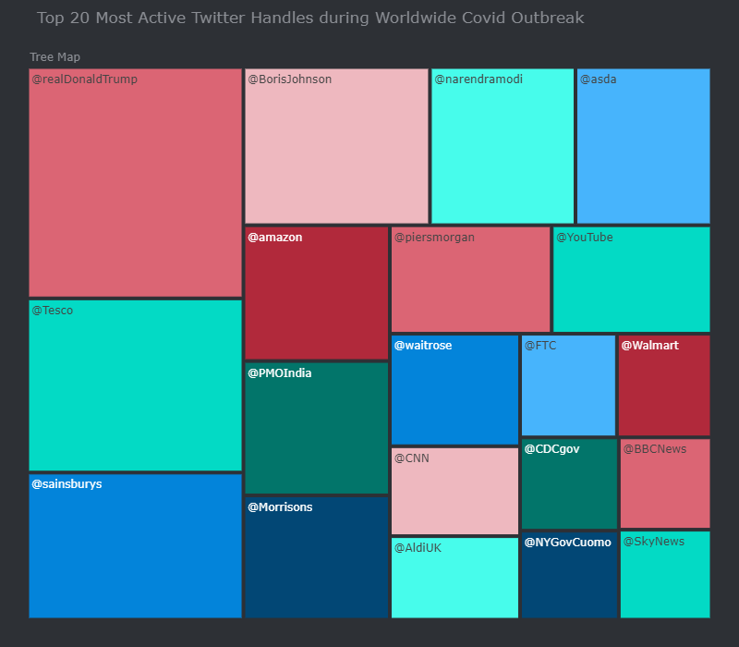
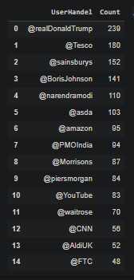
MOST ACTIVE AND MENTIONED USER HANDLES

Slide 8
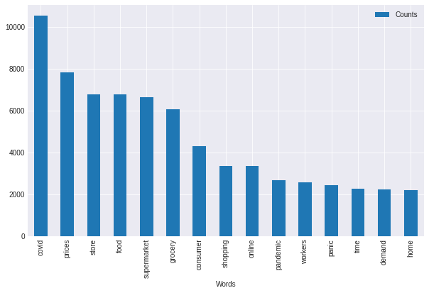
MOST USED WORDS IN TWEETS
Its not a surprise that covid is the most common word used in the tweets. It made more than 12000 appearance in tweets globally. After then that words like, prices, store, food, supermarket and grocery were most used words.

Slide 9
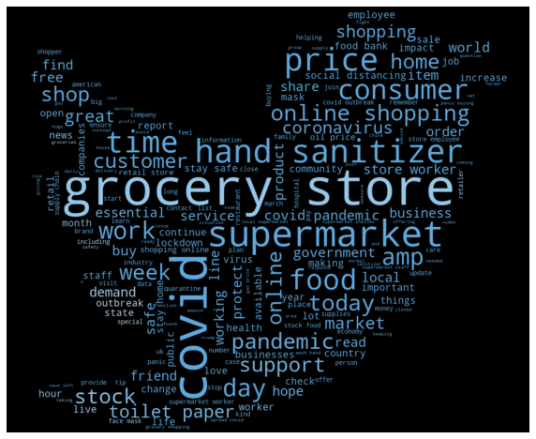
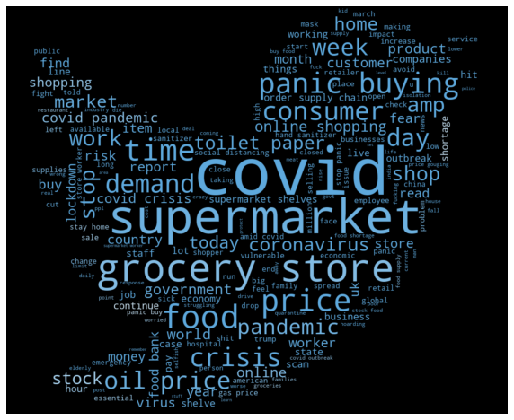
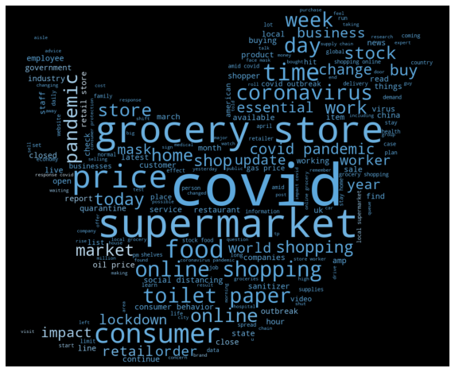
WORD CLOUDS WITH SENTIMENTS
Words in Positive tweets:
Grocery, store, covid, supermarket, hand sanitizer, support, customer, online, time, consumer, etc.
Words in Negative tweets:
Grocery, store, covid, supermarket, crisis, pandemic, panic buying, demand, oil price, work, etc.
Words in Neutral tweets:
Grocery, store, covid, supermarket, hand sanitizer, price, coronavirus, online shopping, world, etc.

Slide 10
TEXT PREPROCESSING
Lemmatization
Stemming
Short Words Removal
Text Cleaning with Neattext
Tokenization
Test-Train Split
TF-IDF
NeatText is a simple NLP package for cleaning textual data and text preprocessing. Simplifying Text Cleaning For NLP & ML
Tokenization is the process of tokenizing or splitting a string, text into a list of tokens.
Lemmatization is a text normalization technique used in NLP, that switches any kind of a word to its base root mode
Stemming is the process of reducing a word to its root form.
Removal of unwanted words basically with less than 2 characters to reduce noise.
Split arrays or matrices into random train and test subsets.
TF-IDF stands for term frequency-inverse document frequency

Slide 11
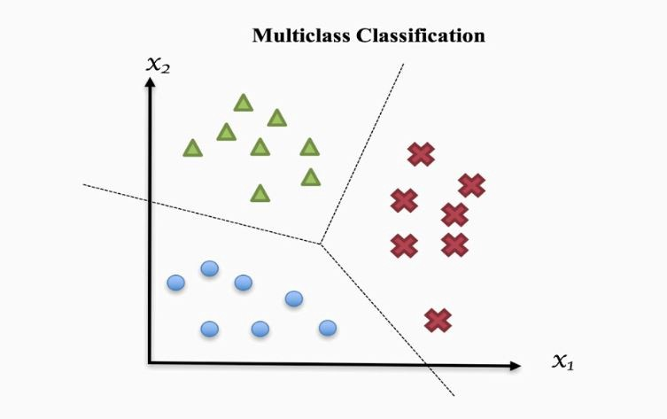
MODEL IMPLEMENTATION
Multiclass classification:
Whether it’s spelled multi-class or multiclass, the science is the same. Multiclass classification is a machine learning classification task that consists of more than two classes, or outputs.
We are given a set of training samples separated into K distinct classes (In this dataset it is POSITIVE, NEGATIVE & NEUTRAL sentiments) and we create an ML model to forecast which of those classes some previously unknown data belongs to. The model learns patterns specific to each class from the training dataset and utilizes those patterns to forecast the classification of future data.

Slide 12
Some of the most popular algorithms for multi-class classifications that I have used in this project:
Multinomial Naive Bayes Classifier
Stochastic Gradient Descent - SGD Classifier
SVM (Support Vector Machine)
AdaBoosted Decision Trees
Multinomial Logistic Regression
And for Hyper parameter tuning I have used GridSearchCV :
The GridSearchCV class in Sklearn serves a dual purpose in tuning this model. The class allows you to,
Apply a grid search to an array of hyper-parameters
Cross-validate your model using k-fold cross validation

Slide 13
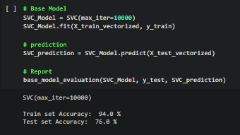
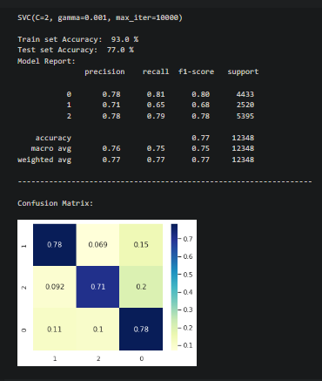
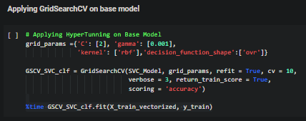

Slide 14
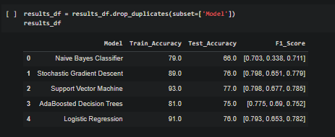
MODEL COMPARISON
Support Vector Machine and Logistic Regression performed better than the other three classifiers, with Support Vector Machine having a slight advantage with a mean F1 score of around 0.76 combined while overall model accuracy is 77%.

Slide 15
CONCLUTION
1. Speaking of locations, Most of the tweets has been made anonymously or without a location share, which contribute around 21% of the total tweets made globally. On the second place, It is London and London, England both contributed around 2.5% of total tweets made globally.
#coronavirus and other versions of it were the most trending hashtags during the timeline.
@realDonaldTrump and @Tesco were the most tagged and active users on the twitter.
Its not a surprise that covid is the most common word used in the tweets. It made more than 12000 appearance in tweets globally. After that mostly, Food and Service related words were mostly used.
Initially, 5 target sentiments were given for the classification later then converted into 3-Class targets i.e. POSITIVE, NEGATIVE and NEUTRAL which made Sentiment Classification a little easier.
6. For vectorization, TF-IDF vectorizer has been used, which Convert a collection of raw documents to a matrix of TF-IDF features.
7. For a Multiclass Classification, SVC Classifier (both base and hypertuned) model performed well with test accuracy of 77% and f1_score of 0.76.

Slide 16

REFERENCES
REFRENCES
AlmaBetter Project Description for addition information: https://grow.almabetter.com/data-science/projects/Coronavirus-Tweet-Sentiment-Analysis
Study Resource : https://scikit-learn.org/stable/modules/multiclass.html
For more Coronavirus related info please visit: https://www.cdc.gov/coronavirus/2019-ncov/index.html
My GitHub Repository: https://github.com/Sanket7994/Coronavirus_Tweet_Sentiment_Analysis

Slide 17


