Slide 1
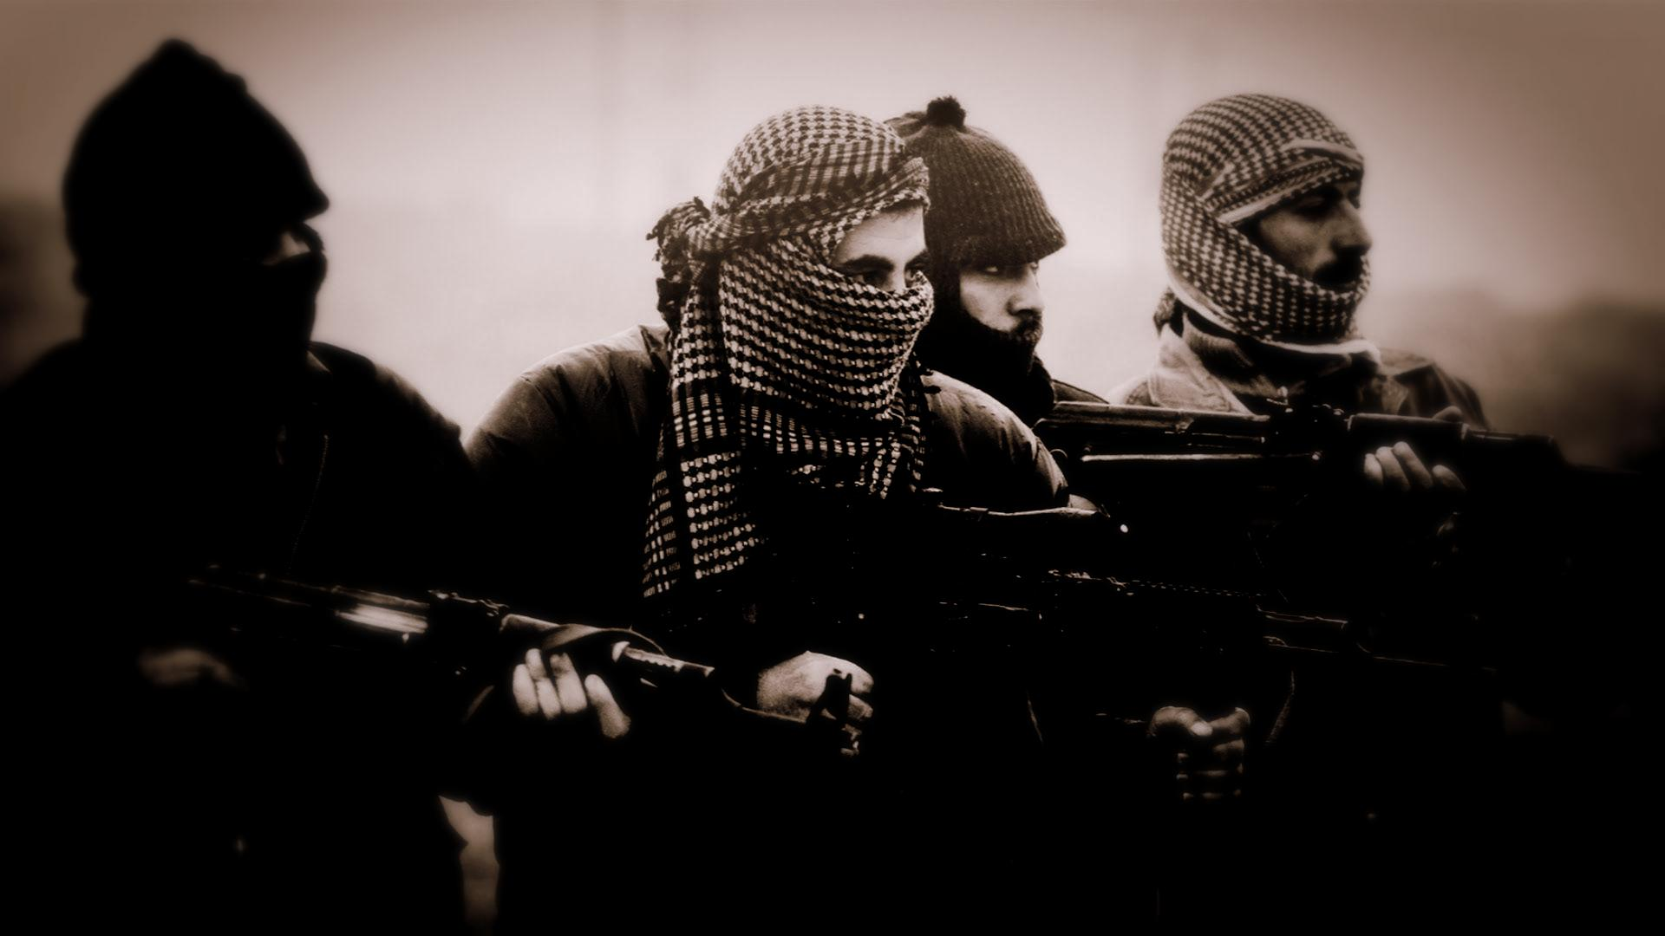

EXPLORATORY DATA ANALYSIS PROJECT ON GLOBAL TERRORISM
PROJECT CONTRIBUTORS:
SANKET CHOURIYA
ZAKIYA
SURAJ KOLI
Participants : Ruchitha Kanakaiah Bijja & Dinesh Bhuyan

Slide 2

INTRODUCTION
The GTD defines a terrorist attack as the threatened or actual use of illegal force and violence by a non-state actor to attain a political, economic, religious, or social goal through fear, coercion, or intimidation.
The GTD is an event-level database containing around 181,691 records of terrorist attacks that took place around the world since 1970 to 2017. Researchers at the National Consortium maintain the database for the Study of Terrorism and Responses to Terrorism (START), headquartered at the University of Maryland.
The GTD was designed to gather a wide variety of etiological and situational variables pertaining to each terrorist incident. Depending on availability of information, the database records up to 135 separate attributes of each incident, out of which we used 25 attributes in this analysis.

Slide 3
DATABASE VARIABLES
iyear - Year of incident
extended - Duration of incident (less or more than 24 hour)
Summary - A brief narrative summary of the incident, noting the “when, where, who, what, how, and why.”
alternative_txt - This variable identifies the most likely categorization of the incident other than terrorism.
country - This field identifies the country or location where the incident occurred.
region - This field identifies the region in which the incident occurred and divided into 12 categories.
city - This field contains the name of the city, village, or town in which the incident occurred.
attacktype1_txt - This field captures the general method of attack and often reflects the broad class of tactics used.
success - This field identifies If the incident was successful or not.
suicide - This variable is coded “Yes” in those cases where there is evidence that the perpetrator did not intend to escape from the attack alive.
weaptype1_txt - This field records the general type of weapon used in the incident.
weapsubtype1_txt - The corresponding weapon sub-types for each primary weapon type.
targtype1_txt - The target/victim type field captures the general type of target/victim.
targsubtype1_txt - The target subtype variable captures the more specific target category.
natlty1 - This is the nationality of the target that was attacked.
gname - Terrorist gang name
nkill - Total Number of Fatalities
nkillter - Number of Perpetrator Fatalities
nwound - Total Number of Injured
propextent_txt - Property Damage Type (Minor, Major, Catastrophic, Unknown)
Ishostkid - This field records whether or not the victims were taken hostage
ransom - This field records whether or not the attacker demanded ransom money or not
ransomamt – ransom money demanded
ransompaid – ransom money given
hostkidoutcome_txt – This field captures the eventual fate of hostages and kidnap victims.

Slide 4
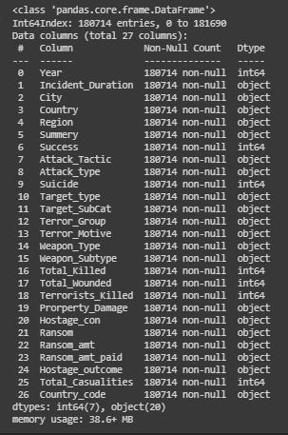
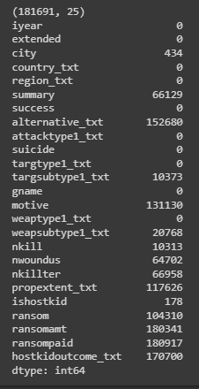
DATA SELECTION AND MODIFICATION
Uncleaned data variables with null values
Renaming columns, Fixing structural errors and Filtering unwanted elements
Cleaned Dataset

Slide 5
DATA ANALYSIS CONTENT TABLE
TERRORISM AROUND THE WORLD
Countries that suffered the most number of Terror attacks/Hostile situations
Number of deaths from terrorism at Different Regions around the world
Most Targeted Cities in the world by Terrorism
Correlation Matrix
Top 10 active Terrorist groups as per Region
Top 10 active Terrorist groups in the World since 1970
Total Causalities caused by Top 15 Terrorist Groups across the world since 1970
TERRORISM ACTIVITY TREND IN INDIA
Number of Attacks since 1970
Total Number of Killed and wounded personals caused by Terrorism in India
Top 10 Terrorist Group activities and there most used Attack
CONVENTIONAL STRATEGIES OF TERRORISTS
Hostage and Kidnapping situation Analysis
Most used Main Weapon and Sub-Weapon Type by Terrorist Groups across the World
Targeted Vandalism caused by Terrorism since 1970

Slide 6

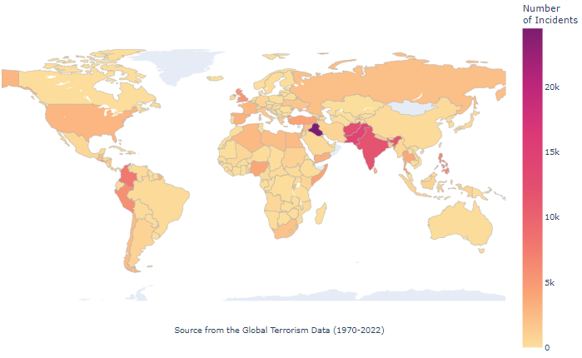
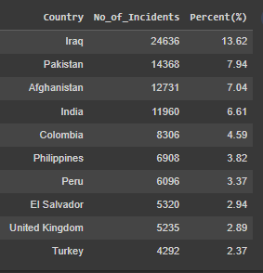
Countries that suffered the most number of Terror attacks/Hostile situations
From above map, We see the number of terrorism attacks by country on this map.
Iraq – the country has faced staggering 24636 number of such attacks between 1970 to 2017
which accounted for 13.62% of terrorism attacks in the world

Slide 7
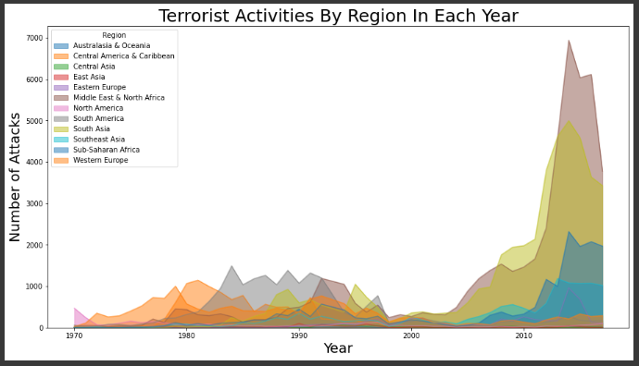
Number of deaths from terrorism at Different Regions around the WORLD
In this chart, we see the number of deaths from terrorism by region. Out of 3,99,380 deaths till now from terrorism included in the Global Terrorism Database 1,35,745 which is roughly 33.27% occurred in the Middle East and North Africa. As when we move to South Asia, the situation doesn`t feel good either as on-paper about 1,00,225 confirmed deaths has been recorded which contribute 25.09% of the total death mark compared to the world.

Slide 8
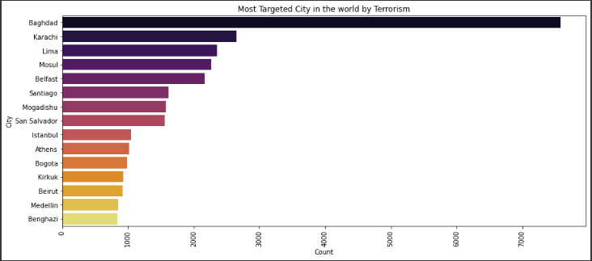
Most Targeted Cities in the WORLD by Terrorism
In this chart, Baghdad which is situated in Iran is most attacked prone city in the world with record 7589 terror incidents since 1970-2017. After that, Karachi from Pakistan in placed second with 2652 confirmed incidents.

Slide 9
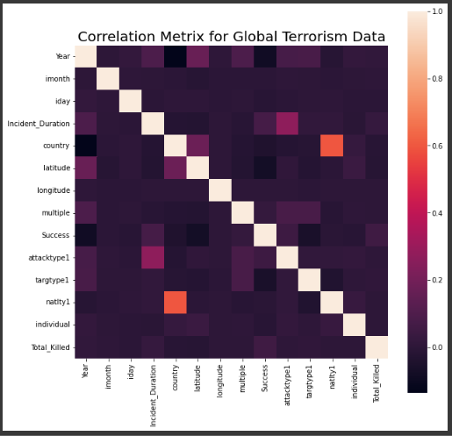
Correlation Matrix
Another relation we can see is among 'natlty1' and 'country'. There correlation index is 0.6 Here 'natlty1' defines the nationality of the attacker and 'country' defines the country where the attack took place. This observation shows that most of the attacks are done by the citizen of their own country. Such a relation provides an interesting insight into how to perceive international terrorism as the proportion of international terrorism is significantly less in comparison with domestic terrorism.
There a another mildly strong yet interesting correlation we can observe which is in between 'attacktype1' and 'Incident_Duration', here the index is 0.27 which shows the relation between the different type of attack tactic can be a game changer for more resilience in attack duration.
The block representing 'iyear' and 'success' has a darker shade which means that both these parameters are inversely related to each other. There correlation index is -0.086 So, over time, the rate of success of any attack has reduced.

Slide 10
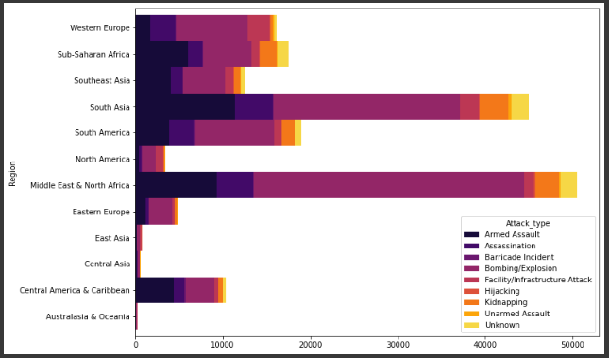
Top 10 active Terrorist groups as per Region
As per our observation, It is clear that 'Middle East & North Africa' is most dangerous place to be at. Total 49,576 attacks has been faced by them since 1970. Where 'South Asia' is just behind with 44,479 attacks till now.

Slide 11
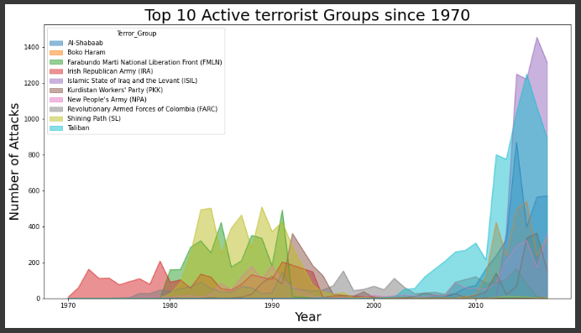
Top 10 active Terrorist groups in the World since 1970
On the scale of number of terror attacks done by a group since 1970, 'Islamic State of Iraq & the Levant (ISIL)' tops the chart with more than 1400 attacks. while 'Taliban' hold the second place.

Slide 12
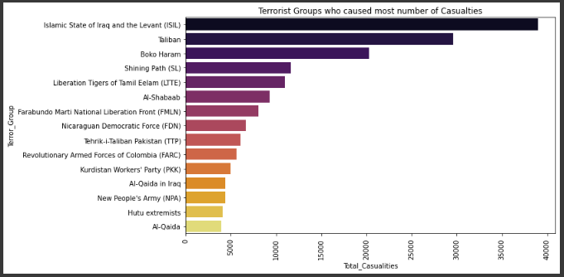
Total Causalities caused by Top 15 Terrorist Groups across the world since 1970
After analysis, It is visual that 'Islamic State of Iraq and the Levant (ISIL)' were on a killing spree where they murdered 38,793 personal since 1970, Most on compared to other groups. Taliban is again on second place with 29,564 kills.

Slide 13

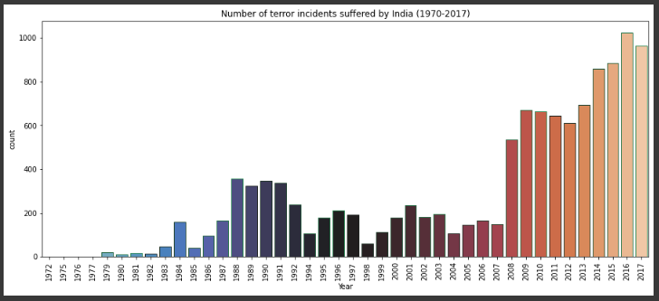
Number of Attacks since 1970 in INDIA
From the figure above, we came to know that the total number of terrorist attacks in the years from 1972 to 2017. It is visible that attacks slowly start to increase from 1985 until about 1992 where until 2003 we see an unstable trend in Terrorist activities then after 2007, it again starts increasing exponentially.

Slide 14
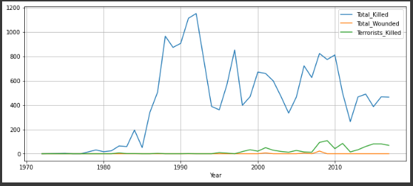
Causalities throughout the year in INDIA
In India, Till now 18,663 people has been confirmed dead, 34 confirmed wounded against 933 terrorists has been encountered. As per calendar year In 1992, India seen the most deadliest year of terrorism at which total 1076 personal had been killed. On the other hand, On year 2009 India Encountered the most of number of terrorist which is 108.

Slide 15
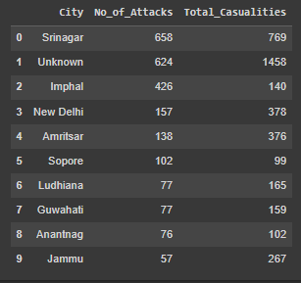
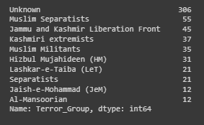
Since 1972, Srinagar which is in Jammu and Kashmir has been the center of the dispute and terror attacks in India. Srinagar has been under attacks record 658 times on which 769 people have lost there lives.
Almost half of those number of attacks has been done by Unknown groups. On the second place, Srinagar has been terrorized 55 times by 'Muslim Separatists' and 45 times by 'Kashmiri extremists'.

Slide 16
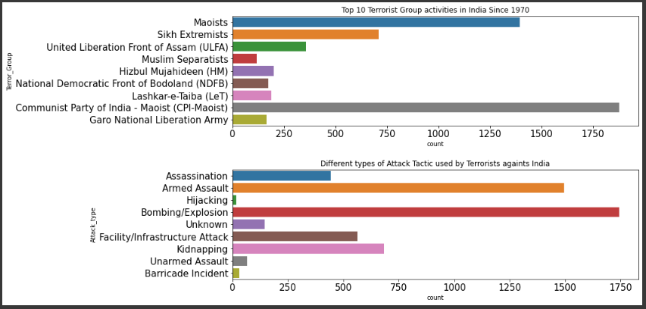
Top 10 Terrorist Group activities and there most used Attack against INDIA

Slide 17

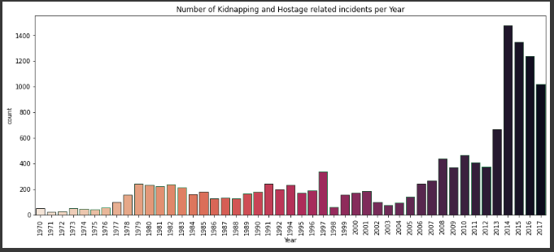
Hostage and Kidnapping Incident Trend since 1970
Since 2004, There is sudden increase in Kidnapping/Hostage related incidents across the world.
The situation seems controlled till year 2012, but again it can been seen that the number of incidents increasing exponentially.

Slide 18
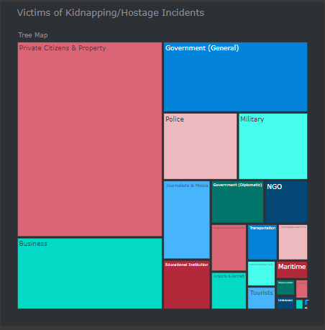
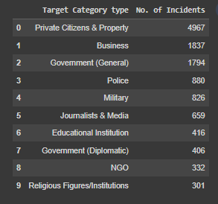
Most common targets of Hostage and Kidnapping by Terror groups

Slide 19
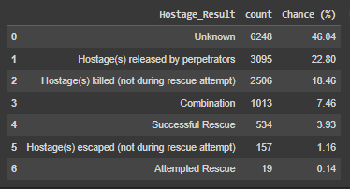
Hostage/Kidnapping Facts
Successful Kidnapping/Hostage attack for where ransom amount was given to attackers: 1.25%
Maximum ransom amount ($) demanded by attackers: 100000000
Maximum ransom amount ($) given to attackers: 41000000
Failed Kidnapping/Hostage attack for where no ransom amount was given to attackers: 3.48%
Kidnapping/Hostage incidents where no ransom amount was demanded or contact made by attackers: 92.63%
Hostage/Kidnapping result after either giving Ransom or rescue mission by Anti-terror forces

Slide 20
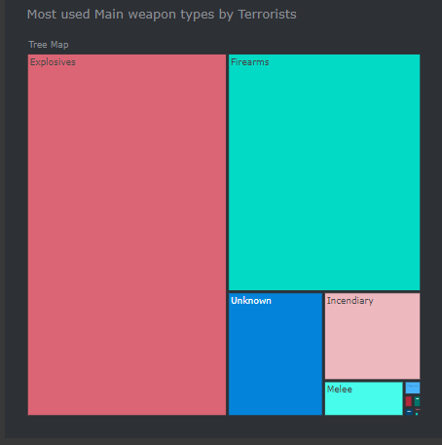
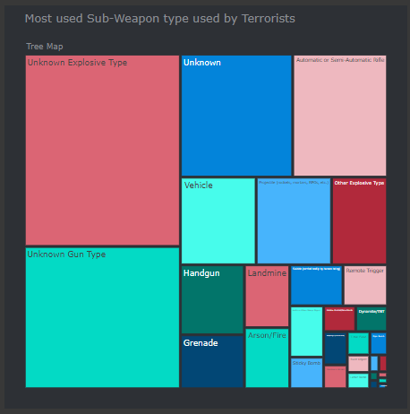
Most Common Main Weapon and Sub-Weapon Type
used by Terrorist Groups across the World
Seems like Terrorist do like 'Explosives' very much like this is the most used Weapon category across the world terror groups. There have been around 90626 incidents related to Explosives and Bombings. Where as Terrorists also have used confirmed 56397 Firearms related attacks.

Slide 21
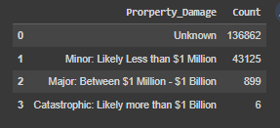
Targeted Vandalism caused by Terrorism since 1970
As per the records, There have been staggering 1,33,087 incidents where the property damage was unaccusable or unrecorded. However As per the frequency, Terror attacks are more likely to have a Minor Category of property damaged which is around or less than 1 Million Dollars, which obviously doesn't sound Minor. Till now, only 6 Incidents have been confirmed where the property damaged is likely to be more than 1 Billion Dollars

Slide 22

CONCLUSIVE POINTS
Iraq – the country has faced staggering 24636 number of such attacks between 1970 to 2017 which accounted for 13.61% of terrorism attacks in the world.
Attacks were more during 2014 and then in 2015. When compared to attacks from 1970 onwards, the last 6 years scored a maximum. But from 2014 onwards count started decreasing.
Iraq dominates all the countries and it has the highest number of attacks and then Pakistan, Afghanistan, and India follow it.
Middle East and North Africa and South Asia are the two regions who encountered the most number of terror attacks since 1970.
For most of the attacks, The target is Private Citizens & property and the next is on Military leads.
Most of the attacks were through either Bombing or Explosion.
Most used known Attack tactic by terror group is 'Insurgency/Guerilla Action'. Where the majority of tactic is random or just unknown.
'Islamic State of Iraq and the Levant (ISIL)' were on a killing spree where they murdered 38,793 personal since 1970, Most on compared to other groups. Taliban is again on second place with 29,564 kills.
'Islamic State of Iraq & the Levant (ISIL)' and 'Taliban' are two most active Terrorist groups in the last 5 years.
Srinagar which is in Jammu and Kashmir has been the center of the dispute and terror attacks in India.
Seems like Terrorist do like 'Explosives' very much like this is the most used Weapon category across the world terror groups.
Private Citizens and Property related incidents are most common target for Hostage/Kidnapping incidents.
As per analysis, You have about 22.18% chance to get out of kidnapping situation without any hard, but 18.46% bad luck that you won't.

Slide 23

REFERENCES
REFERENCES
Official Global Terrorism Site for insights and dataset: https://ourworldindata.org/terrorism
AlmaBetter Capstone Project Tab: https://grow.almabetter.com/data-science/projects/Global-Terrorism-Dataset
Wikipedia : https://en.wikipedia.org/wiki/Terrorism
My GitHub Repository: https://github.com/Sanket7994/Globle_Terrorism_Capstone_Project

Slide 24

THANK YOU!

