Slide 1
case study on HEALTH INSURANCE CROSS SELL PREDICTION
Presented By:
1. Sagar Mali (42)
2. Sahil Chavan (43)
3. Sanket Desai (44)
4. Sarvesh Raut (45)
5. Shivraj Shelar (46)

Slide 2
Problem Statement
Our client is an Insurance company that has provided Health Insurance to its customers now they need your help in building a model to predict whether the policyholders (customers) from past year will also be interested in Vehicle Insurance provided by the company.
An insurance policy is an arrangement by which a company undertakes to provide a guarantee of compensation for specified loss, damage, illness, or death in return for the payment of a specified premium. A premium is a sum of money that the customer needs to pay regularly to an insurance company for this guarantee.

Slide 3
Business Goal:
Building a model to predict whether a customer would be interested in Vehicle Insurance is extremely helpful for the company because it can then accordingly plan its communication strategy to reach out to those customers and optimize its business model and revenue.
Now, in order to predict, whether the customer would be interested in Vehicle insurance, you have information about demographics (gender, age, region code type), Vehicles (Vehicle Age, Damage), Policy (Premium, sourcing channel) etc.

Slide 4
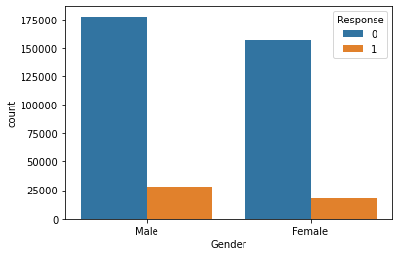
Count of Gender with respect to the target variable
Exploratory Data Analysis:
Male are more interested in buying vehicle insurance than female.

Slide 5
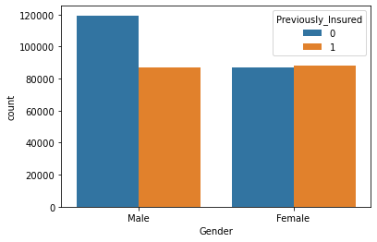
Count of Gender with respect to the Previously insured:
Here no of insurance already bought are same with respect to male and female

Slide 6
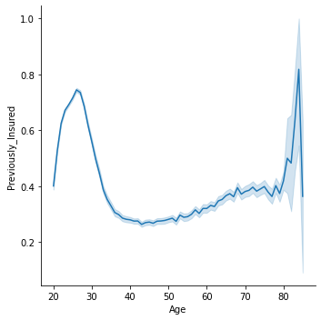
Between age of 20-30 years most of the people already bought vehicle insurance but between 30-50 years of age people tend not to buy A vehicle insurance after 50 years of age people again started to buy vehicle insurance
AGE vs PREVIOUSLY INJURED:

Slide 7
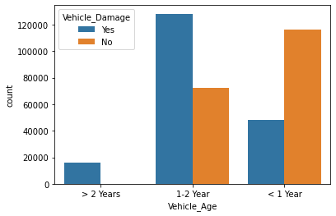
When vehicle age is less than 1 year, accident are likely to happen less when vehicle age is between 1 to 2 year accident are likely to happen more when vehicle became older than 2 year, accident are happen
VEHICLE AGE vs VEHICLE DAMAGE:

Slide 8
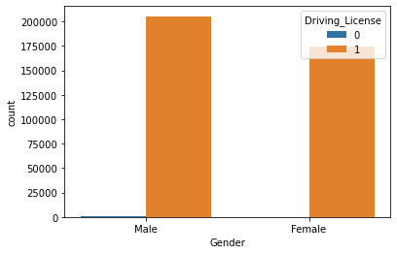
Number of female have a driving license = 175020 number of male have a driving license = 206089
GENDER vs DRIVING LICENSE:

Slide 9
COUNT FOR VEHICLE DAMAGE vs RESPONSE:
Vehicle Damage | Response | count
No | 0 | 187714
No | 1 | 982
Yes | 0 | 146685
Yes | 1 | 45728

Slide 10
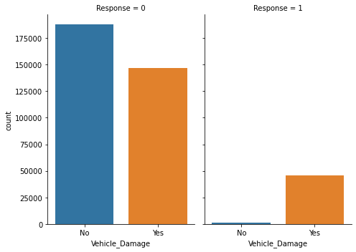
COUNT FOR VEHICLE DAMAGE vs RESPONSE:
From the above graph we can conclude that if the vehicle is damaged then people are interested in buying insurance.

Slide 11
COUNT of VEHICLE AGE vs RESPONSE:
INDEX | Vehicle Age | Response | count
0 | 1-2 Year | 0 | 165510
1 | 1-2 Year | 1 | 34806
2 | < 1 Year | 0 | 157584
3 | < 1 Year | 1 | 7202
4 | > 2 Years | 0 | 11305
5 | > 2 Years | 1 | 4702

Slide 12
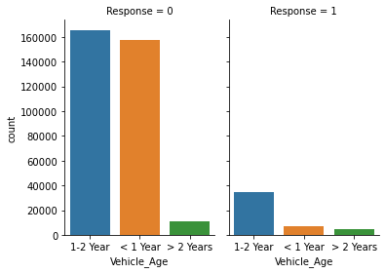
COUNT FOR VEHICLE AGE vs RESPONSE:
From the above graph we can conclude that if the age of vehicle is between 1-2 year then the insurance are bought more as compared to less than 1 year and greater than 2 year

Slide 13
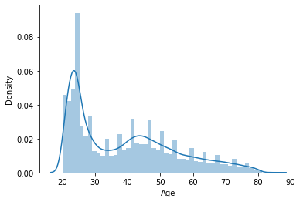
The people between range of 20 to 30 are more as compared to others.
Density plot for age:

Slide 14
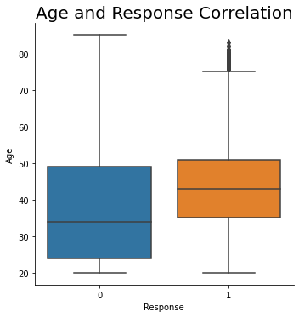
Young people under age 35 have little interest in insurance and people over the age 35 tend to be more interested in buying insurance
Age and Response Correlation:

Slide 15
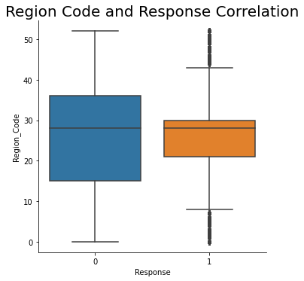
Region code Vs Response:
There is less correlation between region code and response

Slide 16
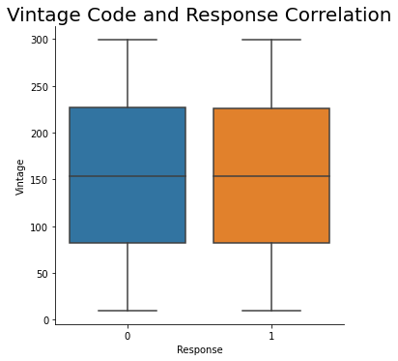
From graph we can conclude that vintage has no effect on the response. The rate of positive and negative feedback seems to be same
Vintage Code and Response Correlation:

Slide 17
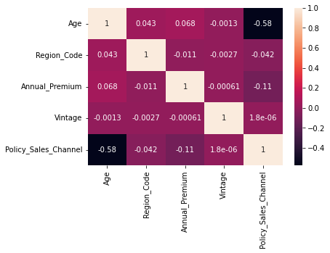
Correlation Matrix(Heatmap)
We have plotted heatmap to check relationship between the columns with each other

Slide 18
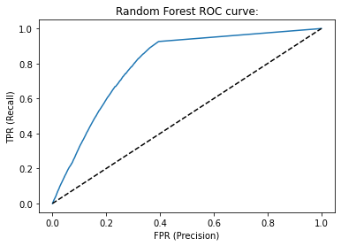
Model Building:
Random Forest classifier
Accuracy Score: 84.2486
F1 Score: 0.2663
Area Under Curve(AUC): 0.7988

Slide 19
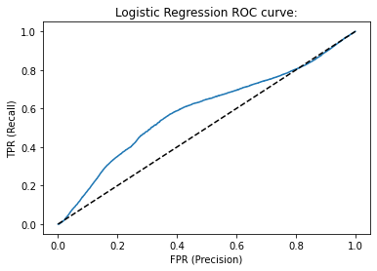
Logistic Regression:
Accuracy Score: 87.69
F1 Score: 0.0
Area Under Curve(AUC): 0.5883

Slide 20
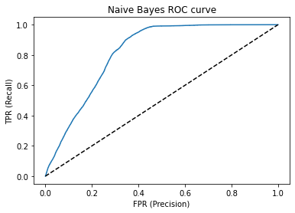
Naive Bayes Algorithm:
Accuracy Score: 82.03
F1 Score: 0.333
Area Under Curve(AUC): 0.8170

Slide 21
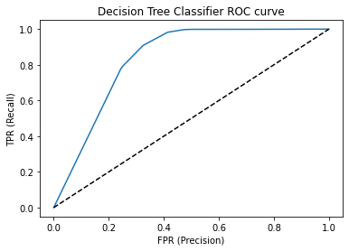
Decision Tree Classifier:
Accuracy Score: 88.00
F1 Score: 0.0
Area Under Curve(AUC): 0.8324

Slide 22
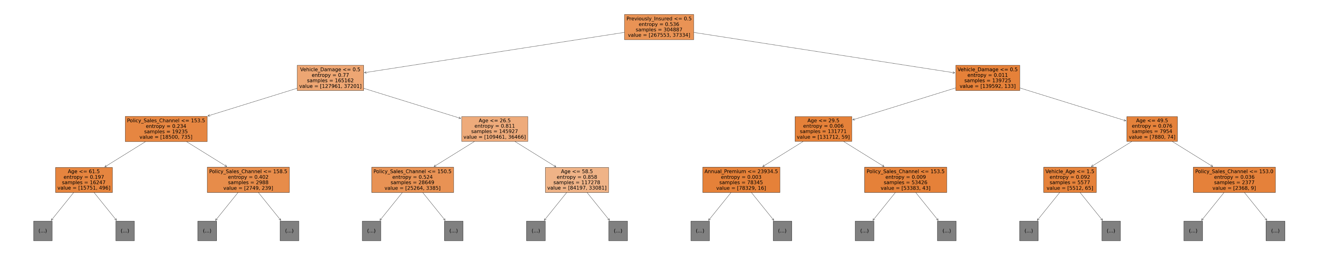
Visualization of Decision tree

Slide 23
Algorithm Selection:
We trained our model using various algorithms and checked accuracy, f1score and auc(area under curve), so it is seen that f1score of naive bayes algorithm is better than all other applied algorithms
So, we will choose a naive bayes algorithm for this dataset.
Naive bayes score
F1_score: 0.33300866854972244
Auc: 0.8170637745343865

Slide 24
Conclusion:
From the above exploratory data analysis, we analysed the data and extracted
the following insights:
How age is related with the response(target) column i.e. consumers above the age of 35 are more interested in buying insurance
How Vehicle age is related to the response(target) i.e. Consumers with vehicle age between 1 and 2 years are more interested in buying insurance
How vehicle damage is related to the response(target) column i.e. People who has damaged their vehicle in past and also not interested in vehicle insurance are more as compared to people who has not damaged their vehicle and also interested in vehicle insurance
How gender is is related with the response(target) column i.e. Response from male consumers is slightly greater than female consumers.

