Slide 1

Sanket S Thorat.
Roll.NO.:-33.
SUB:-BIBD.
Topic:-MongoDB
Class:-MSC-CS(Part 1).

Slide 2
Introduction:-
MongoDB, the most popular NoSQL database, is an open-source document-oriented database. The term ‘NoSQL’ means ‘non-relational’. It means that MongoDB isn’t based on the table-like relational database structure but provides an altogether different mechanism for storing and retrieving data. This format of storage is called BSON ( similar to JSON format).

Slide 3
Architecture:-
MongoDB is designed to meet the demands of modern apps with a technology foundation that enables you through:
Database: In simple words, it can be called the physical container for data. Each of the databases has its own set of files on the file system with multiple databases existing on a single MongoDB server.
Collection: A group of database documents can be called a collection. The RDBMS equivalent to a collection is a table. The entire collection exists within a single database. There are no schemas when it comes to collections. Inside the collection, various documents can have varied fields, but mostly the documents within a collection are meant for the same purpose or for serving the same end goal.

Slide 4
Architecture:-
Document: A set of key-value pairs can be designated as a document. Documents are associated with dynamic schemas. The benefit of having dynamic schemas is that a document in a single collection does not have to possess the same structure or fields. Also, the common fields in a collection document can have varied types of data.
The document data model – presenting you the best way to work with data.
A distributed systems design – allowing you to intelligently put data where you want it.
A unified experience that gives you the freedom to run anywhere – allowing you to future-proof your work and eliminate vendor lock-in.
With these capabilities, you can build an Intelligent Operational Data Platform, underpinned by MongoDB. Download the Architecture Guide where we dive deeper into the technology foundations of MongoDB.

Slide 5
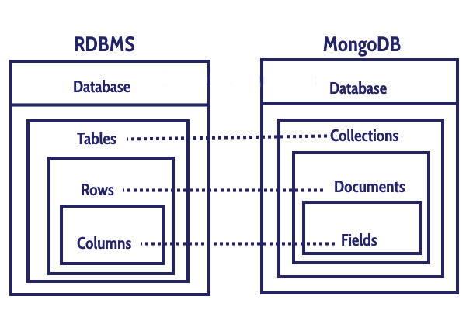
Advantages of mongoDB:-
There are many great features inbuilt with MongoDB. As compared to RDBMS, so let’s discuss MongoDB Benefits.
Flexible Database:-
We know that MongoDB is a schema-less database. That means we can have any type of data in a separate document. This thing gives us flexibility and a freedom to store data of different types.

Slide 6
Advantages of mongodb:-
Sharding:-
We can store a large data by distributing it to several servers connected to the application. If a server cannot handle such a big data then there will be no failure condition. The term we can use here is “auto-sharding”.
High Speed:-
MongoDB is a document-oriented database. It is easy to access documents by indexing. Hence, it provides fast query response. The speed of MongoDB is 100 times faster than the relational database.
High Availability:-
MongoDB has features like replication and gridFS. These features help to increase data availability in MongoDB. Hence the performance is very high.

Slide 7
Advantages of mongodb:-
Scalability:-
A great advantage of MongoDB is that it is a horizontally scalable database. When you have to handle a large data, you can distribute it to several machines.
Ad-hoc Query Support:-
MongoDB has a very advanced feature for ad hoc queries. This is why we don’t need to worry about fore coming queries coming in the future.
Easy Environment Setup:-
It is easier to setup MongoDB then RDBMS. It also provides JavaScript client for queries.
Full Technical Support:-
MongoDB Inc. provides professional support to its clients. If there is any problem, you can directly reacha MongoDB client support system.

Slide 8
Disadvantages of mongodb:-
Nothing is fully complete or perfect. In spite of having so many advantages, MongoDB to has some limitations. Let’s discuss some of them here.
Joins not Supported:-
MongoDB doesn’t support joins like a relational database. Yet one can use joins functionality by adding by coding it manually. But it may slow execution and affect performance.
High Memory Usage:-
MongoDB stores key names for each value pairs. Also, due to no functionality of joins, there is data redundancy. This results in increasing unnecessary usage of memory.

Slide 9
Disadvantages of mongodb:-
Limited Data Size:-
You can have a document size, not more than 16MB.
Limited Nesting:-
You cannot perform the nesting of documents for more than 100 levels. This was all about the Advantages Of MongoDB Tutorial. Hope you like our explanation.

Slide 10
Conclusion:-
MongoDB is a popular NoSQL database solution that suits modern development requirements.

