Slide 1
Project 2
Cross-sell of Personal protection insurance

Slide 2
Problem Statement
Find out whom the bank should target from the pool of customers that currently do not have a PPI and What type of PPI product they should target them with?
The sample data contains details of consumers’ product ownership, credit standing, outstanding amounts, and whether they already have an insurance product (called PPI / personal protection insurance), if any, the type of PPI product they own.

Slide 3
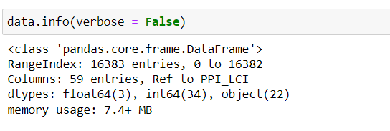
Dissecting the data
Data contains 59 columns and 16383 rows.
Data has 25 categorical columns and 24 continuous columns.

Slide 4
Columns
Categorical data
Continuous data
Final Grade
Loan type
Mosaic class
Residential status
Telephone
Martial status
Gender
Employment status
Full time/part time
Current account
Prem/temp employee
Credit cards
Payment method
Bankruptcy detected
CIFAS detected
PPI
Category
PPI type
Credit score
Term
Net Advance
Mosaic
Time at address
Number of dependent
Time in employment
Income range
Time with bank
Value of property
Outstanding mortgage Bal
Age

Slide 5
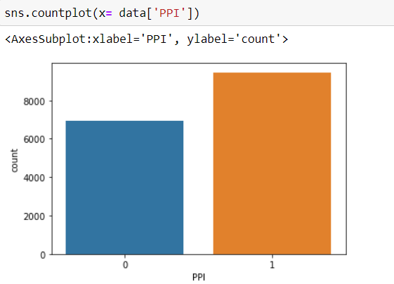
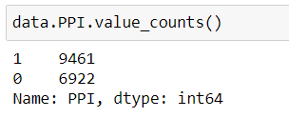
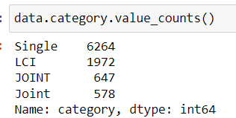
PPI
Data has information about customers that already have PPI.
This customers are represented by “1” in PPI columns. While “0” represent customers with no PPI.
The column “category” has the data on which type of insurance.
Mainly Single , Life and Critical insurance and joint family.

Slide 6
Categorical data
After separating consumers having PPI from data we can find out what are their properties(i.e. what makes them eligible for PPI).
For a field, if 99% of the consumers are falling into a discrete category then that field is dominant.
The dominant fields are :
Current account.
Full-time or Part-time employees.
Permanent or Temporary employees.
Bankruptcy detected.
CIFAs

Slide 7
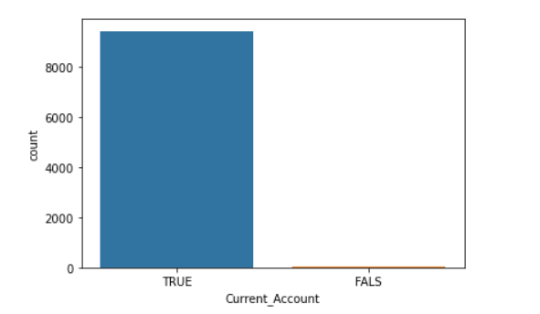
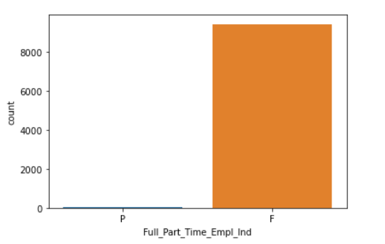
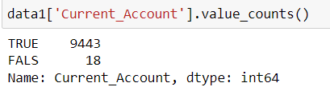
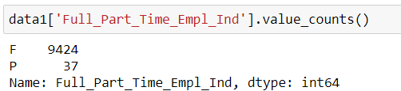
True – 99.8 % False – 0.2 %
Part-time – 0.4 % Full-time – 99.6 %

Slide 8
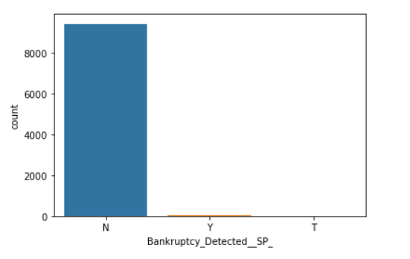
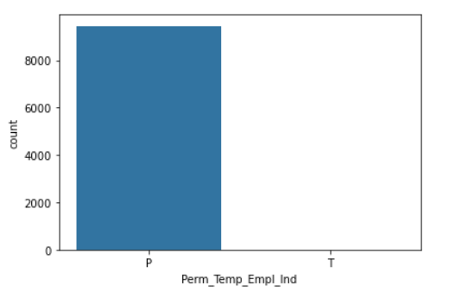
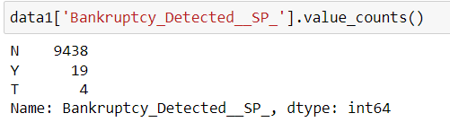
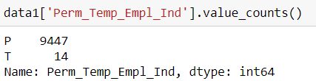
No – 99.7 % Yes – 0.2 % T – 0.004%
Perm – 99.8 % Temp – 0.2 %

Slide 9
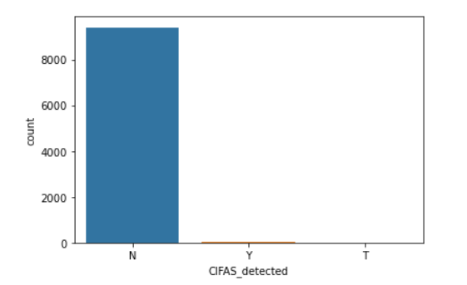
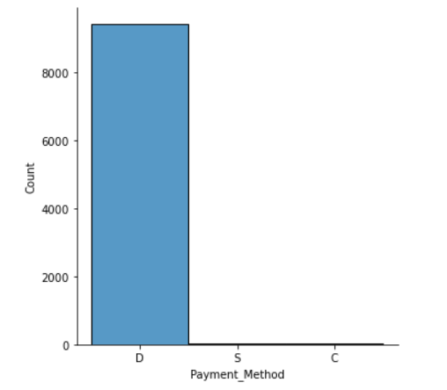
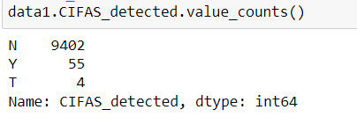
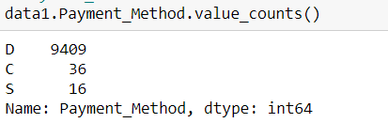

Slide 10
Continuous data
For continuous data we are referring to the probability distribution which states that 95% of data falls between -2σ and +2σ of the Gaussian curve.
After iterating over continuous variables the fitting variables are:
Credit score
Value of property
Total outstanding balances
Mosaic
Time at the address
Income range
Age
Outstanding mortgages balance
Time with the bank
Bureau data
Term

Slide 11
Determined ranges of variables
Sr. no. | Variable | Mean | Mode | Range
1 | Credit score | 871 | 953 | 700.9 to 1041
2 | Value of property | 151377 | 120000 | 57784.5 to 244970.6
3 | Total outstanding balances | 68366 | 0 | 0 to 221190.5
4 | Mosaic | 31.3 | 44 | 0 to 62.9
5 | Time at address | 129 | 60 | 0 to 355.7
6 | Income range | 4.4 | 6 | 1.41 to 7.38
7 | Age | 44.7 | 45 | 22.8 to 66.7
8 | Outstanding mortgages balance | 61441 | 0 | 0 to 205982.4
9 | Time with the bank | 197.9 | 240 | 0 to 409.6
10 | Bureau data | 539.51 | 0 | 0 to 1629
11 | Term | 61.7 | 60 | 7.23 to 116.24

Slide 12
Mean gives the average over the whole dataset and is used to calculate the standard deviation of the range.
Mode is the most common value and represents the most preferred value.
Based on the assumptions we have determined the following data set as the possible consumer base.
https://github.com/SanketBalasahebNitnaware/Project2/blob/main/consumer_base.xlsx

Slide 13
For the next part of the problem, i.e. what product should the consumer be targeted with?
Categories
Joint
Life and critical illness
Types
L – Life
CI – Critical Illness
S- Sickness
U- Unemployment
A- Accident
Single

Slide 14
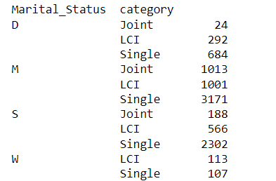
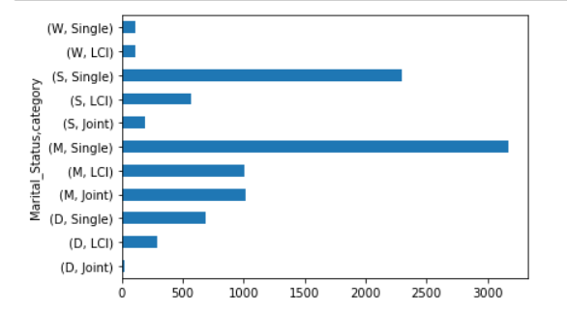
Categories with respect to marital status
Married people are the largest group of buyers. But the biggest category is still single therefore they can be offered joint insurance.
Second biggest group is unmarried people.

Slide 15
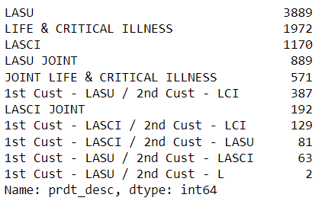
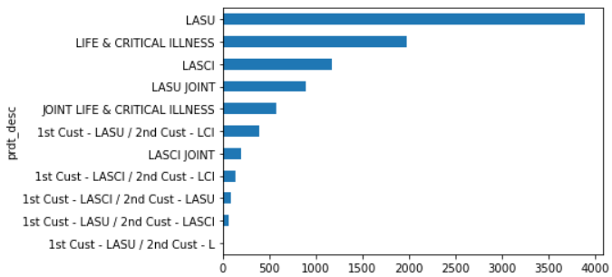
Product descriptions count
Insurance covering Life, Accident, Sickness, and Unemployment is the most popular product. Followed by LCI and LASCI.
The top 3 products are in the “Single” category and consist of 74.31% of the data.

Slide 16
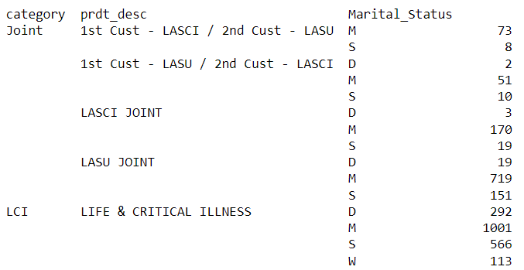
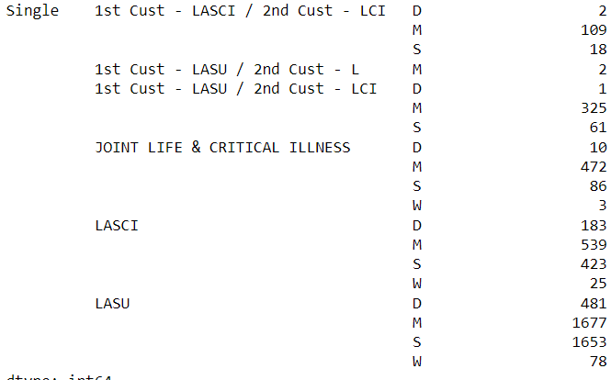
Effect of Martial status
From the table we can conclude LASU is popular with married and unmarried people.
Therefore it should be the star of the insurance line-up, followed by the LCI.

Slide 17
the Following chart contains summarised results:
Marital Status
Employment status
Product
S
LASU
M
G
5185
LASU joint
M
LASU / L
S
P
LCI
3056
D
LCI joint
D
H
LASCI
1000
T
LASCI joint
W
U
LASCI/LCI
220
R
LASCI/LASU

Slide 18
Results
The chart of Time in employment vs age with hue as employment status is accessible by the following link
https://drive.google.com/file/d/1unuRNFqusJZg5eg7x8_w9yog8Q3wUqOL/view?usp=sharing
The Excel file with the projected consumers’ named consumer base is uploaded with two sheets (consumer base and product to offer ). The following link directs to the excel file:
https://github.com/SanketBalasahebNitnaware/Project2/blob/master/consumer_base.xlsx
The Jupyter notebooks for further study are linked below :
Project 2 a
Project 2 b

