Slide 1
FIVP Innovative Assignment
Steganography
(Data Hiding in Image)
Using Image Processing
Submitted By :
Rushi Patel (18BCE201)
Sanket Cheladiya (18BCE042)

Slide 2




Steganography (Data Hiding in Image)
Data Hiding
Data Hiding

Slide 3
What is Steganography
Steganography is one technique of hiding private or sensitive information within multimedia. Here we use images that appear to be nothing out of the ordinary.
The difference between the cryptology and steganography is that steganography involves hiding information in same file such that it appears that no information is hidden at all.
If a person views the encrypted image, he or she will have no idea that there is any hidden information, therefore the person will not attempt to decrypt the information.
Steganography (Data Hiding in Image)

Slide 4
History of Steganography
Steganography is used to secretly communicate information between people.
During World War 2 invisible ink was used to write information on pieces of paper so that the paper appeared to the average person as just being blank pieces of paper. Liquids such as milk, vinegar and fruit juices were used, because when each one of these substances are heated they darken and become visible to the human eye.
In Ancient Greece they used to select messengers and shave their head, they would then write a message on their head. Once the message had been written the hair was allowed to grow back. After the hair grew back the messenger was sent to deliver the message, the recipient would shave off the messenger's hair to see the secret message.
Steganography (Data Hiding in Image)

Slide 5
How It Works?
This project is developed for hiding any information in image file.
This project has two methods – Encrypt and Decrypt.
In encryption the secret information is encrypted in Image file.
Decryption is retrieving the secret information from an image file.
Encryption and Decryption Process uses the same key for security of data from intruders.
Steganography (Data Hiding in Image)

Slide 6
How It Works?
User needs to run the application. The user has two tab options – Encrypt and Decrypt.
If the user selects Encrypt, the application gives the screen to select the image file, information file and option to save the image file.
If the user selects Decrypt, the application gives the screen to select only the image file and asks the user where the user wants to save the secret file.
Steganography (Data Hiding in Image)

Slide 7
How it Works?
Encrypt Image
Set a security key
Enter text to hide in image
Decrypt Image
Reenter key to verify
Extract Data from Image

Slide 8
Methodology Involved
Various Image Processing techniques are used for Encrypting Text inside a Image.
Some Methods are :
Least Significant Bit (LSB)
Masking and Filtering
Transform Techniques
Steganography (Data Hiding in Image)

Slide 9
Methodology Involved
Encryption process
We have taken Input Image and Converted it into Array of Pixels(RGB).
We have taken Information File and Security Key from User.
That Information File and Security Key and embedded inside Pixels of Image. (Pixel values are changed.) – Encryption Process
Then the Image is created from altered Array of Pixels.
Image will have very minor difference from original image but it is only identified when both images are together.
Steganography (Data Hiding in Image)

Slide 10
Methodology Involved
Minor Difference in processed Image
Data Hiding
Data Hiding

Slide 11
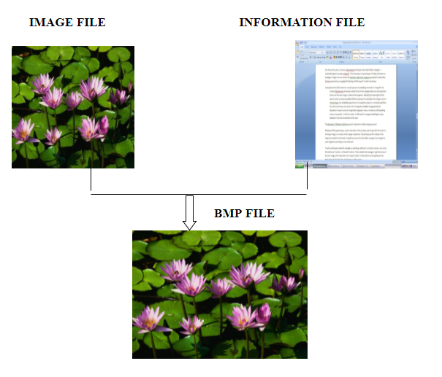
Methodology Involved
Encryption process
Steganography (Data Hiding in Image)

Slide 12
Methodology Involved
Decryption process
We have encrypted image.
We will convert that into Array of Pixels (RGB).
Will check whether security key is matching or not.
If it is matching than reverse process of encryption is done to retrieve information stored.
This information will be same as original.
Steganography (Data Hiding in Image)

Slide 13
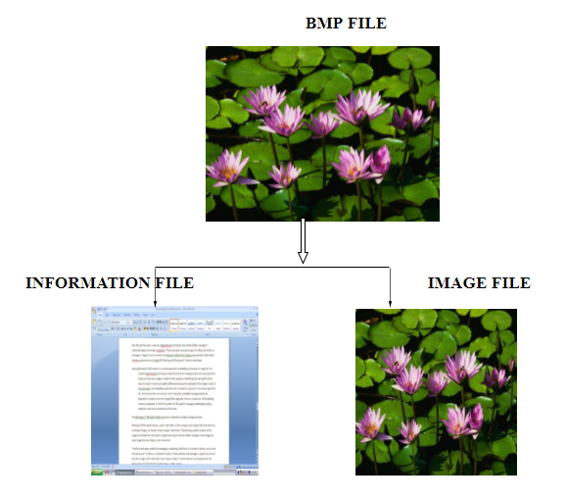
Methodology Involved
Decryption process
Steganography (Data Hiding in Image)

Slide 14
How It Works?
In 5 steps, we can write :
Enter Input Image and Information File
Encryption Process
Generating Processed Image
Decrypt Processed Image
Retrieve Information File
Steganography (Data Hiding in Image)

Slide 15
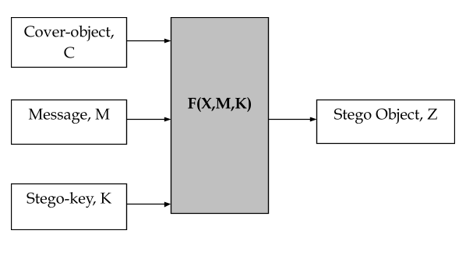
Methodology Involved
Flow Diagram
Steganography (Data Hiding in Image)

Slide 16
Encrypt Image Code
Reads Image, Set Key and Enter Text
x=cv2.imread(“1.jpg")
i=x.shape[0] #Prints dimensions of Image
j=x.shape[1]
key=input("Enter key to edit : ")
text=input("Enter text to show : ")
#You can take input from file
Steganography (Data Hiding in Image)

Slide 17
Encrypt Image
Hides data in Image in pixels
for i in range(l):
x[n,m,z]=d[text[i]]^d[key[kl]]
n=n+1 #Spacing
m=m+1
m=(m+1)%3 #Prints in vertical line
kl=(kl+1)%len(key)
cv2.imwrite("encrypted_img.jpg",x)
os.startfile("encrypted_img.jpg")
Steganography (Data Hiding in Image)

Slide 18
STEP 2
Decrypt Image
Reenter key to verify
Extract Data from Image
Steganography (Data Hiding in Image)

Slide 19
Decrypt Image Code
Reads Encrypted image and Checks Key
x=cv2.imread(“encrypted_img.jpg")
key=input("Re enter key to extract text : ")
Steganography (Data Hiding in Image)

Slide 20
Decrypt Image
Decrypt Message from Image
decrypt=""
if key == key1 :
for i in range(l):
decrypt+=c[x[n,m,z]^d[key[kl]]]
n=n+1
m=m+1
m=(m+1)%3
kl=(kl+1)%len(key)
print("Entered text was : ",decrypt)
else:
print("Key doesn't matched.")
Steganography (Data Hiding in Image)

Slide 21
Applications
Water Marking
Fingerprinting
Confidential communication and secret data storing
Protection of data alteration
Access control system for digital content distribution
Media Database systems
And many more…
Steganography (Data Hiding in Image)

Slide 22
Thank You

