Slide 1

Government College of Engineering Karad
(An Autonomous Institute of Government of Maharashtra)
Information Technology Department
Final Year B. Tech. [SEM VII]
Seminar Title: AI LEGAL ASSISTANT USING RAG
Student Name & Roll No. : 1) Soham Sunil Malvadkar (22141229)
2) Sanket Nivas Chopade (22141234)
3) Abhijeet Vilas Ganjave (22141236)
4) Akash Anada Khot (22141244)
5) Sanket NandKumar Adake (22143248)
Guide Name : Dr. S. A. Thorat

Slide 2
Problem Statement Background & Motivation
PROBLEM STATEMENT :
• Legal research is time-consuming (hours → seconds)
• Common people struggle with complex legal jargon
• Traditional chatbots hallucinate wrong laws
• Limited access to affordable legal consultation
MOTIVATION :
• Democratize legal knowledge access
• Bridge the gap between legal experts and common people
• Provide 24/7 accurate legal assistance

Slide 3
Literature Survey / Existing Approaches
EXISTING APPROACHES :
1. Traditional Search Engines
- Generic information, not case-specific
- No contextual understanding
2. Basic Chatbots
- Hallucinate legal information
- No citation of actual laws
- Limited to training data cutoff
3. Manual Legal Research
- Time-consuming (hours/days)
- Requires legal expertise
- Costly for common people

Slide 4
Objectives of Proposed Work
PROJECT OBJECTIVES :
✅ Develop AI system that reads real legal documents
✅ Provide accurate, cited legal answers
✅ Create simple explanations of complex laws
✅ Ensure data privacy and security
✅ Support multiple document formats
✅ Enable conversational memory

Slide 5
Methodology
1. DOCUMENT PROCESSING -
- PDF/text extraction with OCR support
- Intelligent chunking (1000-word segments)
- Vector embeddings generation
2. RETRIEVAL SYSTEM -
- FAISS for lightning-fast similarity search
- Context-aware document retrieval
- Relevance scoring
3. RESPONSE GENERATION -
- Groq AI for legal summarization
- Citation of exact law sections
- Simple language translation

Slide 6
Hardware and Software Required
Software Requirements:
• Python 3.8+
• Streamlit framework
• FAISS library
• Groq API access
• Internet connection
Hardware Requirements :
• Minimum 4GB RAM
• 2GB storage space
• Modern web browser
• Stable internet connection

Slide 7
Q&A Session Thank You

Slide 8
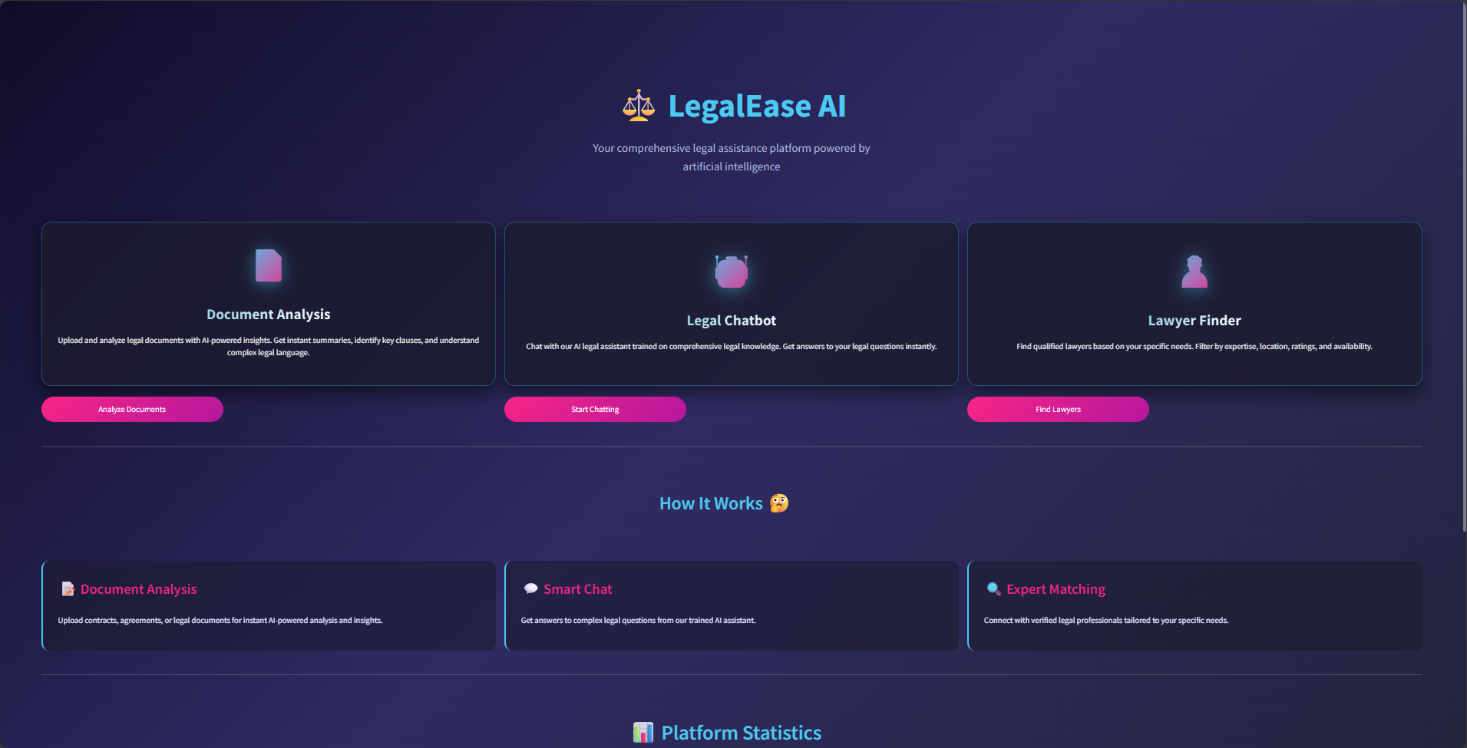
User Interface

