Slide 1
CI Workflow Demo
Demonstrate complete build process through Continuous Integration.

Slide 2
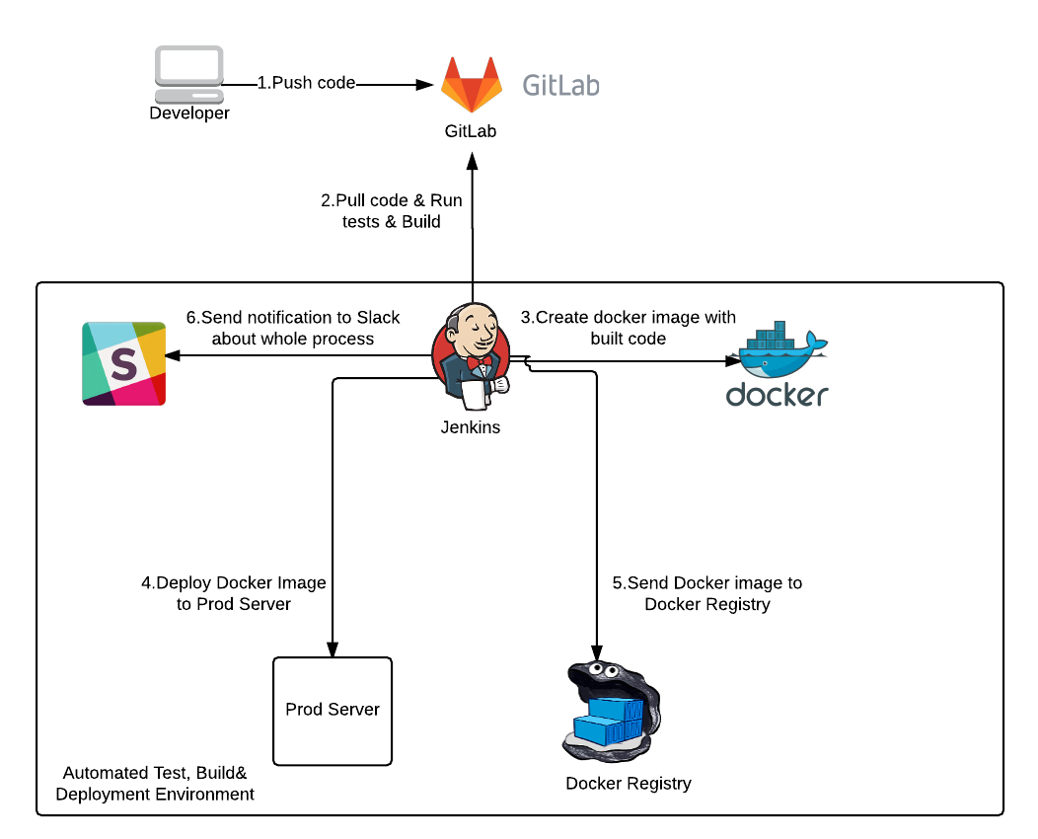

Slide 3
Pipeline
We have Spring Boot Standalone Application. Build the continuous integration pipeline through Jenkins.
Build Process through Jenkinsfile. We can define multiple stages in pipeline.
First the source code will compile then it will test & and Create the Docker images, Pushing the image in Docker Hub.
Slack Integration with Jenkins. One the job will complete either fail the notification is send.

