Slide 1


ONLINE REAL ESTATE
TEAM - 5
Bhagyalaxmi Belkod
Chethana Rajashekar
Mohammed A. Sharif
Sanket Jori

Slide 2



Problem Statement:
To build an Online Real-Estate Property Listing Web-Application.

Slide 3


User Operations
Register new user
View list of properties
USER
Search properties
Contact property owner

Slide 4

Admin Operations
Add new properties
Update properties
ADMIN
View list of properties
Delete properties

Slide 5





DOCKER
HUB
DOCKER
DOCKERFILE
ADD
BUILD
RUN
COMMIT
And
PUSH
CODE
DOCKER IMAGE
DOCKER
CONTAINER

Slide 6
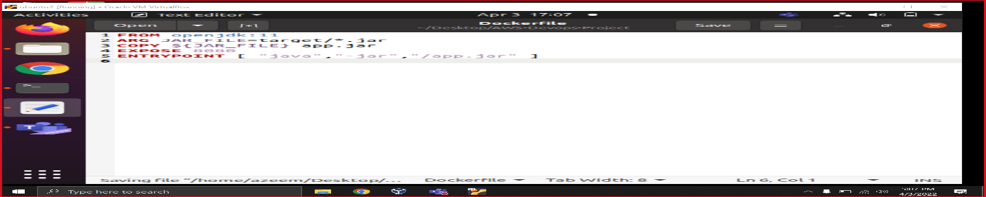
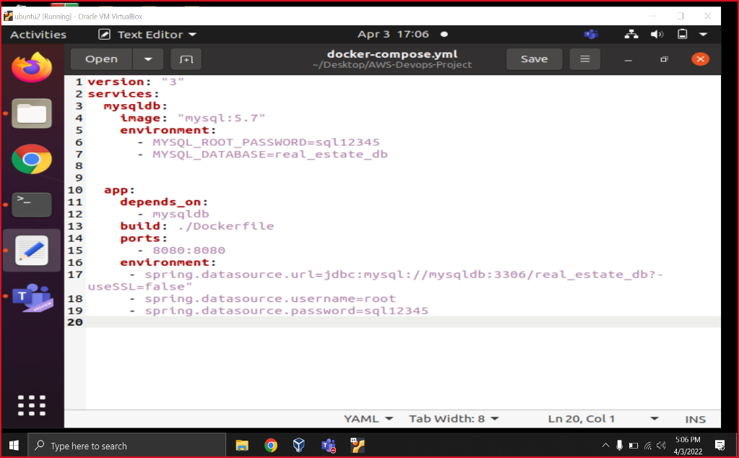
DOCKER
1. DOCKERFILE
2. DOCKER-COMPOSE

Slide 7
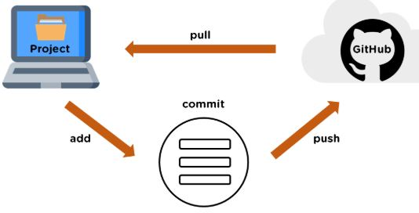
GITHUB

Slide 8


ANSIBLE - KUBERNETES
MASTER Node
SERVER
SSH
WORKER Node
SSH

Slide 9
THANK YOU

