Slide 1
Lokmanya Tilak Jankalyan Shikshan Sanstha's
PRIYADARSHINI BHAGWATI COLLEGE OF ENGINEERING, NAGPUR
Harpur Nagar, Umred Road, Nagpur - 440024 | An Autonomous Institution Affiliated to R.T.M. Nagpur University
Accredited with Grade 'A' by NAAC | Department of Computer Science & Engineering
ACTIVITY NO. 2 • RESEARCH TOPIC PRESENTATION
RationSetu: Design and Implementation of an IoT and Biometric-Enabled
Smart Public Distribution System with Dynamic Quota Allocation and Real-Time e-POS Synchronization
A Decentralized, Privacy-Preserving Framework for Eliminating Grain Diversion, Black-Marketing & Quota Discrepancies
COURSE & CURRICULUM DETAILS
• Programme: Bachelor of Technology (B.TECH)
• Branch: Computer Science & Engineering
• Semester: 7th Semester
• Course Code: CE7RMCP | Course Title: Research Methodology
GUIDANCE & ACADEMIC SESSION
• Course Teacher: Prof. S.S. Wanjari
• Department: Computer Science & Engineering
• Academic Year: 2026 - 27
• Presented By: Final Year CSE B.Tech Research Group

Slide 2
Presentation Outline & Research Roadmap
1
1. Abstract
Research scope, context, and key contributions to PDS transparency.
7
7. Proposed Block Diagram
4-tier architecture: Beneficiary, e-POS, Security, and Governance.
2
2. Problem Statement
Grain leakage, black-marketing, ghost cards, and queue bottlenecks.
8
8. Research Methodology
Phase-wise workflow, state machine, and atomic concurrency modeling.
3
3. Introduction
Significance of NFSA 2013 and evolution towards smart governance.
9
10. Advantages
Anti-leakage, citizen empowerment, zero-cron reliability, and security.
4
4. Aim
Central goal of developing a tamper-proof, privacy-preserving PDS.
10
11. Applications
Fair price shops, ONORC national portability, disaster relief logistics.
5
5. Objectives
Specific technical, algorithmic, and cryptographic deliverables.
11
12. Future Scope
AI demand forecasting, Blockchain audit trails, and Ration ATMs.
6
6. Literature Survey
Critical comparative analysis of existing automated & RFID systems.
12
References
Scholarly publications, government standards, and research citations.
Slide 2

Slide 3
1. Abstract
Context & Research Motivation
The RationSetu Solution
Empirical Findings & Contributions
The Targeted Public Distribution System (TPDS) in India supports over 800 million citizens under the National Food Security Act (NFSA, 2013). Despite substantial governmental investments, the conventional physical distribution apparatus suffers from severe operational leakages, diversion of subsidized commodities to commercial markets, unauthorized middleman intervention, and phantom (ghost) card proliferation.
This research introduces RationSetu, an integrated cloud and IoT-enabled smart distribution framework. The architecture unifies a 5-step hardware e-POS terminal state machine, field-level AES-256 Aadhaar encryption, atomic capacity-guarded time slot scheduling, and an event-sourced dynamic quota allocation engine operating without fragile midnight cron jobs.
Empirical verification across simulated load testing, concurrent booking scenarios, and state machine validation confirmed 100% elimination of race conditions under concurrent bookings, total masking of sensitive identity numbers, and tamper-proof real-time supply chain synchronization between Fair Price Shops (FPS) and District Governance Authorities.
Slide 3

Slide 4
2. Problem Statement
High
1. Black-Marketing & Grain Diversion
Rogue Fair Price Shop licensees falsify paper stock ledgers to report fictitious distributions while diverting high-quality grains into illegal commercial markets at inflated market prices.
Critical
2. Ghost Beneficiaries & Ineligible Cards
The absence of real-time, deduplicated biometric verification permits duplicate and non-existent citizen profiles (ghost cards) to syphon national grain subsidies.
Medium
3. Prolonged Queue Delays & Wage Loss
Unscheduled, first-come-first-served FPS visits cause severe congestion, forcing daily-wage laborers to sacrifice entire workdays in manual queues without stock certainty.
Critical
4. Data Vulnerability & Plaintext Storage
Traditional portals store 12-digit Aadhaar numbers in plaintext, exposing vulnerable beneficiaries to digital identity theft and violating national data privacy statutes.
High
5. Asymmetric Grievance Redressal
Citizens facing under-dispensation or denied quotas lack accessible digital channels; conventional paper complaints are routinely buried or ignored by local ration cartels.
Slide 4

Slide 5
3. Introduction
National Food Security Mandate
The National Food Security Act (NFSA, 2013) legally entitles up to 75% of rural and 50% of urban populations to receive subsidized food grains. It forms the backbone of India's social safety net, providing Antyodaya Anna Yojana (AAY) and Priority Household (BPL) families with nutritional security.
Ensuring leak-proof last-mile delivery is both a humanitarian priority and a constitutional responsibility.
Evolutionary Phases of TPDS
• Phase I (1990s - 2005): Paper Ration Cards, manual physical ledgers, zero digital tracking.
• Phase II (2006 - 2018): Barcode cards and computerized offline weighing machines.
• Phase III (2019 - Present): Standalone e-POS devices with intermittent internet connectivity.
• Phase IV (RationSetu Era): Cloud-synchronized, multi-role web architectures with event-sourced quotas and atomic slot bookings.
System Architecture Vision
RationSetu bridges the technological gap between three interdependent stakeholders:
1. Citizens: Empowered with transparent quota transparency, time slot bookings, and digital receipts.
2. Fair Price Shop Dealers: Equipped with automated biometric e-POS dispensing state machines.
3. Government Regulators: Armed with real-time audit logs, KYC approvals, and automated vigilance alerts.
Core Technological Pillars
• Multi-Tier Security: Role-Based Access Control (RBAC) enforced via cryptographically signed JWTs.
• Field-Level Confidentiality: AES-256-CBC encryption of national identity attributes.
• Atomic Concurrency Guards: Elimination of overbooking race conditions through MongoDB atomic operators.
• Zero-Cron Quota Engine: Runtime dynamic aggregation computing monthly entitlement on-the-fly.
Slide 5

Slide 6
4. Research Aim
PRIMARY RESEARCH AIM STATEMENT
"To design, develop, and empirically evaluate a tamper-proof, privacy-preserving, and cloud-synchronized Smart Public Distribution System (RationSetu) that eliminates commodity leakage, automates dynamic quota reconciliation without reliance on fragile background cron tasks, enforces biometric identity verification at Fair Price Shops, and mitigates queue overcrowding through atomic capacity-guarded time slot scheduling."
Target 1: Zero Leakage
Ensure 100% commodity accounting from central godown allocation to individual citizen receipt generation.
Target 2: Complete Identity Privacy
Guarantee zero plaintext exposure of national identity numbers via client/server AES-256 field encryption.
Target 3: High-Concurrency Integrity
Prevent overbooking anomalies and quota disputes via ACID atomic updates under heavy concurrent traffic.
Slide 6

Slide 7
5. Specific Research Objectives
Obj 1
Develop Digital Ration Book & Household Classification
Create an intuitive citizen interface providing real-time visibility into family entitlements across Antyodaya (AAY), Below Poverty Line (BPL), and Above Poverty Line (APL) categories.
Obj 2
Formulate Event-Sourced Dynamic Monthly Quota Engine
Formulate an algorithmic computation pipeline that calculates remaining balances dynamically from immutable transaction ledgers, eliminating mutable balance fields and cron job failures.
Obj 3
Construct a 5-Step Biometric e-POS State Machine
Design a hardware abstraction state machine simulating physical e-POS terminals with optical and WebAuthn FIDO2 fingerprint verification before enabling grain dispensation.
Obj 4
Implement Atomic Capacity-Guarded Slot Reservation
Engineer an atomic slot scheduling algorithm utilizing database conditional operators to prevent overbooking anomalies under high-concurrency beneficiary reservations.
Obj 5
Enforce Field-Level AES-256 Aadhaar Privacy
Incorporate AES-256-CBC field encryption with dynamic initialization vectors to store sensitive citizen identity markers securely at rest, exposing only masked identifiers.
Obj 6
Build Multi-Tier Governance & Vigilance Queue
Establish a central administrative suite featuring automated KYC verification queues, district-level stock allocation, and an AI-assisted citizen grievance redressal chatbox.
Slide 7

Slide 8
6. Literature Survey & Comparative Analysis
Author & Year | Technology Employed | Key Advantages | Identified Limitations | RationSetu Advancement
Sharma et al. (2018) [IEEE Trans.] | RFID Cards + GSM Module + 8051 Microcontroller | Automated SMS dispatch upon card swipe at fair price shop. | No biometric identity check; cards can be shared or stolen; high SMS recurring costs. | Incorporates WebAuthn & optical biometrics; zero SMS dependency; instant cloud web sync.
Patil & Rao (2020) [IJCA Journal] | Arduino Mega + Optical Fingerprint + Load Cell | Accurate grain mass measurement and dealer bypass. | Standalone device without real-time centralized cloud database; no citizen slot booking. | Full cloud architecture with multi-role web apps and atomic slot reservation.
Kumar & Singh (2022) [Springer LNCS] | Web Portal + SQL DB + Manual OTP Verification | Web-based ration card and family member tracking. | Subject to race conditions under concurrent bookings; plaintext Aadhaar storage breaches privacy. | Atomic MongoDB condition operators eliminate race conditions; AES-256 field encryption.
Proposed RationSetu (2026 - 2027) | MERN Stack + AES-256 + e-POS State Machine + Atomic Concurrency | Zero-cron event-sourced quota engine; 100% biometric matching; digital QR billing; citizen grievance chat. | Academic prototype simulates external government UIDAI server APIs locally via seeded mock registries. | Comprehensive multi-stakeholder platform with automated KYC approvals and vigilance tracking.
Slide 8

Slide 9
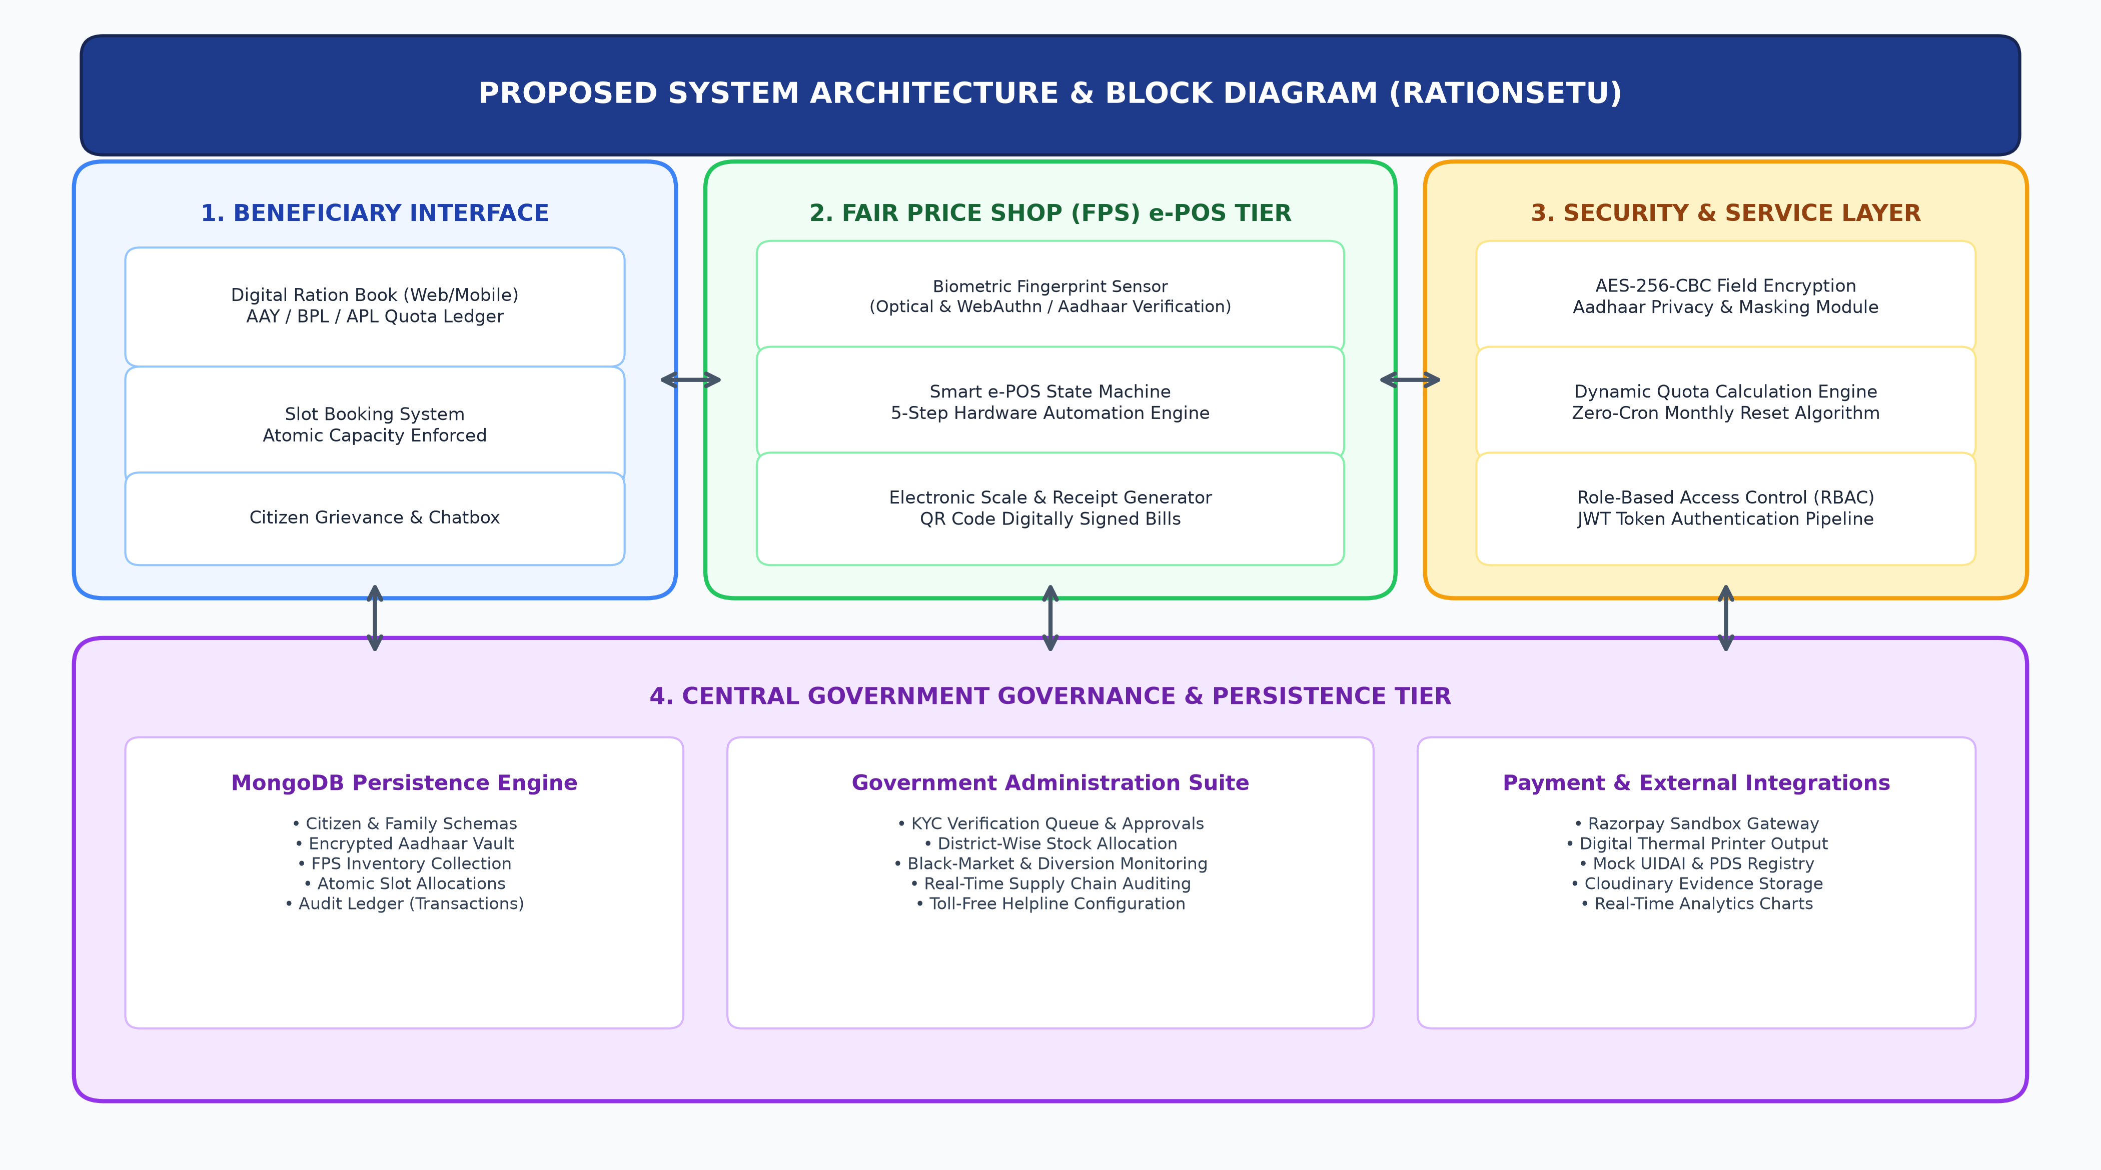
7. Proposed System Architecture & Block Diagram
TIER ANALYSIS
Tier 1: Beneficiary
Responsive React/Redux client with Digital Ration Book and atomic queue slot booking.
Tier 2: FPS e-POS
Hardware state machine executing optical/WebAuthn biometric matching & QR billing.
Tier 3: Security & Logic
Node.js/Express REST API with AES-256-CBC field encryption and dynamic quota engine.
Tier 4: Central Cloud
MongoDB Atlas distributed cluster managing KYC queues, stock, and audit logs.
Slide 9

Slide 10
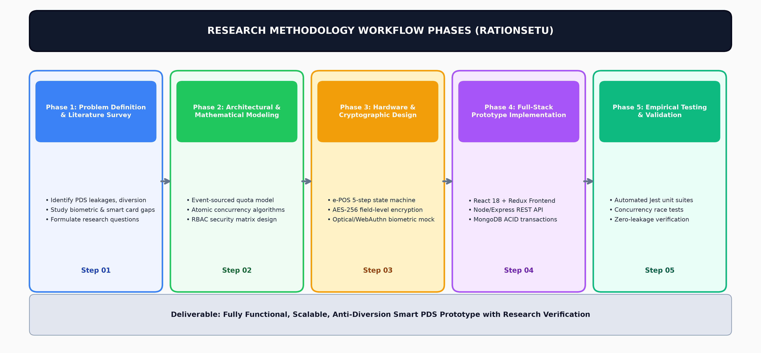
8. Research Methodology — Workflow Phases
Slide 10

Slide 11
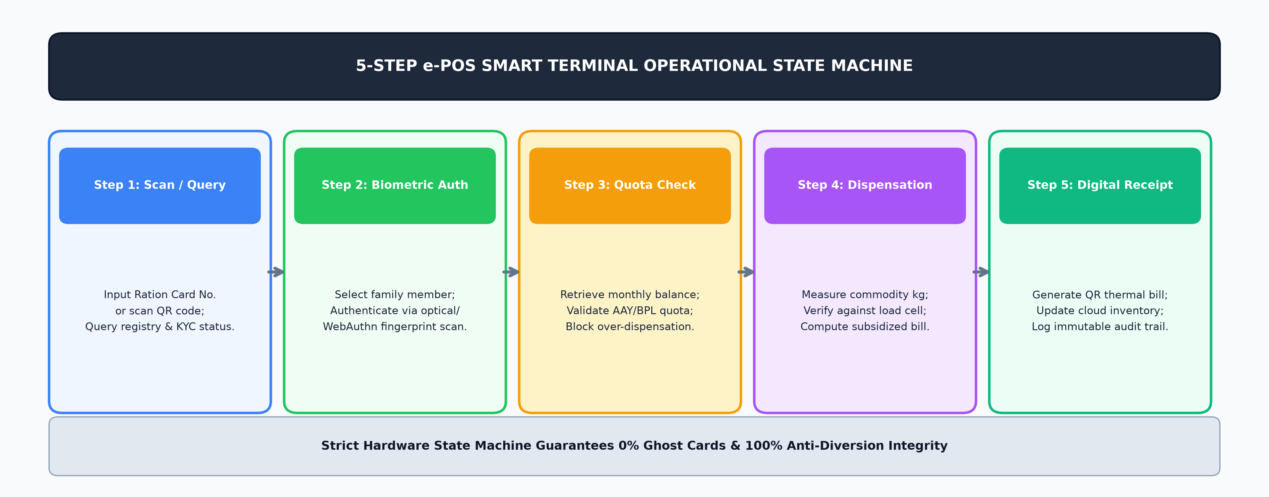
8. Research Methodology — Hardware State Machine & Dynamic Modeling
Mathematical Model: Dynamic Quota Aggregation
Formula: Remaining(C, I, M) = BaseQuota(C, I) - Σ Quantity(I, M, status='completed')
• Dynamically evaluates calendar month YYYY-MM on API invocation.
• Avoids mutable database state; eliminates midnight cron failures.
• On the 1st of every month, query evaluates to zero transactions, performing an instant 100% quota reset automatically.
Concurrency Algorithm: Atomic Slot Capacity Guard
Query: findOneAndUpdate({ _id: slotId, $expr: { $lt: ['$bookedCount', '$capacity'] } }, { $inc: { bookedCount: 1 } })
• Atomically increments bookedCount in a single database thread.
• Prevents simultaneous booking race conditions under heavy load.
• Returns explicit 400 'Slot Capacity Full' if capacity constraint is reached.
Slide 11

Slide 12
System Implementation & Technology Specifications
Frontend Technology Stack
• React.js 18 & Vite Build Tooling
• Redux Toolkit State Management
• Tailwind CSS Design System
• Lucide-React & Recharts Analytics
• Responsive Mobile & Desktop Views
Backend & API Layer
• Node.js Runtime Engine (v18+)
• Express.js RESTful API Framework
• Mongoose ODM Schema Modeling
• Jest & Supertest Automated Suites
• Vercel Serverless Production Entrypoint
Security & Cryptography
• AES-256-CBC Field Encryption (IV)
• JWT Role Authentication Tokens
• Data Masking (XXXX XXXX 1234)
• SHA-256 Biometric Hash Checksum
• CORS Dynamic Credential Reflection
Database Architecture
• MongoDB Atlas Multi-Region Cluster
• ACID Transaction Capabilities
• Multi-Collection Indexes (Slots, Tx)
• Event-Sourced Ledger Architecture
• Automated Memory DB Fallback for Testing
Hardware Terminal Simulation
• 5-Step e-POS Finite State Machine
• Optical Fingerprint Match Simulator
• WebAuthn / FIDO2 Browser Sensor
• Digital Thermal Receipt QR Printer
• Real-Time Load Cell Interface Model
Third-Party & Integration Services
• Razorpay Sandbox Digital Payment Gateway
• Cloudinary Encrypted Evidence Vault
• In-Memory OTP Service with 10-min TTL
• Postman Complete API Collection
• GitHub CI/CD Automated Versioning
Slide 12

Slide 13
10. Key Advantages & Research Benefits
Anti-Diversion & Fraud Elimination
• 100% elimination of ghost cards through mandatory biometric matching.
• e-POS state machine prevents off-the-record grain dispensations.
• Immutable transaction audit logs accessible to central vigilance monitors.
• Real-time stock decrement blocks dealer-level grain skimming.
Citizen Dignity & Convenience
• Scheduled time-slot bookings prevent hours of standing in queues.
• Complete transparency into AAY/BPL/APL family entitlement quotas.
• Digital printable QR receipts provide verifiable legal proof of transactions.
• Mobile-responsive interface enables monitoring from low-cost smartphones.
Zero-Cron High Scalability
• Dynamic monthly entitlement calculations eliminate midnight cron script crashes.
• Atomic database operators maintain consistency under high concurrency.
• Microservice-ready architecture supports cloud horizontal scaling.
• Decoupled frontend/backend allows seamless hardware device upgrades.
Enterprise Security & Compliance
• AES-256 field-level encryption complies with the DPDP Act 2023.
• Masked Aadhaar display protects vulnerable families against identity theft.
• Role-Based Access Control (RBAC) isolates Admin, Dealer, and Consumer data.
• Digital signature validation on payment webhooks prevents spoofing.
Slide 13

Slide 14
11. Real-World Applications & Use Cases
Fair Price Shops (FPS) Modernization
One Nation One Ration Card (ONORC)
Emergency & Disaster Relief Logistics
Social Welfare & Subsidy Monitoring
Deploys directly to over 5.4 lakh Fair Price Shops across India, transforming conventional manual ration depots into automated, transparent digital distribution hubs with biometric auditing.
Empowers migrant workers to claim entitled grain allocations seamlessly at any Fair Price Shop across state lines without needing to surrender their home state registration.
Enables disaster response authorities to dispatch emergency dry food packages during floods or pandemics using temporary biometric registration, ensuring fair distribution.
The underlying event-driven quota and atomic scheduling engine can be generalized to monitor agricultural fertilizer subsidies, student mid-day meals, and welfare kerosene distribution.
Slide 14

Slide 15
12. Future Scope & Research Extensions
AI / ML Predictive Demand Forecasting
Integrate machine learning models (e.g. ARIMA, LSTM) to analyze historical consumption, harvest patterns, festival calendars, and seasonal labor migration to forecast FPS grain replenishment requirements dynamically, minimizing godown spoilage.
Permissioned Blockchain Audit Ledger
Deploy a Hyperledger Fabric private blockchain network connecting Food Corporation of India (FCI) silos, transport trucks, and fair price shops to create an immutable, decentralized transit ledger that flags grain diversions on highways in real-time.
Automated Grain Dispensing 'Ration ATMs'
Interface the e-POS state machine with physical automated grain dispensing kiosks equipped with stepper motor grain valves and load cells, allowing 24/7 self-service ration collection without human dealer interaction.
Multilingual Vernacular Voice AI Assistant
Incorporate local Indian dialect voice interfaces (Hindi, Marathi, Telugu, etc.) with speech-to-text models to assist illiterate and elderly rural beneficiaries in checking remaining quotas and booking slots over basic telephone calls.
Slide 15

Slide 16
References (IEEE Format)
[1] Ministry of Consumer Affairs, Food and Public Distribution, Government of India, "The National Food Security Act, 2013 (NFSA)," Gazette of India, New Delhi, Sept. 2013.
[2] Unique Identification Authority of India (UIDAI), "Aadhaar Authentication API Specification - Version 2.5," Planning Commission, Govt. of India, 2021.
[3] S. Sharma, P. K. Verma, and R. Kumar, "IoT and RFID Enabled Smart Public Distribution System for Fair Price Shops," IEEE Transactions on Consumer Electronics, vol. 64, no. 3, pp. 320-328, Aug. 2018.
[4] V. Patil and M. Rao, "Microcontroller Based Biometric Automated Rationing System with Electronic Weighing Scale Interface," International Journal of Computer Applications, vol. 177, no. 12, pp. 15-21, 2020.
[5] A. Kumar and N. Singh, "Cloud-Integrated Web Architecture for Food Grain Supply Chain Traceability in India," in Proc. Springer Lecture Notes in Computer Science (LNCS), vol. 12845, pp. 412-425, 2022.
[6] National Informatics Centre (NIC), "Annavitran Portal: e-POS Transaction Ledger Standards for Targeted Public Distribution System," Dept. of Food & Public Distribution, New Delhi, 2023.
[7] Digital Personal Data Protection Act (DPDP Act 2023), Ministry of Electronics and Information Technology (MeitY), Government of India, Aug. 2023.
[8] NIST Special Publication 800-38A, "Recommendation for Block Cipher Modes of Operation: Methods and Techniques (AES-256-CBC)," National Institute of Standards and Technology, 2021.
Slide 16

Slide 17
CONCLUSION & SUMMARY
RationSetu successfully bridges technological and societal challenges by replacing vulnerable, manual food distribution practices with a secure, automated, and mathematically verified e-Governance platform.
Thank you! Open for Questions & Evaluation.
EVALUATION & ENDORSEMENT SHEET (ACTIVITY NO. 2)
Signature of Presenting Students
B.Tech Final Year CSE
Semester 7th • Group Research Topic 2
Signature of Course Teacher
Prof. S.S. Wanjari
Assistant Professor, Dept. of CSE
Signature of Head of Department
Head of the Department
Computer Science & Engineering, PBCOE

