Slide 1
IBM University Engagement
Project Submission
AI Interview Trainer Agent
Exploring the Power of Agentic AI with IBM Granite and IBM Bob

Slide 2

Project Title & Student Details
Project Title – AI Interview Trainer Agent
Domain – Education / Career Development
Student Name | Recent Passport Photo | Email ID | Mobile number [WhatsApp]
Sanket Kolhe |  | sanket.kolhe@mitaoe.ac.in | 7385740431

Slide 3
Problem Statement – AI Interview Trainer Agent
The Challenge
Candidates often struggle to prepare for interviews because relevant technical, role-specific, HR, and behavioral questions are scattered across different sources.
Generic interview preparation does not adapt well to a candidate’s job role, experience level, skills, or background.
Candidates also need structured model answers, actionable improvement feedback, mock interview practice, and a clear preparation plan.
The Objective
Build an AI-powered Interview Trainer Agent that uses Retrieval-Augmented Generation (RAG), IBM Granite, and agentic workflows to create personalized interview preparation.

Slide 4
Proposed Solution – AI Interview Trainer Agent
A personalized interview preparation system built with IBM Granite through IBM watsonx.ai, RAG, ChromaDB, and a Gradio interface.
The candidate provides role, experience, skills, and professional background.
The RAG pipeline retrieves relevant interview knowledge before content generation.
The system generates technical, role-specific, HR, and behavioral questions with model answers, tips, and a 7-day strategy.
Answer Evaluation provides a score, strengths, weaknesses, technical accuracy, communication feedback, and improvement suggestions.
Mock Interview conducts a stateful interview one question at a time and produces final performance feedback.

Slide 5
Technology Used
IBM Bob – used during project development, coding, testing, and workflow implementation.
IBM Granite – ibm/granite-4-h-small for AI-powered generation through IBM watsonx.ai.
IBM watsonx.ai / Watson Machine Learning – model runtime and API access.
RAG – retrieves relevant knowledge before generation to improve context and relevance.
ChromaDB – local persistent vector store for semantic retrieval.
Sentence Transformers – all-MiniLM-L6-v2 for local embeddings.
LangChain – document processing and RAG pipeline components.
Gradio – interactive web interface.
Python + Pytest – application development and testing.

Slide 6
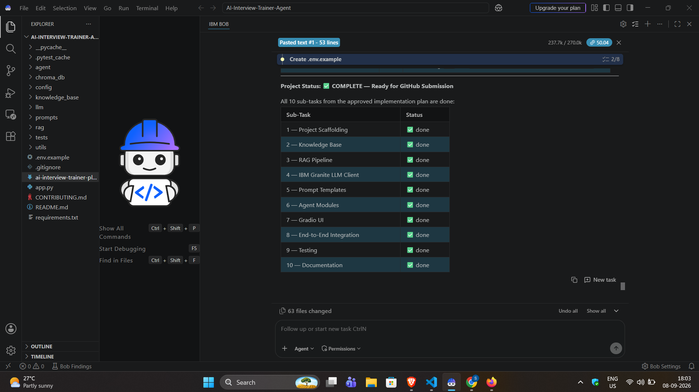
Required Files Created / Implemented Using IBM Bob
IBM Bob project implementation status and completed development tasks

Slide 7
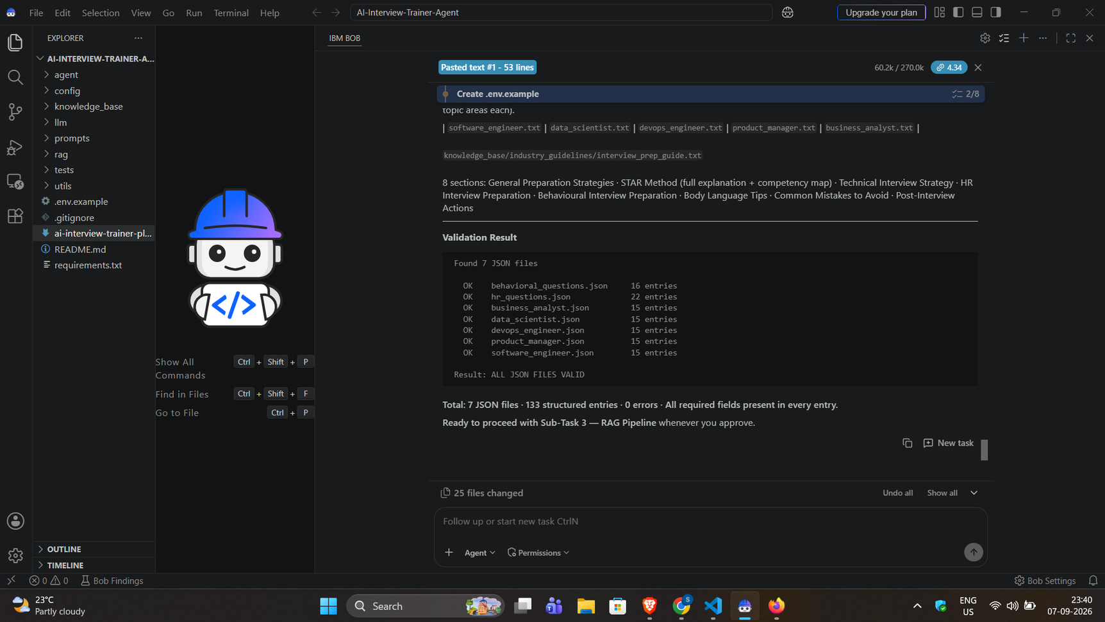
IBM Bob Development & Validation Screenshot
Knowledge-base validation and application-readiness checks performed during development

Slide 8
Architecture Blueprint
Candidate
↓
Gradio Web Interface
↓
Profile Parser → Structured User Profile
↓
Interview Orchestrator
├── Question Generator
├── Answer Generator
├── Answer Evaluator
├── Feedback Agent
└── Mock Interviewer
↓
RAG Retrieval Layer
Document Loader → Chunking → Embeddings → ChromaDB
↓
Relevant Context
↓
IBM Granite via watsonx.ai
↓
Questions • Model Answers • Tips • Evaluation • Mock Feedback • 7-Day Plan

Slide 9
RAG Pipeline & Data Flow
1. Curated knowledge base stores technical, HR, behavioral, role-specific, and interview-preparation content.
2. Documents are loaded and split into manageable chunks.
3. Sentence-transformer embeddings convert text into vector representations.
4. ChromaDB stores the vectors for semantic retrieval.
5. A user profile and interview request are used to retrieve relevant context.
6. Retrieved context is combined with prompts and passed to IBM Granite.
7. Generated content is formatted into the Interview Kit and evaluation/feedback outputs.

Slide 10
Role of Agentic AI in the Solution
Agentic AI makes the application more than a static question generator by coordinating multiple specialized workflows.
Question generation focuses on technical, role-specific, HR, and behavioral preparation.
Answer evaluation analyzes candidate responses and produces structured feedback.
The Mock Interviewer maintains session state, asks questions sequentially, and processes submitted answers.
The Feedback Agent combines performance information into an overall assessment and 7-day preparation plan.
The system is profile-aware: role, experience, skills, and background influence the generated preparation content.

Slide 11
Implementation, Testing & Reliability
IBM Bob was used during implementation to create and refine the project files, prompts, RAG components, agent modules, UI, testing, and documentation.
The project includes automated tests, application import checks, prompt validation, knowledge-base validation, and UI handler checks.
The application handles missing or unavailable IBM credentials gracefully.
When IBM Granite is unavailable because of service or token-quota limitations, supported flows use Local Fallback Mode so the demonstration can continue.
The UI clearly indicates when a local fallback is being used rather than silently presenting it as live Granite output.

Slide 12
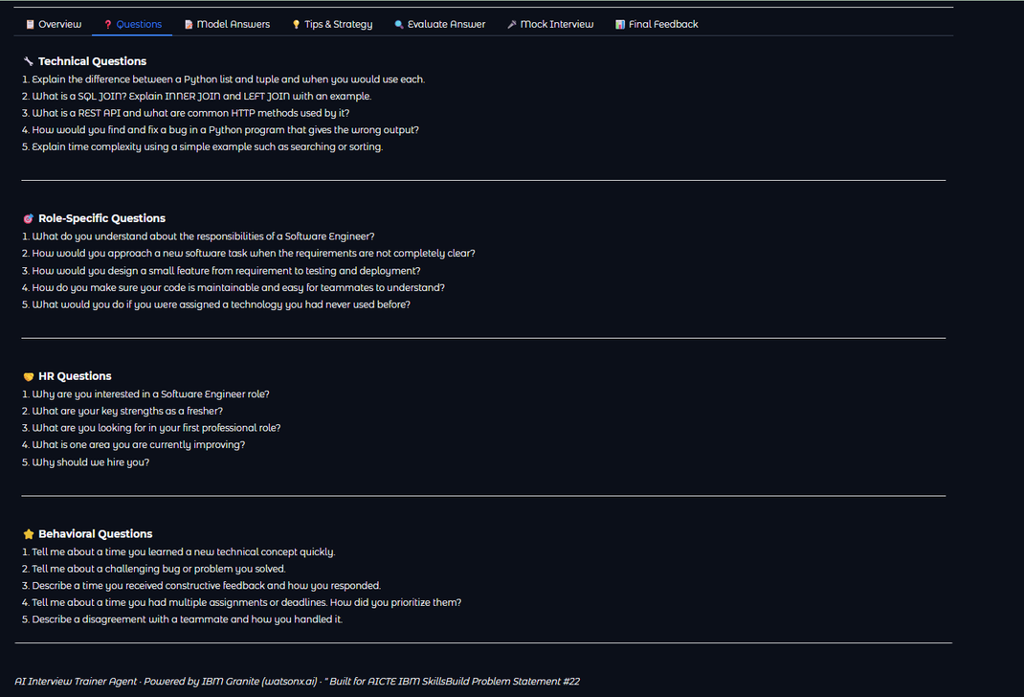
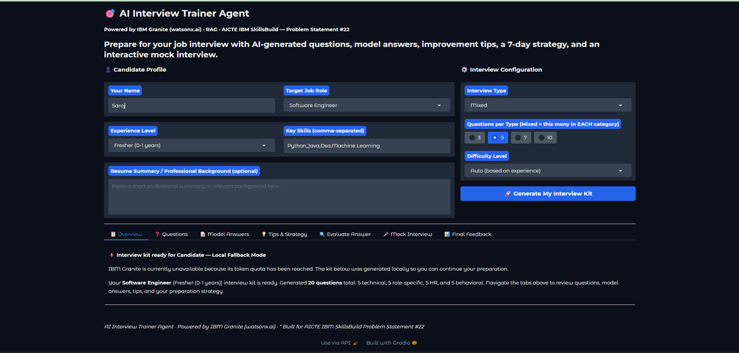
Project Output Screenshot – Interview Kit
1. Project Overview & Candidate Profile
2. Generated Interview Questions

Slide 13
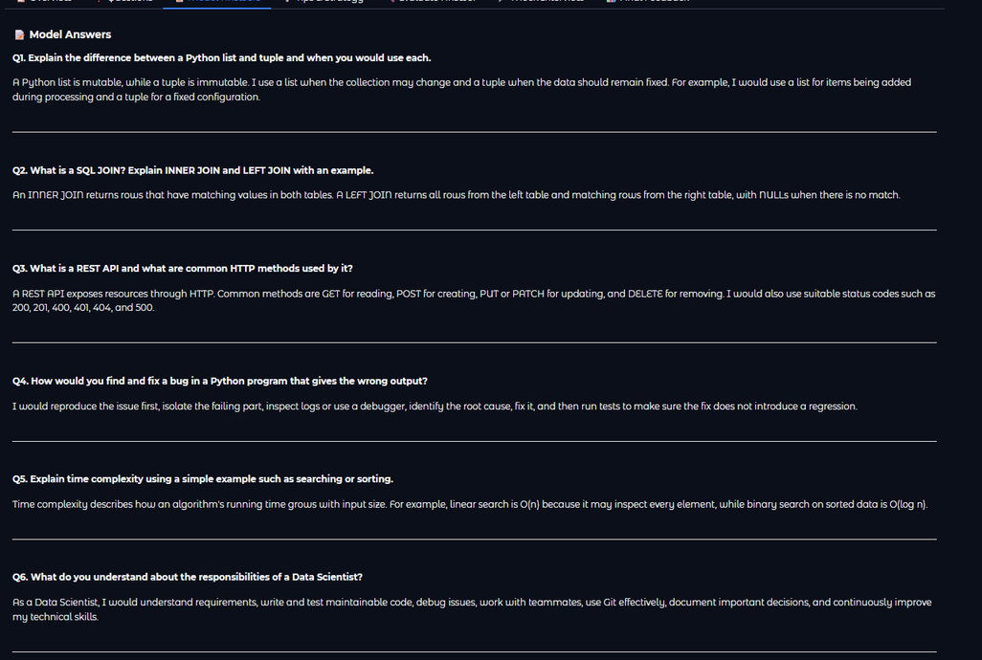
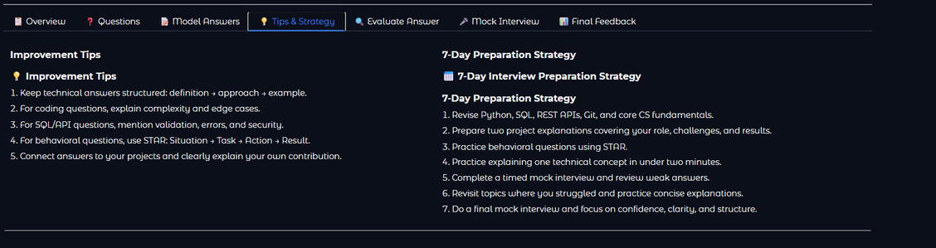
Project Output Screenshot – Preparation Content
3. AI-Generated Model Answers
4. Personalized Tips & 7-Day Strategy

Slide 14
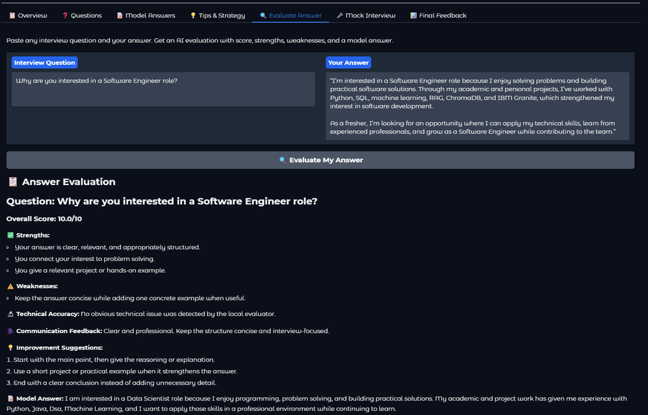
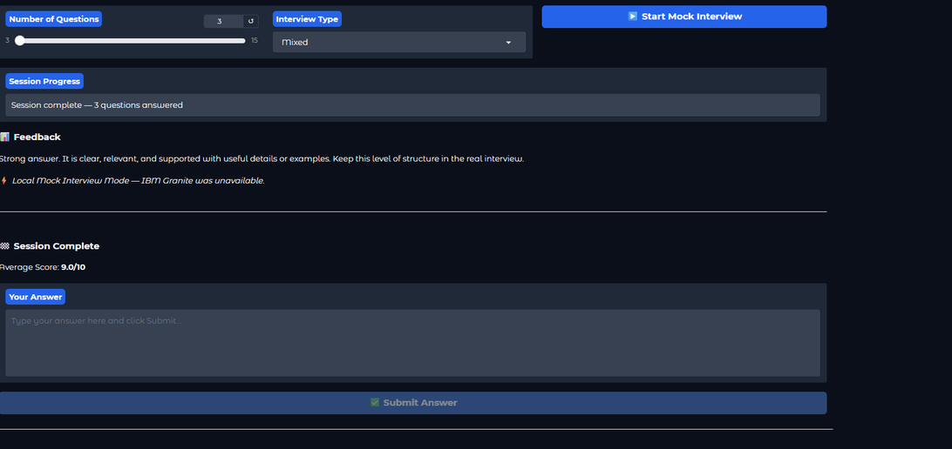
Project Output Screenshot – Evaluation & Mock Interview
5. AI Answer Evaluation & Feedback
6. Interactive Mock Interview

Slide 15
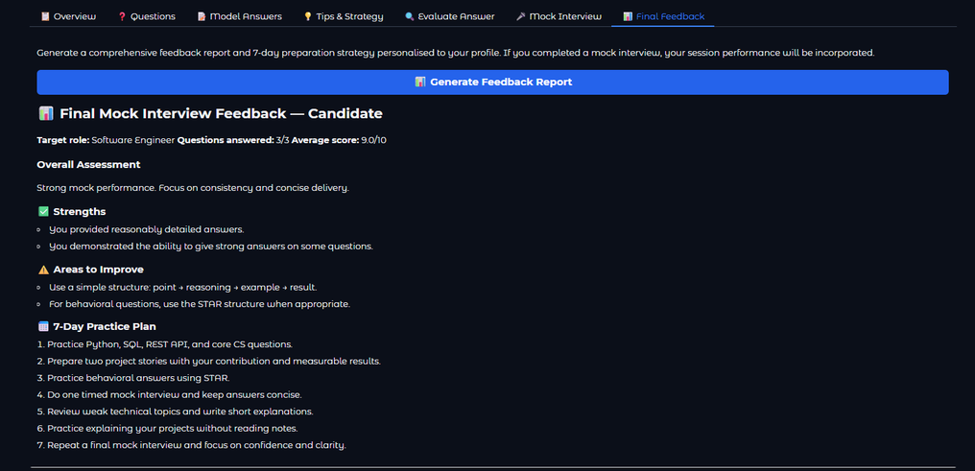
Project Output Screenshot – Final Performance
7. Final Mock Interview Feedback & Performance Summary
8. IBM Bob Development / Implementation Evidence

Slide 16
Novelty and Uniqueness
Personalized interview preparation based on role, experience level, skills, and background.
RAG-based retrieval connects interview generation with a curated knowledge base.
Multiple interview categories are generated in one workflow: technical, role-specific, HR, and behavioral.
Answer Evaluation provides structured scoring and actionable improvement guidance.
Interactive Mock Interview supports sequential questioning and session-level performance feedback.
The Final Feedback module turns performance into a practical 7-day preparation plan.
Local Fallback Mode improves demonstration reliability when the live IBM Granite service is unavailable.

Slide 17
GitHub Link
Public GitHub Repository
https://github.com/SanketKolhe2005/AI-Interview-Trainer-Agent

Slide 18
Future Scope
PDF resume upload with automatic profile extraction.
Persistent interview history and progress tracking.
Voice-based mock interviews and speech-to-text answers.
Multilingual interview preparation.
Advanced analytics dashboards for answer quality and progress.
More job roles, larger knowledge bases, and domain-specific interview tracks.
Cloud deployment and stronger user authentication/session management.

Slide 19
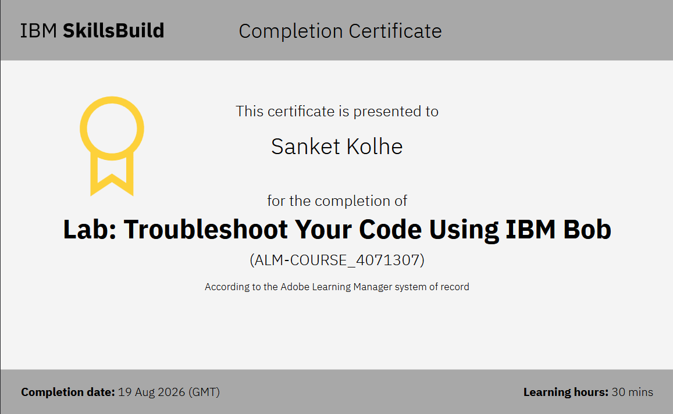
Certificate Earned
IBM BOB Certificate

Slide 20
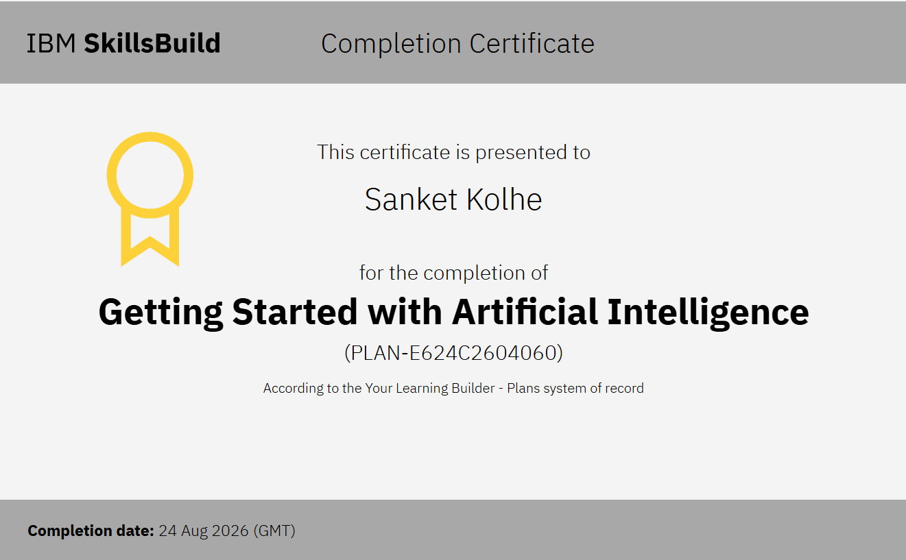
Certificate Earned
Credly certificate(Getting Started with Artificial Intelligence)

Slide 21
Thank You!
AI Interview Trainer Agent
AICTE IBM SkillsBuild – Problem Statement #22

