Slide 1

SEASONAL AGRICULTURE PERFORMANCE ANALYSIS
Major Project – VOIS × AICTE
Submitted By
Sanket Digambar Kolhe
College
MIT Academy of Engineering
AICTE STU ID
STU663d064790ec21715275335

Slide 2

PROBLEM STATEMENT
Agricultural performance is influenced by seasonal variations in environmental conditions, farming practices, resource availability and market conditions.
Raw agricultural data does not clearly explain how agricultural performance changes from one season to another.
This project analyzes the provided agricultural dataset to identify meaningful seasonal patterns, trends, relationships and variations.
The analysis supports evidence-based understanding and better seasonal agricultural planning.

Slide 3
Seasonal Agriculture Performance Analysis examines 4,000 agricultural records across Kharif, Rabi and Zaid seasons. The project covers data exploration, data cleaning, descriptive analysis, seasonal comparisons, visualization and relationship analysis. Yield, production, profit, rainfall, water efficiency and disease/pest risk are studied to identify meaningful seasonal differences and trends.

Slide 4

WHO ARE THE END USERS?
Farmers and agricultural planners
Agricultural stakeholders and decision-makers
Data analysts and researchers
Students working with agricultural data
Users interested in evidence-based seasonal agricultural planning

Slide 5

Technology Used
Python
Pandas — data cleaning, transformation and aggregation
NumPy — numerical analysis
Matplotlib — data visualization
Google Colab / Jupyter Notebook — analysis and documentation
CSV — source dataset

Slide 6
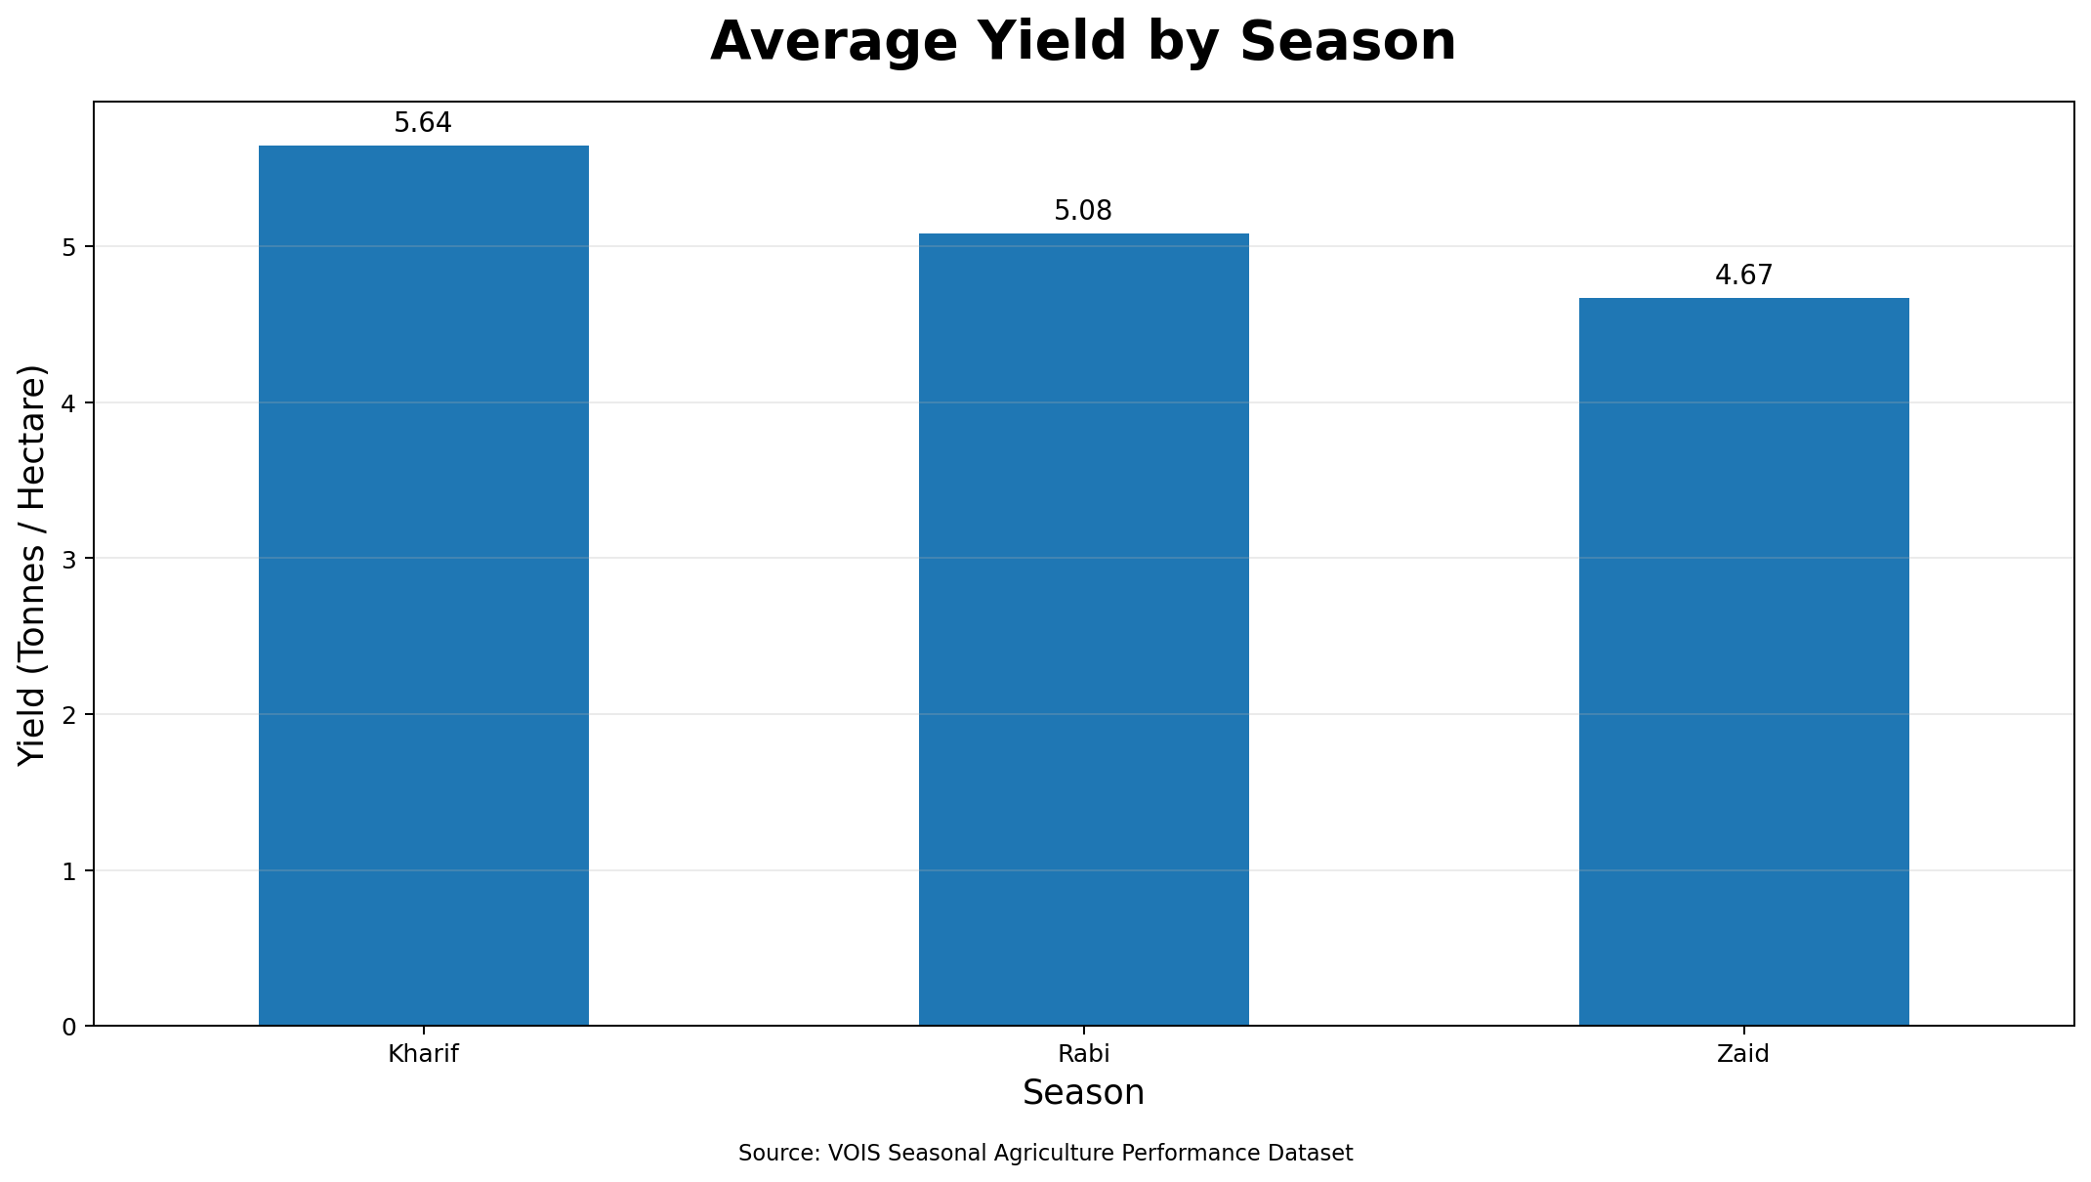
RESULTS
RESULT 1 — Average Yield by Season
Kharif records the highest average yield at 5.64 tonnes/hectare.

Slide 7
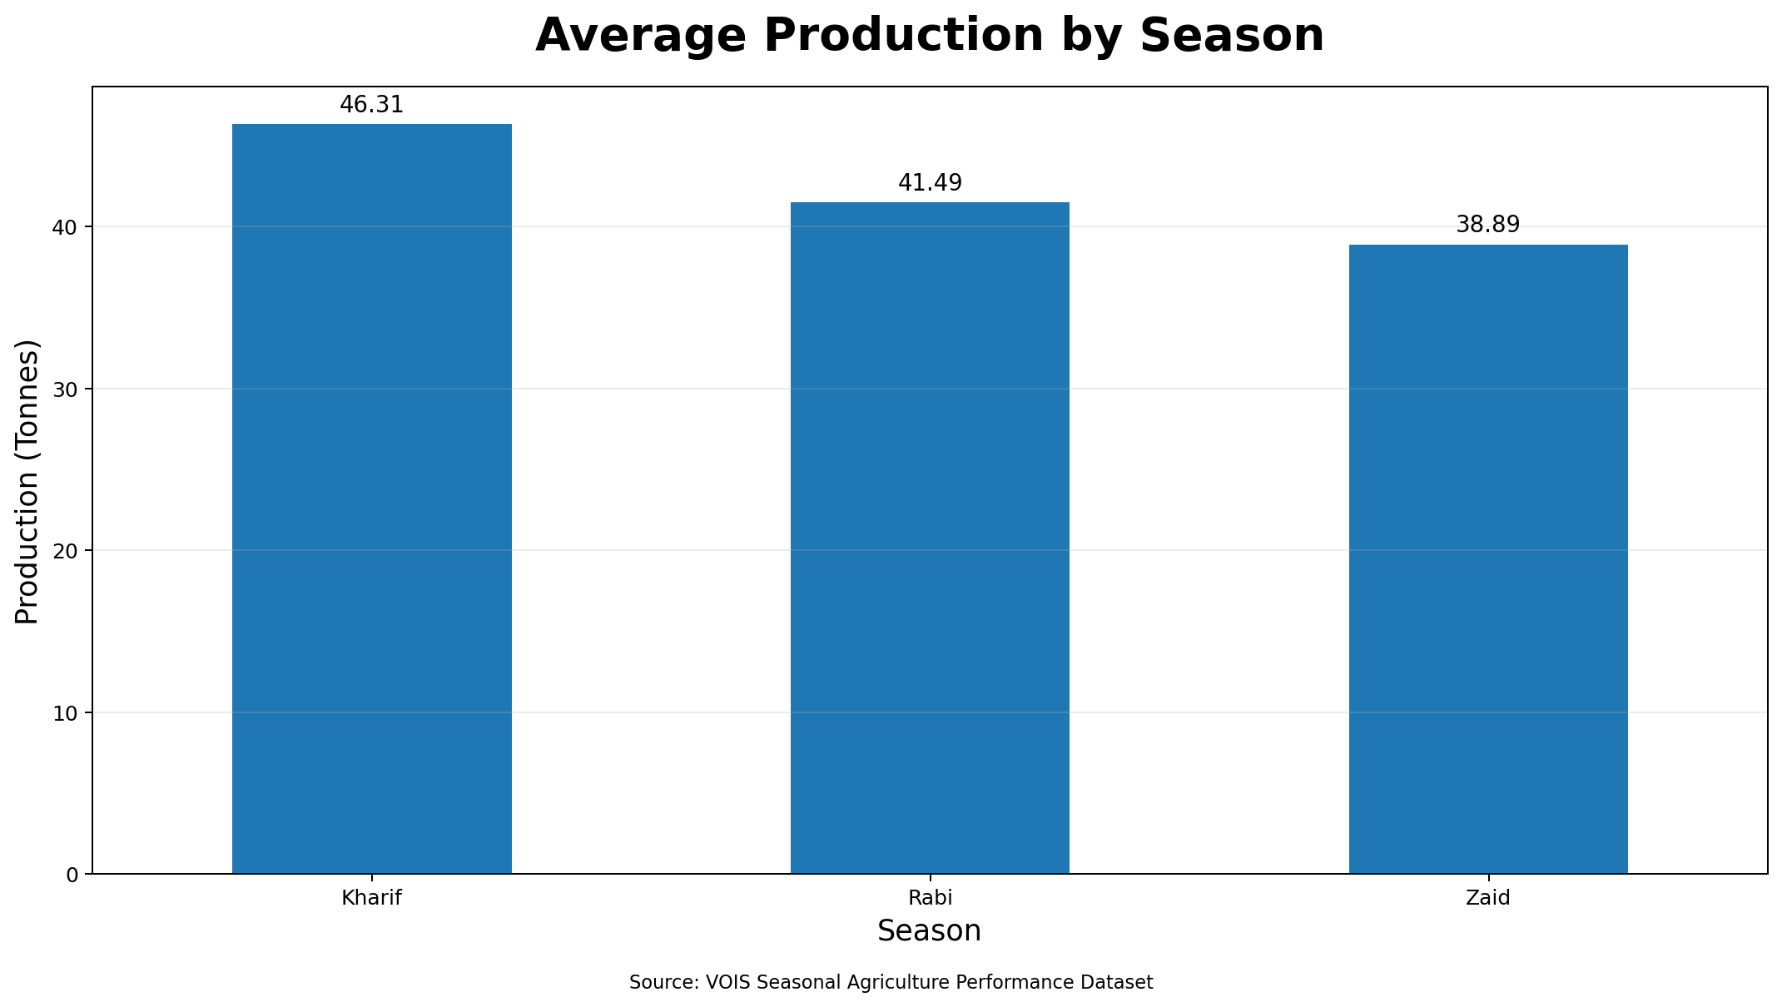
RESULTS
RESULT 2 — Average Production by Season
Kharif has the highest average production at 46.31 tonnes.

Slide 8
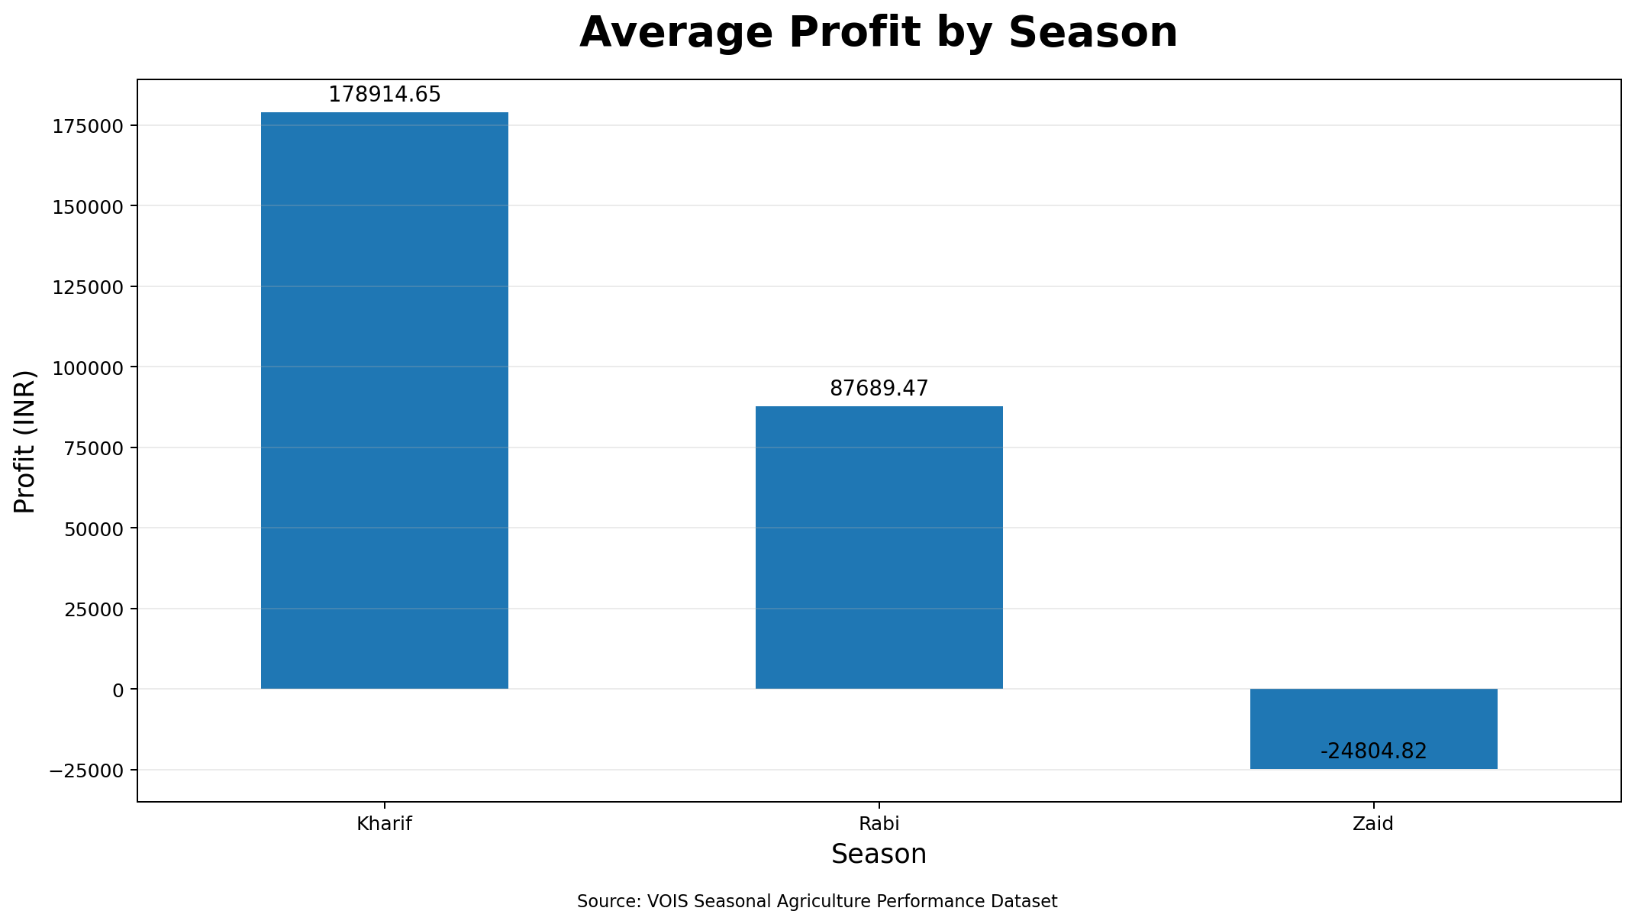
RESULTS
RESULT 3 — Average Profit by Season
Kharif has the highest average profit at ₹178,915.

Slide 9
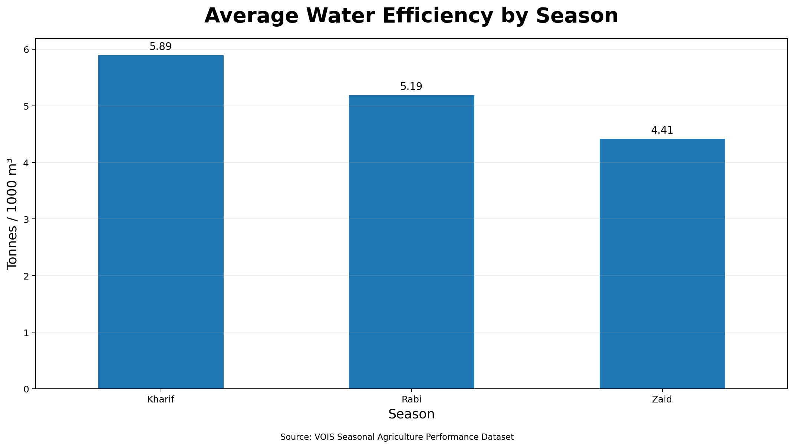
RESULTS
RESULT 4 — Water Efficiency by Season
Average water efficiency is 5.89 for Kharif, 5.19 for Rabi and 4.41 tonnes/1000 m³ for Zaid.

Slide 10
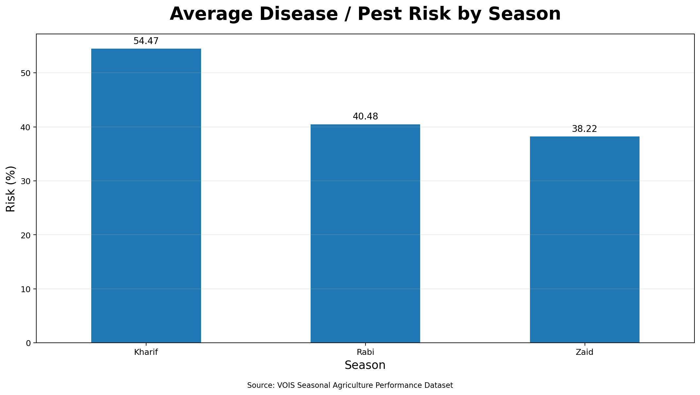
RESULTS
RESULT 5 — Disease / Pest Risk by Season
Kharif shows the highest average disease/pest risk at 54.47%, compared with Rabi and Zaid.

Slide 11
Future scope
Extend the analysis using larger and more recent agricultural datasets.
Develop interactive dashboards for seasonal agricultural monitoring.
Integrate weather and market-price data for deeper analysis.
Apply predictive analytics for yield and economic outcome forecasting.
Perform more detailed crop-, district- and state-level seasonal analysis.

Slide 12
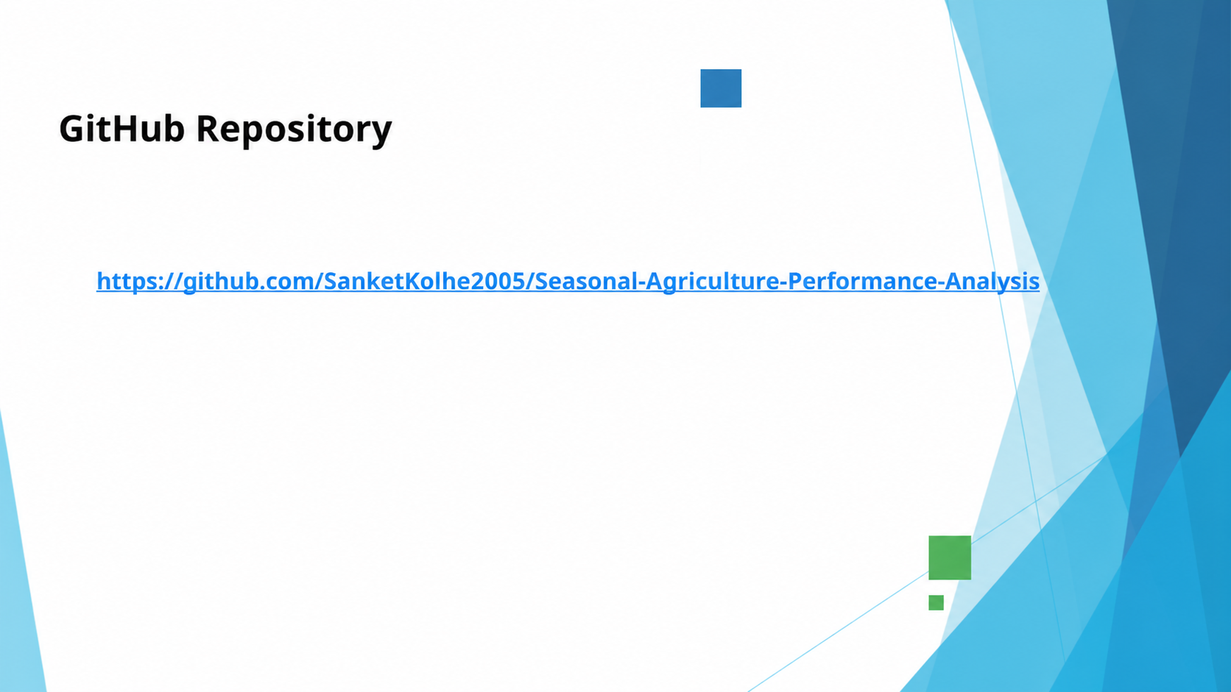
GitHub Repository
https://github.com/SanketKolhe2005/Seasonal-Agriculture-Performance-Analysis

Slide 13


Certificate of Completion

Slide 14
Thank You
Seasonal Agriculture Performance Analysis
.
.

