Slide 1
Summer Project Report
Online teaching-learning platform
Name: Sanket Kumar Dawar
Roll: 2019BCS-054

Slide 2
Project
Overview
This project is focused towards enhancing online teaching-learning by providing one single web application for all academic needs of both student and teachers.
The objective of this project is to build one single platform for both teachers and students, to manage all the day-to-day academic related activities. such as Online Class, Notes, Assignments etc. to ensure better efficiency in the process of teaching.

Slide 3
Context
As last year we saw a breakout of a serious pandemic, which affected us in many ways.
Education system also took a major hit.
Soon online classes became the main source of teaching-learning[2].
But there was no good product addressing this huge increase in demand

Slide 4
Problems with the existing online E-learning web/apps
No proper way to manage all the academics related activities. Different web/apps for different uses Eg. one for online class, one for notes, one for assignments.
no feature to record the class by default we need to record manually or use third party app which is not convenient.
To clear any doubt student have to either email or wait for the next online class, which may take too much time andthe process becomes too frustrating for both student and teacher.

Slide 5
Objective of the project (solution to the above problems
Recorded class. If a student misses any class for any reasons, He should be able to access the classes, the project ensures that by recording the class and storing it.
To simplify Online Education by bringing all the needs of teachers and students in one single web app. So that we can spend more time learning and teaching than managing the web/apps.

Slide 6
Notes making is most important while learning, so objective is to provide students an easier way to take notes and for teachers to provide notes.
Reduce gaps between student and teacher, the only ways student can contact teacher or vice versa, is to whatsapp, e-mail or to wait for the next live class. By providing an inbuilt discussion feature the project aims to ease the communication.

Slide 7
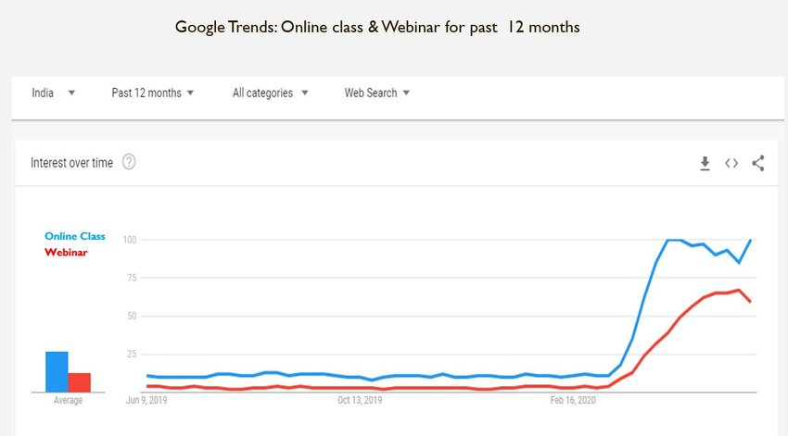
Methodology
With the recent pandemic situation, the concept of online classes saw an huge increase.
As you can see in the given graph, the queries related to online class and online education increased by almost 90 percent

Slide 8
Project hypothesis
A simple Server-Client web based application.
By using simple technologies like MERN Stack, a web-based application can be built for this project.

Slide 9
Software Requirements
(1) Node.Js and Express.Js are used for backend .
(2) React.Js is used for frontend development.
(3) MongoDB is used as database
(4) Some other tools and setups used are -
-Git for project management
-Mongoose, Nodejs lib for better management of MongoDB
-BcryptJs and JWT, Node Js libraries for authentication.
-Bootstrap and CSS for responsive and better User interface.
- PostMan Development tool

Slide 10
Mechanism/Algorithm
Two separate interfaces, one for Teachers and other for Students, with some minor changes. Each Student and teacher will be enrolled with some subjects and in those subjects there will be all the functionalities related to that subject. Following are some steps to explain the basics -
(1) Authentication - Through a signUP and Login system, user will be verified and and authenticated and once authenticated, user will be redirected to the Homepage.
(2) HomePage -The homepage consists of all the subjects user are enrolled to, with some info like batch name and Faculty name.
(3) Subject -Onclicking a particular subject, user can access the the subject. which consists of four 'tabs'
Class, Notes, Assignments, Discussion.

Slide 11
(4) Class - In class, There are previously recorded class, and a link for the live online class.
(5) Notes- for teachers there is an option for uploading the notes, and a list of all the previously
uploaded notes. For students a list of all the notes provided by the teacher.
(6) Assignment - For Teachers, there will be Take assignment option along with due date and
marks. On uploading the assignment, student will be notified about the assignment and
can access the PDF and has to submit in time.
(7) Discussion - student can ask any doubt directly to the teacher.

Slide 12
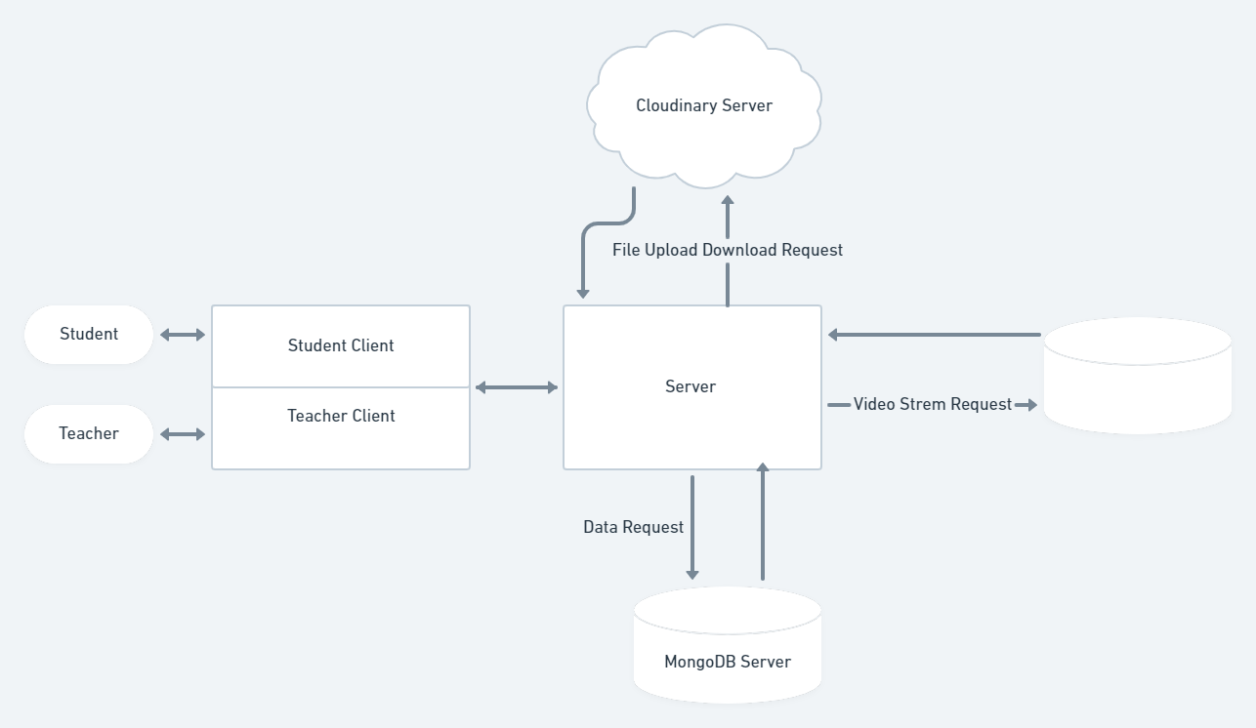
System Design

Slide 13
Thank You

