Slide 1
Group Members:
Open University Learning Analytics Dataset (OULAD) analysis
Bala Gopinath Kuchibatla
Sanketkumar Patel
Abhi subramaniyam kamuju
Rajashekar Allam
Kyung Jin kwak

Slide 2
1.
Introduction &
Motivation

Slide 3
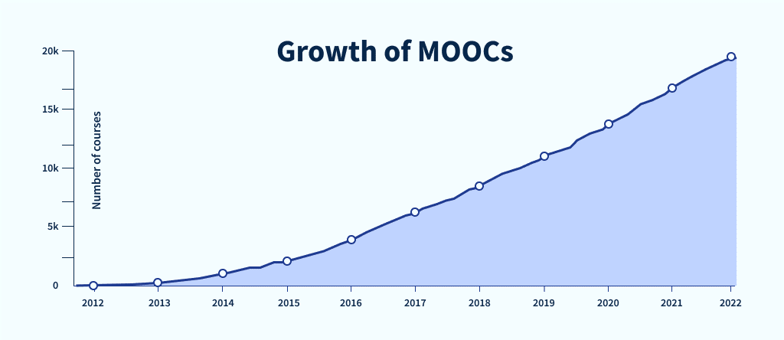
INTRODUCTION
In 2022, 220 million people subscribed to at least one MOOC(Massive open Online Course), which is a significant increase from 2021's 40 million.
Compared with traditional face-to-face teaching, online learning undoubtedly has many advantages. It breaks the limitation of learning time and space, greatly expands the scale of students, and improves the autonomy of students.
However, online learning has some problems, some of them are High Dropout Rates, Lack of Personal Interaction, Assessment and Feedback Challenges ,etc. This results in many students failing online courses.
To solve this problem, many researchers have suggested using machine learning algorithms to identify Dropout and at-risk students timely and accurately, and thus to provide adaptive learning intervention or support for them.
Figure 1: The above figure shows which shows the increasing number of Massive Open Online Courses (MOOCs) from 2012 to 2022.
3

Slide 4
MOTIVATION
By examining each student's learning habits and advancement, machine learning algorithms are able to generate customized learning pathways for them. This increases engagement and lowers dropout rates by meeting each student's unique needs and making sure they receive the most relevant information and support.
Instructors can identify at-risk students early in the course by using predictive analytics. This makes it possible to implement timely interventions that can greatly increase student success and retention rates, such as more tutoring, counseling, or alternate learning resources.
Early prediction allows for the development of personalized learning plans tailored to the needs of at-risk students, fostering a more supportive and customized educational experience.
Educational institutions can better allocate resources, such as tutoring, counseling, and financial aid, to those who need them most, improving the efficiency and effectiveness of these resources.
4

Slide 5
2.
About Dataset

Slide 6
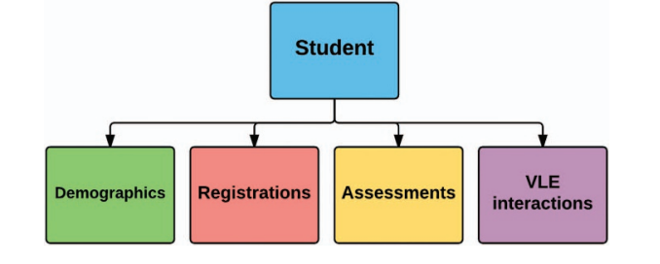
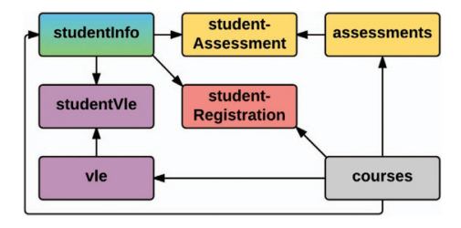
ABOUT DATASET
The OULAD data set contains information from courses presented at the Open University (OU). What make s the dataset unique is the fact that it contains demographic data together with aggregated clickstream data of students’ interactions in the Virtual Learning Environment (VLE).
This enables the analysis of student behaviour, represented by their actions. The dataset contains the information about 22 courses, 32,593 students, their assessment results, and logs of their interactions with the VLE represented by daily summaries of student clicks (10,655,280 entries).
In general, we distinguish three different data types:
Demographic—represents the basic information about the students including their age, gender, region, previous education, etc.
Performance—reflects students’ results and achievements during their studies at the OU.
Learning behaviour—is the log of student activities in the VLE.
Figure 2: Overall dataset structure. The student is linked with the information about his/her demographics and registrations for the modules. For each student-module-presentation triplet, the dataset contains the results of the students’ assessments and logs of student interactions with VLE.
Figure 3: Detailed dataset structure. Table studentInfo is linked to vle courses and assessments table via coresponding "student" table.
6

Slide 7
RAW DATA SUMMARY
TABLE | ROW,COLS | COLUMN NAMES
assessments | 206, 6 | ['code_module', 'code_presentation', 'id_assessment', 'assessment_type', 'date', 'weight']
courses | 22,3 | ['code_module', 'code_presentation', 'id_assessment', 'assessment_type', 'date', 'weight']
studentAssessment | 173912, 5 | ['id_assessment', 'id_student', 'date_submitted', 'is_banked', 'score']
studentInfo | 32593, 12 | ['code_module', 'code_presentation', 'id_student', 'gender', 'region', 'highest_education', 'imd_band', 'age_band', 'num_of_prev_attempts', 'studied_credits', 'disability', 'final_result']
studentRegistration | 32593, 5 | ['code_module', 'code_presentation', 'id_student', 'date_registration', 'date_unregistration']
studentVLE | 10655280, 6 | ['code_module', 'code_presentation', 'id_student', 'id_site', 'date', 'sum_click']
vle | 6364, 6 | ['id_site', 'code_module', 'code_presentation', 'activity_type', 'week_from', 'week_to']
25,149 unique students, 7 courses from 2 semesters (Feb & Oct) across 2 years (2013 and 2014)
7

Slide 8
3.
Objectives

Slide 9
POSSIBLE OBJECTIVES
Predicting Student Early Dropout: Identify students at risk of dropping out early in the course.
Predicting Students Who Are At-Risk: Identify students who are at risk of failing out early in the course.
Predicting Student Performance: Forecast final grades or performance in specific assessments.
Analyzing Student Engagement: Understand how different types of student interactions with the virtual learning environment (VLE) affect their learning outcomes.
Assessment Impact: Examine the relationship between different types of assessments (TMA, CMA, Exam) and student outcomes.
OUR OBJECTIVES
Early dropout prediction : To identify students who are at risk of dropping out early in their academic journey and implement timely interventions to improve retention rates.
Why? : Working on predicting and preventing student early dropout is crucial because it directly enhances student success by providing timely support and resources to those at risk, ensuring they have the best chance to complete their education and achieve their academic and personal goals
Early At-risk prediction : To identify students who are at risk of academic failure in the educational process.
Why? : Predicting at-risk students allows educational institutions to provide timely and personalized interventions, such as academic support, counseling, and mentoring. This proactive approach enhances students' academic success, personal development, and well-being, leading to higher retention and graduation rates.
9

Slide 10
4.
Proposed Solution &
Challenges Faced

Slide 11
PROPOSED SOLUTION
Implementing Time Series Forest Model: Predicting student dropouts and at-risk students using interactions data.
Experimenting with ML Algorithms: Testing DT, RF, XGBoost, LightGBM with demographics and assessment data.
Creating Meta Model: Combining demographics, behavioral, and assessment data features.
Handling Class Imbalance: Using SMOTE over-sampling technique.
Evaluation Metrics: Assessing models based on Recall, AUC, and Accuracy scores.
11

Slide 12
Modeling Flow
TSF(Baseline model)
Included demo features (meta model)
SMOTE
Experimented regular models with different feature sets
created cluster-based features
Meta model with cluster-based features
Regular ML models (DT, RF, XGB & LGBM)
KPI comparison
12

Slide 13
CHALLENGES
Data Quality and Completeness : There were numerous missing values, which made the analysis challenging and required additional effort to address the gaps in the data.
Feature Engineering: Identify and develop pertinent features that capture the details of student performance. Additionally, evaluate the impact of these features on model accuracy and interpretability.
Model Selection and Tuning: Choose the right predictive model and optimize its parameters for best performance.
Table | assessments | Courses | Student Assessment | studentInfo | Student Registration | studentVLE | vle
Missing rows | 11 | 0 | 173 | 1111 | 22560 | 0 | 523
13

Slide 14
5.
Preprocessing, Modeling &
Results

Slide 15
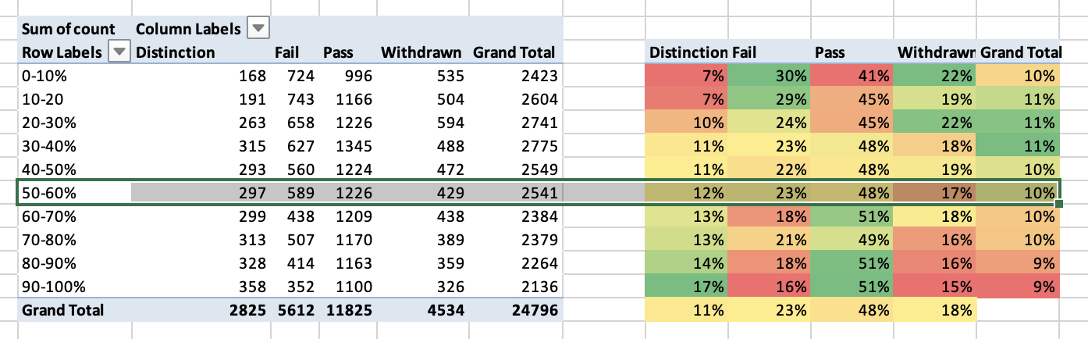
Handling Missing data
Imd_band is being imputed with "50-60%"
Final_weighted_score is NAN for 197 records(withdrawn, fail), so imputed with zeros.
15

Slide 16
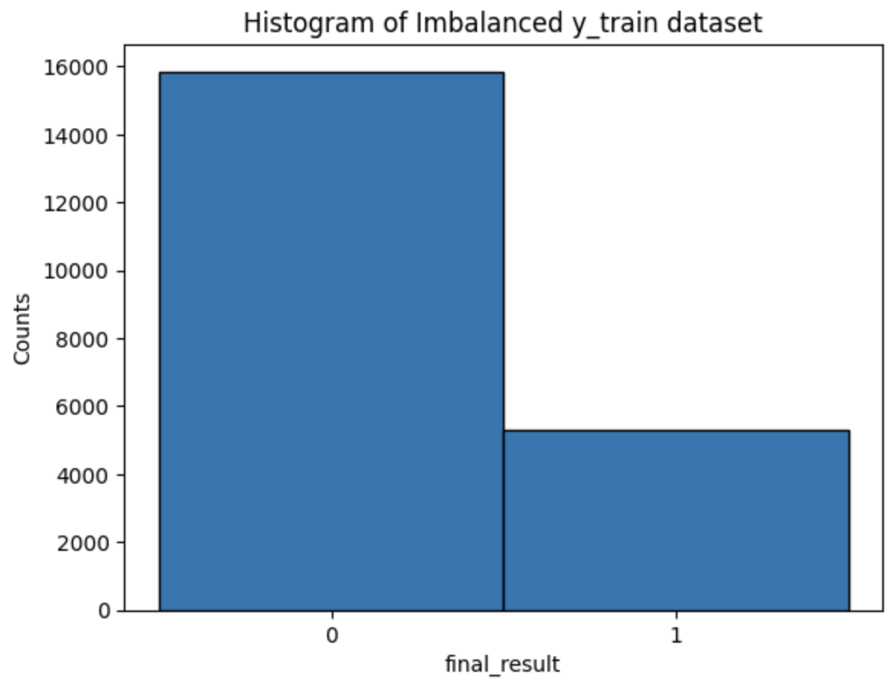
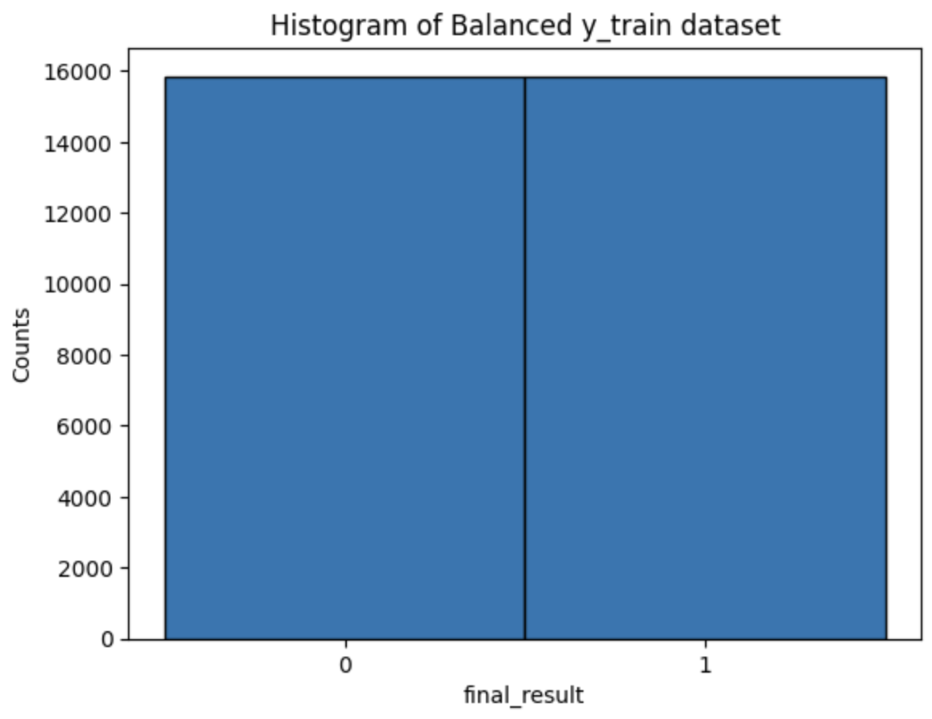
Handling Class Imbalance (Dropout)
SMOTE (Oversampling technique where the synthetic samples are generated for the minority class.)
Oversample the label 1 dataset only with the training dataset, and then apply to the model
Found improvement of Label 1 performance from all models (Time Series Forest, XGBoost, Meta-Model)
16

Slide 17
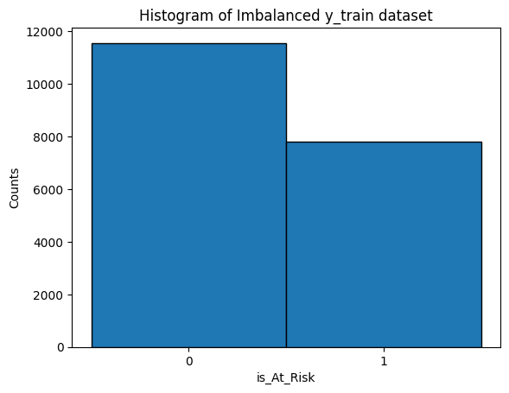
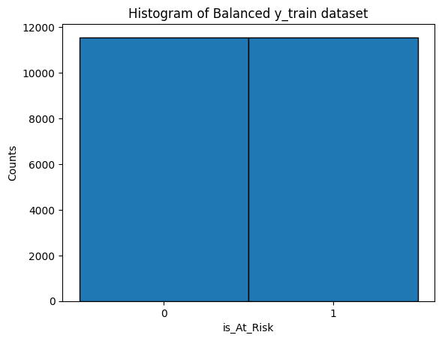
Handling Class Imbalance (At-risk)
Oversample the label 1 dataset only with the training dataset, and then apply to the model
Found improvement of Label 1 performance from all models (Time Series Forest, XGBoost, Meta-Model)
17

Slide 18
Feature Engineering & selection
Created clustered-based columns: demographic clusters using K-Prototypes method and 'behavioral_cluster', 'assessments_cluster' using K-Means method.
Developed additional features such as the average number of clicks per day using interactions data.
Generated percent of on-time submissions and final weighted score features using assessments data.
Demographics data selected features: 'avgClicksPerDay', 'final_weighted_score', 'perc_ontime_sub', 'demographic_cluster', 'behavioural_cluster', 'assesments_cluster'
Interactions data (time series): all days from -25 to 269
18

Slide 19
Train & Test Data
Target: "isDropout"
Training data size: 31,638
Test data size: 6,449
Features used :
Demographics data selected features: 'avgClicksPerDay', 'final_weighted_score', 'perc_ontime_sub', 'demographic_cluster', 'behavioural_cluster', 'assesments_cluster'
Interactions data (time series): all days from -25 to 269
Target: "is_At_Risk"
Training data size: 23,114
Test data size: 6,449
Features used :
Demographics data selected features: 'avgClicksPerDay', 'final_weighted_score', 'perc_ontime_sub', 'demographic_cluster', 'behavioural_cluster', 'assesments_cluster'
Interactions data (time series): all days from -25 to 269
19

Slide 20
Dropout Modeling (Early Prediction)
Dropout Modeling Recall Analysis
Cuts | Baseline TSF | Sampled TSF | Meta Model | DT | LightGBM | RF | XGBoost
0 | 5.1% | 33.4% | 3.9% | 39.0% | 34.7% | 31.8% | 36.6%
30 | 17.8% | 24.0% | 3.7% | 33.7% | 42.9% | 36.4% | 40.7%
60 | 36.7% | 37.0% | 9.2% | 39.5% | 48.5% | 37.5% | 45.1%
90 | 45.3% | 44.8% | 19.6% | 41.3% | 49.1% | 39.1% | 45.6%
120 | 57.6% | 60.8% | 34.4% | 39.6% | 48.5% | 39.4% | 48.1%
150 | 64.8% | 72.6% | 48.8% | 40.2% | 52.9% | 38.4% | 49.0%
180 | 68.5% | 80.7% | 57.8% | 42.1% | 54.8% | 41.1% | 50.7%
210 | 70.7% | 85.3% | 60.5% | 41.6% | 54.5% | 40.8% | 50.4%
240 | 73.1% | 89.0% | 64.9% | 42.2% | 53.1% | 40.7% | 51.0%
270 | 74.1% | 90.9% | 66.4% | 42.7% | 58.0% | 41.3% | 53.2%
Sampled TSF excels at higher cut points, achieving 90.9% recall at 270.
Traditional ML models (DT, LightGBM, RF, XGBoost) show consistent but lower recall across all cut points.
Baseline TSF and Meta Model start low but improve significantly, reaching 74.1% and 66.4% recall respectively at cut point 270.
20

Slide 21
Dropout Modeling (Early Prediction)
Dropout Modeling AUC analysis
Cuts | Baseline TSF | Sampled TSF | Meta Model | DT | LightGBM | RF | XGBoost
0 | 54.9% | 54.4% | 69.6% | 53.0% | 57.4% | 56.6% | 56.7%
30 | 63.5% | 55.1% | 69.6% | 52.1% | 60.1% | 56.7% | 59.1%
60 | 74.3% | 65.3% | 71.6% | 52.8% | 64.6% | 59.4% | 62.2%
90 | 78.8% | 71.6% | 75.1% | 54.3% | 65.4% | 59.6% | 63.5%
120 | 84.5% | 80.7% | 82.2% | 54.5% | 66.7% | 59.7% | 63.4%
150 | 88.0% | 85.9% | 86.7% | 55.1% | 66.8% | 60.3% | 63.3%
180 | 90.0% | 89.3% | 89.8% | 56.3% | 66.3% | 61.5% | 63.6%
210 | 91.1% | 90.7% | 91.0% | 55.3% | 65.1% | 60.7% | 62.6%
240 | 92.1% | 92.4% | 92.5% | 55.6% | 67.2% | 61.9% | 63.8%
270 | 92.2% | 92.8% | 92.9% | 55.4% | 69.1% | 61.9% | 65.8%
Meta Model leads initially, but Baseline TSF and Sampled TSF catch up, all reaching ~93% AUC at cut point 270.
Traditional ML models (DT, LightGBM, RF, XGBoost) show relatively stable AUC scores, ranging from 55% to 69%.
Baseline TSF and Sampled TSF demonstrate significant improvement as cut points increase, starting around 55% and ending above 92%.
21

Slide 22
Dropout Modeling (Early Prediction)
Dropout Modeling Accuracy analysis
Cuts | Baseline TSF | Sampled TSF | Meta Model | DT | LightGBM | RF | XGBoost
0 | 73.9% | 66.1% | 82.6% | 60.4% | 63.6% | 64.2% | 61.9%
30 | 76.7% | 71.4% | 82.6% | 64.0% | 65.0% | 65.6% | 65.1%
60 | 80.1% | 75.4% | 83.0% | 61.5% | 68.4% | 69.1% | 67.2%
90 | 81.8% | 78.6% | 84.0% | 62.8% | 68.3% | 68.6% | 68.3%
120 | 83.1% | 81.5% | 84.2% | 64.1% | 69.9% | 67.4% | 67.3%
150 | 83.8% | 83.7% | 85.4% | 64.7% | 67.6% | 69.1% | 65.5%
180 | 84.0% | 84.8% | 86.1% | 65.4% | 65.9% | 69.6% | 65.6%
210 | 84.2% | 84.9% | 85.9% | 64.3% | 65.2% | 67.7% | 63.5%
240 | 84.3% | 85.5% | 86.5% | 64.5% | 67.0% | 69.8% | 64.9%
270 | 84.6% | 85.7% | 86.6% | 63.7% | 66.7% | 69.1% | 65.3%
Meta Model consistently outperforms, maintaining 82-87% accuracy across all cut points.
Baseline TSF and Sampled TSF show steady improvement, reaching 84-86% accuracy at higher cut points.
Traditional ML models (DT, LightGBM, RF, XGBoost) demonstrate more stable but lower accuracy, ranging from 60-70% throughout.
22

Slide 23
Dropout Modeling (Early Prediction) - key points
1. Best Overall Model: Sampled TSF
2. Recall Performance:
• Starts strong at 33.4% (cut point 0)
• Dramatically improves to 90.9% (cut point 270)
• Highest recall scores for most cut points, especially latter half
3. AUC Performance:
• Starts lower but shows significant improvement
• Reaches 92.8% at cut point 270, matching/exceeding other top performers
4. Accuracy:
• Starts lower than some competitors
• Improves to be very competitive by course end (85.7% at cut point 270)
5. Key Strength:
• Best performance in crucial later stages of the course
• Strong improvement across all metrics as course progresses
6. Comparison Note:
• Outperforms Meta Model in recall and late-stage AUC
• Surpasses traditional ML models in all metrics by course end
23

Slide 24
At-risk Modeling (Early Prediction)
At-risk Modeling Recall Analysis
Cuts | Baseline TSF | Sampled TSF | Meta Model | DT | LightGBM | RF | XGBoost
0 | 55.4% | 59.8% | 60.2% | 56.4% | 62.3% | 65.5% | 63.3%
30 | 53.6% | 49.7% | 60.2% | 52.7% | 61.6% | 57.6% | 60.8%
60 | 57.8% | 55.1% | 61.3% | 57.5% | 67.8% | 60.6% | 65.1%
90 | 61.4% | 57.5% | 65.6% | 57.8% | 67.8% | 60.6% | 65.5%
120 | 69.1% | 62.8% | 72.0% | 60.9% | 68.4% | 63.0% | 67.7%
150 | 74.9% | 67.6% | 75.6% | 63.0% | 69.8% | 64.3% | 69.5%
180 | 79.0% | 73.7% | 79.4% | 63.9% | 69.6% | 65.1% | 69.8%
210 | 82.7% | 77.3% | 82.4% | 64.1% | 69.8% | 64.7% | 70.1%
240 | 86.1% | 81.2% | 84.8% | 65.1% | 69.1% | 63.9% | 68.7%
270 | 99.4% | 81.8% | 85.1% | 66.1% | 72.2% | 65.6% | 71.7%
Highest Recall Achieved by Meta Model: The Meta Model consistently outperforms others, peaking at 85.1% recall at the 270 cut.
Baseline TSF's Strong Performance at Higher Cuts: Starts at 55.4% and reaches an impressive 99.4% recall at the 270 cut.
Stable Performers: LightGBM and Random Forest maintain strong recall values, with LightGBM reaching up to 72.2% at the 270 cut, while XGBoost consistently delivers around 60-71%.
24

Slide 25
At-risk Modeling (Early Prediction)
At-risk Modeling Accuracy analysis
Cuts | Baseline TSF | Sampled TSF | Meta Model | DT | LightGBM | RF | XGBoost
0 | 57.9% | 53.8% | 73.5% | 54.8% | 60.6% | 60.0% | 58.5%
30 | 63.4% | 59.0% | 73.3% | 56.9% | 62.4% | 59.1% | 61.3%
60 | 70.1% | 65.3% | 74.2% | 58.9% | 65.3% | 62.2% | 65.1%
90 | 74.0% | 69.6% | 76.6% | 60.4% | 66.7% | 64.6% | 66.6%
120 | 79.7% | 76.1% | 81.2% | 61.9% | 67.5% | 65.9% | 67.4%
150 | 83.1% | 81.2% | 84.2% | 63.1% | 69.0% | 67.6% | 68.0%
180 | 87.0% | 85.4% | 87.2% | 63.6% | 68.8% | 68.3% | 68.3%
210 | 89.4% | 87.2% | 89.0% | 63.8% | 68.0% | 67.8% | 68.9%
240 | 90.8% | 90.3% | 91.1% | 64.1% | 69.8% | 68.7% | 69.1%
270 | 99.7% | 90.7% | 91.3% | 62.8% | 68.4% | 68.4% | 67.7%
Best Accuracy: Meta Model: The Meta Model consistently outperforms others, achieving the highest accuracy of 91.3% at the 270 cut.
Baseline TSF's Remarkable Improvement: Baseline TSF shows a significant increase in accuracy, starting from 57.9% and reaching 99.7% at the 270 cut.
Consistent Performance of LightGBM and RF: LightGBM and RF models maintain stable accuracy, with LightGBM peaking at 69.8% and RF at 68.7% at the 240 cut.
25

Slide 26
At-risk Modeling (Early Prediction)
At-risk Modeling AUC analysis
Cuts | Baseline TSF | Sampled TSF | Meta Model | DT | LightGBM | RF | XGBoost
0 | 60.3% | 56.1% | 80.4% | 54.6% | 61.0% | 62.2% | 59.0%
30 | 69.4% | 60.7% | 80.4% | 56.3% | 66.1% | 62.1% | 64.7%
60 | 77.6% | 69.3% | 81.7% | 58.3% | 73.1% | 67.1% | 71.1%
90 | 81.5% | 74.7% | 84.1% | 59.8% | 74.7% | 69.3% | 73.3%
120 | 87.0% | 82.2% | 88.2% | 61.4% | 76.0% | 71.4% | 74.9%
150 | 90.4% | 86.9% | 91.2% | 62.7% | 76.8% | 73.3% | 75.7%
180 | 92.6% | 90.2% | 93.7% | 63.2% | 77.1% | 73.8% | 76.2%
210 | 94.1% | 92.0% | 94.9% | 63.5% | 76.3% | 73.8% | 76.4%
240 | 95.3% | 93.9% | 96.2% | 63.8% | 77.5% | 74.2% | 76.7%
270 | 100.0% | 94.1% | 96.3% | 62.8% | 77.1% | 74.5% | 76.0%
Top Performer: Meta Model: Consistently high AUC values, reaching up to 96.3% at the 270 cut, indicating strong overall performance.
Baseline TSF's High AUC: Baseline TSF shows significant improvement with cuts, starting at 60.3% and reaching a perfect 100.0% AUC at the 270 cut.
Consistent Results Across Models: LightGBM, RF, and XGBoost maintain stable AUC values, with LightGBM peaking at 77.5% and XGBoost at 76.7% at the 240 cut.
26

Slide 27
At-risk Modeling (Early Prediction) - key points
1. Best Overall Model: Meta Model
2. Recall Performance:
- Starts strong at 60.2% (cut point 0)
- Dramatically improves to 85.1% (cut point 270)
- Highest recall scores for most cut points, especially latter half
3. AUC Performance:
- Starts high at 80.4% (cut point 0)
- Shows significant improvement, reaching 96.3% at cut point 270, exceeding other top performers
4. Accuracy:
- Starts strong at 73.5% (cut point 0)
- Remains highly competitive throughout, reaching 91.3% at cut point 270
5. Key Strength:
- Best performance in crucial later stages of the course
- Strong improvement across all metrics as course progresses
6. Comparison Note:
- Outperforms other models in recall and late-stage AUC
- Surpasses traditional ML models in all metrics by course end
27

Slide 28
6.
Conclusion

Slide 29
Conclusion
Early Dropout Student Prediction
Sampled TSF is the best-performing model, with strong performance across recall, accuracy, and AUC metrics, particularly excelling in later stages of the observation period.
Meta Model also shows strong performance, especially in accuracy and AUC.
Traditional ML models (DT, LightGBM, RF, XGBoost) provide stable but lower performance across all metrics.
Early At-risk Student Prediction
Meta Model is the best overall performer, showing strong recall, accuracy, and AUC values, particularly excelling at higher cut points.
Baseline TSF shows remarkable improvement, particularly in higher cuts, achieving perfect or near-perfect scores in recall and AUC.
Traditional ML Models (DT, LightGBM, RF, XGBoost) provide consistent but generally lower performance compared to Meta Model and Baseline TSF, with LightGBM and RF maintaining stable but lower accuracy and AUC values.
29

Slide 30
7.
Lessons Learned &
Future Work

Slide 31
Lesson Learned
Data Quality is Crucial: The importance of thorough data cleaning and preprocessing to handle missing values and outliers. Engaging in exploratory data analysis (EDA) helped identify relevant features and trends.
Feature Engineering Matters: Creating new features through clustering and aggregating behavior data significantly improved model performance. Incorporating demographic, behavioral and assessment features provided a more comprehensive understanding of student engagement.
Meta Modeling Concept: Meta modeling allowed us to leverage the strengths of different base models (e.g., XGBoost & TSF) to improve overall predictive performance. By stacking models, we could capture diverse patterns in the data that individual models might miss.
Class Imbalance Challenges: Addressing class imbalance through techniques like SMOTE improved prediction performance for at-risk & Dropping out students. Importance of evaluating models using multiple metrics (AUC, precision, recall) to get a complete view of performance.
Collaboration and Feedback: Regular discussions with teammates and professors helped refine objectives and methodologies. Peer reviews provided diverse perspectives, enhancing the overall quality of the project.
31

Slide 32
Future Work
Model Deployment: Plan for deploying the final model into a production environment for real-time predictions. Develop a user-friendly dashboard for educators and students for better engagement and student outcome.
Continuous Improvement: Implement a feedback loop to update models with new data and improve predictions over time. Explore additional algorithms or techniques to further enhance prediction accuracy.
Enhanced Feature Engineering: Continue exploring innovative feature extraction methods, including time-series analysis and advanced clustering techniques.
Additional Filtering for Train & Test Data: Consider the students that are active(either pass/Distinction/fail students) at a given point in time for training and testing. This approach resembles the actual scenario (live testing) more.
32

Slide 33

33

