Slide 1

International Institute of Information Technology Bangalore
AI 829
NATURAL LANGUAGE PROCESSING
Hate and Offensive Speech Detection in Hindi and Marathi Social Media Texts
MT2023158 - Manasi Purkar
MT2023051 - Sanket Patil

Slide 2
Problem Statement
Social media has seen immense growth over the past decades and, with it, a subsequent increase in hate speech. Hate speech includes offensive language that can be derogatory and insulting and is usually directed to hurt someone's sentiment.
This project aims to tackle the issue of hate speech in the Hindi and Marathi languages, two prominent languages spoken in India. There is a lack of attention for low-resource languages like Hindi and Marathi in the domain of hate speech detection.
We have Implemented cross lingual transfer learning approach to evaluate and tried to improve performance of target languages(Marathi, Hindi) with limited training data. The ultimate objective is to provide effective tools for automatically identifying and mitigating hate speech in online content written in Hindi and Marathi.

Slide 3
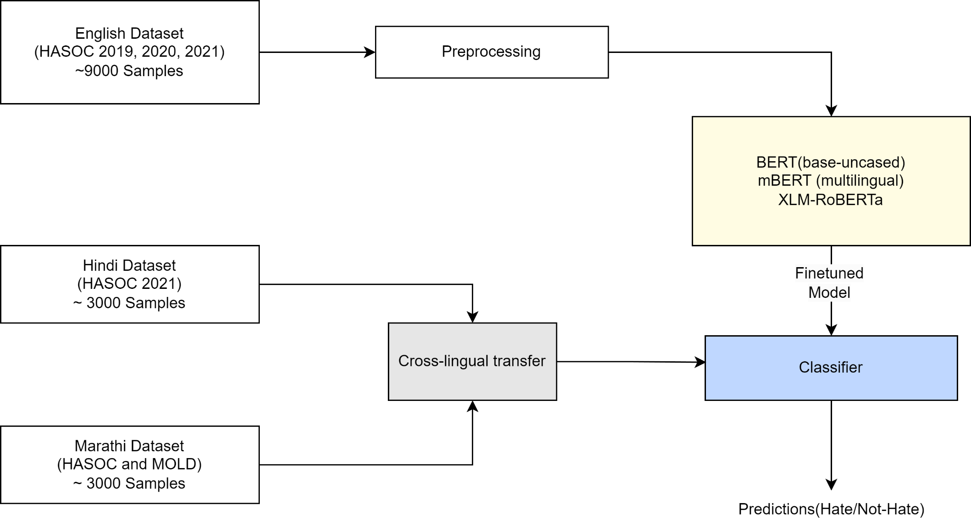
Flow Diagram -

Slide 4
Mandate 2 - Datasets Description and Preprocessing
Datasets used (link):
English - HASOC 2021, 2020, 2019
Hindi - HASOC 2021
Marathi - HASOC and MOLD dataset
We focused on lexical processing of English, Hindi and Marathi text data.
Our processing steps included removing punctuation marks and special characters, hashtags and URLs, which often clutter text data.
We also tackled the challenge of handling emojis, a common element in online communication. Along with it we implemented removing stop words (common words with little value for analysis), converting all text to lowercase to maintain consistency, tokenization, lemmatization and sentence embedding.
Libraries used- Pandas, re, NumPy, stopwordsiso, emoji, scikit-learn, WordNetLemmatizer, BertTokenizer, fasttext, NLTK.

Slide 5
Mandate 3 -
We conducted syntactic processing of the data. Which involves breaking down sentences into their grammatical components, such as nouns, verbs, adjectives, and their relationships. Aim was to understand the roles played by each of the words in the sentence, and the relationship among words and to parse the grammatical structure of sentences to understand the proper meaning of the sentence.
Furthermore, we conducted model selection and Fine-tuning of BERT Based models on English text for a Hate speech detection task. We compared various models' performances to determine the most effective approach. We also analysed results of fine tuning multilingual bert based models on limited target language data.
Models used -
BERT(bert-base-uncased)
mBERT(bert-multilingual-base-uncased)
XLM-RoBERTa
IndicBERT
MuRIL

Slide 6
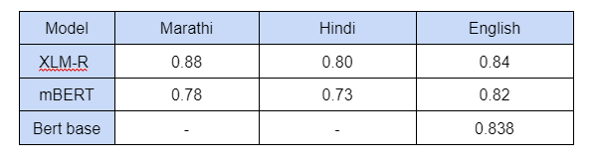
Experimental Results -
Hate speech detection evaluation using F1-score(average=macro):
XMLR model is giving favorable results across all datasets. For Hindi and Marathi, we initially analyzed the results by directly fine-tuning models on the available data. However, the number of samples for Marathi and Hindi is limited. Subsequently, we applied cross-lingual transfer techniques to the Hindi and Marathi texts.

Slide 7
Mandate 4-
Along with models evaluated in previous mandate, in this mandate we evaluated the Hindi and Marathi datasets using the IndicBERT and Finetuned MURIL model.
We applied cross-lingual transfer learning on the finetuned models on english text to get results of Marathi and Hindi texts. In this we tried two methods without giving any example of target language and by providing some samples of target language in training.
Further, we evaluated the results obtained from the FLANT5 model, which is opensource Instruction Finetuned LLM . Without fine-tuning and using prompts, we examined the model's performance.

Slide 8
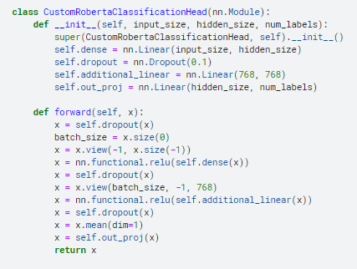
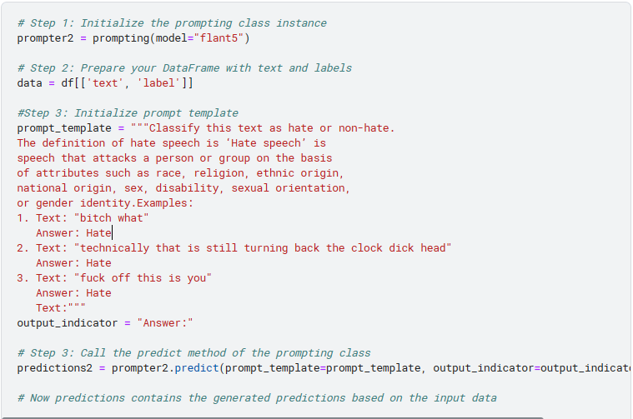
Screenshots

Slide 9
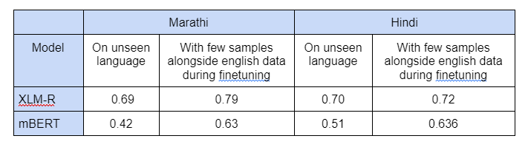
Results-
Cross-lingual hate speech detection evaluation using F1-score(average=macro):
From different models and techniques used so far we observed that XLM-R Model gives the best performance on cross lingual transfer approach

Slide 10
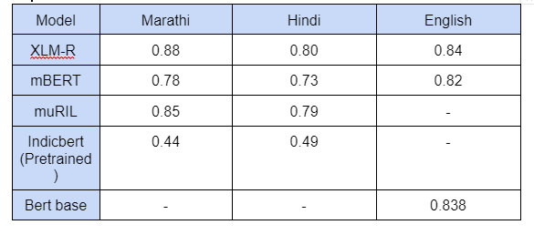
Results
Hate speech detection using Finetuned models evaluation using F1-score(average=macro)

Slide 11
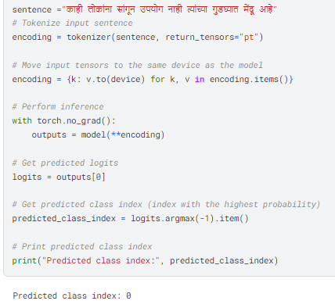
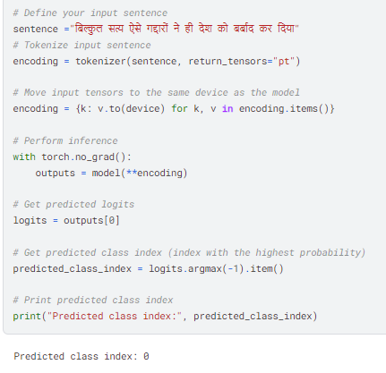
Testing on provided input
Label 0 = Hate Speech Label 1=Non Hate Speech

Slide 12
Challenges faced
Future Work
Finetuning Various Models
Finding open source LLM which gives results by giving prompts
Adding custom classification layer in XMLR model for english dataset
Less validation and test data for Indian Languages.
Identifying Suitable Stopwords Libraries for Hindi and Marathi.
Cleaning scrapped tweets in Hindi and Marathi involved addressing unwanted patterns and noise inherent in social media language.
Cross Lingual accuracy is still less we can try to improve it further using some FSL algorithms.
More LLMs can be tried like GPT3 and can try to increase accuracy by designing prompts efficiently.
More dataset can give better results.

Slide 13
Notebooks
XMLR model is giving good results among all.
CrossLingual Transfer learning using XMLR
Marathi-CrossLingual-XML-with 2 methods
Hindi-CrossLingual-XMLR-with 2 methods
Finetuned XMLR on Marathi and Hindi
Marathi-XMLR
Hindi-XMLR

Slide 14
Thank You!

