Slide 1
IT Infrastructure and Resource Management

Slide 2
Problem Statement
VJTI is large institution which has a variety of laboratories. The equipments in these labs need to be maintained on a regular basis, and the old ones need to be replaced to ensure a proper working environment. This can be achieved efficiently by maintaining a database containing the information of all the equipments and their working status. Each equipment will be assigned a unique id.

Slide 3
Usage Modules
Management Level
Lab Admin Level
Student/Teacher Level

Slide 4
Management Level
Resolving the complaints approved by the lab admin and deciding which supplier to buy components from.
Maintaining the resources by regularly replacing the older components.
Checking the regularity of all the lab admins.

Slide 5
Lab Admin Level
View and modify any data regarding the components of the Computer.
Verify and approve the complaints lodged by students and teachers.
Assign priorities to the approved complaints.

Slide 6
Student/Teacher Level
View the components and technical specification of any computer.
View the working status of any component.
Lodge a complaint regarding faulty components and check the status of their lodged complaint.

Slide 7
Entity
Component (Component_ID, Supplier_ID, Working Status, Warranty, Date_of_purchase, Type)
PC (PC_ID, Lab_ID, OS)
Supplier (Supplier_ID, Name, Total_Complaints, Total_No_Shipped)
Lab (Lab_ID, No_of_PCs)
LabAdmin (LabAdmin_ ID, Lab_ID , No_Of_Complaints_Handled, Last_Login)
Complaint (Complaint_ID, Title, Complainer_ID,Status, Date_Of_Complaint)
Complainer (Complainer_ID, Name, Departement, Designation, Email_ID)

Slide 8
Relationships
Supplied by : <Component, Supplier> N : 1 Total/Total
Comprises of : <PC, Component> 1 : N Total/Partial
has : <Lab, PC> 1 : N Total/Total
incharge of <Lab Admin, Lab> 1 : 1 Total/Total
Approves/ Rejects <Lab Admin, Complaint> 1 : N Partial /Total
About <Complaint, Component> N : 1 Total/ Total
Lodges <Complainer, Complaint> N : M Total/Total

Slide 9
Assumptions/Clarifications
Supplier is included as an entity in our model just to keep a track of complaints received of components supplied by a particular supplier.
Each lab has one lab admin.
email-ids of complainer is requested so that they may be notified through an automated email if their complaint was accepted/rejected.
software related requests may include request for updating a software, installing new software or replacing buggy software.
overall efficiency of the model depends on the regularity of the lab admins and management in resolving the complaints.

Slide 10
Entity Attribute Model

Slide 11
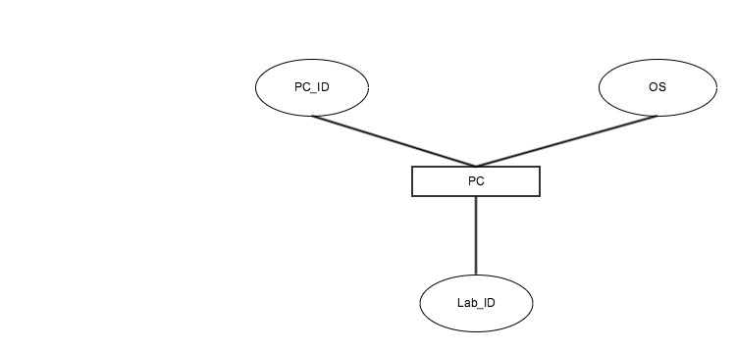
PC

Slide 12
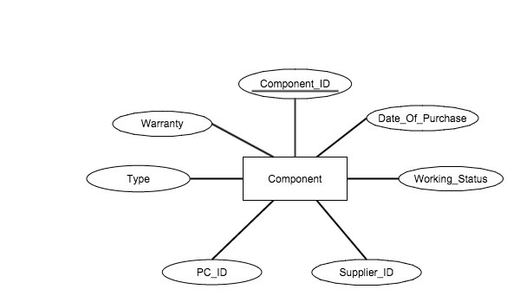
Component

Slide 13
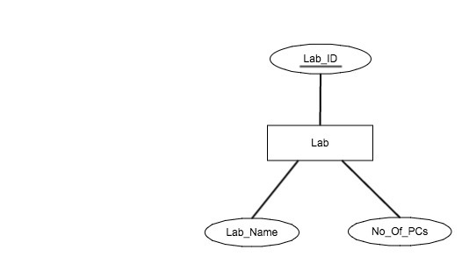
Lab

Slide 14
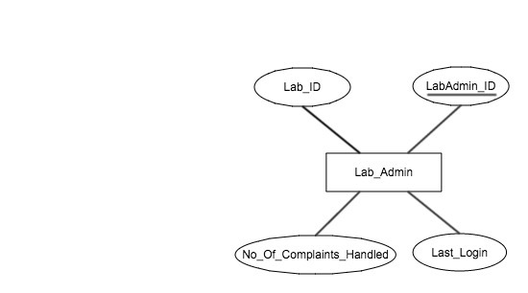
Lab Admin

Slide 15
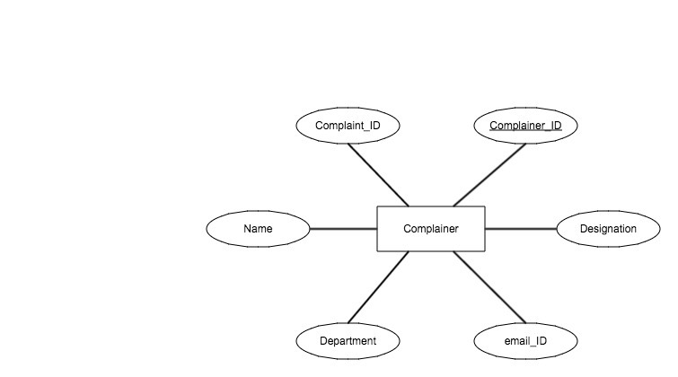
Complainer

Slide 16
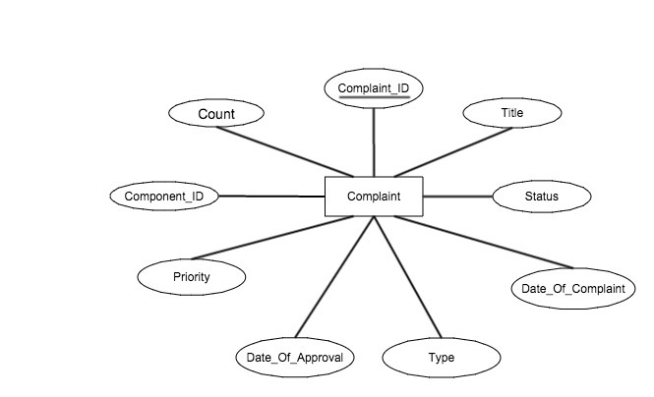
Complaint

Slide 17
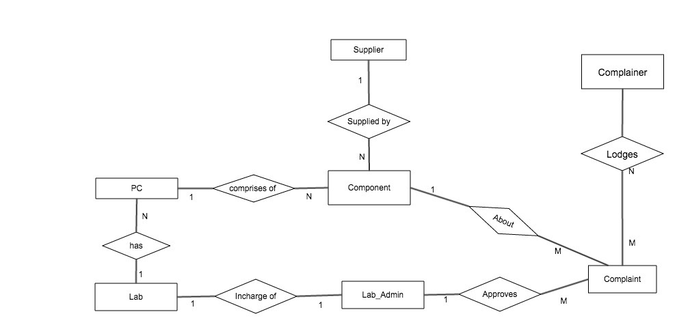
Data Model

Slide 18
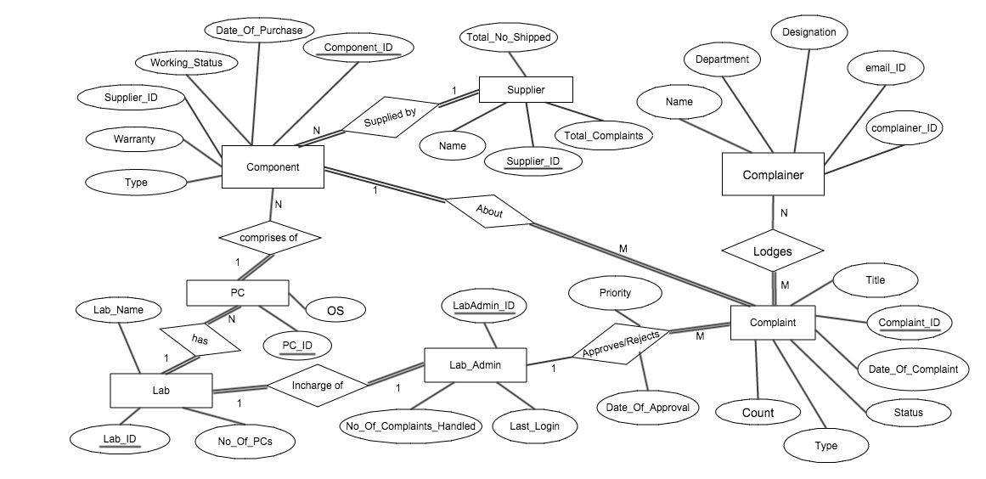
ER Model

Slide 19
Data Dictionary

Slide 20
Complaints
Primary Key - Complaint_ID
Name | Data Type | Constraints | Details
Title | varchar(200) | NOT NULL | Brief description of the complaint
Complaint_ID | INT | NOT NULL UNIQUE
Date_of_complaint | DATE | NOT NULL | Date when the complaint was lodged
Status | INT | NOT NULL | 0-waiting for approval 1-approved, unresolved 2-resolved
Date_of_Approval | DATE | >= date of complaint | date of approval if the complaint was approved
Priority | INT | NOT NULL | priority of the complaint assigned by lab admin
Component_ID | INT | NOT NULL FOREIGN KEY | Component for which the complaint has been lodged
Count | INT | NOT NULL POSITIVE | No of people in favor of the complaint
Type | INT | NOT NULL | Hardware Software 3. Network

Slide 21
Lab Admin
Primary Key - Lab_admin_ID
Name | Data Type | Constraints | Details
Name | varchar(40) | NOT NULL | Name of the Lab Admin
Lab_admin_ID | INT | NOT NULL UNIQUE | Uniquely identify each lab admin
Lab_ID | INT | NOT NULL FOREIGN KEY | identify the lab of which the person is admin of.
No_of_complaints_handled | INT | NON NEGATIVE | no of complaints handled after verification of complaint
Last_login | DATE |  | Indicates how active the admin is

Slide 22
Lab
Primary Key - Lab_ID
Name | Data Type | Constraints | Details
Lab_ID | INT | NOT NULL PRIMARY KEY | used to identify the location of the lab
No_of_pcs | INT | NOT NULL POSITIVE | no of computers in the labs
Lab_admin_ID | INT | NOT NULL FOREIGN KEY | id of the lab incharge

Slide 23
PC
Primary Key - PC_ID
Name | Data Type | Constraints | Details
PC_ID | INT | PRIMARY KEY NOT NULL | Will be used to identify any specific PC set
Lab_ID | INT | FOREIGN KEY NOT NULL | Identify the location of the PC
OS | varchar(20) | NOT NULL | Operating System installed on the computer

Slide 24
Component
Primary Key - Component_ID
Name | Data Type | Constraints | Details
Component_ID | INT | NOT NULL UNIQUE | Uniquely Identify each component
Date_of_purchase | DATE | NOT NULL | date of purchase of the component
Working_Status | BOOLEAN | NOT NULL | 1 - working 0 - not working
Warranty | INT | POSITIVE | no of months of warrant
Supplier_ID | INT | NOT NULL | indicating the supplier of the component
Type | INT | NOT NULL | 1 - CPU 2 - Monitor 3 - Keyboard 4 - Mouse

Slide 25
Supplier
Primary Key - Supplier_ID
Name | Data Type | Constraints | Details
Supplier_ID | INT | NOT NULL UNIQUE | Uniquely Identify each supplier
Name | varchar(100) | NOT NULL | Name of the supplier
No_of_components_supplied | INT | NOT NULL | no of components supplied by that supplier
No_of_complaints | INT | NON NEGATIVE | Total complaints from the components shipped by the supplier. This can be used to track the quality of the products shipped by the supplier.

Slide 26
Complainer
Primary Key - Complainer_ID
Name | Data Type | Constraints | Details
Name | INT | NOT NULL UNIQUE | Uniquely Identify each supplier
Department | varchar(100) | NOT NULL | Name of the supplier
Designation | INT | NOT NULL | no of components supplied by that supplier
E-mail | varchar(100) |  | E-mail id of the complainer will be collected if he wants to be notified with the status of his complaint.

Slide 27
Thank You
Group Members
Omkar Mate 131080026
Vaibhav Savla 131080019
Sanket Kasar 131080006
Mohammed Gadiwala 131080013
Kiran Dange 131080024

