Slide 1
Sentiment Analysis Experiments
Sanket Sheth

Slide 2
Task 1
Binary Classification problem
Multinomial Naive Bayes Classifier
Used bag of words features:
Used scikit countVectorizer to extract the feature
Provided very high accuracy on training data ~98%
This worked well because Count Vectors with Naive Bayes is well suited for text classification based on distribution of words
Also tried Tf-idf:
Used sckit tfidf library
Accuracy was lower than with just count vectors ~96%

Slide 3
Task 1
Baseline: Proportion of GENRE_B in test data ~82%
Our implementation accuracy = 90.56%
Confusion matrix:
GENRE_A accuracy: 90.02%
GENRE_B accuracy: 90.68%
 | GENRE_A | GENRE_B
GENRE_A | 334 | 37
GENRE_B | 160 | 1556

Slide 4
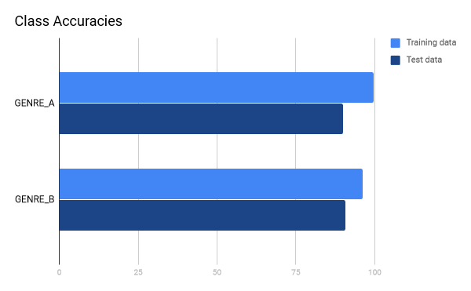
Task 2

Slide 5
Task 2
Class imbalance
  Split the task into two objectives
    First classifier using class labels {“NEUTRAL”, “NON-NEUTRAL”}
      Based on 5-fold stratified CV, Decision tree with bag-of-words feature performed best
    Second classifier on the “NON-NEUTRAL” data using labels {“POSITIVE”, “NEGATIVE”}
      L2 regularized logistic regression
        Cost chosen by 5-fold CV
        Features include TextBlob polarity, indicator for quotes, indicator for negation, proportion of adjectives,

Slide 6
Task 2
Baseline: Proportion of negative labels in test set (48.5386%)
Our Results: 73.5506%
Confusion Matrix:
 | NEG | NEU | POS
NEG | 810 | 40 | 163
NEU | 36 | 20 | 16
POS | 268 | 29 | 705
NEG Accuracy: 79.9605%
NEU Accuracy: 27.7778%
POS Accuracy: 70.3593%

Slide 7
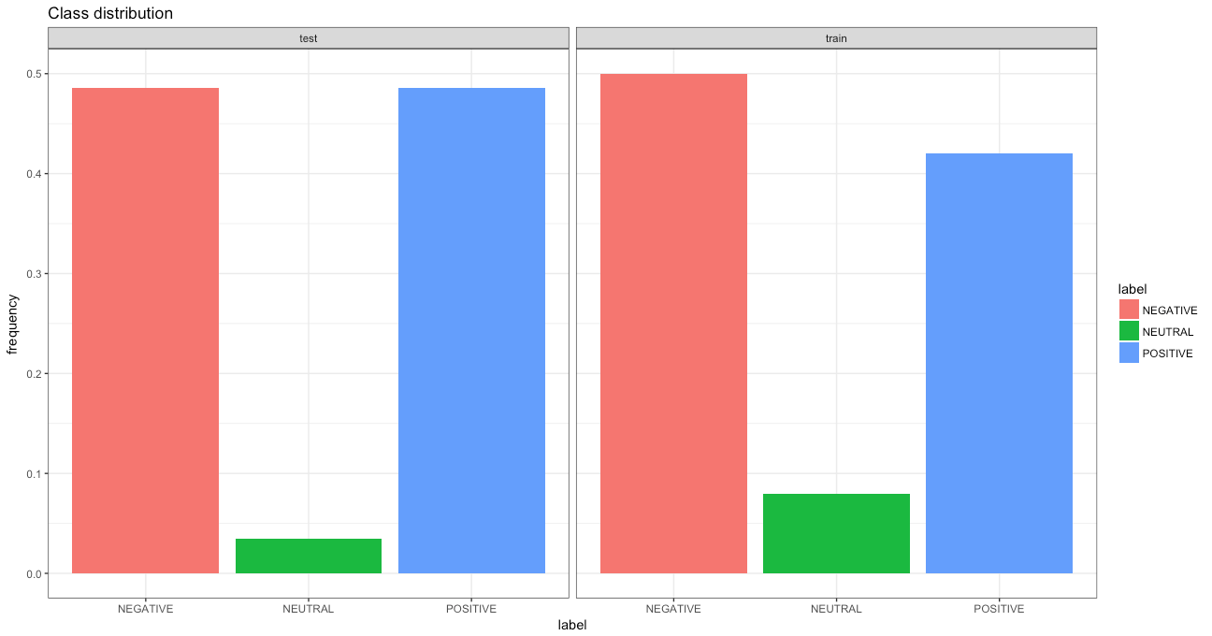
Task 2

Slide 8
Task 3: Approach
Multi-Class Classification:
  Logistic Regression (L1):
    Using bag of words as features
      Using scikit learn countVectorizer gave the best results.
      The classes are very distinct which makes this idea viable.
      Cost selected on the basis of the best training accuracy.
  Support vector machines/ OnevsAll Classifier/Decision Tree/Random Forest/ Logistic Regression:
    Using POS tags/ Word and Sentence Count / Genre /Polarity /Punctuations as features
      Did not achieve much success as features were not good enough for distinction.
      Lower casing and preprocessing the input created a difference.
      Best among the worst was by logistic regression.

Slide 9
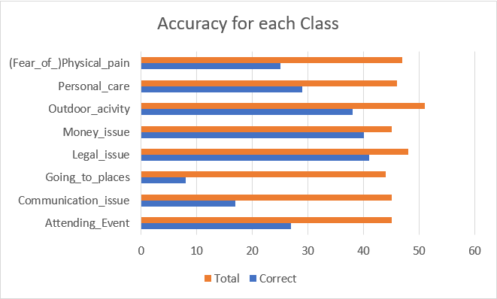
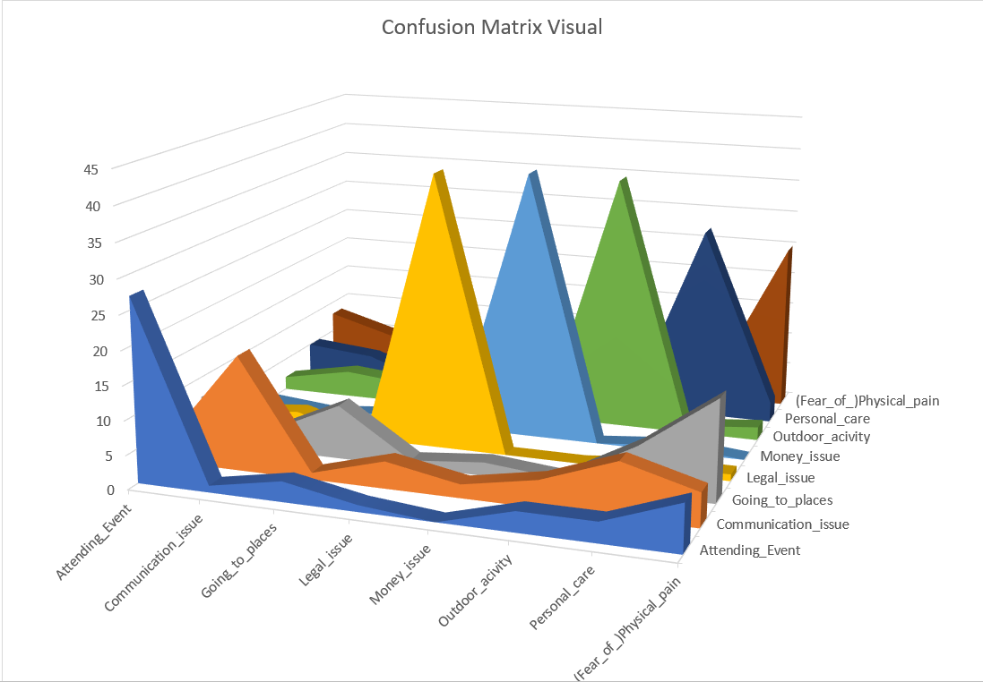
Task 3: Visuals
Accuracy for each class Confusion Matrix Plane

Slide 10
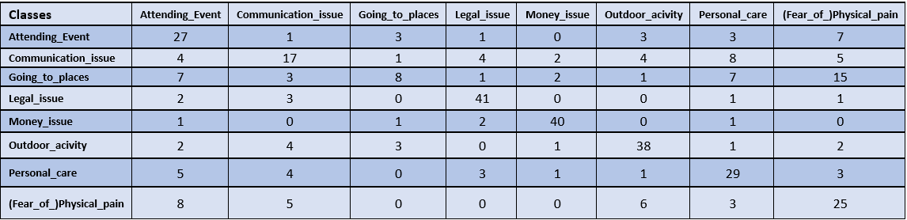
Task 3: Results
Baseline: Proportion of GOING_TO_PLACES in test set (11.3333%)
Our Results: 60.64%
Confusion Matrix:

Slide 11
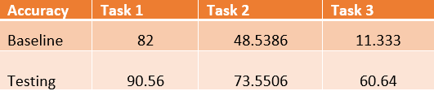
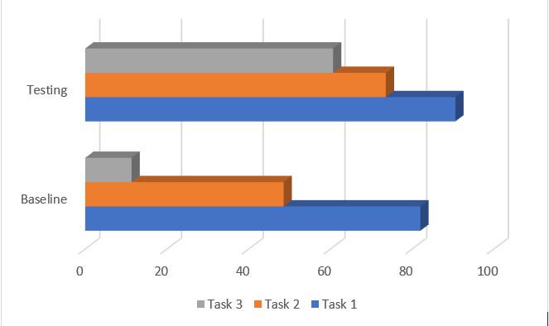
Accuracy

Slide 12
Conclusion
Collecting meaningful features is hard
Neutral sentences did not seem to be much different than non-neutral
Model overfitting is a huge possibility in multi-class classification.

