Slide 1


Airbnb
Hotel Management System
Notes:
1
1

Slide 2
CONTENT
INTRODUCTION
WHAT IS AIRBNB HOTEL MANAGEMENT SYSTEM?
WHY AIRBNB HOTEL MANAGEMENT SYSTEM BECOME EASY
E-R DIAGRAM
Unified Modeling Language Diagram(UML)
DATA FLOW DIAGRAM OPENING A NEW ROOM
ADVANTAGE
Features
CONCLUSION
REFERENCES

Slide 3
INTRODUCTION
Airbnb (ABNB) is an online marketplace that connects people who want to rent out their homes with people who are looking for accommodations in specific locales.
The company has come a long way since 2007, when its co-founders first came up with the idea to invite paying guests to sleep on an air mattress in their living room. According to Airbnb's latest data, it has in excess of six million listings, covering more than 100,000 cities and towns and 220-plus countries worldwide.
In this article, we break down how Airbnb works, how it makes money, and the pros and cons of using its online marketplace.

Slide 4

What is Airbnb Hotel Management System?
Airbnb (ABNB) is an online marketplace that connects people who want to rent out their homes with people who are looking for accommodations in specific locales

Slide 5
Airbnb Hotel Management Software aims
Guest bookings
Guest details
Point of sale
Telephony
Accounts receivable
Sales and marketing
Event Management
And many more features

Slide 6
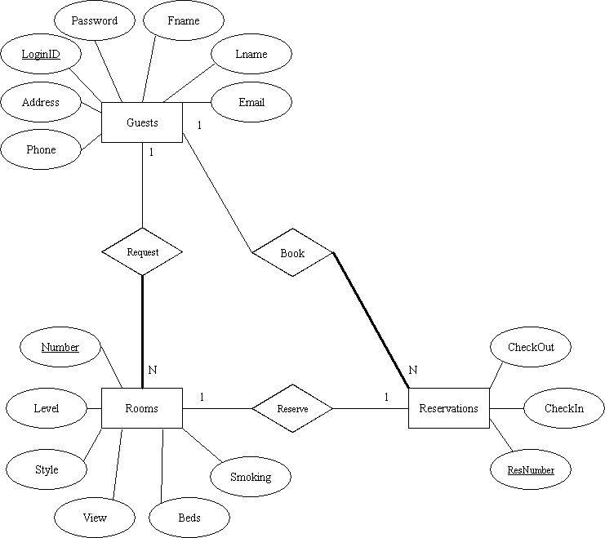
E-R DIAGRAM

Slide 7
Unified Modeling Language Diagram(UML):-

Slide 8
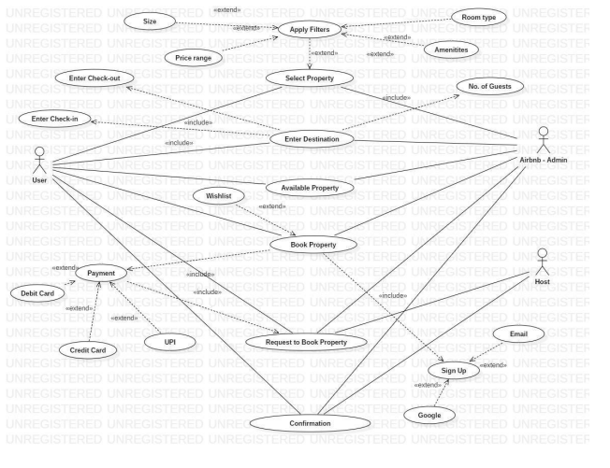
Use case Diagram:-

Slide 9
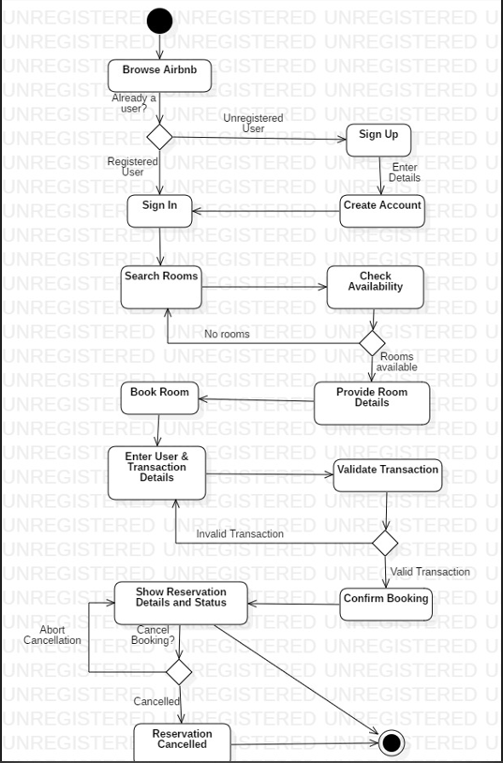
Activity Diagram:-

Slide 10
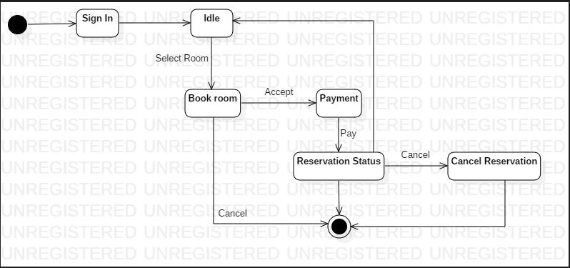
State-chart Diagram:-

Slide 11
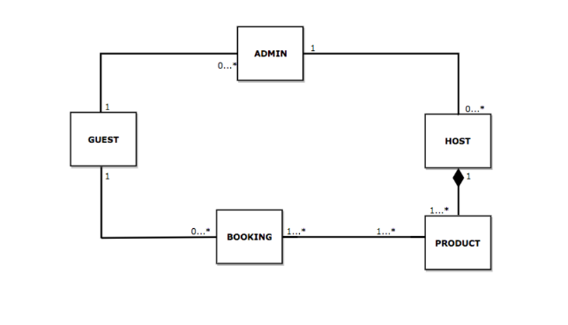
Class Diagram (without attributes):-

Slide 12
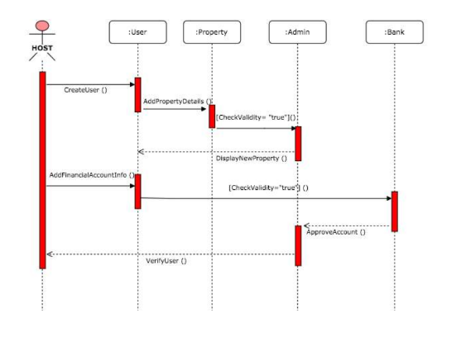
Sequence Diagram:-

Slide 13
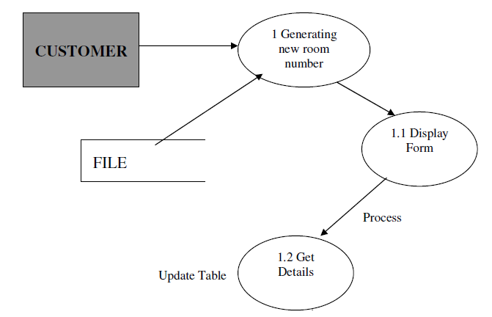
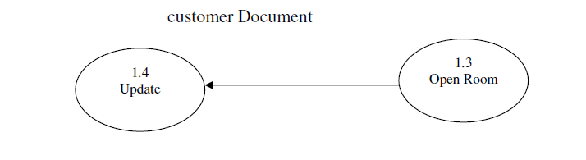
DATA FLOW DIAGRAM OPENING A NEW ROOM

Slide 14
ADVANTAGE
Airbnb is an online marketplace that connects people who want to rent out their homes with people who are looking for accommodations in specific locales.
Airbnb offers people an easy, relatively stress-free way to earn some income from their property.
Guests often find Airbnb is cheaper, has more character, and is homier than hotels.
Airbnb makes the bulk of its revenue by charging a service fee for each booking.
Cons of using this service include not getting what you expected, and, for hosts, renting your place to someone you haven’t had the chance to meet first.

Slide 15
How Does Airbnb Make Money?
Airbnb’s business model is quite profitable. The company, like Uber, Lyft, and others, has capitalized on the sharing economy, essentially making money renting out property that it doesn’t own.
Every time a reservation is made, Airbnb takes a cut. When you click on a property, you'll find to the right of the page a breakdown of the fees you'll be charged if you go ahead and book. One of these fees is a service fee, which covers the cost of running the platform and providing support; this basically makes up the bulk of Airbnb's revenue.
According to the company’s website, most guest service fees are under 14.2% of the booking subtotal. Hosts, meanwhile, are charged 3% or more of the total amount earned for each booking.
Airbnb also operates an alternative payment structure that you might see from time to time. It's mandatory for hotels and some specific types of hosts (including software-connected ones) located in certain regions of the world to cover the service fee in full rather than split it with guests. When this is the case, the person offering accommodation will usually be charged about 14% to 16% of the booking subtotal. Exceptions include mainland China, where the host-only fee is fixed at 10%.

Slide 16
Airbnb Features:-
Property Verification and Certification | Booking Management
Payment Gateway Integration | Property Management Dashboards
Guest Check-In and Check-Out | Dynamic Pricing
Host Payout Management | Host Performance Metrics
Basic Reporting | Advanced Reporting
Integration with Third-Party Services | 24/7 Customer Support

Slide 17
Other Features
System Setup & Master Files Maintenance
Hotel Guest Information Database Maintenance
Hotel Room Reservation
Hotel Room Availability
Hotel Check-In & Check-Out
Billing & Invoicing System
Guest Message System
Management Reports

Slide 18
User Interface Design (Screen Layout)

Slide 19
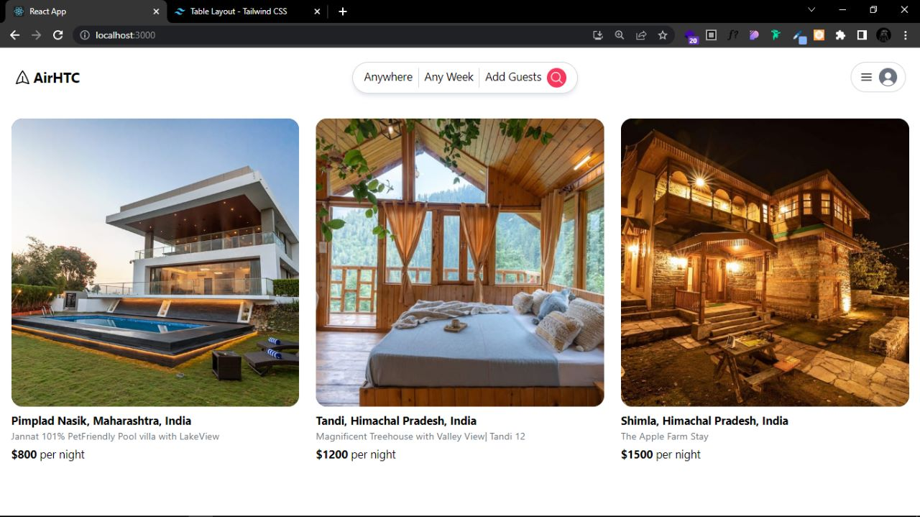
Home page:-

Slide 20
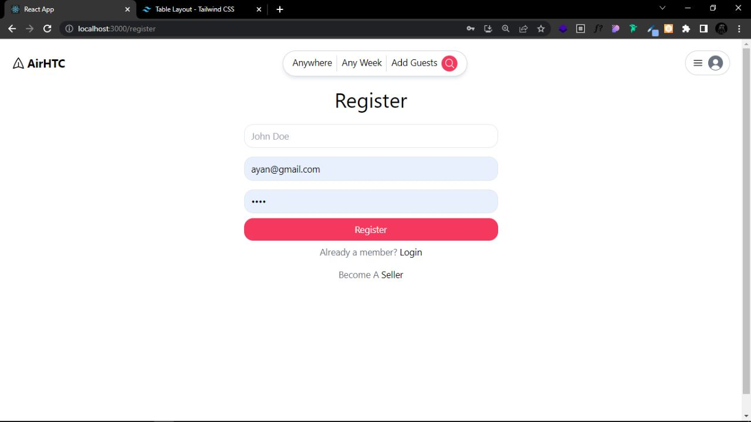
Register page:-

Slide 21
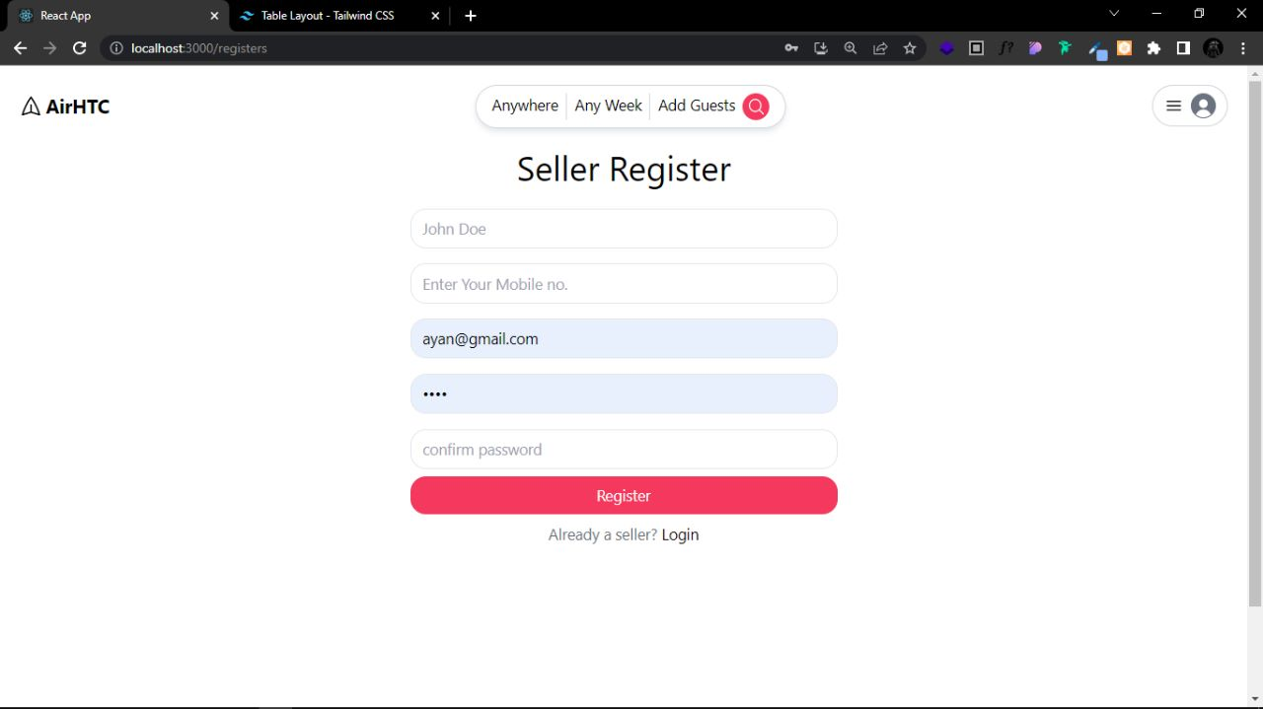
Seller Register:-

Slide 22
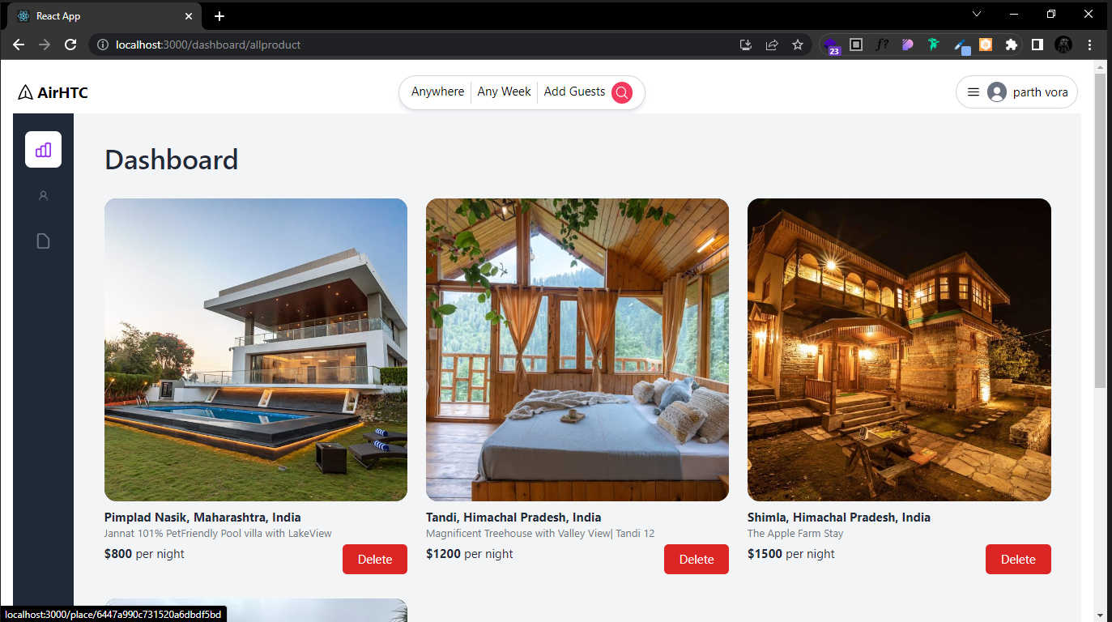
Dashboard:-

Slide 23
CONCLUSION
This project is designed to meet the requirements of Online Hotel Management. It has been developed in VB & Mas-Access keeping in mind the specifications of the system.
For designing the system we have used simple data flow diagrams.
Overall the project teaches us the essential skills like:
Using system analysis and design techniques like data flow diagram in designing the system.
Understanding the database handling and query processing.

Slide 24
References
Guidelines of Sneha Patel
https://www.youtube.com
https://www.airbnb.co.in
https://www.goibibo.com
https://www.makemytrip.com
https://es.wikipedia.org/wiki/Airbnb

Slide 25
Thanks

