Slide 1
Final Project Loan Approval Prediction based on Machine Learning Approach
By Sanket Sutar
Data Analyst

Slide 2
Agenda
Motivation
Problem Statement
Objectives
Background
Dataset Specifications
Machine Learning Prediction Model
Logistic Regression
Decision Tree Classifier
Random Forest Classifier
Experimental Result

Slide 3
Motivation
1

Slide 4
Motivation
The distribution of the loan is the core business part of almost every bank. The main portion of the bank’s assets is directly coming from the profit earned from the loans distributed by the banks.
The prime objective in the banking environment is to invest their assets in safe hands.
Today many bank/ financial companies approve the loan after a regress process of verification and validation but still there is no surety whether the chosen applicant is the deserving right applicant out of all applicants.
Through this system we can predict whether that particular applicant is safe or not and the whole process of validation of features is automated by machine learning technique.

Slide 5
Problem statement
2

Slide 6
Problem statement
Loan prediction is very helpful for the employee of banks as well as for applicants also. The aim of this search is to provide a quick, immediate and easy way to choose the deserving applicant. It can provide a special advantage to the bank. The loan prediction system can automatically calculate the weight of each feature taking part in a loan processing and on new test data same features are processed with respect to their associated weight.
A time limit can be set for the applicant to check whether his/her loan can be sanctioned or not. A loan prediction system allows jumping to a specific application so that it can be checked on a priority basis.
This search is exclusively for managing authority of bank/ finance company. The whole process of prediction is done privately no stakeholders would be able to alter the processing. The result against a particular loan id can be sent to various departments of banks so that they can take appropriate action on the application.

Slide 7
objectives
3

Slide 8
Objectives
The primary goal of this search is to extract patterns from a common loan-approved dataset and then build a model based on the extracted patterns, in order to predict likely loan defaulters by using classification data mining algorithms.
Historical data of the customers will be used in order to do the analysis. Later on, some analysis will also be done to find the most relevant attributes, i.e, the factors that affect the prediction result most.

Slide 9
Dataset specifications
4

Slide 10
Dataset specifications
Variable | Description | Datatype
LoanAmount | Loan amount applied in dollars | integer
Gender | Gender of an applied person Male/Female | String
Married | Is the applied person is married Yes/No | String
Dependents | No of dependent people on that person | Integer
Education | The person is Graduated or not Yes/No | String
Self_Employed | Does the person has a business Yes/No | String

Slide 11
Dataset specifications
Variable | Description | Datatype
Credit_History | The person is having credit history 0/1 | Integer
Property_Area | Person’s property area Urban/Semi-Urban/ Rural | String
Total_Income | Total income of the person in dollars | Float
Loan_Status | The loan approval Status Yes/No | String

Slide 12
Process of Machine Learning
Get Data
Train Model
Improve
2
4
1
3
5
Clean, Prepare
& Manipulate Data
Test Data

Slide 13
Logistic Regression
5

Slide 14
Logistic Regression
Logistic regression is one of the most popular Machine Learning algorithms, which comes under the Supervised Learning technique.
It is used for predicting the categorical dependent variable using a given set of independent variables.
Logistic regression predicts the output of a categorical dependent variable.

Slide 15
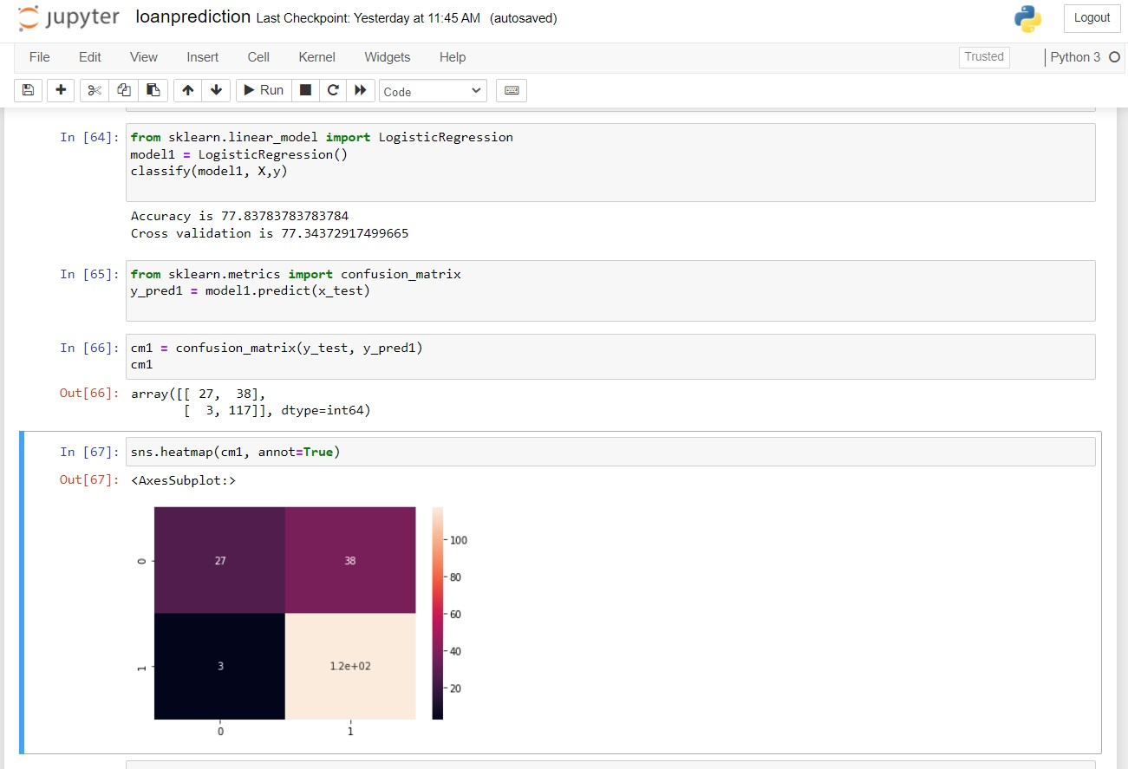
Model Implementation

Slide 16
Decision Tree Classifier
6

Slide 17
Decision tree classifier
Decision Tree is a Supervised learning technique that can be used for both classification and Regression problems, but mostly it is preferred for solving Classification problems. It is a tree-structured classifier, where internal nodes represent the features of a dataset, branches represent the decision rules and each leaf node represents the outcome.
In a Decision tree, there are two nodes, which are the Decision Node and Leaf Node. Decision nodes are used to make any decision and have multiple branches, whereas Leaf nodes are the output of those decisions and do not contain any further branches.
The decisions or the test are performed on the basis of features of the given dataset.
It is a graphical representation for getting all the possible solutions to a problem/decision based on given conditions.
It is called a decision tree because, similar to a tree, it starts with the root node, which expands on further branches and constructs a tree-like structure.

Slide 18
Decision Node
Root Node
Sub-Tree
Decision Node
Decision Node
Leaf Node
Leaf Node
Leaf Node
Decision Node
Leaf Node
Leaf Node

Slide 19
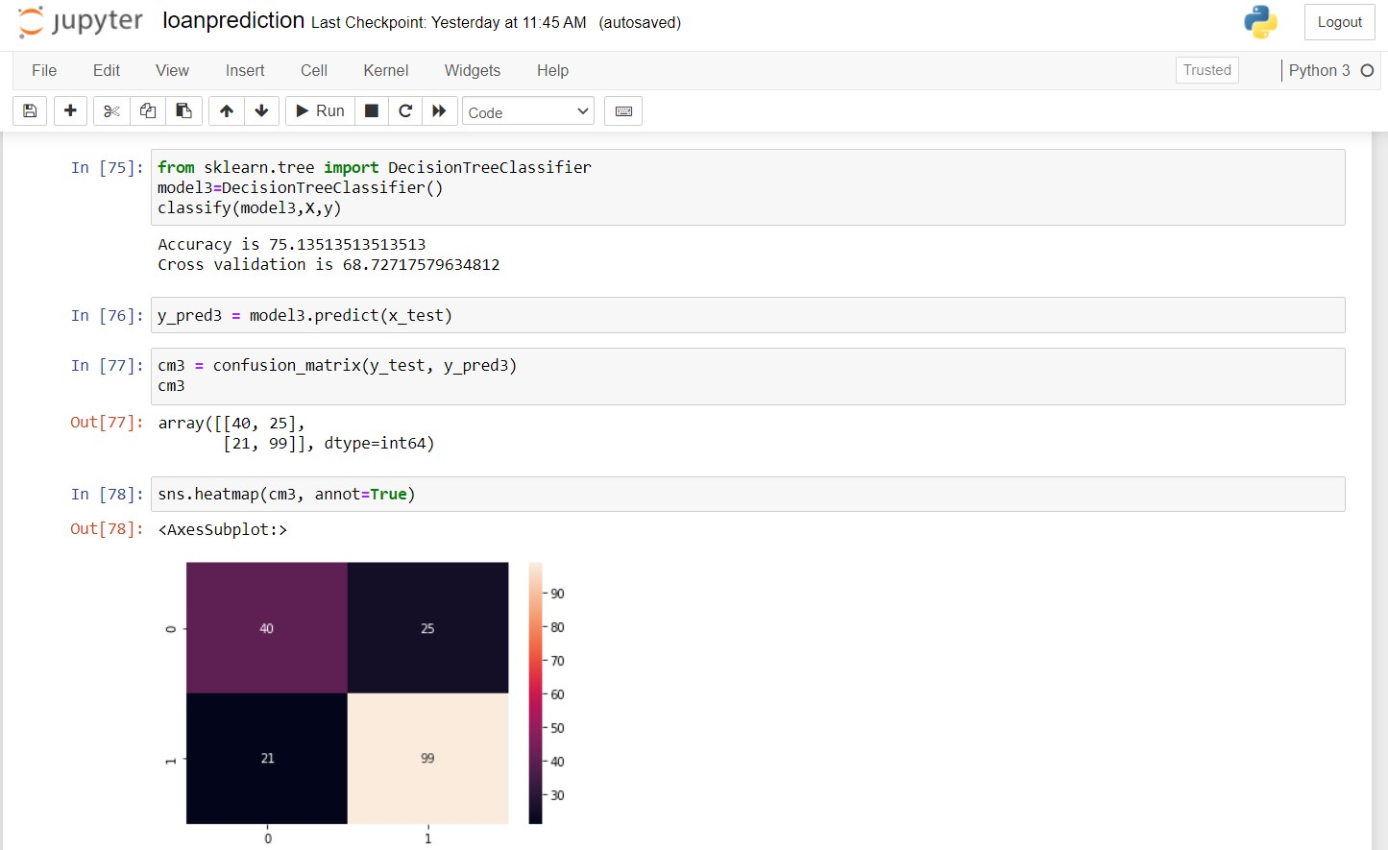
Model Implementation

Slide 20
Random Forest
7

Slide 21
Random Forest classifier
Random Forest is a popular machine learning algorithm that belongs to the supervised learning technique. It can be used for both Classification and Regression problems in ML.
It is based on the concept of ensemble learning, which is a process of combining multiple classifiers to solve a complex problem and improve the performance of the model.
As the name suggests, "Random Forest is a classifier that contains a number of decision trees on various subsets of the given dataset and takes the average to improve the predictive accuracy of that dataset." Instead of relying on one decision tree, the random forest takes the prediction from each tree, and based on the majority votes of predictions, it predicts the final output.
The greater number of trees in the forest leads to higher accuracy and prevents the problem of overfitting.

Slide 22
Random Forest classifier
Training
Set
Training
Data
1
Training
Data
2
…
Training
Data
n
Decision
Tree
1
Decision
Tree
2
…
Decision
Tree
n
Test
Set
Voting
(Averaging)
Prediction

Slide 23
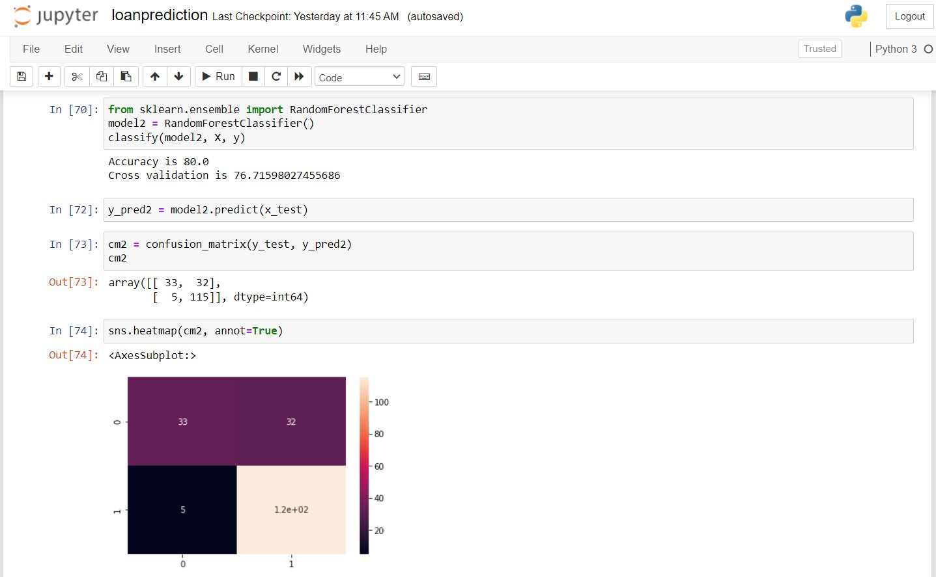
Model Implementation

Slide 24
Experimental Result
7

Slide 25
Accuracy
Logistic
Regression
77.8378
Cross-Validation
77.3437
Decision Tree
Classifier
75.1351
Cross-Validation
68.7271
Random Forest
Classifier
80.0
Cross-Validation
76.7159

Slide 26
Machine learning algorithms will train different models if the training dataset is changed.
Stochastic machine learning algorithms use randomness during learning, ensuring a different model is trained each run.
Differences in the development environment, such as software versions and CPU type, can cause rounding error differences in predictions and model evaluations.

Slide 27


Slide 28
Thanks!
Any questions?
You can find me at:
sutarsanket881@gmail.com
+91 7028550043

Slide 29

Desktop project
Show and explain your web, app or software projects using these gadget templates.

Slide 30
SlidesCarnival icons are editable shapes.
This means that you can:
Resize them without losing quality.
Change fill color and opacity.
Change line color, width and style.
Isn’t that nice? :)
Examples:

