Slide 1
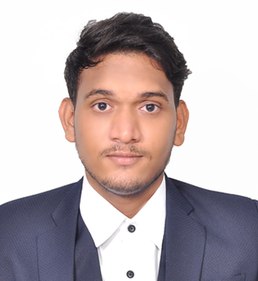



Sanket Bolamwar
Bachelor of Engineering
Electrical : 2018 - 2022
Intern
Skills
Java 11 | Java Basics, OOPS, Generics, Collections, Arrays, Loops, Lambda Exp, Stream API Junit, Mockito, Servlets
Spring core | IOC & Dependency Injection, Autowire
Spring REST | REST controllers, Implementation of GET, POST, PUT & DELETE, Bean Validation & Exception Handling, Testing Services, Controller & Repository layer
Spring Data JPA | Implement DAO layer using spring Data repositories, Transaction Management
Spring Boot Microservices | Spring Boot Starters, annotations, Messaging Service, Sync/Async comms, Swagger API documents
Spring Cloud | Eureka, Netflix Ribbon, Feign Client, Netflix Hystrix, Netflix Zuul & Config Server
Angular | Components, Services, Modules, Routing, Forms & Validation, Testing using Jasmine & Karma
Database | MongoDB No SQL Basics, My SQL RDS Basics
UI Tech | HTML 5 & CSS 3,JavaScript, ES6 & TypeScript Reusable templates, Optimized UI Designed
Tools | Git, Postman, Maven, IDE
Devops | CI/CD, Jenkins configuration, Build Pipelines, notifications, quality gate understanding
Add On skills | Communications, Team management. Peer learning
sanketbollamwar@gmail.com
+91 7709496916
Java Full Stack Developer with Angular
Hands on experience in creating microservices with Spring boot, Spring Security, Spring Cloud Rest API Gateway, Eureka server, swagger, load balancing.
Proficient in creating Single page Web Application in Angular with Authentication with route guards, Angular reactive forms, angular routing.
Hands on experience with NodeJS & spring boot in case study and upskilling his knowledge continuously.
Experience in creating documentation with swagger and in unit testing using Junit, Mockito including code quality using best practices.
In-depth understanding of deploying spring boot applications.
Online Railway Reservation Application
Completed end to end case study of Online Railway Reservation Application along with JWT authentication, Swagger and payment testing using Stripe, responsive UI with Tailwind CSS and Angular used for user interface.
Backend (MongoDB), Midware (Spring Boot) and Frontend (Angular) at Capgemini Degreed Platform
Learned and recompiled all concepts of the backend, midware and frontend technologies to polish my skills to work on real time projects.
Desktop Based Banking Management Application:
Desktop based application to perform all the basic operation necessary for the banking related operations using (CPP).
Check out my work on GitHub & Video Profile

