Slide 1
College of Engineering Pune
________________________________
Course : Data Structures and Algorithms (DSA II)
Mini- Project Demonstration
AY : 2020-21

Slide 2
Heap Manager
Name : Sanket Ukhaji Khaire
MIS : 111903086
Batch : S1 (Div 2)

Slide 3
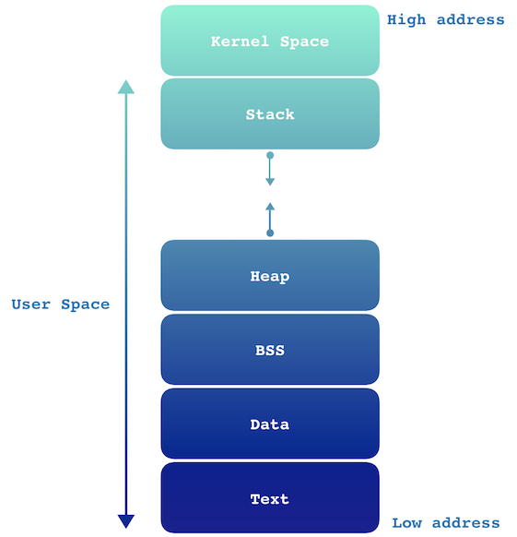
Basic MEMORY LAYOUT

Slide 4
Project Overview
Heap is an area of dynamically allocated memory that is managed automatically by the operating system or memory manager library
A standard C programming environment contains four functions that allow management of the runtime heap: malloc(), free(), calloc(), and realloc().
The heap manager is for Linux-based Operating systems (Ubuntu, Linux etc.) only .
It is particularly for applications requiring quick dynamic memory allocation and deallocation which have adequate amount of memory.
System Calls : 1) sbrk() increment programs data space by increment bytes passed as parameter,
return prev program break on success and -1 on failure
2) brk() sets the end of data segment to the value specified by addr passed as parameter,
returns 0 on success and -1 on failure
Algorithms used : Best fit algorithm, Linear Search
Data-structures used : Array of head pointers, Customized Doubly-Linked-lists, Heap

Slide 5
K & R implementation
Ptr to next free memory chunk
Size
Of chunk
Free memory to be given to user
To the next free memory header
List of free chunks
Free chunk
Chunk in use
Free chunk
Chunk in use
Free chunk

Slide 6
Disadvantages of K&R malloc and free
Each traversal for malloc and free is of linear time
Also Large amounts of fragments are formed
This causes decrease in efficiency
Also the probability to get block of exact size is reduced
Use of first fit algorithm

Slide 7
Implementation Details
The main intention of the project is to optimize the memory allocation by using best fit algorithm and reducing memory fragments.
Memory is requested from the operating system in the form of large chunks of 1KB
The brk() and sbrk() system calls are used for this purpose
To re-use the memory given to the user an array of pointers to free-list is maintained which contains the pointers to the memory locations which have been freed and hence can be used to allocate memory efficiently and with minimum time complexity.

Slide 8
CHUNK STRUCTURE
HEAD :
Pointer to the next chunk in free list ( null if no free memory)
Size of the chunk along with status
FREE MEMORY
Contains free memory to be allotted to the user
TAIL :
Pointer to the PREVIOUS chunk in free list ( null if no free memory)
Size of the chunk
Ptr to next free memory chunk
Size
Of chunk with status
Free memory to be given to user
Size
Of chunk
Ptr to prev free memory chunk

Slide 9
ARRAY OF POINTERS TO FREE LIST
1
2
3
4
5
ARRAY
NULL :

Slide 10
RELATION BETWEEN BYTES AND UNITS
Memory is allocated in multiples of size of metadata (HEAD or TAIL)
UNIT SIZE :
size of head = size of tail = 16 bytes = 1 unit of chunk
Minimum units of chunk :
Head + one unit +Tail
Memory unit = (required bytes – 1)/unitsize + 1
Indices of the free bin array represents respective no of units in each node of linked list
pointed by that member of array
E.g. : Index no 4 has linked list of free memory of 4 units each and so on…

Slide 11
MALLOC
FREE
Find out the metadata(header) of the memory to be freed
Calculate the units of the chunk of memory
Inserting the chunk of memory in the array of free list at appropriate place
Changing the status of chunk to free for further use
Searching for free block of memory in free list
Requesting for more memory from system if no free memory
Splitting the memory and allotting the required to user
Returning the pointer to the free memory to the user

Slide 12
WORKING OF MALLOC2
Initially memory is requested from the operating system if no free memory is available
Since system calls are slow minimum 1KB of memory is fetched from the system
The required memory is allocated to the user and the remaining is inserted in to the free list of respective units
If the memory required is slightly smaller than available free chunk then memory is allocated as it is
If the free memory is large enough then it is splitted and the required memory is returned to user

Slide 13
WORKING OF FREE2
Free function frees the memory allocated to the user
The chunk of memory is simply linked to the free linked list of respective size for further use
WORKING OF CALLOC2
This function calls malloc
Each byte of memory is set to 0 by using function ‘memset’ in string.h and pointer to free memory is returned to user

Slide 14
WORKING OF REALLOC2
Sandard library realloc do one of the following things when called
1) It spreads or compresses the memory keeping the memory pointer unchanged or
2) It copies the previous memory and reallocates it at different memory position
What my realloc2 does is that if memory needs to be compressed it simply splits it into 2 parts ,the required one is returned to the user and the other one is freed for further use
But when user demands for more memory while reallocation, what I do is find the best memory fit of required bytes , copy the previously written data bytes using ‘strncpy’ function from string.h library and return the new memory pointer

