Slide 1

Suman Ramesh Tulsiani Technical Campus
Faculty of Engineering
Mauje : Khamshet, Pune-Mumbai Highway(NH4), Tal: Maval, Dist: Pune-410405.
Approved By A.I.C.T.E. New Delhi, Recognized by Govt. of Maharashtra, Affiliated to University of Pune.
“CROSS-PLATFORM APPLICATION DEVELOPMENT IN REACT NATIVE”
Presented by,
Mr. Sanket Sabale
( Roll. No.26)
Under the Guidance of,
Prof. A. M. Dalvi
Department of Computer Engineering

Slide 2
Contents
Introduction
Motivation
Problem Statement
Objectives
Literature Survey
System Architecture
System Modules / Methodology
Conclusion and Future Scope
References

Slide 3
“Introduction”

Slide 4






Which Companies Uses React Native ???

Slide 5
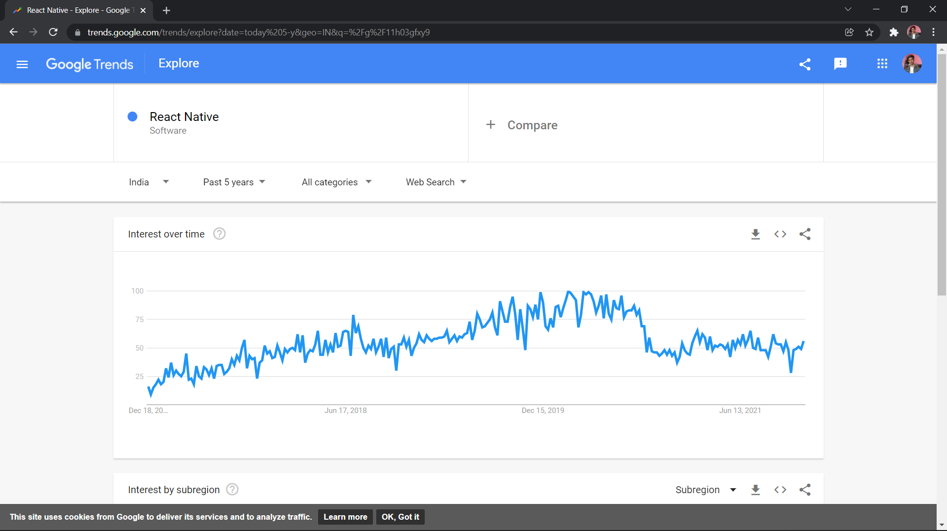
TRENDS

Slide 6

What is Native Apps?
Native apps Build using one Programming Language and Specifically for one Platform.

Slide 7
REQUIREMENT FOR REACT NATIVE?
HTML,CSS and JavaScript
Programming Experience Needed also Little bit knowledge on ReactJS.

Slide 8
WHAT IS REACT NATIVE ? (INTRODUCTION)
React native is UI-Software Framework.
It can create IOS and Android app.
It uses JavaScript to write code.
It more liked one when its come in market and Lots of companies are Hiring Developers.

Slide 9
“ LITERATURE SURVEY ”

Slide 10
“ LITERATURE SURVEY ”
sr.no | Title of Page | Author | Published Year | Finding | Future Scope
1. | React Native Based Mobile App for Online Experimentation | Xingwei Zhou etal. | 2020 | IEEE Xplore. | Helps Student To get Practical Experience Through 3D
2 | React Native Supplements. | Paul etal. | 2019 | Springer. | Guide For Developers

Slide 11
sr.no | Title of Paper | Author | Published Year | Finding | Future Scope
3 | Mobile Development in Swift, Java and React Native | Hugo Brito etal. | 2019 | IEEE Xplore. | Comparing Technologies
4 | JavaScript in Mobile Applications: React native vs Ionic vs NativeScript vs Native Development. | Anabela Gomes etal. | 2018 | IEEE Xplore. | JavaScript Development with more Technology

Slide 12
“ PROBLEM SURVEY AND OBJECTIVES ”

Slide 13

What is a Problem that React Native is trying to solve?
If any company want to create app for android and ios then they need to hire two different developers for completing app but in react native with a single code base we can develop app for both platforms and that things saves companies times and money so companies are most like to hire react native developers.

Slide 14


What is Single Code Base ?
Code That use for both platform but in one Language its called as single code base.
With the help of JavaScript we can create app for ios as well as for android.

Slide 15
WE CAN USE BACKEND SERVER IN IT?
Django ( Python Framework )
Spring ( Java Framework )
Flask ( Python Framework )

Slide 16
“Architecture”
React Native Code
Expo App
Native Modules
Implementation
Expo App
Converts Android Code(Java, Kotlin)
Converts IOS
Code
(swift, objective-C)
Creating Android
Modules
Creating IOS
Modules

Slide 17
“System Modules/Methodology”

Slide 18
React native vs Flutter ?
React Native
Can Bundle Code From JS To Native.
More Easy To learn if you are a web developer.
Support of many libraries.
Flutter
Use Dart Programming Language for Bundle things up.
Uses OOP Based Concepts

Slide 19
Different Technologies Like React Native?
Flutter
Created By Google used for cross-platform application development with dart language support.
IONIC
Based on Angular Framework Concepts are similar like React Native but a huge Framework to build apps.
Xamarin
.NET Based Framwork for building apps for android and IOS, It uses C# Programming Language.

Slide 20
5000+
185,244+
500+
Apps on Playstore
Developers in India
Companies All over the world uses React Native.

Slide 21
Other Platforms to compare data
 | Debugging | UI-Kits | Performance
React Native | 1.5m+ | 50+ | 7.5/10
Flutter | 1.2m+ | 30+ | 8/10
Native | 0.5m+ | 10+ | 9/10
Option
Technology

Slide 22
Conclusion
We can use React Native for Developing Android and IOS app but one thing you need to keep in mind is that it usage third party libraries so performance that we get it really bad on higher level applications, so that if you are building something like website app (creating web app on android or ios ) then its better to use that thing, also if you are creating app for UI Thing then its better as well.

Slide 23
Future Scope
If React Native can add Some More UI built-in Components it will be more great and save lots of time. The future of react native is great many companies are hire react native developers for creating apps and they also also don’t wan’t to hire two developers for two platforms.

Slide 24
Reference
Xingwei Zhou, “React Native Based Mobile App for Online Experimentation”, IEEE Xplore, 2020.
Paul, “React Native Supplements”, Springer, 2019.
Hugo Barito, “Mobile Development in Swift, Java and React Native”, IEEE Xplore, 2019.
Anabela Gems, “JavaScript in Mobile Applications: React native vs Ionic vs Flutter vs Native Development”, IEEE Xplore, 2018.

Slide 25
Thank You!
Any questions?
You can find me at:
@github.com/sanketscode
Sanket.202165@srttc.ac.in

