Slide 1
“CROSS-PLATFORM APPLICATION DEVELOPMENT IN REACT NATIVE”

Slide 2






Which Companies Uses React Native ?

Slide 3
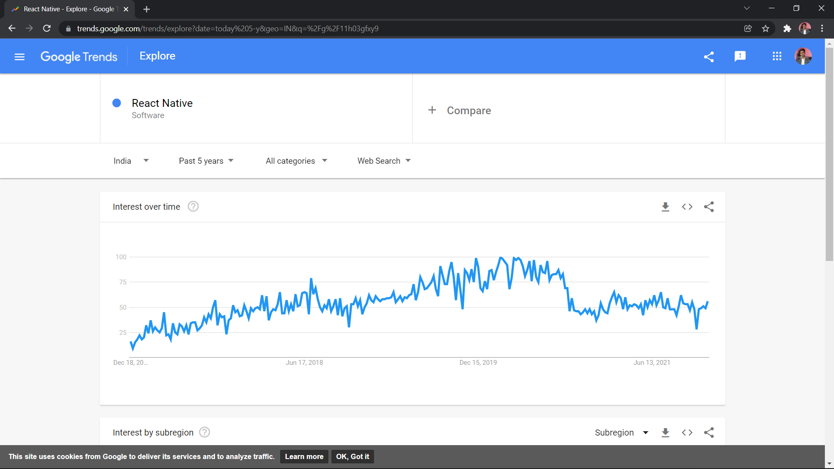
TRENDS

Slide 4
Lets Start To Understand why React Native is best to create Cross-Plaform apps.

Slide 5

What is Native Apps?
Native apps Build using one Programming Language and Specifically for one Platform.

Slide 6
What is React Native ? (Introduction)
React native is UI-Software Framework.
It can create IOS and Android app.
It uses JavaScript to write code.
It more liked one when its come in market and Lots of companies are Hiring Developers.

Slide 7

How React
NATIVE WORKS?

Slide 8
Requirement For React Native?
HTML,CSS and JavaScript
Programming Experience Needed also Little bit knowledge on ReactJS.

Slide 9
React native vs Flutter?
React Native
Can Bundle Code From JS To Native.
More Easy To learn if you are a web developer.
Support of many libraries.
Flutter
Use Dart Programming Language for Bundle things up.
Uses OOP Based Concepts

Slide 10
Different Technologies Like React Native?
Flutter
Created By Google used for cross-platform application development with dart language support.
IONIC
Based on Angular Framework Concepts are similar like React Native but a huge Framework to build apps.
Xamarin
.NET Based Framwork for building apps for android and IOS, It uses C# Programming Language.

Slide 11
Literature Survey
sr.no | Title of Page | Author | Published Year | Finding | Future Scope
1. | React Native Based Mobile App for Online Experimentation | Xingwei Zhou etal. | 2020 | IEEE Xplore. | Helps Student To get Practical Experience Through 3D

Slide 12
sr.no | Title of Page | Author | Published Year | Finding | Future Scope
2 | React Native Supplements. | Paul etal. | 2019 | Springer. | Guide For Developers

Slide 13
React Native Architecture
React Native Code
Expo App
Native Modules
Implementation
Converts Android Code(Java, Kotlin)
Converts IOS
Code
(swift,objective-C)
Creating Android
Modules
Creating IOS
Modules

Slide 14

How React Native Uses ReactJS?
ReactJS is Frontend Library and some state concepts are in it so react native also support some of the state components that are available in ReactJS.

Slide 15
ADVANTAGES
Basic Structure for Develop apps.
Easy To add External Library.
Many Backend Framework Support.
Customizable Builds

Slide 16
LIMITATIONS
More Requirements To Learn React Native.
Less Third Party Dependencies as compare to Native Apps.
Takes To much Time while Debugging.

Slide 17
5000+
185,244+
500+
Apps on Play Store which build with react native.
Developers in India.
Companies All Over the world Use React Native.

Slide 18
Other Platforms to compare data
 | Debugging | UI-Kits | Performance
React Native | 1.5m+ | 50+ | 7.5/10
Flutter | 1.2m+ | 30+ | 8/10
Native | 0.5m+ | 10+ | 9/10

Slide 19
Conclusion
We can use React Native for Developing Android and IOS app but one thing you need to keep in mind is that it usage third party libraries so performance that we get it really bad on higher level applications, so that if you are building something like website app (creating web app on android or ios ) then its better to use that thing, also if you are creating app for UI Thing then its better as well.

Slide 20
Reference
(IEEE) React Native Based Mobile App for Online Experimentation, Xingwei Zhou, 2020.
(Springer) React Native Supplements, Paul, 2019.

Slide 21
Thanks!
Any questions?
You can find me at:
@github.com/sanketscode
Sanket.202165@srttc.ac.in

