Slide 1
Weight Capacity Checker:
Ankita Bhowmik and Sankhadip Paul

Slide 2
Problem Statement:
It will be used to find the towing capacity of a device or vehicle.

Slide 3
Requisites:
Arduino
Nodemcu esp8266
Weight Sensor HX711
Load Cell 1kg (only for implementation)
Android Studio
Firebase

Slide 4
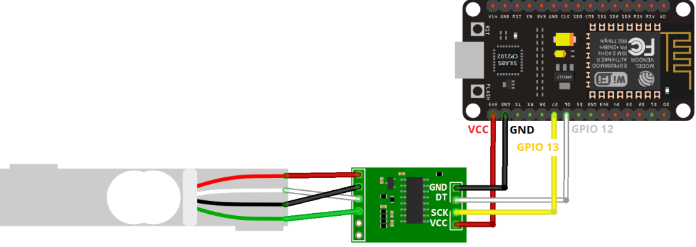
Circuit Diagram:

Slide 5
CONNECTIONS:
Load Cell | HX711 | HX711 | ESP8266
Red (E+) | E+ | GND | GND
Black (E-) | E- | DT | GPIO 12 (D4)
White (A-) | A- | SCK | GPIO 13 (D5)
Green (A+) | A+ | VCC | 3.3V

Slide 6
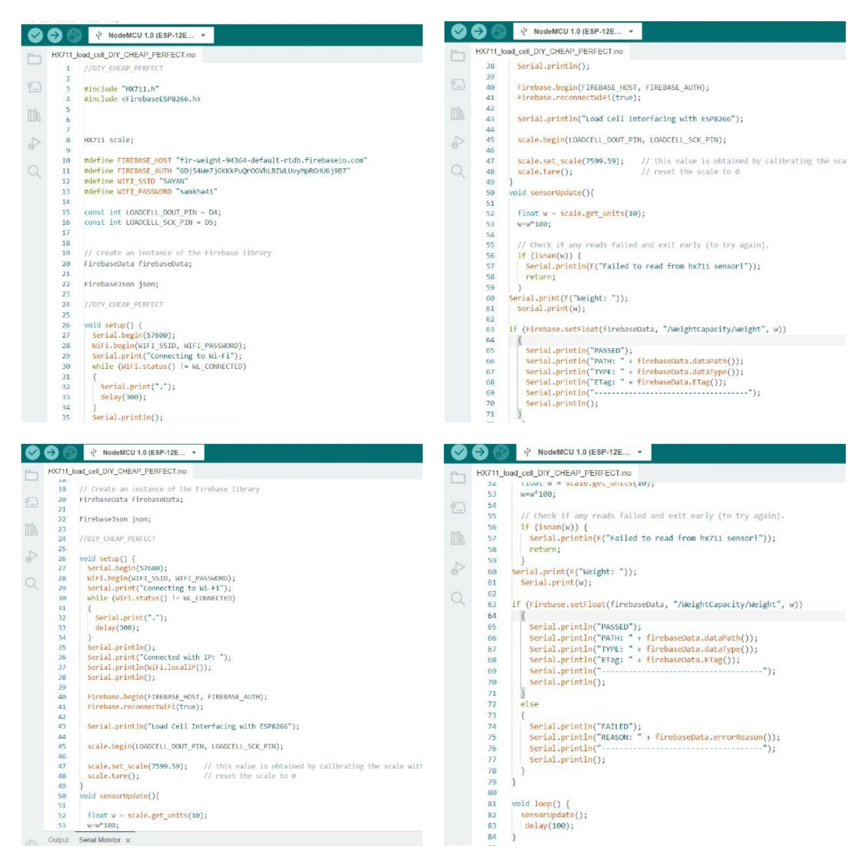
Code written for nodemcu and weight sensor connectivity:

Slide 7
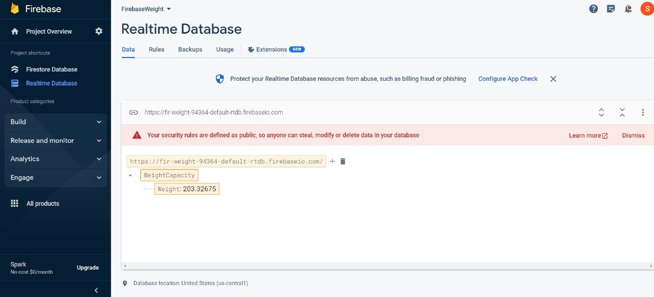
REALTIME FIREBASE DATA:

Slide 8
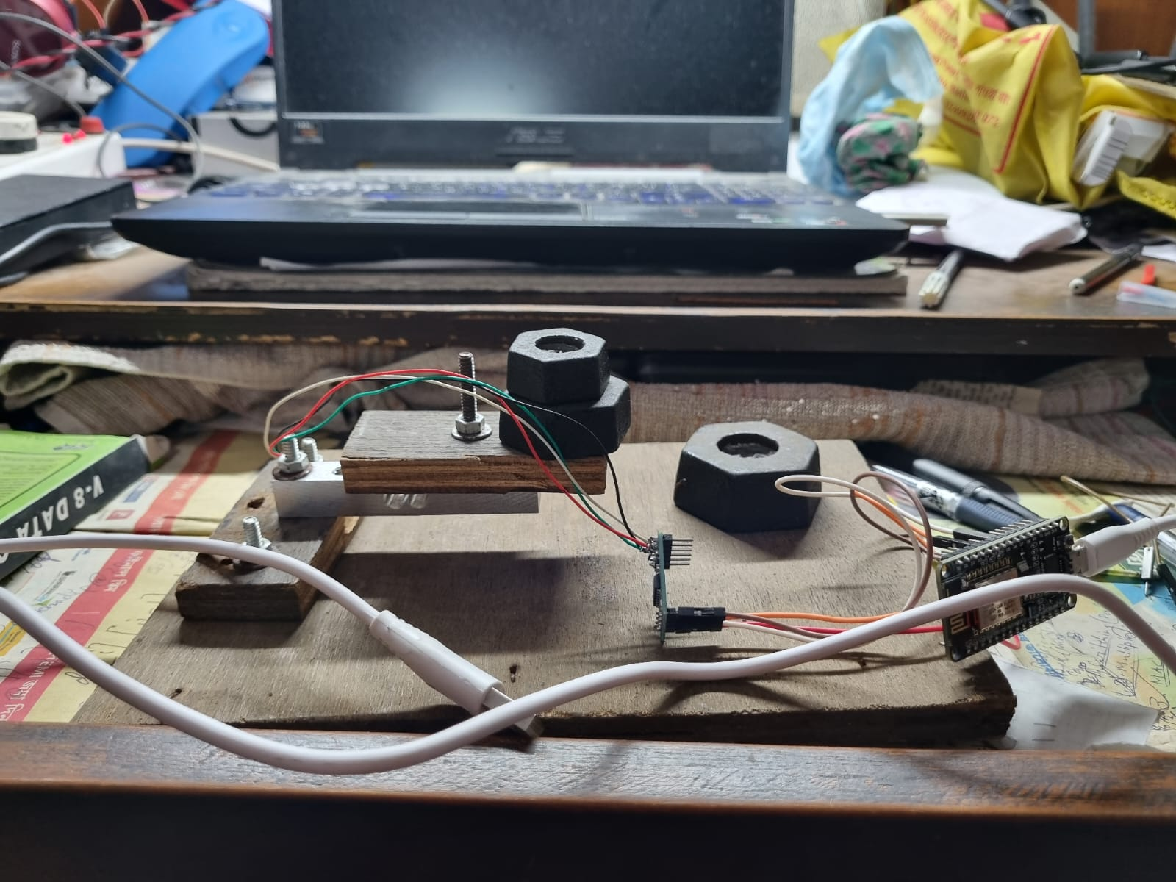
NODEMCU AND WEIGHT SENSING MACHINE:

Slide 9
Now for Android app

Slide 10
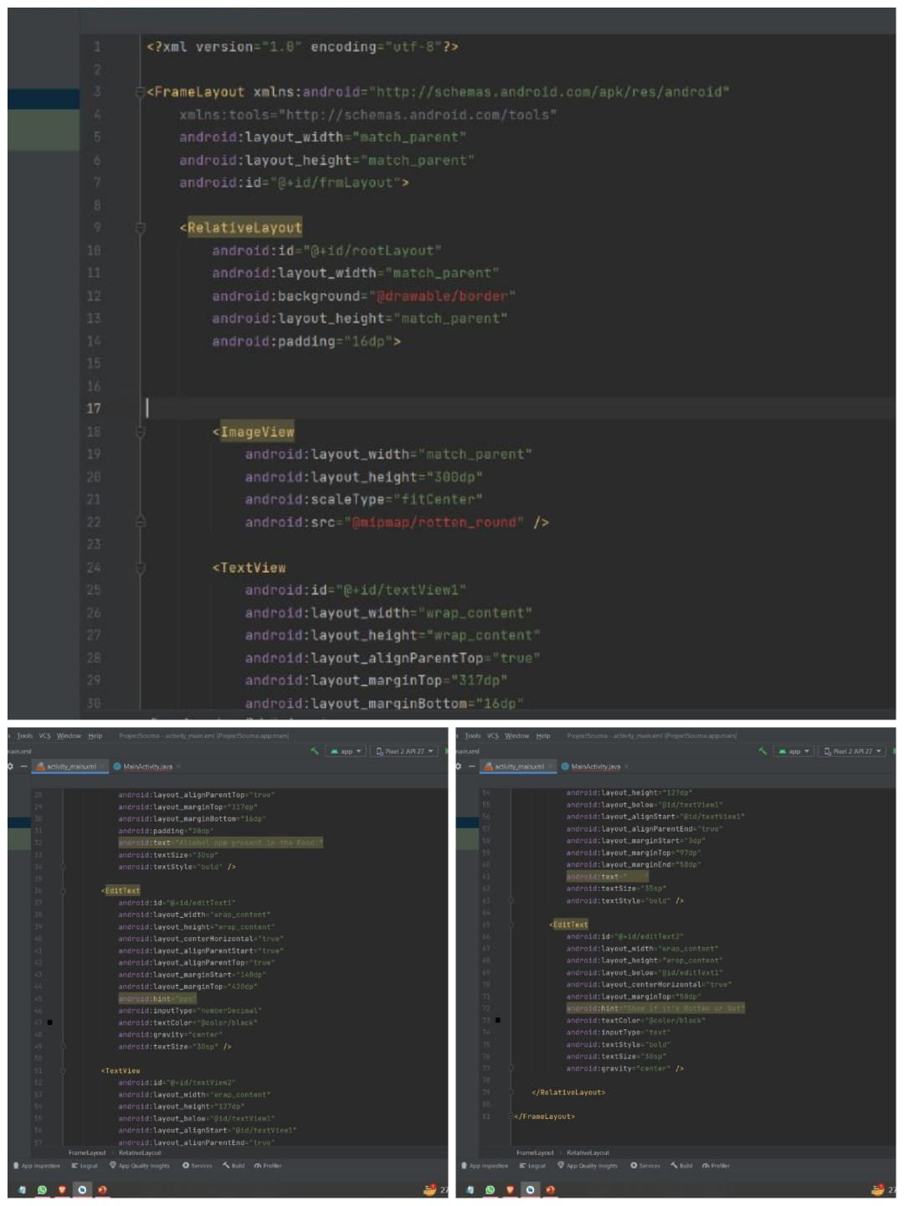
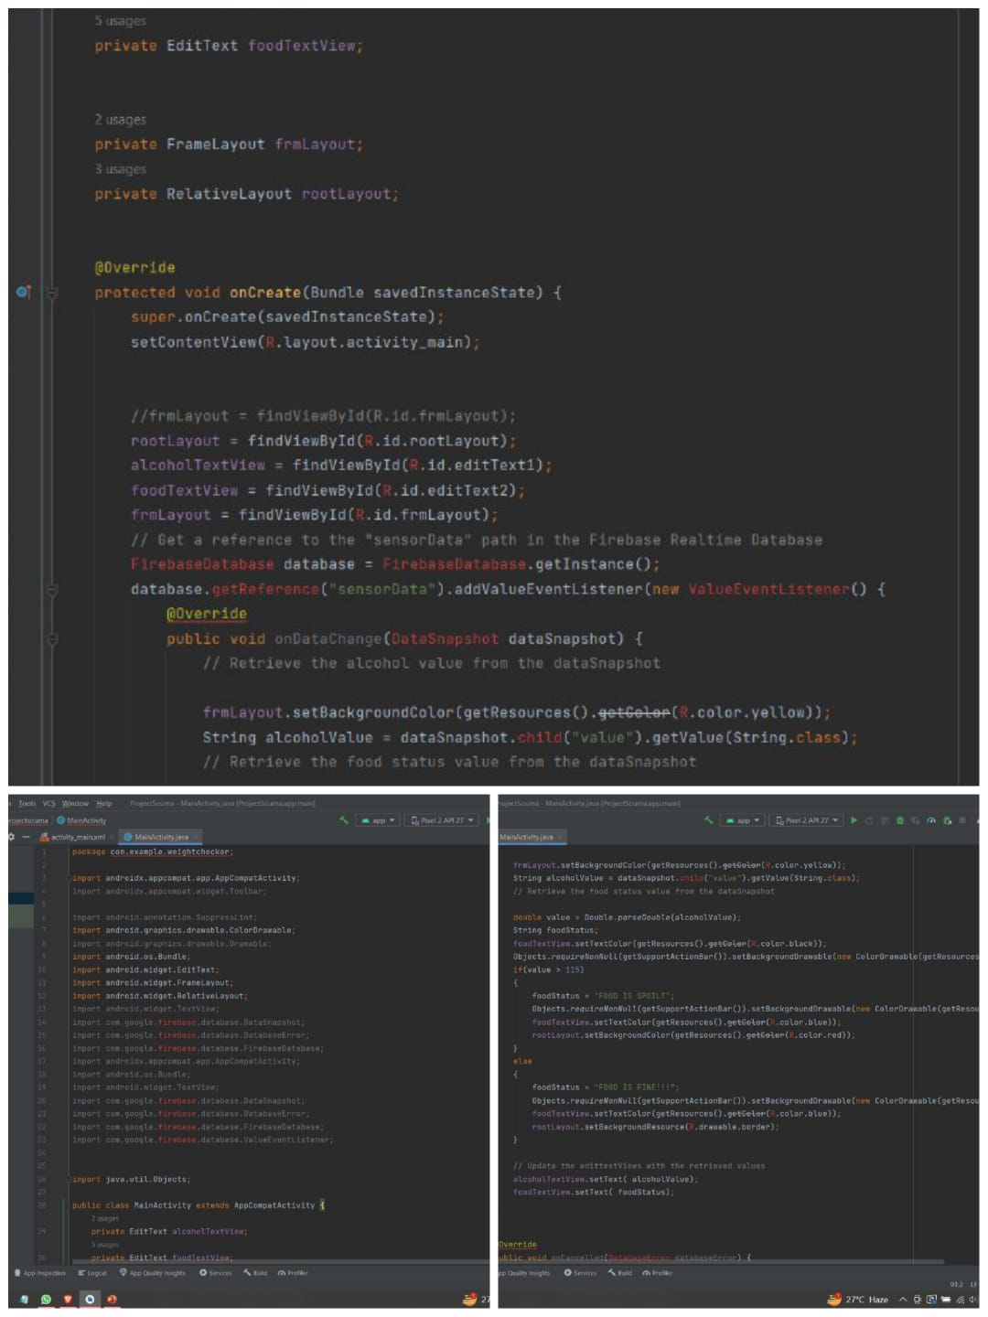

Slide 11
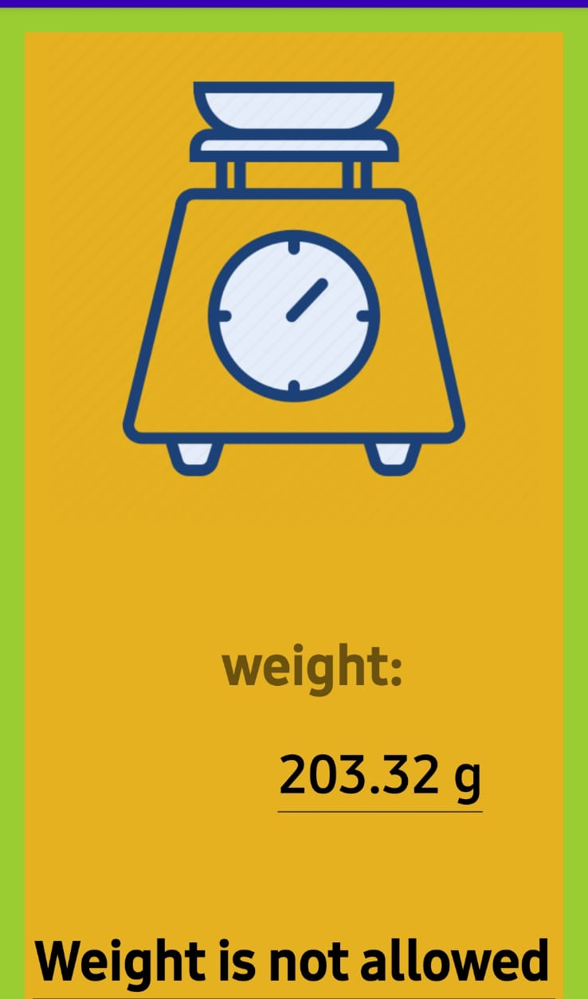
The Android App:
For display

Slide 12
THANK YOU

