Slide 1

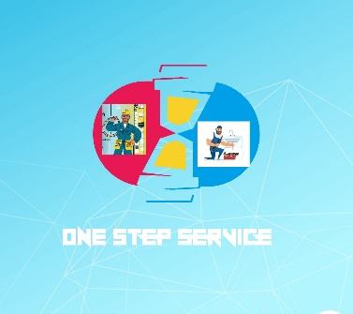

Business idea on app based service for household as well as businesses
Techno International Newtown
SYN-NOVA
Department of Business Management & IIC, TINT
Business idea competition
Participants:
Sankhadip Roy
Parthib Biswas
Debjyoti Sen
IT 1st year 2021 -25
Techno International Newtown
Guided by:
Prof. Srijan Sengupta
Department of Basic Science & Humanities,
TINT

Slide 2
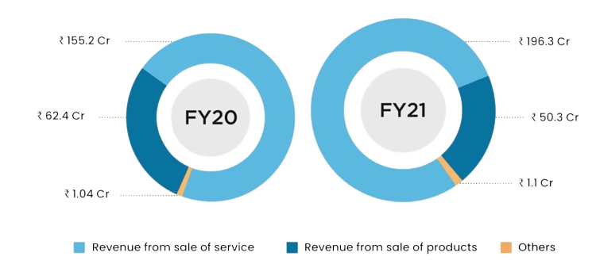
PROBLEM DEFINITION
A large number of people face problem of hiring skilled Labor's [electrician, plumber ,carpenter, mechanic etc] from their locality within time at reasonable cost and a large number of Labor's do not get work in their locality without middle man.
We found that approximately 96% of the customers that we interviewed are facing this problem.
OUR VISION:
To make a application where customers will get all types of skilled workers.

Slide 3
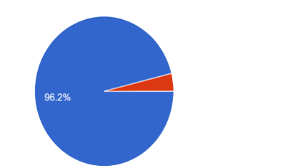
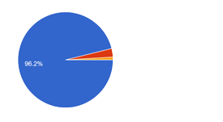
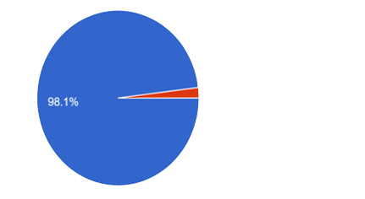
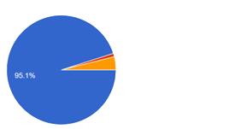
SURVEY
1.Diffuclty in finding skilled workers.
2.Elimination of middle man.
3.Dialy wage workers facing problem.
4.Potential customer.

Slide 4

QUESTIONS | RESULTS
1.How many customers did you interview? | 104
2.How many of them agree this is a problem that needs to be solved? | 96.2%
3.How many of them said they can already solve this problem and don’t need a new solution? | 4.9%
4. What is your Customer Segment? | Old aged people,Busy corporate personnel Young generation
5. What is your Niche? | Service

Slide 5
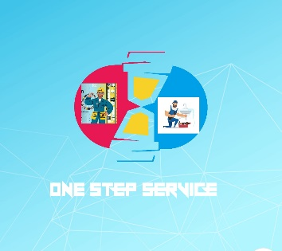
Feature of our application
1)Different option for different type of works.
2)Customers can report any type of bad experience, in case genuine, fees will
be refunded.
3)If the worker didn’t reach the customer’s given address within 1 hour the fees will be refunded.
4)Workers will be notified when and where work has been given to him as soon as the customer
books by AI.
Proposed app name and logo
One-step service
Target milestone
We will start firstly with individual customers and for small businesses . later we will scale it up to work with big businesses like flat promoters, educational institutions
Key metrics
No. of download of our app or visitors of our website
No. of booking

Slide 6


Lean canvas
Early adopters
Outsider college students near Newtown
PG owners of Newtown
Corporate working professionals near Newtown
Risk Factor
Other potential competitors in this market like urban company
Difficulty in finding skilled workers
Investment
We need initially 6 lakhs of investment to start our app development & hiring workers.
Customer segment
Working professionals
Aged people
Outsider students
Initial advertisement process
Ads on social media like Facebook, YouTube
Posters, hoarding banner

Slide 7

SOLUTIONS
We will be creating an app where people can find workers through internet.
It will also ensure that there is no monopoly of workers.
It will reduce the involvement of middlemen.
Customer’s profit
Get workers at lowest wage
Within 1 hour
Only by a tap
Worker’s profit
Gets full time job by joining us
Will be paid more
Better sustainable job

Slide 8
REVENUE MODEL
Customer payment(100%)
Company gave 60% of customer payment to workers
Gross revenue 40%
Gross revenue +
App based ads
(100%)
Investment for Advertising-20%
Investment for R&D-20%
Net Revenue-40%
Investment for giving customer attractive discount-20%

Slide 9

Skills in our team
Goal oriented decisions
Good technical knowledge
Excellence in management skills
A good idea about market
Good communication skills
Openness to new ideas
Tech savvy
Creative and customer-concentric focus

Slide 10

Students
Sankhadip Roy
Ph. No.9734756696
Email ID: sankhadiproy23@gmail.com
Parthib Biswas
Ph No. 7797495109
Email ID:parthibbiswas35@gmail.com
Debjyoti Sen
Ph. No. 8910547210
Email ID:debsen2003@gmail.com
Mentor
Prof. Srijan Sengupta
Ph. No. 6291921472
Email ID:srijan.sengupta@tict.edu.in

Slide 11
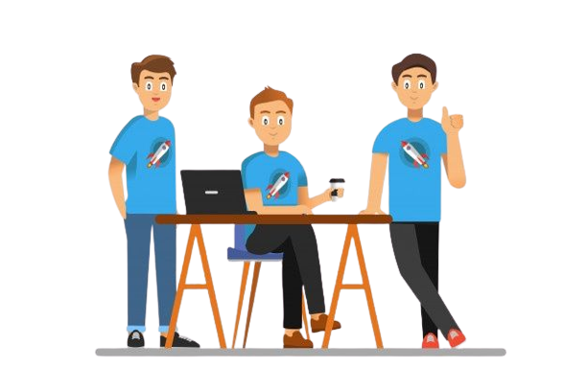
Thank You

