Slide 1
FUNDAMENALS OF BLOCKCHAIN
PRESENTED BY
DEBOJYOTI BOSE
SAPTARSHI SANTRA
SANKHADIP ROY

Slide 2
What is block chain?
Blockchain is the nexus of digitized , decentralized public ledger of data Assets, and all relevant exchanges shared among the participants in a network. It is totally safe and open source. Nowadays it is very useful to store data and also This technology gives us more security from cyber hacker.

Slide 3
Why blockchain?
Blockchain started in 2008 as away to store and secure digital currency. It was a part of a proposal made for Bitcoin by Satoshi Nakamoto. And bitcoin was the first application of a blockchain network. One of its primary benefits is that the recorded information is can't not be changed without any agreement between all involved parties or nodes.
Other benefits include:
Decentralized: Transactions happen on a network of computers.
Immutability: If a transaction is created, it can not be modified.
Open: All the transactions are visible to all the nodes.
Security: Due to encryption feature, Blockchain is almost always secure.

Slide 4
Blockchain technology focused on:
Creating a system that provides a self-monitoring, self-regulating, and cyber-resilient data transaction operation.
Assuring in operation and protection of a truly efficient data exchange system

Slide 5
Introduction
Blockchain is the backbone Technology of digital cryptocurrency Bitcoin. The blockchain is a distributed database of records of all transactions or digital event that have been executed and shared among participating parties. Each transaction verified by most of the participants in the system. It contains very single records of each transaction . Bitcoin is the most popular cryptocurrency an example of the blockchain.

Slide 6
HOW TO IMPLEMENT BLOCK CHAIN?

Slide 7
FIRST OF ALL WE NEED TO DEFINE A STRUCTURE WITH
Data to record on the block chain (i.e. transaction details.)
Block Hash: an ID of this block which is generated by cryptographic techniques.
Hash of the previous block, so that its linked to the chain of block and improve its security.
Timestamp: time stamp of when the block was created and added to the block chain.
Proof of Work: It’s the amount of work taken to derive the hash of this block.

Slide 8
Convert the blocks data to JSON format so that we can concat it with the other info.
We concat the prev. block hash, data, timestamp, and proof of work(PoW).
We generate the hash of the above concat using SHA256 algo.
Return the hash result in base 16, with lowercase letter A-F.
The block chain structure must have:
Genesis block: the first block created.
An array containing other block of the chain.
A number denoting the level of difficulty: the number of ‘0’ before the hash

Slide 9
Verification
Here we recalculate the hash of each block on the chain and compare them to the stored hash in the item and also compare the previous hash of the next block, that should be equal to the current blocks hash.
Since the hash is calculated by the content of the block, a slight change in the content will generate a completely different hash value.

Slide 10
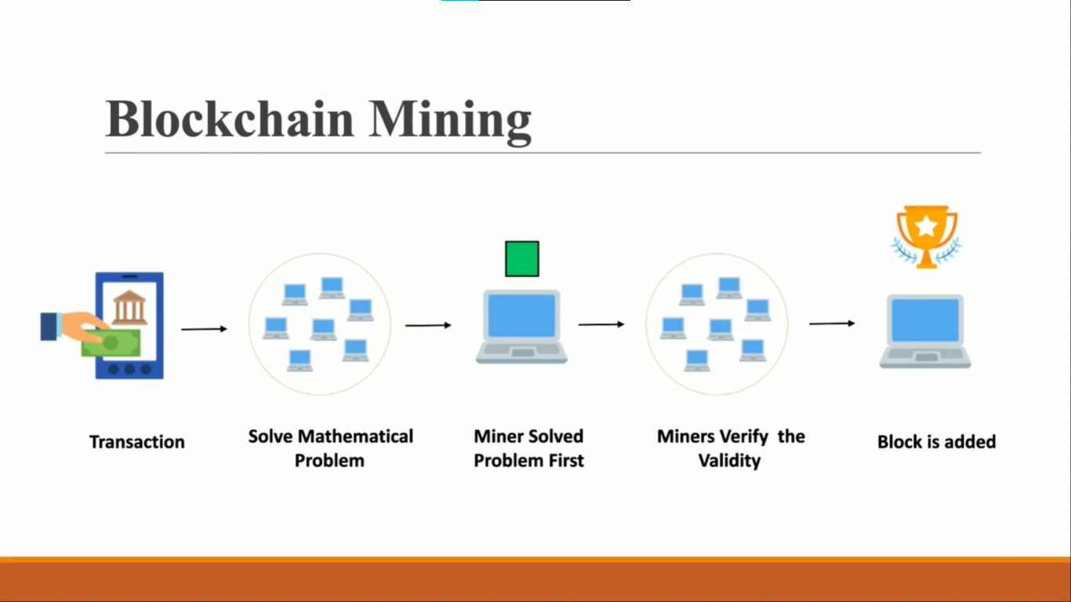

Slide 11
Blockchain Mining
What is Blockchain mining ?
Blockchain Mining Is a process in which Blockchain miner add transaction data to a digital currency’s global public ledger of past transactions after solving puzzles.
Mining a New Block
After a block’s capacity is full (exceeds its transaction capacity or size), verified transactions are temporarily kept in a memory pool called MEM POOL.
Then for every transaction a hash is created to secure all transactions. Then Markle tree is created for every hash to extract a Markle root.
After collecting and arranging verified transactions in a candidate block the miner needs to construct the block header

Slide 12
Block header contains
a summary of all the transaction data in the candidate block
a link to the previous block in the chain also known as a parent block
a timestamp showing the time of creation of the block
a valid Proof-of-Work
Block Header is then Hashed to get a Block Identifier
Mining new blocks involve generating the block’s hash with a certain number of leading zeros (0s). The number of leading zeros is provided by the difficulty level of the current Blockchain. This means that if the blockchain has a difficulty of 3, we have to generate a block that starts with three zeros “000” e.g., “000f34abad….”.
After deriving the hash from the block’s content, we can’t change the content, but we can certainly increase the proof of work (PoW) value until we satisfy the TARGET mining condition.
To implement this, we have create a mine() method for the Block class that will keep incrementing the PoW value and calculating the block hash until we get a valid hash.

Slide 13
Adding new blocks to the blockchain
To add a new block, an add Block method will :
Collects the details of a transaction (sender, receiver, and transfer amount) from
the parameter.
Creates a new block with the transaction details.
Mines the new block with the mine method of the Block class.
Push the newly created block to the chain property of the blockchain.
Validating the Blockchain
A miner who will solve the provided problem first, will broadcast the block and other people add it to the blockchain by verifying the block properties mentioned below,
The block data structure is syntactically valid
The block header hash is equal to or less than the target (enforces the Proof-of-Work)
The block timestamp is less than two hours in the future (allowing for time errors)
The block size is within acceptable limits
The first transaction (and only the first) is a Coinbase transaction
All transactions within the block are valid using the transaction checklist discussed in Independent Verification of Transactions

