Slide 1
DBMS PROJECT COLLEGEZONE
BY
ARNAV
SANKHYA
RISHABH

Slide 2
ABOUT
College zone is a one-way stop for every student to guide them through phases of enrollment into colleges of their choice
The platform features a all-work done online system which allows students to get admission to colleges of their choice without any hassle of visiting colleges for registration purposes
Colleges can also keep track of students enrolled ,accepted and keep a head count of seats in each branch available. They can validate student’s uploaded documents for easy registration procedure once admission is finalized.

Slide 3
What's new from already present technologies in the market?
All admission portals present in the market are just middle-men between college and students and act more as a gateway.
Collegezone allows students to interact with the college of their choice by viewing their websites and contacting the colleges enabling them to make wiser choices in selecting college of their choice.
Collegezone also allows colleges to login and use the portal to get student details enabling them to validate all their documents digitally reducing manual labor.

Slide 4
Technology used
College zone is a website with the following technologies in use:
Front end: HTML,CSS,JAVASCRIPT AND AJAX
Back end: PHP, MYSQL

Slide 5
Tables in database
Admin
Branches
Colleges
Exam results
Preferences
Seats
students

Slide 6
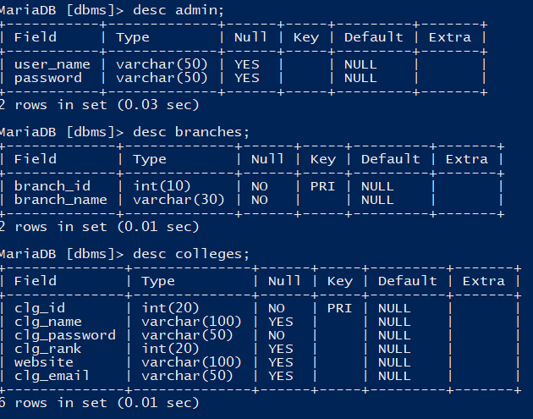
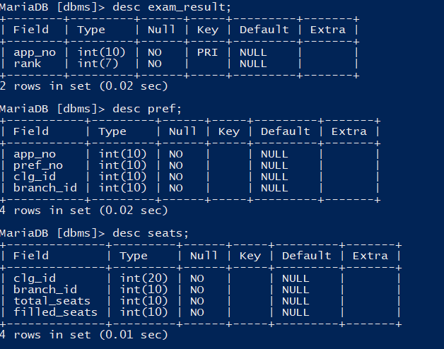
Description of tables

Slide 7
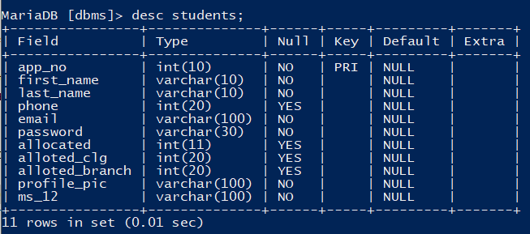
Description of tables

Slide 8
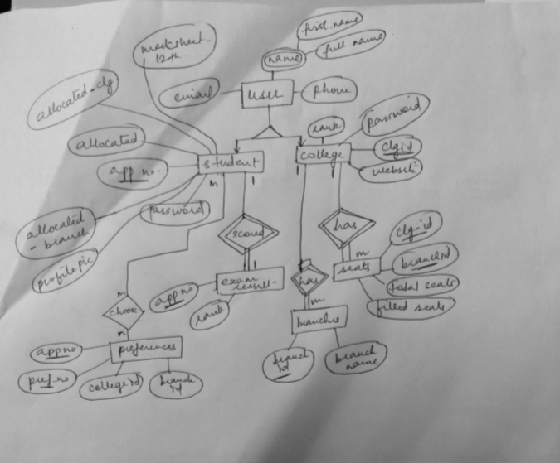
Er diagram

Slide 9
FEATURES
Student and colleges profile details
Student login is done by their exam application number and a auto-generated password by the portal which is received through an email.
Students can select colleges of their choices and have to submit before a valid date
Students can view colleges, their NIRF rankings and their website and contact information directly from the portal
Once allotment round has been completed and database is updated, Colleges can view the students who have chose them and can validate their documents.

Slide 10
DEMO

