Slide 1
Predicting Spatio-temporal temperature variations using Machine learning models
Sanket Shah | AU2140057
Ruchil Shah | AU2140119
Saumya Shah | AU2140165
Bhavy Jhaveri | AU2140168
CSE541 Computer Vision
Section 1 Instructed by - Prof. Mehul Raval
-Presented by Group 9

Slide 2
Problem Statement:
In numerous scientific and engineering disciplines, understanding spatio-temporal variations in physical parameters is critical for insightful analysis and predictive modeling.
This project aims to address the challenge of classifying spatio-temporal data images into distinct categories based on the underlying physical parameter they represent.
Specifically, we focus on leveraging transfer learning techniques in conjunction with the VGG19 deep learning architecture to achieve accurate classification.

Slide 3
Introduction:
In this project, we initially propose a predictive model for temperature forecasting utilizing Convolutional LSTM networks.
By leveraging deep learning techniques like Convolutional LSTM networks, we aimed to capture complex temporal dependencies in temperature data effectively.
Also, used spatio-temporal dataset parameters such as pressure, velocity, temperature, total-energy, heat-flux for classification approach based on the contour.
Employed transfer learning with VGG19 for classifying various spatio-temporal parameters images, addressing challenges in computer vision.

Slide 4
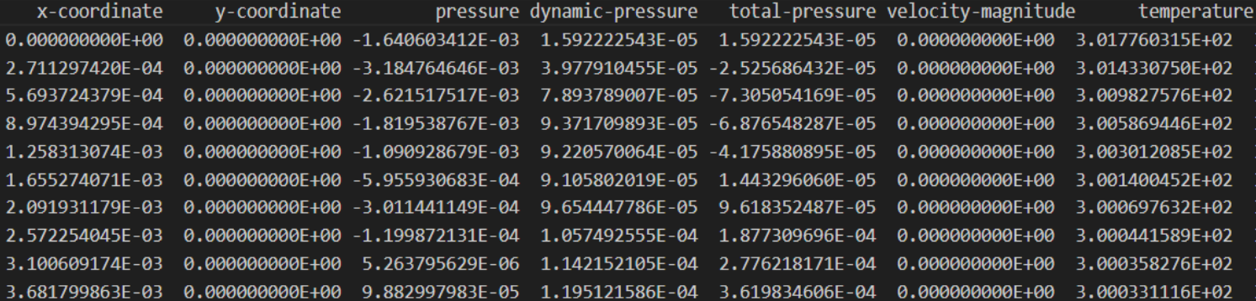
Datasets Discussions:

Slide 5
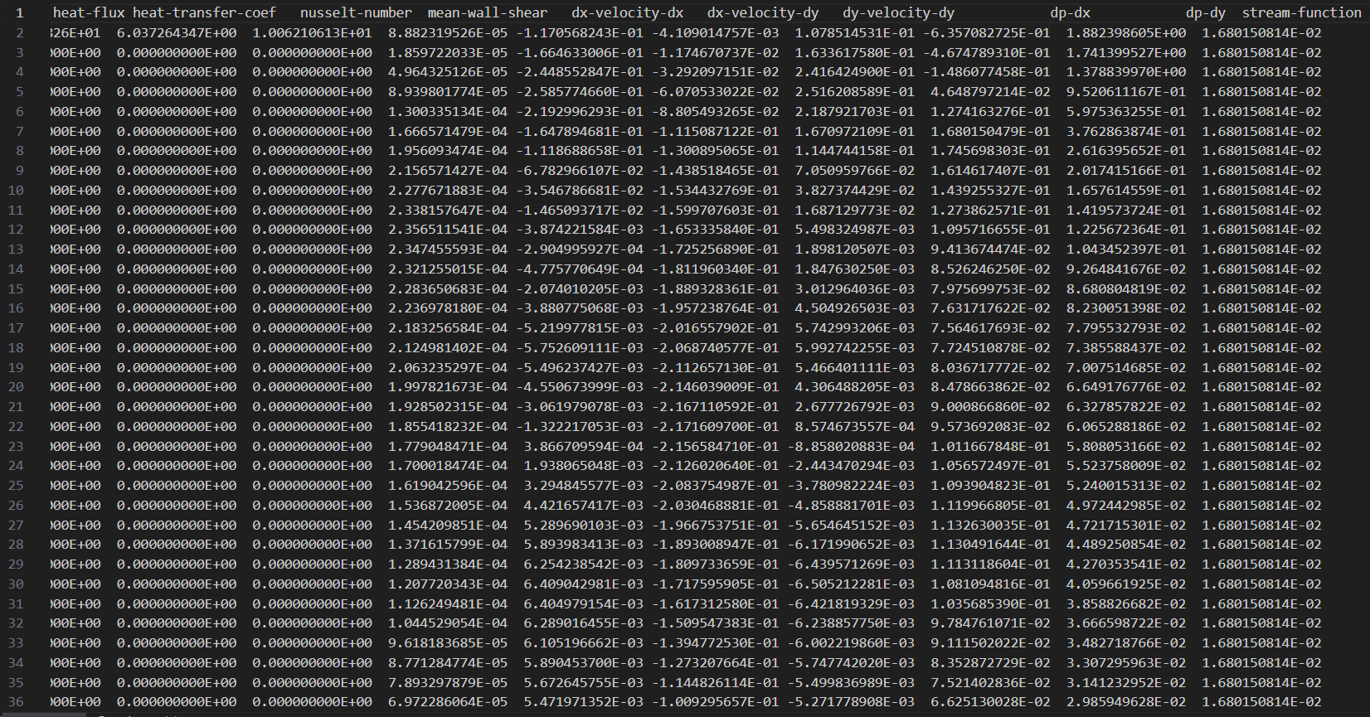
Datasets Discussions:

Slide 6
Methodology:
Convo-LSTM approach:
Prediction through Convo-lstm network
Classification:
Asking the user for the input of particular second and parameter
Convert the collected data into a 2D space.
Plot contours using the transformed 2D data arrays.
Utilize VGG19 architecture for transfer learning-based classification.
Train the model to classify contours into eg-heat flux or temperature categories.

Slide 7
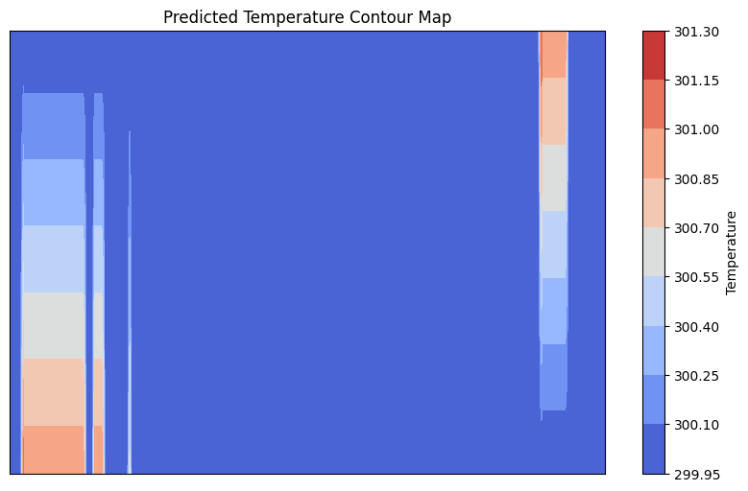
Results(1/3):

Slide 8


Results(2/3):

Slide 9
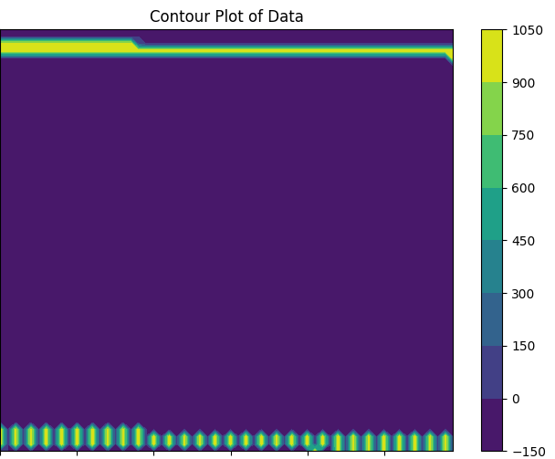
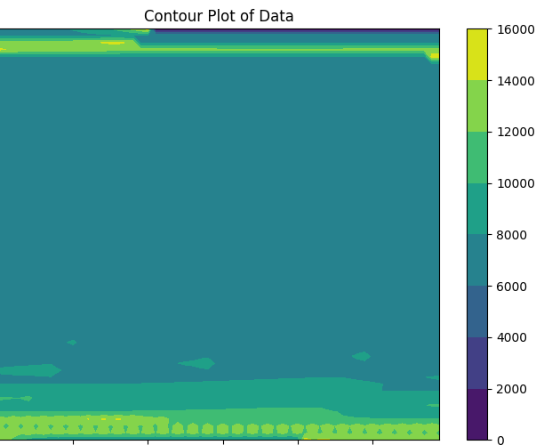
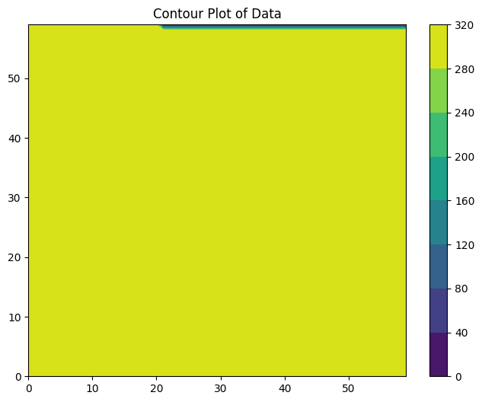
Results(3/3):

Slide 10
Conclusion:
Temperature forecasting and image classification challenges are addressed with innovative methodologies.
Comprehensive solutions are developed leveraging Convolutional LSTM networks for temperature forecasting and transfer learning with VGG19 for image classification.
The combined approaches offer a comprehensive solution applicable to various domains including weather prediction, industrial processes.

Slide 11
References
1) Pawar, S., Rahman, S. M., Vaddireddy, H., San, O., Rasheed, A., & Vedula, P. (2019). A deep learning enabler for nonintrusive reduced order modeling of fluid flows. Physics of Fluids.
2) Amato, F., Guignard, F., Robert, S., & Kanevski, M. (2020). A novel framework for spatio-temporal prediction of environmental data using deep learning. Scientific Reports.
3) Ahmed, S. E., San, O., Rasheed, A., & Iliescu, T. (2021). Nonlinear proper orthogonal decomposition for convection-dominated flows. Physics of Fluids.
4) Arun. (2022, January 6). Spatio-Temporal Data Analysis using Deep Learning - Arun - Medium. Medium.

Slide 12
Thank You !

