Slide 1
Predicting Spatio-temporal temperature variations using Machine learning models
Sanket Shah | AU2140057
Ruchil Shah | AU2140119
Saumya Shah | AU2140165
Bhavy Jhaveri | AU2140168
CSE541 Computer Vision
Section 1 Instructed by - Prof. Mehul Raval
-Presented by Group 9

Slide 2
Problem Statement:
Develop a deep learning model for Predicting Spatio temporal temperature variations using Machine Learning models
Train the model using spatio-temporal data available from CFD for a small time duration.
Predict temporal data and compare with CFD model results available for higher time duration.

Slide 3
Introduction:
Forecasting temperature changes in space and time is crucial for various applications, akin to predicting weather or managing factory temperatures.
Computational Fluid Dynamics (CFD) simulations are used to understand how fluids move and heat up in complex systems.
The project focuses on using deep learning to predict temperature changes over time and space.
CFD data is transformed into grayscale images for analysis.
The popular deep learning model, AlexNet, is utilized to understand these images and predict temperature changes.

Slide 4
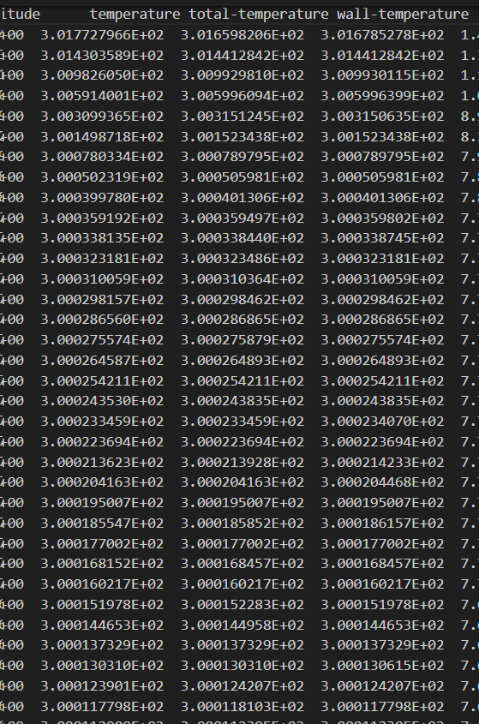
Datasets Discussions:
Dataset: Fluid flow and temperature measurements in computational domain.
Parameters: Pressure, temperature, velocity, and heat transfer properties.
Coordinates: X and Y positions of nodal points.
We have considered the 3 different temperature part as our dataset for predicting temperature variation.

Slide 5
Methodology:
Data Collection and Preprocessing:
- Collected CFD data on fluid flow and temperature distributions.
- Preprocessed numerical data.
- Converted data into grayscale images for visualization and analysis.
Model Architecture Selection:
- Selected AlexNet, a CNN architecture.
- Fine-tuned AlexNet on converted dataset.
- Enabled capturing spatial and temporal patterns in temperature data.
Temporal Forecasting:
- Visualizing the variation in temperature.

Slide 6
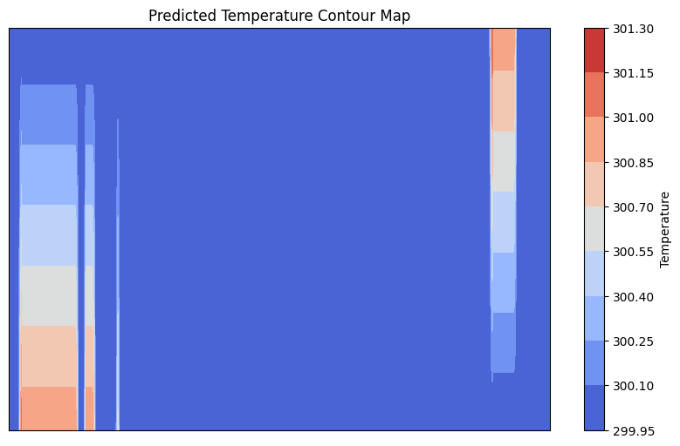
Result:

Slide 7
Conclusion and Future Work:
Data Source:
Computational Fluid Dynamics (CFD) data.
Model Development:
Transforming CFD data into grayscale images to facilitate understanding and analysis.
Training the deep learning model, specifically AlexNet, to comprehend these images and predict temperature changes over time and space.
Future Work:
Investigating the integration of LSTM networks to capture temporal dependencies in temperature fluctuations for enhanced prediction accuracy.

Slide 8
References
1) Pawar, S., Rahman, S. M., Vaddireddy, H., San, O., Rasheed, A., & Vedula, P. (2019). A deep learning enabler for nonintrusive reduced order modeling of fluid flows. Physics of Fluids.
2) Amato, F., Guignard, F., Robert, S., & Kanevski, M. (2020). A novel framework for spatio-temporal prediction of environmental data using deep learning. Scientific Reports.
3) Ahmed, S. E., San, O., Rasheed, A., & Iliescu, T. (2021). Nonlinear proper orthogonal decomposition for convection-dominated flows. Physics of Fluids.
4) Arun. (2022, January 6). Spatio-Temporal Data Analysis using Deep Learning - Arun - Medium. Medium.

Slide 9
Thank You !

