Slide 1



The fundamentals of commons applied to academia
Tine De Moor
Utrecht University
The International Association for the Study of the Commons (IASC)

Slide 2
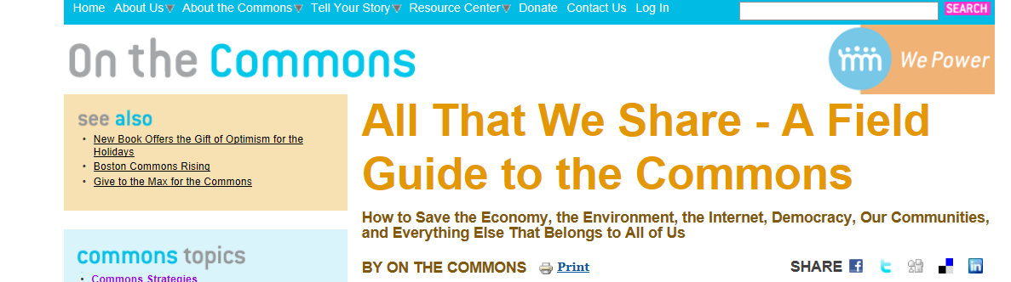
Commons?
Refers today to many different things:
Different types of resources: from tangible to virtual
Different governance regimes: from group-governance (club goods) to public governance to open access
=> Very wide definition: Wikipedia: “The commons is resources that are owned in common or shared between or among communities populations”

Slide 3
commons?
Peer-to-peer-economy?
All the resources we own collectively?
Common Property Regimes?
Common Pool Resources?
Citizens’ initiatives?
All that we share?
Sharing economy?
Collaborative consumption and production?
Common Pool Institutions?

Slide 4
Scientific Analysis of commons: since 1980s
Common Property Regimes?
Common Pool Resources?
Common Pool Institutions?

Slide 5
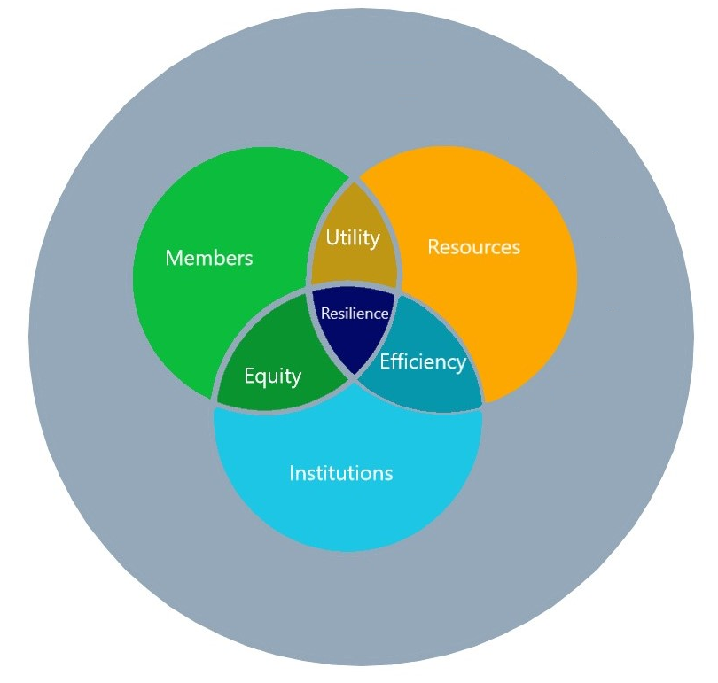
Commons=Groups with rights + collective resources + self-devised rules
Groups of citizens creating and managing a collective good and/or service, whereby the individual use right of the group members is set and limited the by collective decisions of all group members

Slide 6
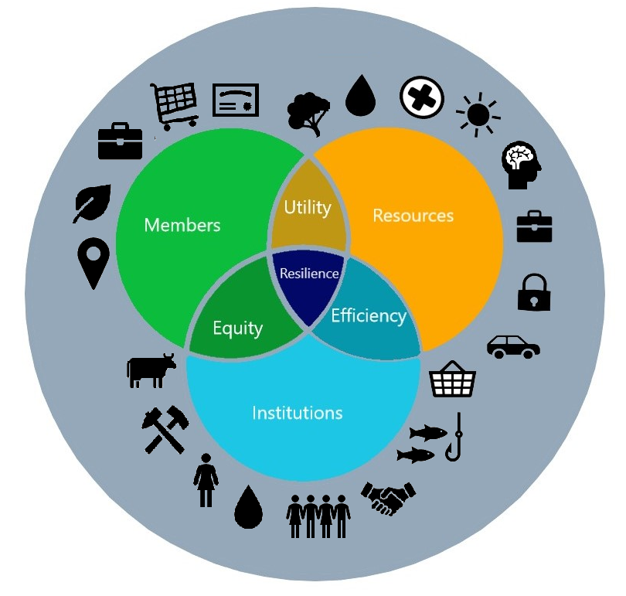
Commons=Groups with rights + collective resources + self-devised rules
RESOURCES:
Land
Water
Wood
Care
Energy
Knowledge
Work
Social Security
Transport
Services
….
MEMBERS:
Owners
Consumers
Laborers
Producers
Users
INSTITUTIONS:
Commons, Guilds, Beguinages, Water boards, Cooperatives, Mutuals, Fishing Communities, Irrigation Communities

Slide 7
Commons=Groups with rights + collective resources + self-devised rules
MEMBERS
Builds on reciprocity through participation of a well-defined group of people
RESOURCES:
RIVALROUS
-RIVALROUS
use has effect on stock
-EXCLUBALE
use can be phyiscally delimited
INSTITUTIONS:
based on Self-regulation-Self-sanctioning-Self-governance

Slide 8
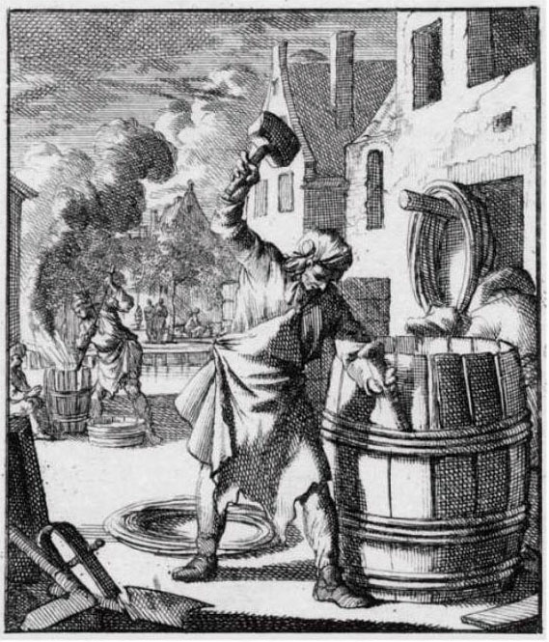
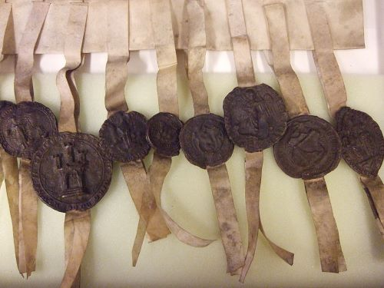
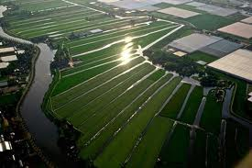
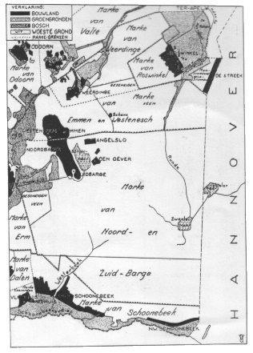
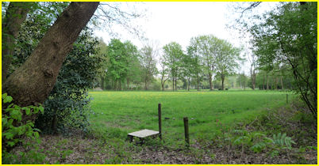
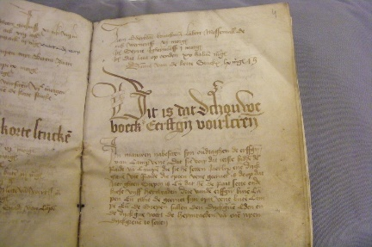
First wave of institutions for collective action: Commons, guilds, waterboards...: 1000-1600 (example netherlands)
log

Slide 9
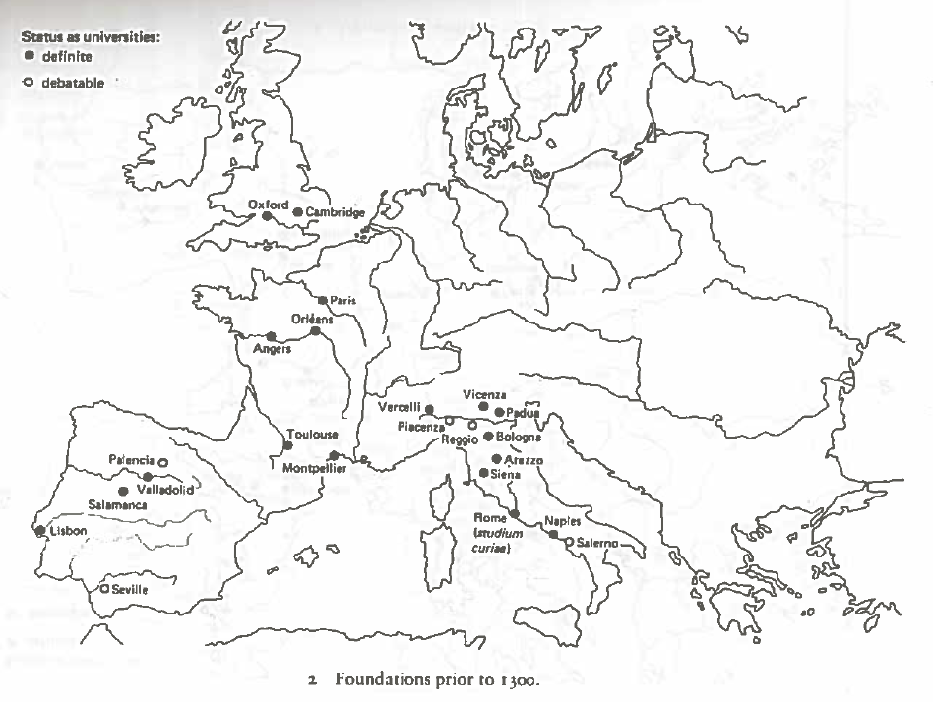
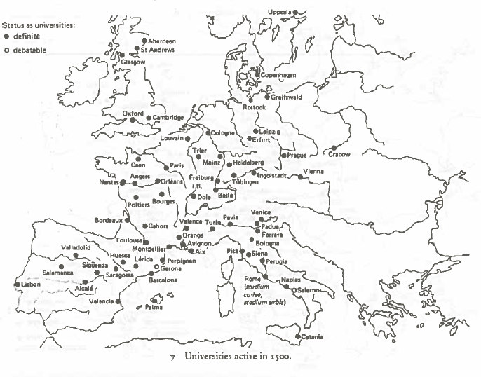
Universities in Europe (1)
Bron: De Ridder-Symoens, H. and Rüegg, W. (eds.) 1994. A History of the University in Europe, Volume I + II. Cambridge: Cambridge University Press pp. 69-74; 95-103.

Slide 10
First wave of institutions for collective action: Commons, guilds, waterboards...: 1000-1600 (example netherlands)
Liberalization
Formation of nation-states
log

Slide 11
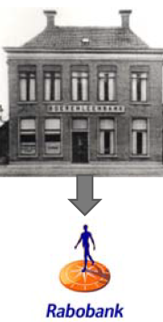

Second wave: Cooperatives, associations, labour unions, 1880-1920

Slide 12
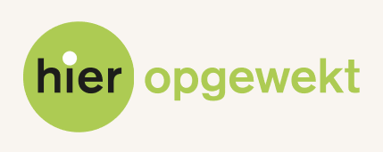


EvolutiOn of the number of new cooperatives per sector 1990-2012 (netherlands)

Slide 13
Institutions for collective action
CONDITIONS
MOTORS
URBANISATION
INDIVIDUAL MOTIVATIONS
RISK SHARING
MARKET DEVELOPMENT/COMMERCIALISATION OF GOODS
“FREEDOM” TO ORGANISE/WEAK SUPRA-LOCAL POWER
WEAKENED TRADITIONAL FORMS OF NETWORKS (E.G. FAMILY)
LEGAL BASIS FOR GROUP RESPONSIBILITY
ADVANTAGES OF SCALE
LESSER TRANSACTION COSTS

Slide 14
UNIVERSITAS!
Western Europe:
From 11th century onwards: legal recognition of groups via development of a legal personhood -> Universitas
Started with Church in Rome: allowed a legal person to draw contracts, borrow and lend, make and amend bylaws, under its own name.
-> soon to be taken over by towns, colleges, and universities, merchant guilds….
-> 16th century: Western World accepts Roman law fully
In contrast to, for example, S-Eastern Europe:
Byzantine empire until 1299: Roman law
1299-1922: Ottoman empire -> Islamic law (although not everywhere) -> no concept of legal personhood.

Slide 15
Institutions for collective action
CONDITIONS
MOTORS
URBANISATION
INDIVIDUAL MOTIVATIONS
RISK SHARING
MARKET DEVELOPMENT/COMMERCIALISATION OF GOODS
“FREEDOM” TO ORGANISE/WEAK SUPRA-LOCAL POWER
WEAKENED TRADITIONAL FORMS OF NETWORKS (E.G. FAMILY)
LEGAL BASIS FOR GROUP RESPONSIBILITY
ADVANTAGES OF SCALE
LESSER TRANSACTION COSTS

Slide 16
The commons and the market: an ambiguous relationship
Threat of commercialisation: “as a rational being, each heardsman seeks to maximize his gain” (Hardin, 1968)
-> Can market development go together with development of institutions for collective action??
Market stimulates need for regulation of rights
Market pressure helps to identify what commons are intended for: primarily self-sufficiency
But markets can also fail….
-> Institutions for collective action as a modus vivendi in stabilizing developing markets?

Slide 17
Institutions for collective action
CONDITIONS
MOTORS
URBANISATION
INDIVIDUAL MOTIVATIONS
RISK SHARING
MARKET DEVELOPMENT/COMMERCIALISATION OF GOODS
“FREEDOM” TO ORGANISE/WEAK SUPRA-LOCAL POWER
WEAKENED TRADITIONAL FORMS OF NETWORKS (E.G. FAMILY)
LEGAL BASIS FOR GROUP RESPONSIBILITY
ADVANTAGES OF SCALE
LESSER TRANSACTION COSTS

Slide 18
Individual motivations to form/join a collectivity
Economies of scale
Collective bargaining position towards authorities
Sharing risks and resources
Lower search and information costs
internal agreement on the price of the goods
collective meetings with compulsory attendance
Reduced transaction costs due to group-based access regulation
Advantages: yes!
But COOPERATION also creates social dilemmas….

Slide 19
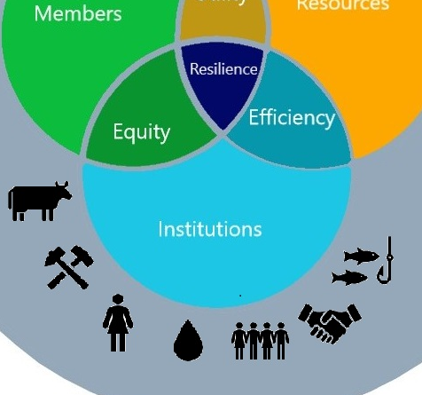
Equality or equity?
-Equality: EQUAL ACCESS to resources
Accessibility to governance regimes and redistributive mechanisms
Equal share to use/appropriation of the resource
access to resources is fair instead of conditioned by wealth, thus undermining feelings of unfairness
-Equity -> Fairness-FAIR USE of the resources:
equal OPPORTUNITIES within the organisation/common
-in participation: equity as a right to be part of the decision-making process of rules that potentially restrict individual appropriation level
-in resource benefits: -Rights are limited to what is needed within the household
BUT: Difficulty in commons: linking fairness to variable needs over time

Slide 20
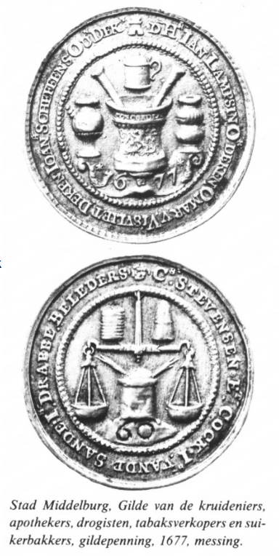
Rights come with responsibilities: Tools used to facilitate equity
Right to vote in meetings (linked to household), but also obligation to attend meetings
-> Understanding the rationale behind a decision is essential to ensure efficient resource use (no more than the resource can handle)
Election of representatives but also rotation of responsibilities (incl. the annoying ones)
Intensive social control and sanctions for malefactors but also liability of those who shirk responsibility

Slide 21
Is this applicable to universities?
Hierarchical build-up of careers -> prevents horizontal decision-making?
-> potential rupture as between guild masters and journeymen?
Knowledge: what kind of resource?
Who contributes to publications? E.g. no consensus on author order, development Citizen Science etc.
Who can harvest? Increasing attention for Open Access
Market mechanisms in a public body?

Slide 22
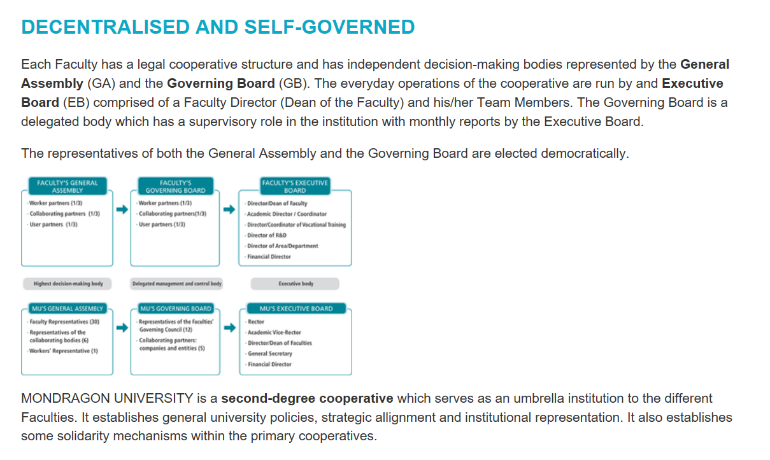
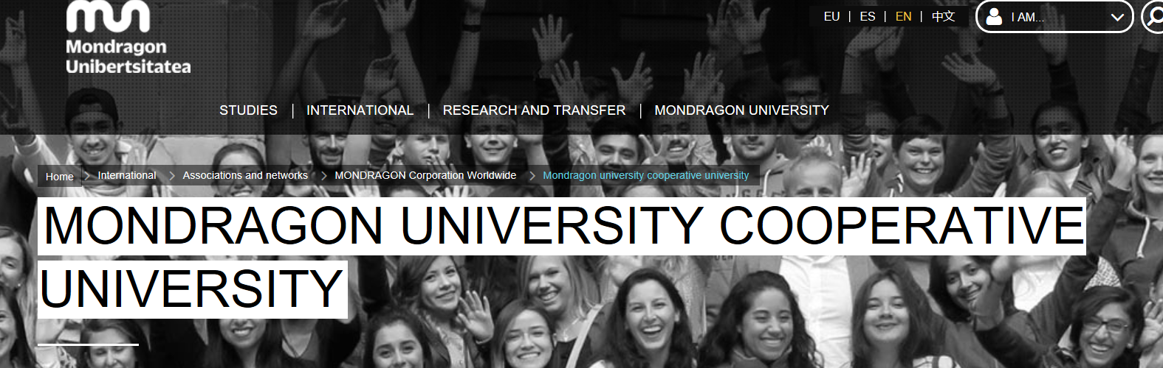
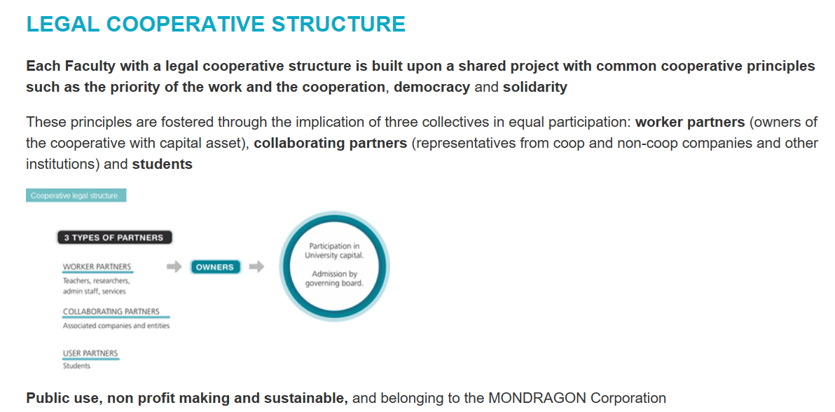
Is there no alternative?

Slide 23
