Slide 1
APPLIED DATA SCIENCE PORTFOLIO
Sanman Yadav
smyadav@syr.edu

Slide 2
Courses
IST 687 – Helped me get to know what is data science and how the data science project pipeline works.
IST 652 – Helped me understand how to scrape data from different websites to use for my analysis. Was an introduction to NoSQL. Helped me understand how to organize unstructured data for analysis.
IST 659 – Helped me make complex queries and I had to create a database form scratch and populate it and maintain it.
IST 718 – Gave me an hands on experience on big data technologies and went in deep when it came to statistical analysis and machine learning.

Slide 3
Courses (continued)
IST 719 – Helped me understand visuals and to tell a story from my visuals. This course helped me understand the importance of good visuals.
IST 722 – Developed a unified data warehouse. Did ROLAP, MOLAP and maintained a data warehouse.
IST 707 – Helped me solidify all the concepts that I learnt in IST 718. The project in this was the most well rounded because I got to use all the techniques that I learnt.
SCM 651 – This got me to think about a problem from a business perspective and present in the most concise manner.

Slide 4
Courses (continued)
MAR 653 – I understood many different techniques to find which factors that affect the market. Eg. PCA
MBC 638 – Learned statistical concepts and different ways to check for distribution of data. This course also taught me about hypothesis testing and confidence intervals.
CIS 700 – I got to learn about different neural networks and their applications. Since the course was based on reading research papers , I got to use research papers formulas to code in my assignments and labs.

Slide 5
Tools and Technologies
During the course of my masters I had a hands on number of tools. Some of them are: Python, R, SQL, NoSQL, PySpark, Hadoop, Docker, Weka, MS Access, MongoDB, PyMongo, Jira, Tableau, PowerBI, SAP, MSSQL, MS Visio
During the course of my masters I also had a chance to learn some machine learning algorithms. Some of them are: Linear Regression, Logistic Regression, Random Forest, Decision Tree, Gradient Boosting, XGBoost, SVM, PCA, Naïve Bayes, Convolutional/ Recurrent/ Wide Residual/ Echo State/ Hopfield Neural Networks.

Slide 6
Data Scorces
Kaggle: https://www.Kaggle.com
UCI Repository: https://archive.ics.uci.edu/ml/index.php
World Bank Open Data: https://data.worldbank.org/
WHO – Open Data Repository: https://www.who.int/gho/database/en/
US Census Bureau: https://www.census.gov/data.html

Slide 7
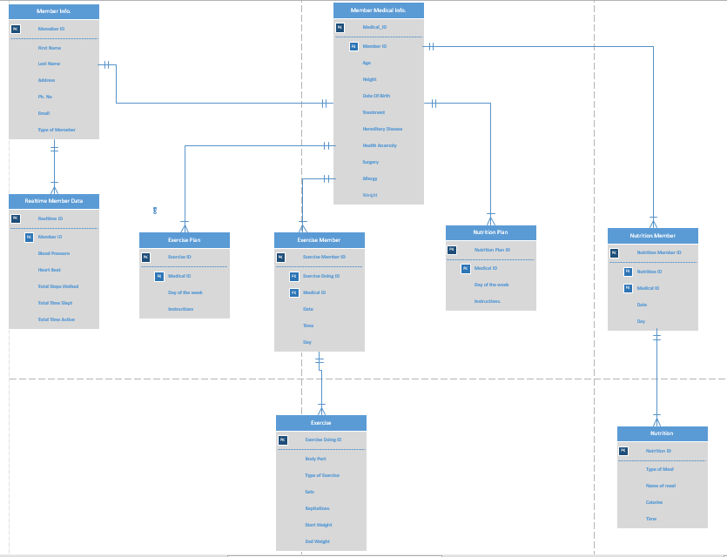
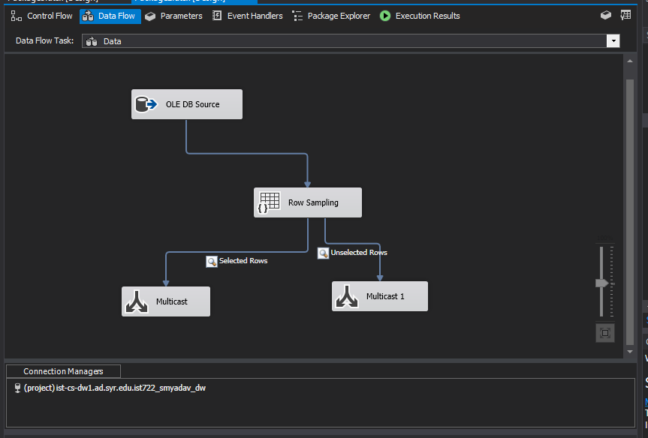
Organizing Data

Slide 8
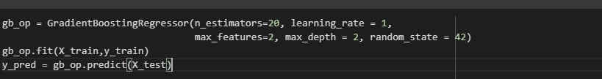
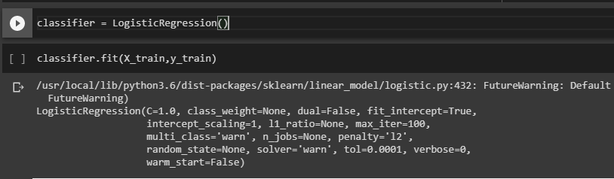
Building Models

Slide 9
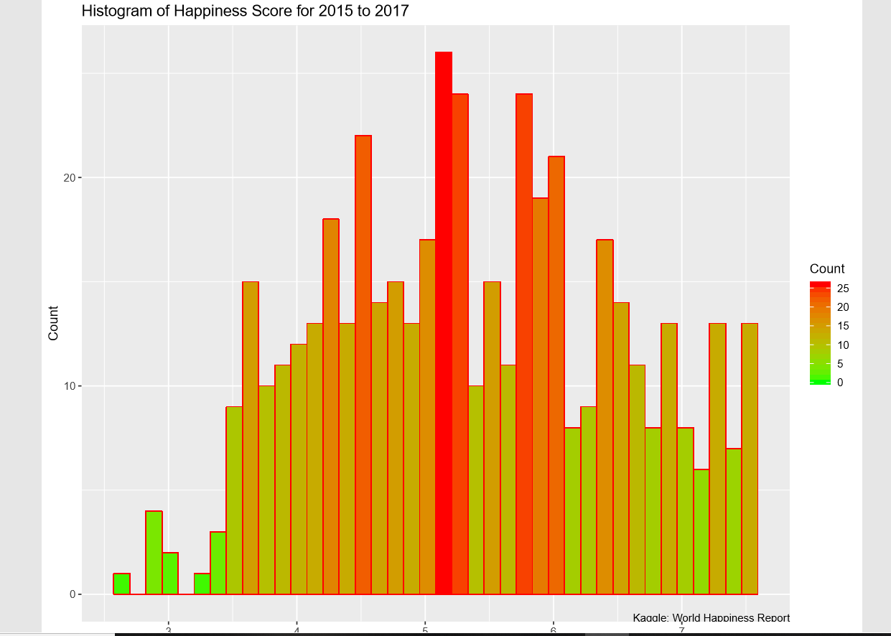
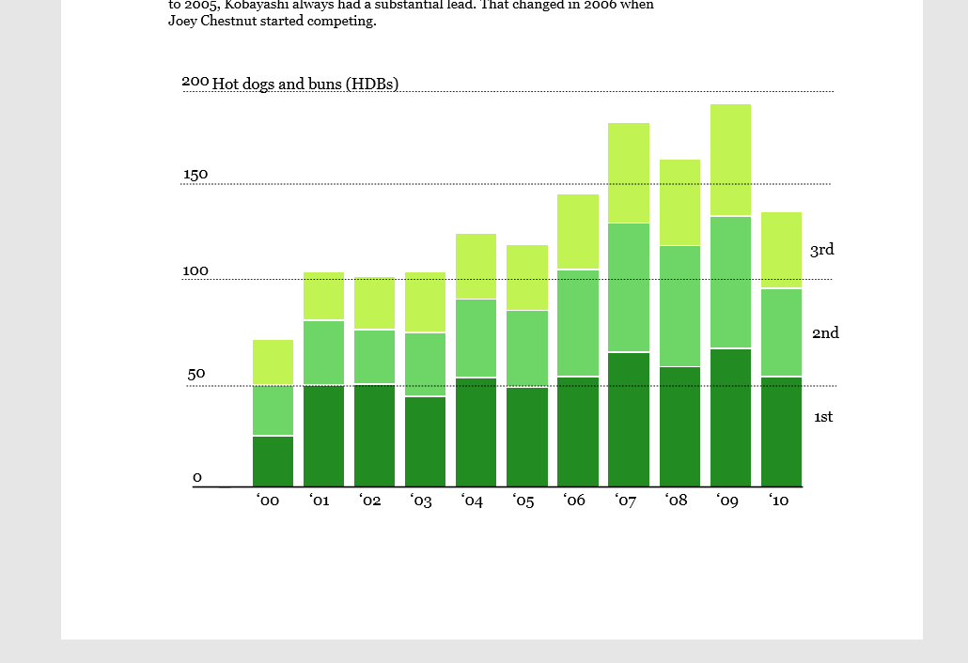
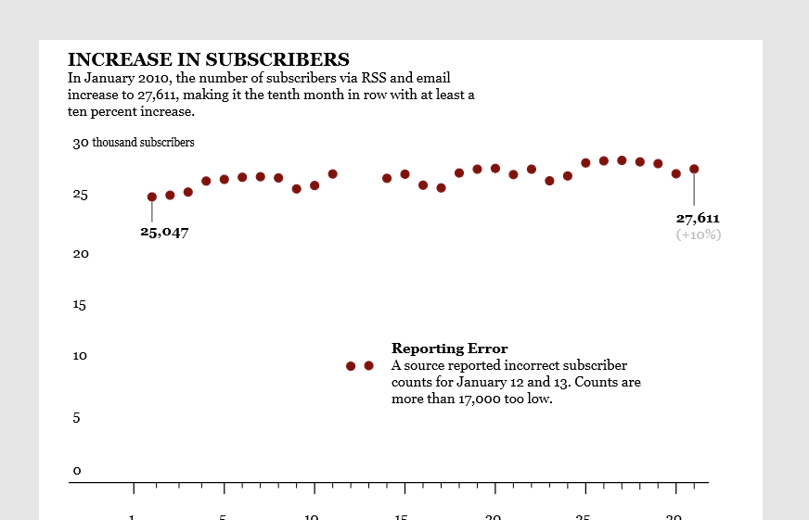
Analysis and Visualization

Slide 10
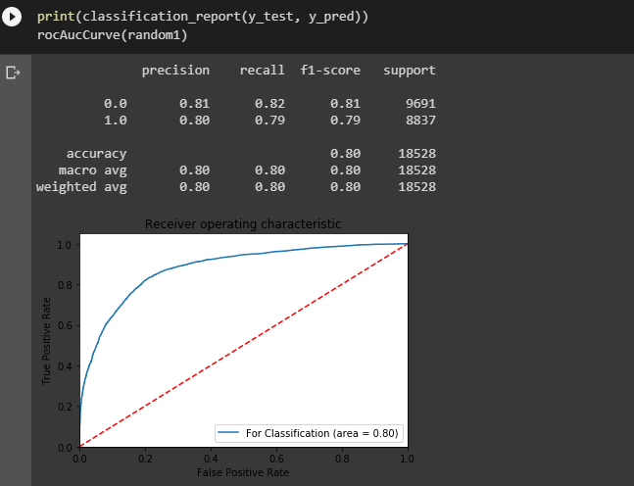
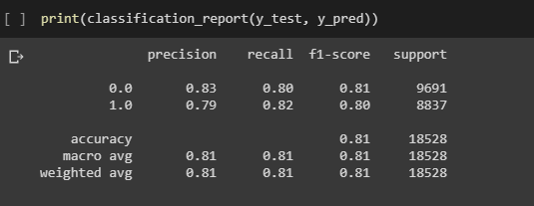
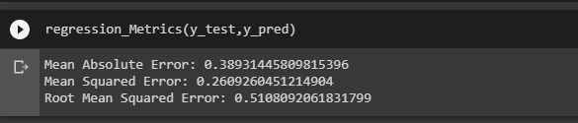
Model Accuracy and Recommendations

Slide 11
Next Steps In the Journey
Want to learn AWS and how is it used in big data analysis.
Will continue to learn about Neural Networks because in the future most of the machine learning algorithms will have at least some Neural Network component to it.
Learn more about data visualization tools like Tableau and Power BI.
Job and Internship.
I interned at Gartner Inc. this summer as Data Science Intern.
As of now I am giving interviews but haven’t received any job offers.

Slide 12
THANK YOU…..

