Slide 1
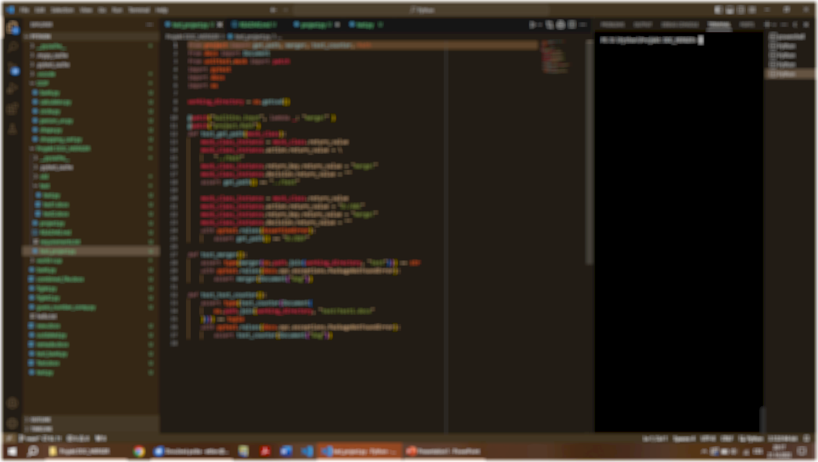
Docx.Merger
CS50‘s final project in Python
Vojtěch Ettler
Brno, Czech Republic

Slide 2
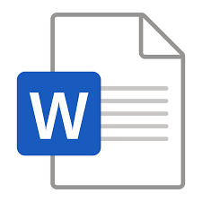
Functions
Lets users navigate to the folder of their chosing
Combines all the Word documents there while skipping any other files
Saves the result with datestamp and labels it as a merged item
Counts words, characters and standard pages of the output
+

Slide 3
Uses
For translators, authors, journalists, and other text specialists
For office workers and anyone working with a great number of docx. documents
For anyone in need of merging several Word documents into one while keeping the style and format of the first file…
merged_2023-10-21_test.docx

Slide 4
Thanks for watching!

