Slide 1
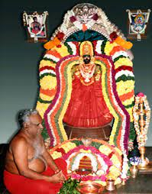

Om Sakthi
ADHIPARASAKTHI ENGINEERING COLLEGE,
MELMARUVATHUR
DEPARTMENT OF COMPUTER SCIENCE AND ENGINEERING
CS8811 PROJECT WORK
CUSTOMER REVIEW SENTIMENT ANALYSIS THROUGH
DEEP LEARNING
PROJECT GUIDE:
Ms. A.JAYANTHI AP/CSE
TEAM MEMBERS:
B.CHARUMATHI (420420104007)
S.SAKTHI UMA(420420104040)
S.SANMATHI(420420104042)
G.MADHUMITHA(420420104030)

Slide 2
INTRODUCTION
Social media is become a vital source of information in this age of digital communication and connectivity.
Determining the sentiment whether good, negative, or neutral by examining text, comments, and posts .
Sentiment analysis and an unprecedented amount of data have emerged with the introduction of social media.

Slide 3
OBJECTIVE
The objective of this project is to develop a robust sentiment analysis framework tailored specifically for Social media data.
We aim to accurately classify tweets into positive, negative, or neutral sentiments using state-of-the-art deep learning techniques.
Additionally, we seek to explore the impact of various factors such as hashtags, mentions, and user engagement on sentiment expression.

Slide 4
LITERATURE REVIEW
YEAR | AUTHOR | TITLE | METHOLOGY | ADVANTAGE& DISADVANTAGE
2023 | Ashima Kukkar | Improving Sentiment Analysis in Social Media by Handling Lengthened Words | NLP, NLTK, Python package, ML | Advantage: It is used in emotion Detection. Disadvantage: It is critical to correctly detect these words in order to provide complete coverage.
2023 | Ruth Olusegun | Text Mining and Emotion Classification on Monkey pox Twitter Dataset: A Deep Learning-Natural Language Processing (NLP) Approach | CNN, LSTM, BilSTM and NRCLEX . | Advantage: Better understanding of people’s emotions is provided. Disadvantage: Weekly and monthly evolution will not be considered.
Notes:
4

Slide 5
2022 | Huang Huang | Sentiment Analysis in E-Commerce Platforms A Review of Current Techniques and Future Directions. | CNN, RNN, LSTM, Transformer, BERT and Generative Pre-Trained (GPT) models. | Advantage: Emotional response Creativity. Disadvantage: It more suitable for the English language, and there is a limitation for other languages.
2022 | Melanie Schreiner | Impact of content characteristics and emotion on behavioral engagement in social media: literature review and research agenda | CNN, LSTM, Bil -STM and NRCLEX . | Advantages: multi-method designs and to create a more elaborate understanding . Disadvantages: Social media data is noisy & unstructured, emojis.

Slide 6
2022 | Shu-Feng Tsao | What social media told us in the time of COVID-19: a scoping review | Subset selection; forward selection; lasso regression; ridge regression; elastic net | Advantage: It is used in emotion Detection. Disadvantage: It is critical to correctly detect these words in order to provide complete coverage.
2021 | Shahid Mehmood | Sentiment Analysis in Social Media for Competitive Environment Using Content Analysis | API, RSS ,HTML | Advantage: Brand reputation can be effectively observed with the help of sentiment analysis Disadvantage: Weekly and monthly evolution will not be considered.

Slide 7
2022 | Binmahfoudh, A. Hussain, M. | Sentiment Analysis of Consumer Reviews Using Deep Learning | LSTM and DCNN models | Advantage: Assuring the effectiveness of classifier cross-validation is an excellent activity Disadvantage: Over-fitting and under-fitting of the models
2021 | Dimple Chehal | Evaluating Annotated Dataset of Customer Reviews For Aspect Based Sentiment Analysis | KNN , NB, SVM and LR | Advantage: Requirement of a labelled dataset to automate ABSA Disadvantage: The involvement of human efforts in obtaining such datasets, and the relatively low accuracy rates

Slide 8
2020 | ALHASSAN MABROUK | Deep Learning Based Sentiment Classification :A Comparative Survey | CNN, RNN and ReeNN | Advantage: It overcomes the high computational cost of NNs. Disadvantage: It requires more training time compared with other techniques.
2021 | Koyel Chakraborty | A Survey of Sentiment Analysis from Social Media Data | CNN, LSTM, Bil -STM and NRCLEX . | Advantage: It is used in emotion Detection. Disadvantage: It is critical to correctly detect these words in order to provide complete coverage.

Slide 9
TO ANALYSE:
The user-submitted text, comments, and other data in the customer review must be analyzed.
TO DO:
We must determine the sentiment analysis (or feedback emotion)of each individual data comment provided by the user using the data that has been analysed.
TO DESIGN:
In order to show the result, we must develop a web application.
PROBLEM STATEMENT

Slide 10
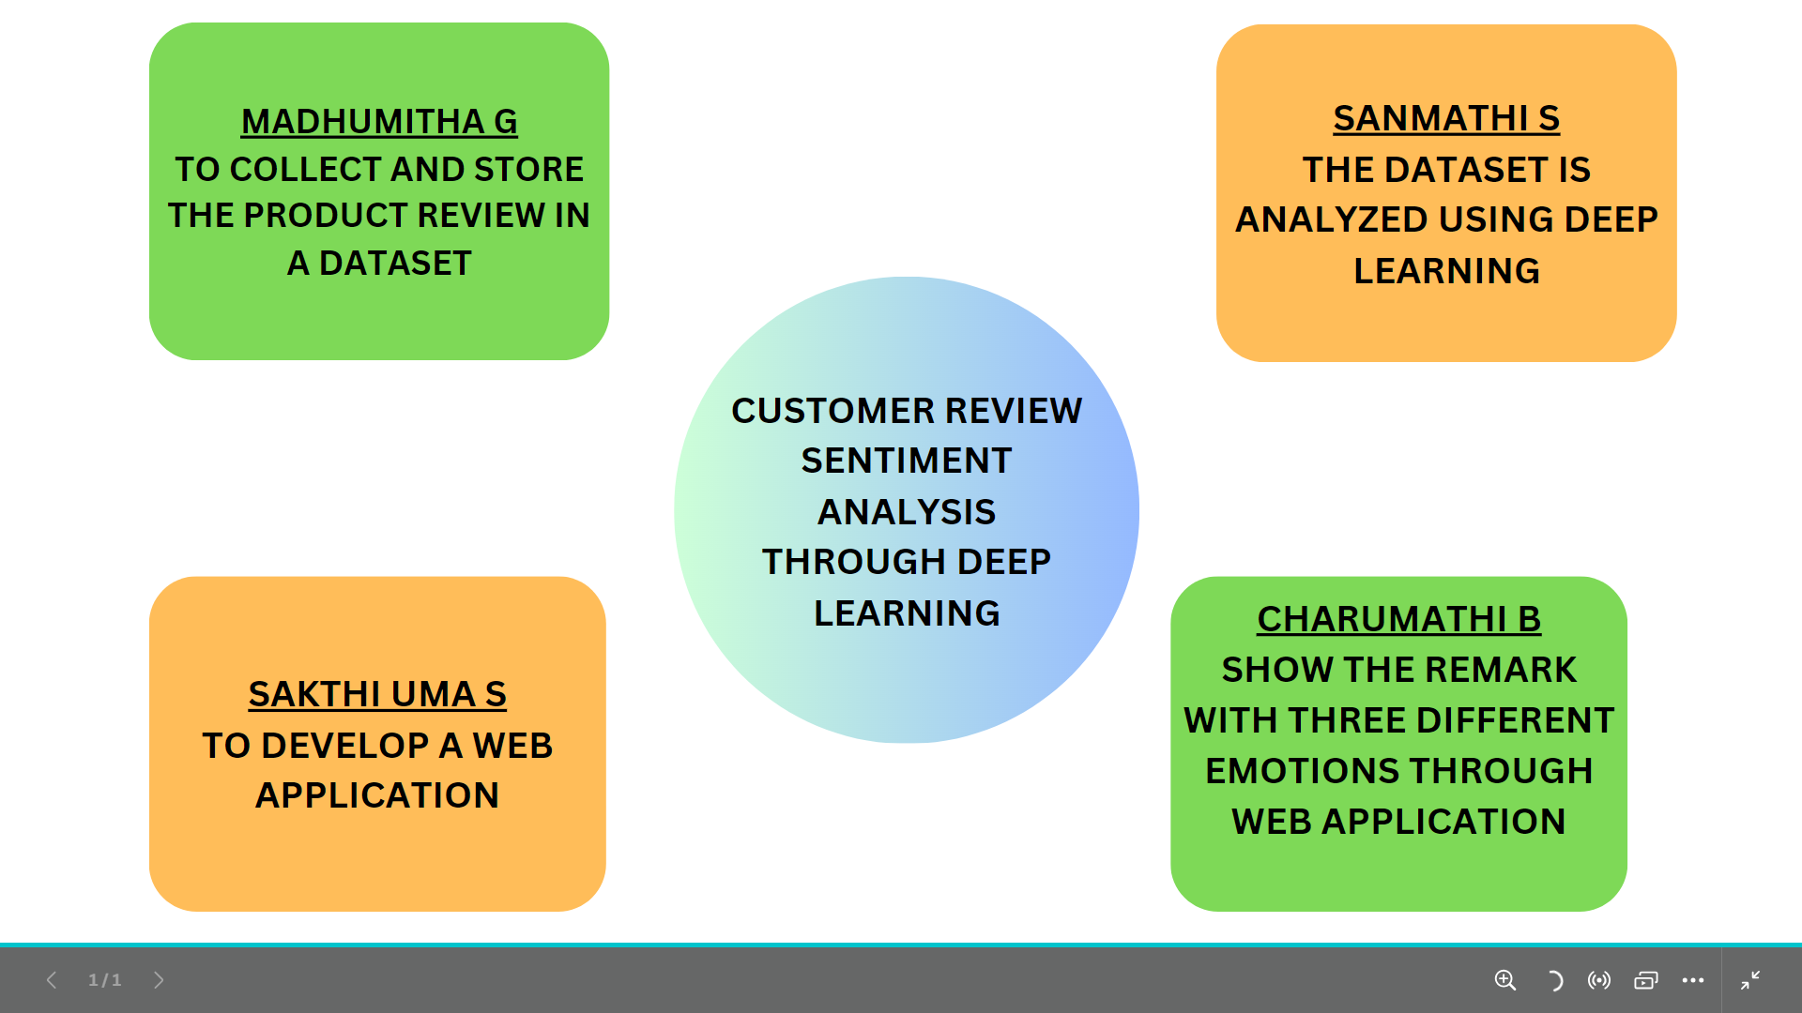
ORGANIZATIONAL CHART

Slide 11
ALGORITHM
BOOSTING ALGORITHMN
Boosting algorithms are a class of machine learning techniques.
Boosting algorithms can be highly effective in extracting sentiment information from text data
SUPERVISED LEARNING
An algorithm uses training data and feedback from humans to learn the relationship of given inputs to a given output.
● Classification task
● Regression task
LOGISTIC REGRESSION
Logistic regression is commonly used for binary classification tasks, where the goal is to classify data into one of two categories. In customer review sentiment analysis, these categories are typically "positive" and "negative."

Slide 12
NAIVE BAYES
The Bayesian method is a classification method that makes use of the Bayesian
theorem. The theorem updates the prior knowledge of an event with the independent
probability of each feature that can affect the event.
SVM
SVM can also be combined with other models to create ensemble methods, such as boosting or stacking, to improve sentiment analysis accuracy.
RANDOM FOREST
Random Forest is widely used for classification, making it suitable for customer review sentiment analysis, where the objective is to classify reviews into "positive" or "negative."
RNN
RNNare a type of neural network designed for processing sequences, which makes them well-suited for tasks involving time-series data, text, and other sequential information.
GRADIENT- BOOSTING TREES
It is a state-of-the-art classification/regression technique. It is focusing on the error
committed by the previous trees and tries to correct it.

Slide 13
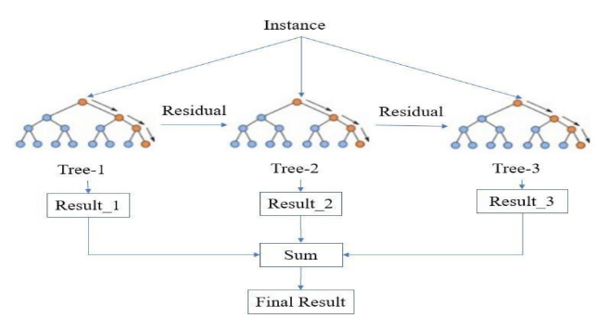

Slide 14
HARDWARE REGUIREMENTS
• OS : Windows 7,8 and 10 ( 32 and 64 bit)
• RAM : 4 GB

Slide 15
SOFTWARE REGUIREMENTS
• Anaconda Navigator
• Python language
• Jupiter notebook • Numpy
• Matplotlib
• Sklearn
• Seaborm
• Pandas

Slide 16
EXPECTED I/P AND O/P OF MODULES
MODULE1 (INPUT)
MODULE 4
(OUTPUT)
TO COLLECT AND STORE THE PRODUCT REVIEW IN A DATASET
SHOW THE REMARK WITH THREE DIFFERENT EMOTIONS THROUGH WEB APPLICATION
MODULE 2
MODULE 3
THE DATASET IS ANALYZED USING DEEP LEARNING
TO DEVELOP A WEB APPLICATION

Slide 17
MODULE 1 :
DATA PROCESSING
Data preprocessing is a crucial step in customer review sentiment analysis
through deep learning.
It involves cleaning, transforming, and preparing the raw text
data to make it suitable for input into a deep learning model.
MODULE 2 :
DATA INTEGRATION
Data integration in the context of customer review sentiment analysis involves
combining and merging data from multiple sources .
And to create a comprehensive dataset for training and testing deep learning models.

Slide 18
MODULE 3:
DATA CLEANING
Data cleaning is a crucial step in preparing customer review data for sentiment
analysis through deep learning.
It involves identifying and correcting errors,inconsistencies, and irrelevant information in the raw data.
MODULE 4 :
DATA TRANSFORMATION
Data transformation involves converting text data into numerical
representations that can be input into machine learning algorithms.

Slide 19
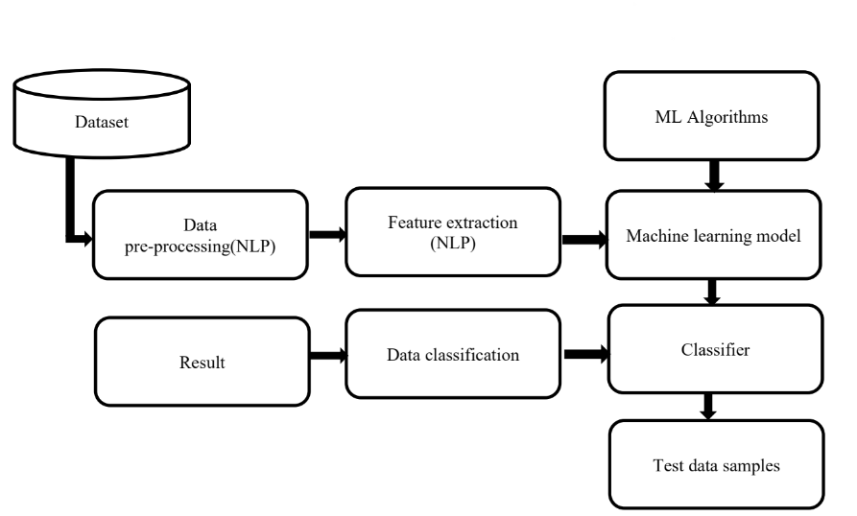
ARCHITECTURE DIAGRAM

Slide 20
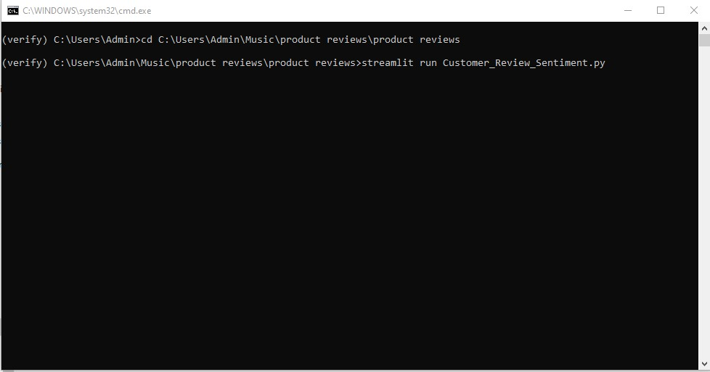
INPUT SCREENSHOT

Slide 21
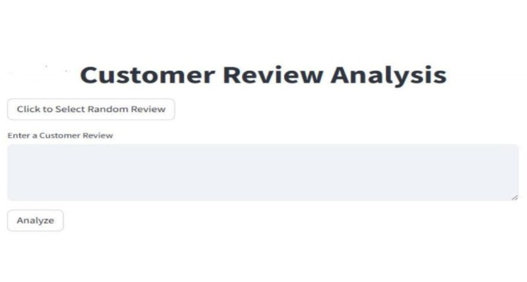
OUTPUT SCREENSHOT 1

Slide 22
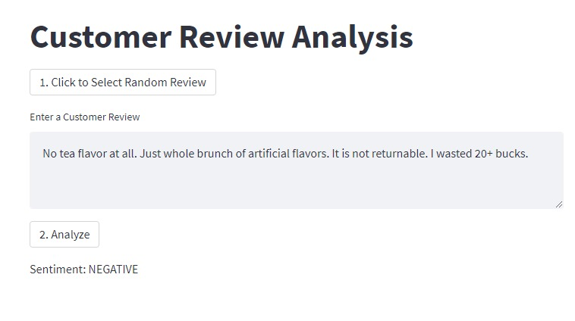
OUTPUT SCREENSHOT 2

Slide 23
TIMELINE CHART
MONTH 1 :
Research and Planning - (week 1)
Stakeholder Interviews and Requirements Gathering - (week 2)
Data Collection and Annotation - (week 3)
Model Selection and Development – (week 4)
MONTH 2:
Design -(week 1)
Prototype Development – (week 2)
Integration with Social Media Platforms – (week 3)
Testing and Validation – (week 4)
MONTH 3:
Full Deployment - (week 1)
Monitoring, Evaluation, and Updates -( week 2)

Slide 24
ADVANTAGES
• Adaptability to Deceptive Tactics
• Continuous Learning
• Enhanced Accuracy

Slide 25
FUTURE ENHANCEMENT
InfoBot 2.0 could expand with multilingual support, personalized recommendations, and social media integration. Voice recognition, real-time updates, virtual campus tours, and alumni network integration would enrich user experience. A feedback mechanism ensures continuous improvement, solidifying InfoBot 2.0 as a valuable college inquiry tool.

Slide 26
CONCLUSION
The proposed Customer Review Sentiment analysis Through Deep learning is a significant advancement in the field of sentiment analysis, offering enhanced accuracy through advanced NLP and dynamic adaptation.This system is designed to evaluate the compatibility of customer reviews with their corresponding ratings, which is essential for e-commerce platforms like Amazon.com.

Slide 27
REFERENCES
Ali Hakami, Nada, and Hanan A. Hosni Mahmoud. "Deep Learning Analysis for Reviews in Arabic E-Commerce Sites to Detect Consumer Behavior towards Sustainability." Sustainability 14, no. 19 (2022): 12860.
Qorich, Mohammed, and Rajae El Ouazzani. "Text sentiment classification of Amazon reviews using word embeddings and convolutional neural networks." The Journal of Supercomputing (2023): 1-26.
Wang, Mengsheng, Hailong You, Hongbin Ma, Xianhe Sun, and Zhiqiang Wang. "Sentiment Analysis of Online New Energy Vehicle Reviews." Applied Sciences 13, no. 14 (2023): 8176.
Ahmed, Zishan, Shakib Sadat Shanto, and Akinul Islam Jony. "Advancement in Bangla Sentiment Analysis: A Comparative Study of Transformer-Based and Transfer Learning Models for E-commerce Sentiment Classification." Journal of Information Systems Engineering & Business Intelligence 9, no. 2 (2023).

Slide 28
Samir, H. A., Abd-Elmegid, L., & Marie, M. (2023). Sentiment analysis model for Airline customers’ feedback using deep learning techniques. International Journal of Engineering Business Management, 15, 18479790231206019.

Slide 29
THANKYOU!!

