Slide 1
Output Screenshots
~Sanmati Nikam

Slide 2
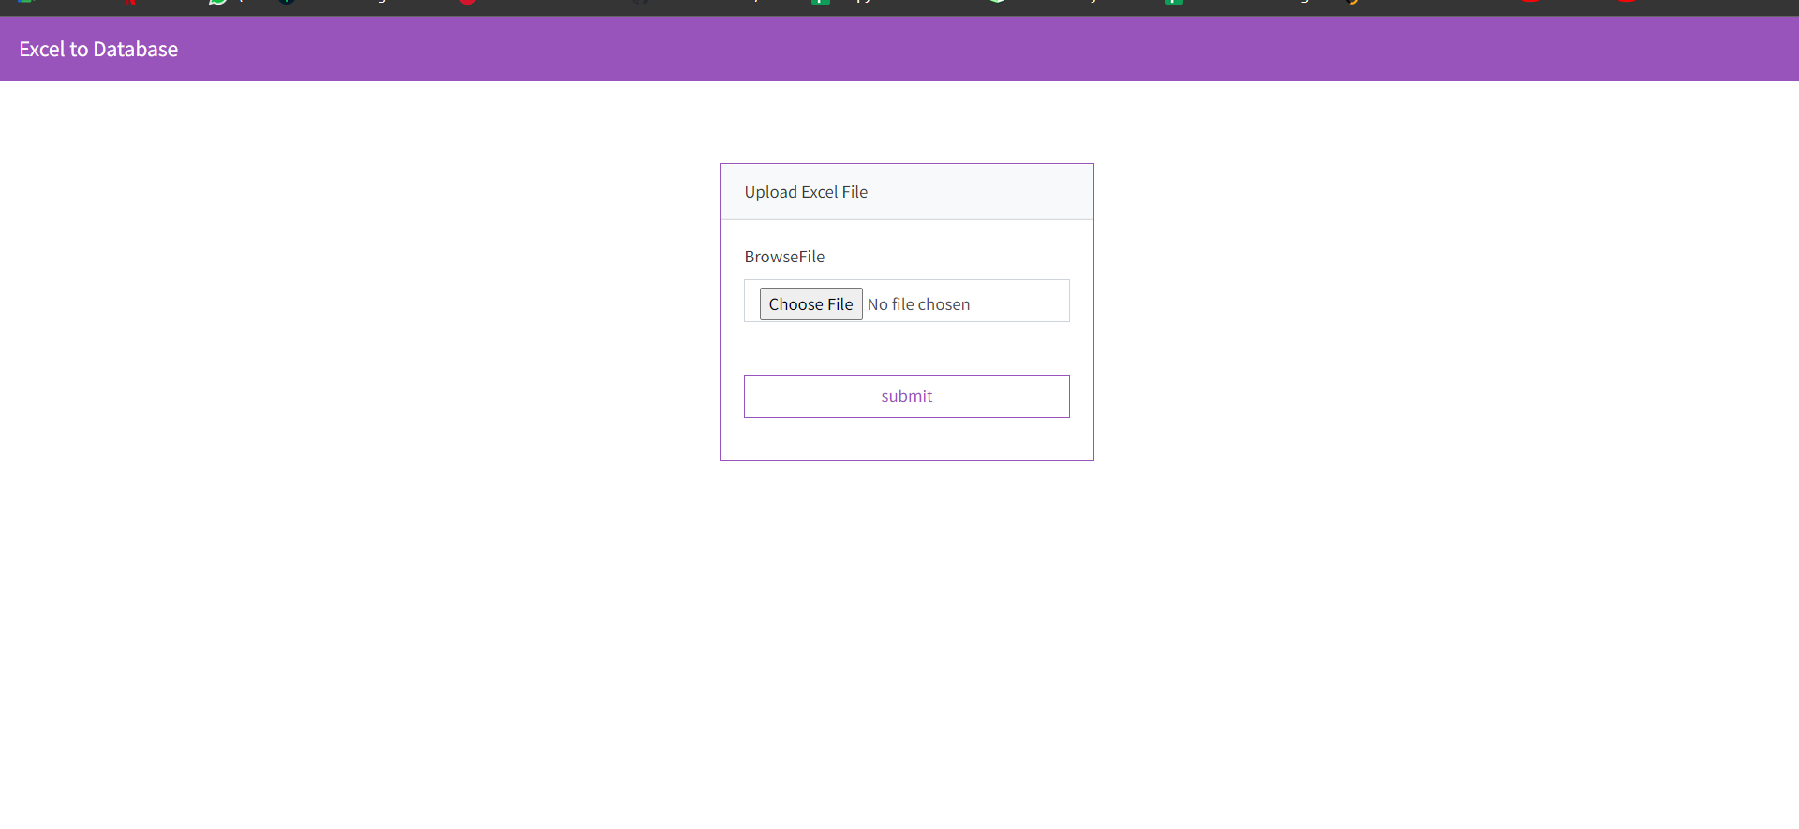
Landing Page

Slide 3
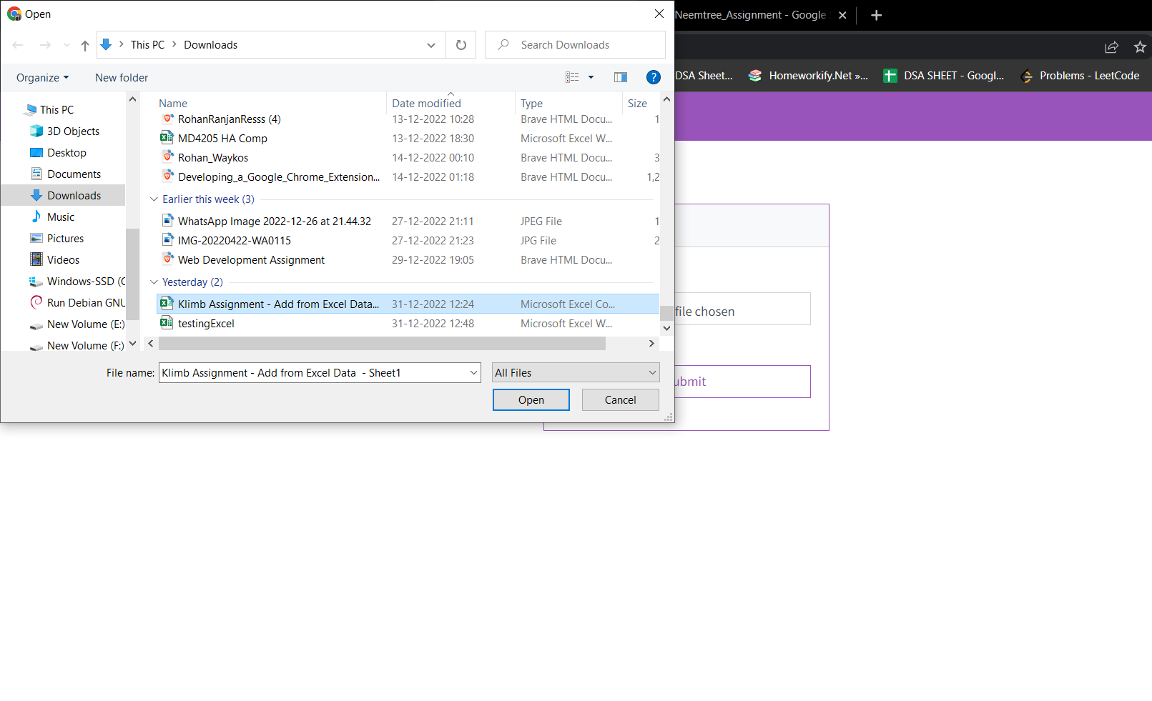
Browse Files

Slide 4
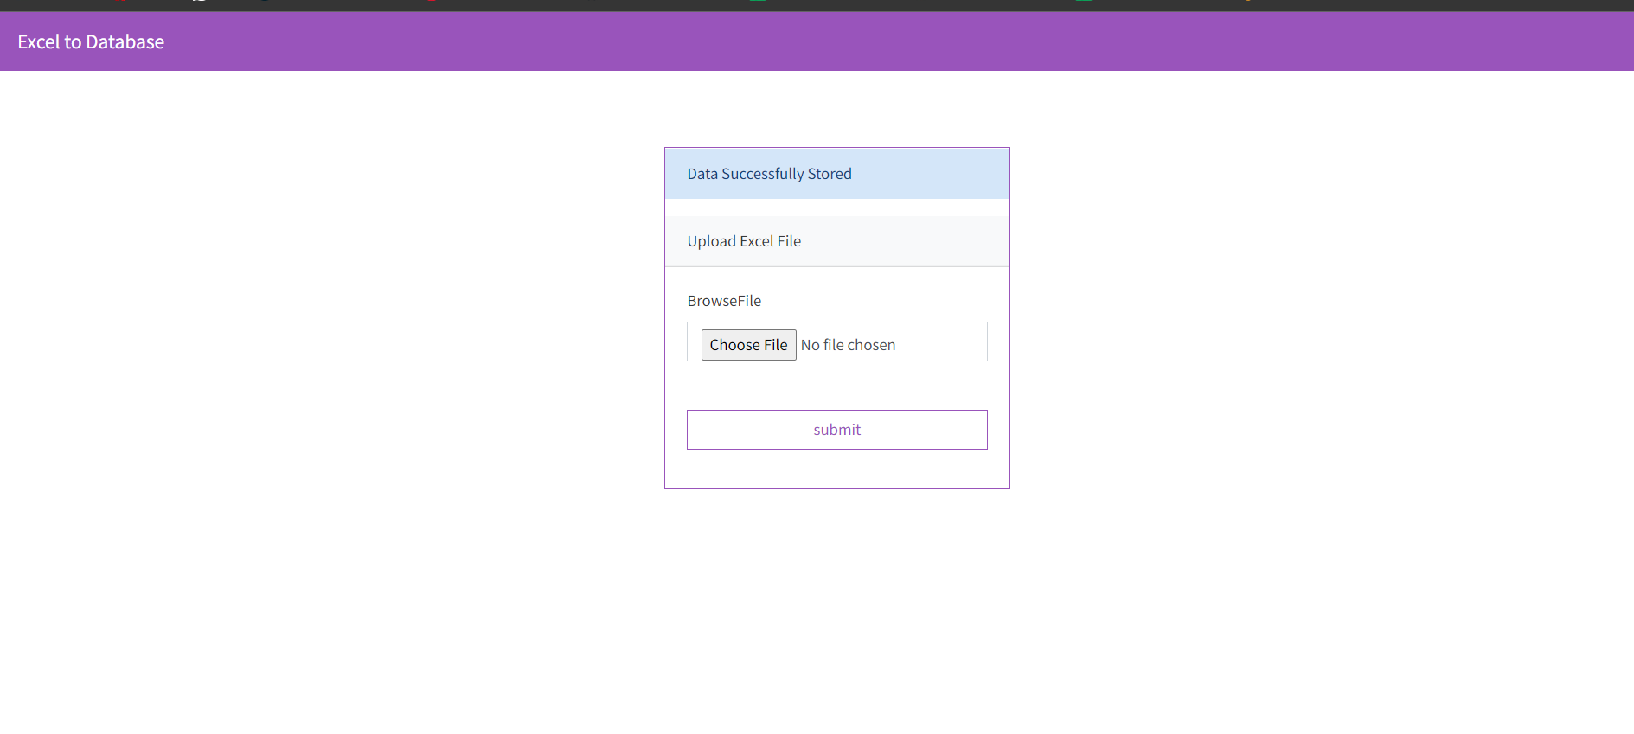
After choosing the excel file and clicking on submit:-

Slide 5
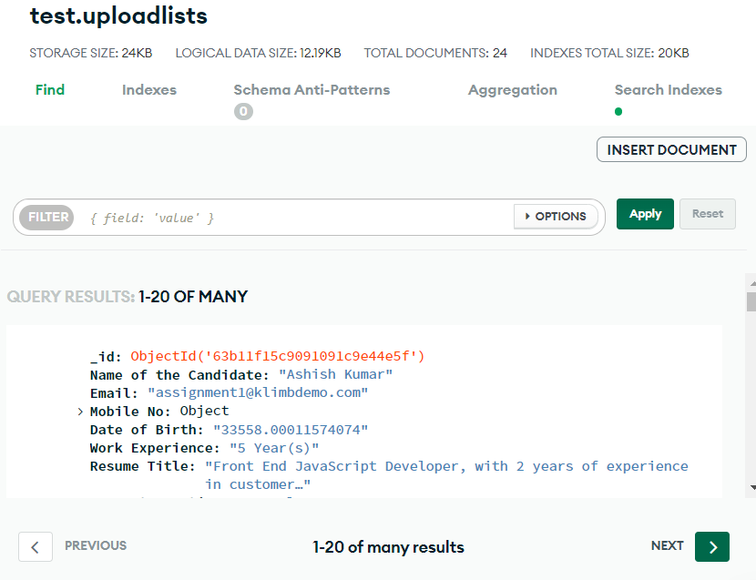
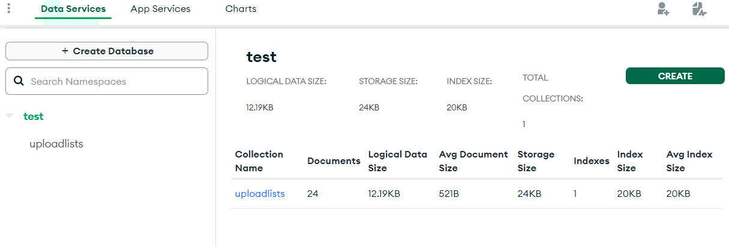
Database
As Email id should be unique each document that contains duplicate email is deleted from database and only unique records are stored.

Slide 6
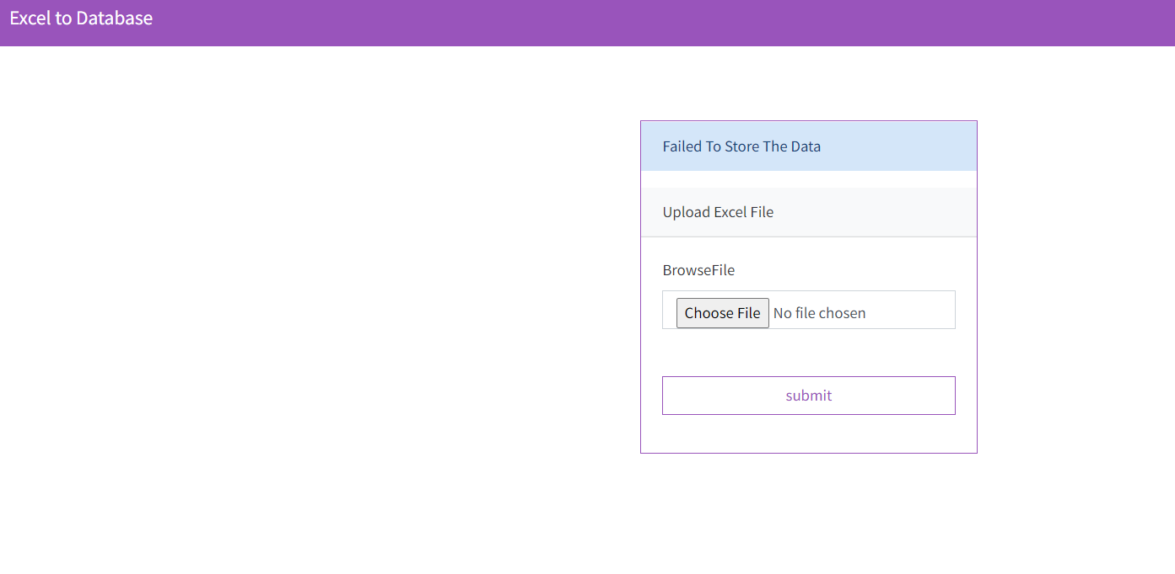
Error message if Excel data does not match with schema

