Slide 1
Motilal Nehru National Institute of Technology Allahabad
GAN-Based Medical Image Generation for Skin Disease Classification
Mini Project (CSN17351)
Submitted by
Mohd Shaad | 20233187
Mayukh Panja | 20233534
Sanmay Kumar Biswas | 20233253
Sahil Mukeshbhai Patel | 20233556
Faculty Mentor: Dr. Rajitha B. • Section C / Team C49

Slide 2
Project overview
A controlled experiment on class-conditioned image generation and downstream classification
Problem: labelled skin-disease image datasets can be limited and uneven across classes.
Approach: train a Conditional GAN to generate class-conditioned 64 × 64 RGB images.
Evaluation: compare a CNN trained on real images with the same CNN trained on real + generated images.
Research question: did the synthetic samples improve validation classification performance?
Section C · Team C49 | Mini Project (CSN17351)

Slide 3
Objectives
Prepare a nine-class skin-disease image dataset.
Train a CGAN using a 128-dimensional latent vector and a 9-dimensional one-hot class condition.
Generate 20 synthetic images per class (180 total).
Train and compare real-only and real-plus-synthetic CNN classifiers.
Interpret accuracy and macro F1 together, with explicit limitations.
Section C · Team C49 | Mini Project (CSN17351)

Slide 4
Dataset
Source: Kaggle — Skin Disease Classification Image Dataset (riyaelizashaju).
Subset used: Split_smol.
Working split: 697 training images and 181 validation images.
No independent test folder was available.
Nine classes: Actinic keratosis; Atopic Dermatitis; Benign keratosis; Dermatofibroma; Melanocytic nevus; Melanoma; Squamous cell carcinoma; Tinea Ringworm Candidiasis; Vascular lesion.
Section C · Team C49 | Mini Project (CSN17351)

Slide 5
Methodology: CGAN
Generator input: random latent noise (dimension 128) + one-hot class label (dimension 9).
Generator output: 64 × 64 RGB synthetic skin-disease image.
Discriminator: learns to distinguish real and generated samples while using class information.
Generation: 20 samples per class × 9 classes = 180 synthetic images.
Observed quality: generated samples were blurry and lacked fine visual detail.
Section C · Team C49 | Mini Project (CSN17351)

Slide 6
Methodology: downstream classifier
Compact CNN: three Conv2D blocks → Global Average Pooling → Dense → Dropout → 9-way softmax.
Model size: 102,089 parameters.
Both experimental conditions used the same classifier design and 10 training epochs.
Real-only condition: 697 real training images.
Augmented condition: 697 real + 180 synthetic = 877 training images.
Section C · Team C49 | Mini Project (CSN17351)

Slide 7
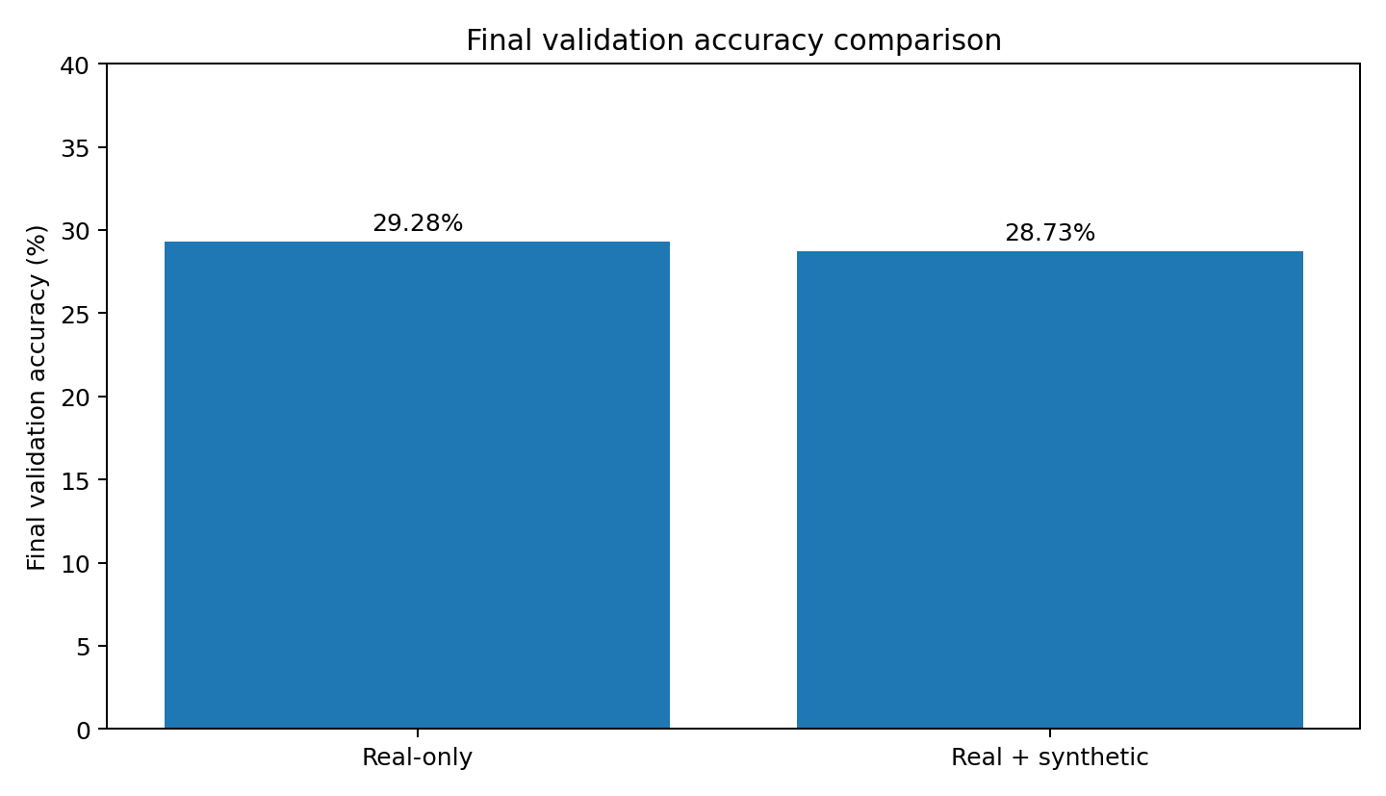
Experimental results
Metric | Real-only | Real + synthetic
Final validation accuracy | 29.28% | 28.73%
Macro F1-score | 0.2223 | 0.2315
Best validation accuracy | 32.60% (epoch 6) | 31.49% (epoch 7)
Final validation loss | 1.6967 | 1.7739
Section C · Team C49 | Mini Project (CSN17351)

Slide 8
What do the results tell us?
Final validation accuracy fell by 0.55 percentage points after synthetic augmentation (29.28% → 28.73%).
Macro F1 increased slightly (0.2223 → 0.2315).
Best validation accuracy during training was higher in the real-only run (32.60% vs 31.49%).
Conclusion: this experiment does not show an overall accuracy benefit from adding the generated images.
Section C · Team C49 | Mini Project (CSN17351)

Slide 9
Synthetic sample check and limitations
Baseline-classifier label agreement: 38/180 generated images = 21.11%. This is a weak proxy, not expert ground truth.
Small dataset and no independent test set.
Generated images were blurry and lacked fine detail.
Only one run per condition; no confidence intervals or significance testing.
Saved classifier models are final-epoch weights, not best-validation checkpoints.
Section C · Team C49 | Mini Project (CSN17351)

Slide 10
Conclusion and future work
Implemented a CGAN-based image-generation pipeline and two downstream CNN training conditions.
Real + synthetic data did not improve final validation accuracy; macro F1 improved only slightly.
Future work: higher-resolution generation, stronger quality checks, dermatologist review, larger dataset, independent test set, best-checkpoint saving, and repeated runs.
Academic prototype only — not clinically validated and not for diagnosis or treatment.
Section C · Team C49 | Mini Project (CSN17351)

Slide 11
Thank you
Questions & discussion
Thank you
Faculty Mentor: Dr. Rajitha B.
Section C · Team C49
Section C · Team C49 | Mini Project (CSN17351)

