Slide 1
Tree command Implementation

Slide 2
Used Data Structures :
Tree
Linked List

Slide 3
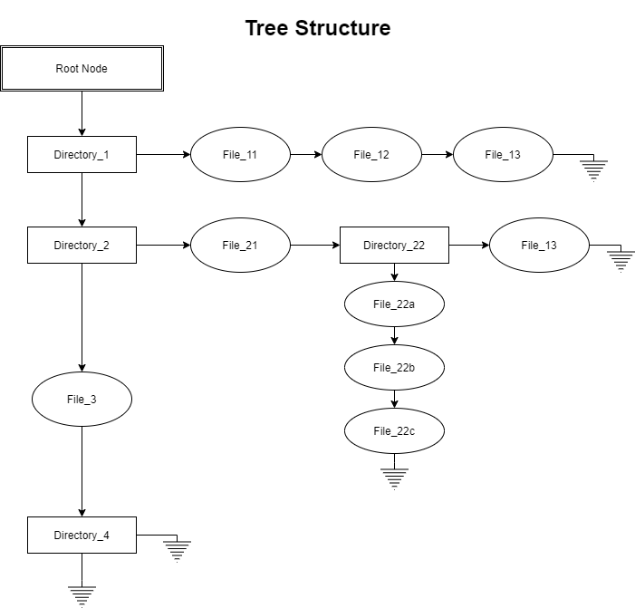

Slide 4
Project Flow
main.c
(According to Number of Command Line Arguments)
1
4
2
3
tree_arg1()
tree_arg2()
tree_arg3()
tree_arg4()
./run
./run -flag
./run –flag option1
./run –flag option1 option2
Create tree structure
and sort alphabetically
Print tree structure

Slide 5
Implemented flags
-a All files are listed(private files also).
-d List directories only.
-f Print the full path prefix for each file.
-L level Descend only level directories deep.
-P pattern List only those files that match the wild-card pattern given.
-I pattern Do not list files that match the given wild-card pattern.
--noreport Turn off file/directory count at end of tree listing.
-o filename Output to file instead of stdout.
-Q Quote filenames with double quotes.
-p Print the protections for each file.
-u Displays file owner name.
-s Print the size in bytes of each file.

Slide 6
Implemented flags
-h Print the size in a more human readable way.
-D Print the date of last modification.
--inodes Print inode number of each file.
-t Sort files by last modification time.
-r Reverse alphabetical order of files/directories.
-X Prints out an XML representation of the tree.
-X -o filename Output an XML representation of the tree to filename.
-J Prints out an JSON representation of the tree.
-J -o filename Output an JSON representation of the tree to filename.
-H -o filename Output an HTML format of the tree to filename.
--help Print usage and this help message and exit.

Slide 7
Struct ADT is
typedef struct node {
char *fname;
int isdir;
int isrootNode;
struct information {
unsigned long int fsize;
char* fpath;
char* fpermissions;
char* fuser_name;
struct last_modification {
short fdate; short fmon; short fyear; short fhour; short fmin; short fsec;
}last_mod;
long int inode;
}info;
struct node *next_ptr;
struct node *inner_ptr;
}node;

Slide 8
Some other features…
Different ANSI colours used for displaying directories, files, executable files.
Sorting algorithm used – Merge Sort
(Time complexity is O(nlogn) in best, average and worst case).
Concept of “make file” is used to compile and remove necessary files only.
Recursive functions for createTree and printTree.
File handling implemented.

