Slide 1
Keylogger and security
CAPSTONE PROJECT
Presented By:
1. Sanmitha V S - College of Engineering Guindy Anna University-Information Science and Technology

Slide 2
OUTLINE
Problem Statement
Proposed System/Solution
System Development Approach
Algorithm & Deployment
Result (Output Image)
Conclusion
Future Scope
References

Slide 3
Problem Statement
In the current digital landscape, characterized by widespread cybersecurity threats, the proliferation of keyloggers emerges as a major apprehension. These covert software tools are crafted to clandestinely monitor and log keystrokes on a user's computer, operating surreptitiously without their awareness. The grave concern lies in the fact that keyloggers have the capability to intercept sensitive information like passwords, credit card details, and various other personal data. This poses significant risks to both individuals and organizations, potentially resulting in identity theft, financial harm, and breaches of privacy.

Slide 4
Proposed Solution
Error Handling: Incorporate mechanisms for handling errors during file operations and keylogging processes.
Modularization: Organize the code into smaller, more cohesive functions to enhance manageability and readability.
File Writing Optimization: Enhance performance by keeping log files open for efficient writing.
JSON Usage: Rectify syntax errors in functions responsible for generating JSON files.
User Interface: Improve user experience by providing clearer messages and feedback within the interface.
GUI Improvements: Introduce additional features such as the ability to select log file locations within the graphical user interface.
Keylogging Features: Expand functionality by integrating options for filtering or customizing logging behavior.
Security: Prioritize ethical usage and include prominent privacy warnings to ensure user awareness.
Compatibility Testing: Conduct thorough testing across multiple operating systems to ensure compatibility and reliability.
Documentation: Enhance clarity by adding comprehensive comments and documentation throughout the codebase.

Slide 5
System Approach
Analysis:
Comprehend requirements thoroughly and assess the current codebase.
Identify potential weaknesses and opportunities for enhancement.
Design:
Establish precise goals to enhance security and usability.
Devise architectural adjustments to address vulnerabilities effectively.
Implementation:
Revise the code, streamline file operations for efficiency.
Testing:
Conduct comprehensive compatibility and functionality assessments.
Deployment:
Package the code and furnish straightforward instructions for deployment.
Maintenance:
Monitor user feedback, resolve issues promptly, and keep the code updated.

Slide 6
Algorithm & Deployment
Algorithm:
Initialization:
Initialize variables to store pressed keys, hold status, and key sequence.
Key Press Event:
Record pressed keys with "Pressed" label.
If key held, record with "Held" label.
Key Release Event:
Record pressed keys with "Pressed" label, if held, record with "Held" label, and generate JSON file..
Start Keylogger Function:
Initialize keyboard listener, update UI, and manage button states.
Stop Keylogger Function:
Stop keyboard listener, Update UI to indicate status.
Manage button states.
Deployment:
Packaging:
Bundle application and dependencies.
Include configuration files and documentation.
Distribution:
Distribute via website, repositories, or physical media.
Installation:
Provide clear installation instructions.
Ensure compatibility across platforms.
Configuration:
Allow user customization of settings.
Security Considerations:
Implement measures to protect against unauthorized access.

Slide 7
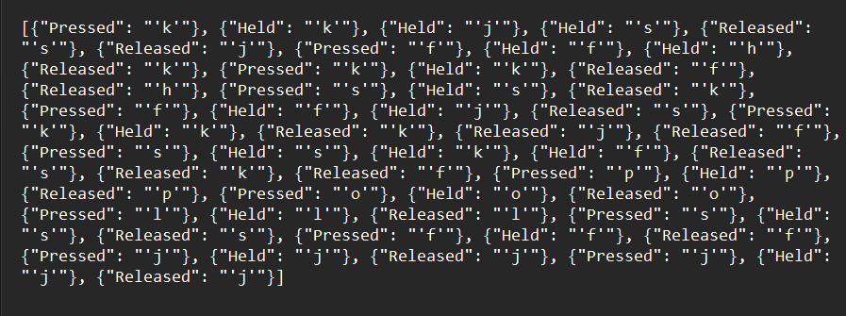

Result
Key_log.json
Key_log.txt

Slide 8
Conclusion
Double-edged Sword: Keyloggers offer potential benefits in cybersecurity (detecting suspicious activity) and parental control (monitoring online safety). However, their ability to capture sensitive information raises ethical concerns.
Evolving Landscape: The future of keyloggers is complex. Advancements in:
Malware: Sophisticated malware could bypass traditional detection, making keyloggers harder to remove.
Hardware: Integration into hardware like keyboards could make them virtually undetectable.
Cloud Storage: Cloud-based storage of keystrokes might create new privacy vulnerabilities.
Legal and Ethical Hurdles: Stricter privacy regulations and growing emphasis on user consent could significantly limit the use of keyloggers, especially in workplaces.
Future Focus: Striking a balance is crucial:
Ethical Use: Utilize keyloggers for legitimate purposes with clear user consent.
Robust Security: Implement strong security measures to protect captured data.
User Transparency: Be transparent about any monitoring practices involving keyloggers.
Public Awareness: As public awareness about keyloggers increases, ethical considerations and potential misuse will likely come under greater scrutiny. Regulations around keylogger use may also become more stringent.

Slide 9
Future scope
Increased Demand:
Potential for growth in cybersecurity and parental control.
Technological Advancements:
Malware developers may create more sophisticated keyloggers.
Keyloggers might be integrated into hardware for stealth.
Cloud-based logging could pose new privacy challenges.
Legal and Ethical Concerns:
Stricter privacy regulations may limit keylogger use.
Emphasis on transparency and user consent will rise.
Future Outlook:
Balance needed between utility and ethical user protection.
Public awareness about keyloggers is likely to increase.
Regulations around keylogger use may become stricter.

Slide 10
References
1. K. C. Yang, "An Improved Keylogging Detection and Prevention System," IEEE Xplore, 2017. [Online].
2. G. Kaspersky, "How to Protect Yourself Against Keyloggers," Kaspersky, 2021.
3. A. Carvey, "Forensic Analysis of Keystroke Dynamics," SANS Institute, 2005. [Online].
4. M. Deshmukh, "Detecting Keylogger Attacks Using Machine Learning Techniques," International Journal of Advanced Research in Computer Science, 2017.
5. C. Silver, "Keylogging and User Privacy," Association for Computing Machinery, 2013.

Slide 11
THANK YOU

