Slide 1
Supply Chain Visibility System with Optimization Analytics Group1
Infosys Springboard Virtual Internship 7.0
Project Presentation
Prepared By : Suryakant Upadhyay
Mentor: Nityasree

Slide 2
Project Objective
To enhance end-to-end visibility across the supply chain through effective use of data analytics.
To identify operational challenges and bottlenecks impacting inventory flow and order fulfillment.
To improve logistics efficiency, inventory management, and overall delivery performance.
To enable data-driven business decisions using interactive dashboards and analytical reports.
Project Modules
Data Collection & Understanding
Data Preprocessing
Data Modeling & KPI Analysis
Power BI Visualization
Insights & Reporting
PAGE 02

Slide 3
Project Execution Milestones
Milestone 1 – Data Acquisition & Cleaning
Collected and understood the supply chain dataset.
Cleaned and prepared the data for analysis.
Milestone 2 – Data Modeling
Analyzed supply chain metrics and developed key performance indicators.
Milestone 3 – Development
Created interactive Power BI dashboards to visualize supply chain performance.
Milestone 4 – Review & Optimization
Reviewed dashboard insights and refined visualizations for better understanding and reporting.

Slide 4
Challenges and Resolution
Challenges
Managing missing, duplicate, and inconsistent data to ensure data quality.
Analyzing the relationships and dependencies among various supply chain attributes.
Simplifying complex supply chain data for clear and easy understanding.
Effectively tracking and evaluating multiple supply chain KPIs.
Resolutions
Performed data cleaning, validation, and preprocessing.
Explored the dataset and analyzed relevant KPIs.
Used interactive Power BI visualizations, filters, and KPI cards.
Selected relevant KPIs and organized them into clear dashboard visualizations for easier analysis.

Slide 5
Future Enhancements & Key Insights
Future Enhancements
Implement IoT-enabled real-time tracking to monitor shipments efficiently.
Utilize Machine Learning techniques for accurate demand forecasting.
Build predictive models to identify potential delivery delays in advance.
Automate supply chain notifications, alerts, and actionable recommendations.
Key Insights
Improved visibility of transportation and delivery performance.
Better monitoring of inventory and supplier performance.
Identified operational bottlenecks to support better decision-making.

Slide 6
Conclusion
The Supply Chain Visibility & Optimization project successfully transformed supply chain data into meaningful insights through data analytics and interactive Power BI dashboards.
Technical Skills
Power BI & Data Visualization
Power Query & DAX
Data Cleaning & KPI Analysis
Soft Skills
Problem Solving
Communication
Teamwork
Presentation

Slide 7
Acknowledgements & References
Acknowledgements
Infosys Springboard Virtual Internship 7.0
Project Mentor : Nityashree
Team Members
References
Kaggle – Supply Chain Dataset
Microsoft Power BI
Infosys Springboard Learning Materials
Project Dataset, Dashboard & Internship Documentation

Slide 8
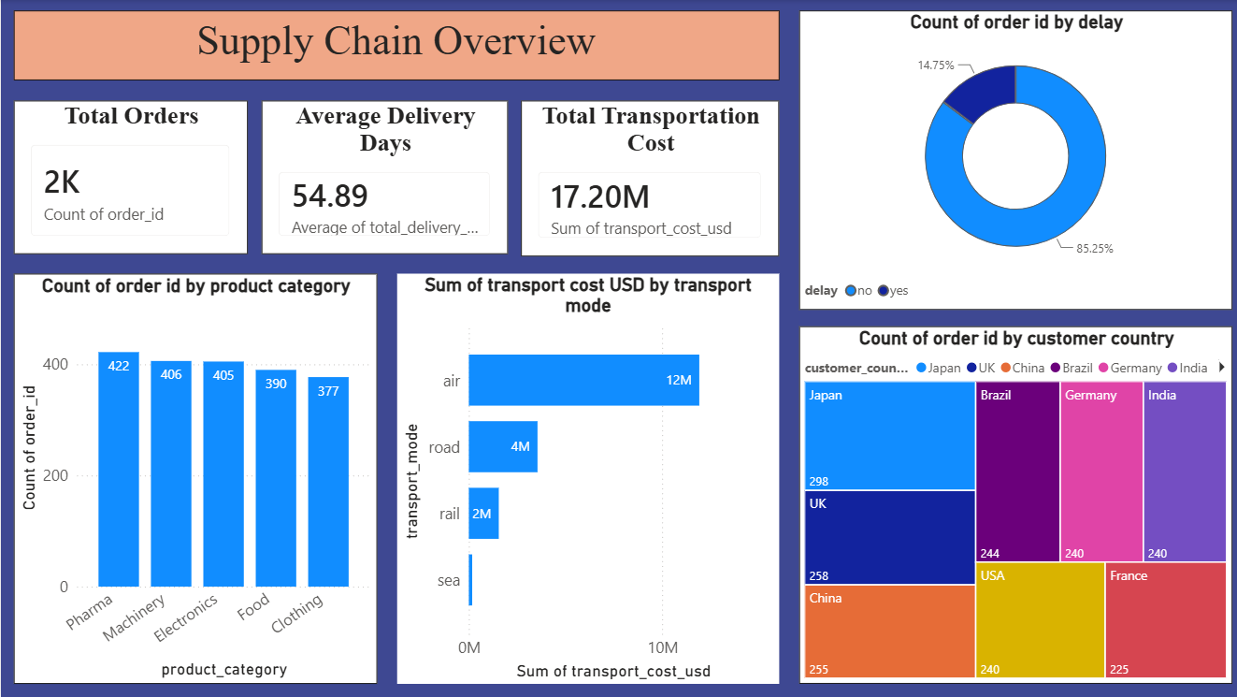
6.1 DASHBOARD 1 – SUPPLY CHAIN OVERVIEW

Slide 9
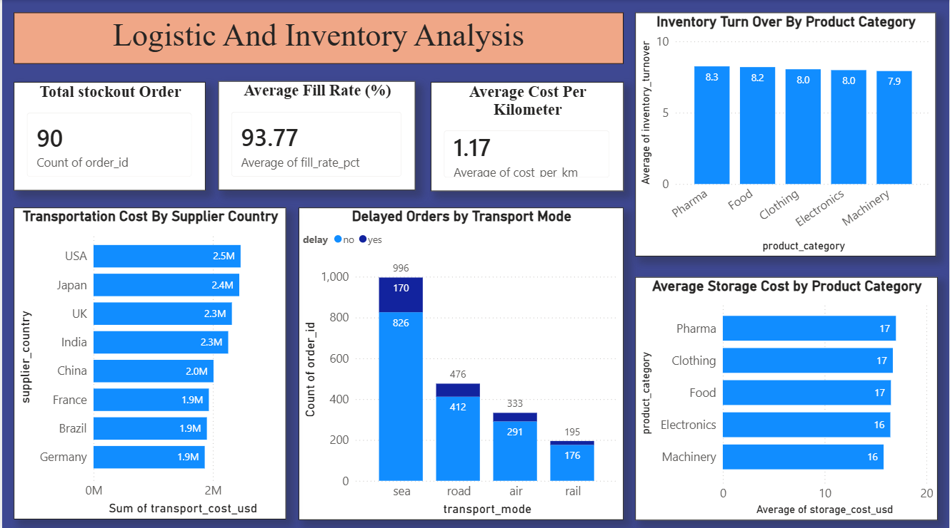
6.2 DASHBOARD 2- LOGISTIC AND INVENTORY ANALYSIS

Slide 10
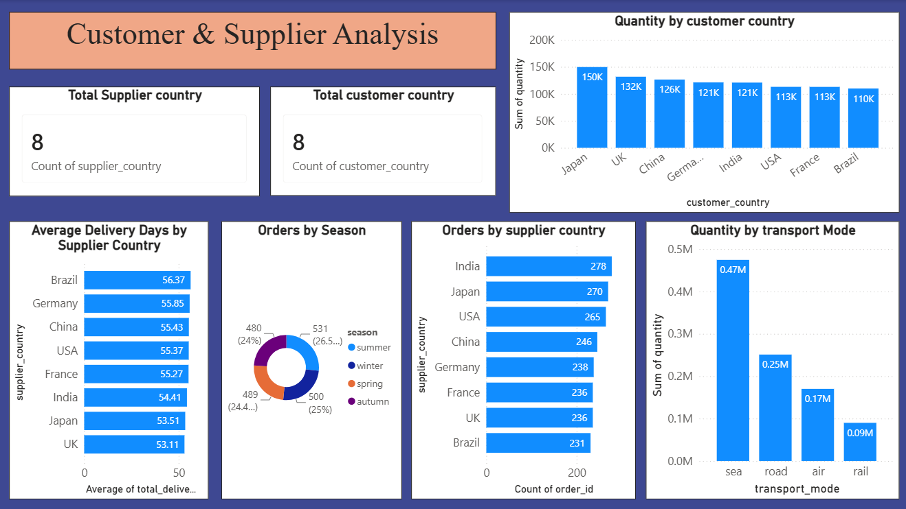
6.3 DASHBOARD 3- CUSTOMER & SUPPLIER ANALYSIS

Slide 11
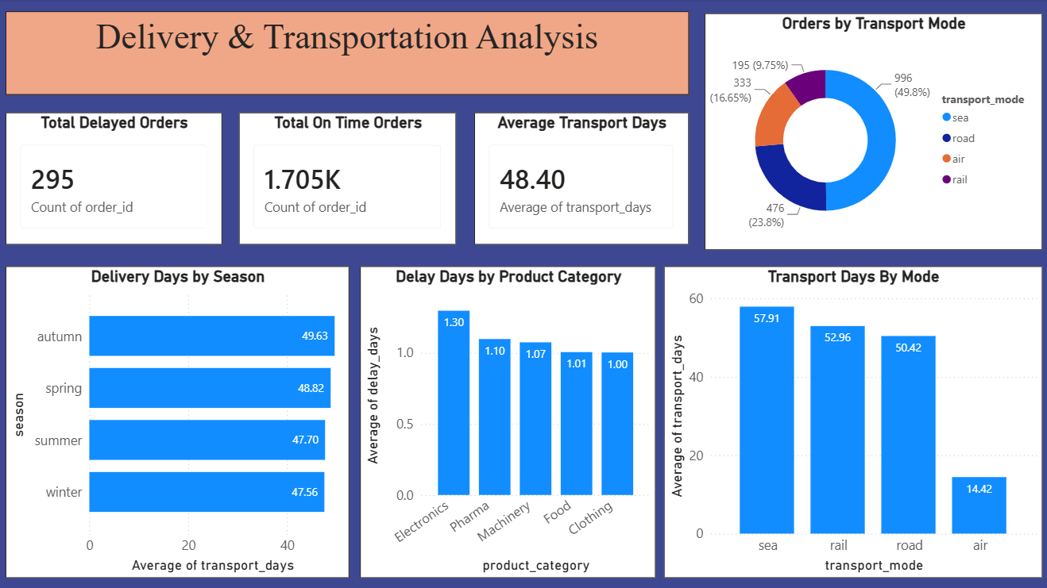
6.4 - DASHBOARD 4 – DELIVERY AND TRANSPORTATION ANALYSIS

Slide 12
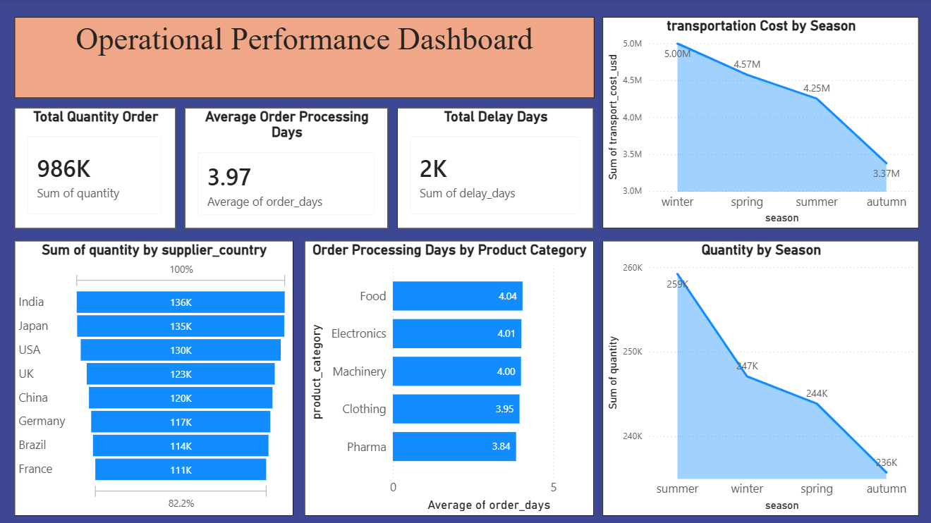
6.5 -DASHBOARD 5 – OPERATIONAL PERFORMANCE DASHBOARD

Slide 13
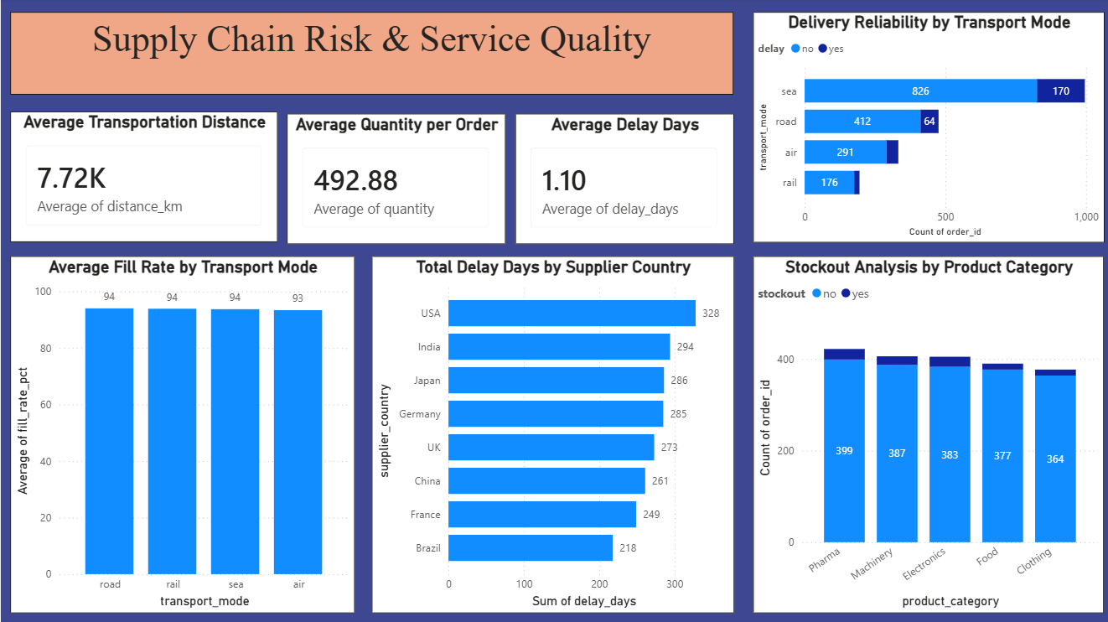
6.6-DASHBOARD 6 – SUPPLY CHAIN RISK & SERVICE QUALITY

Slide 14
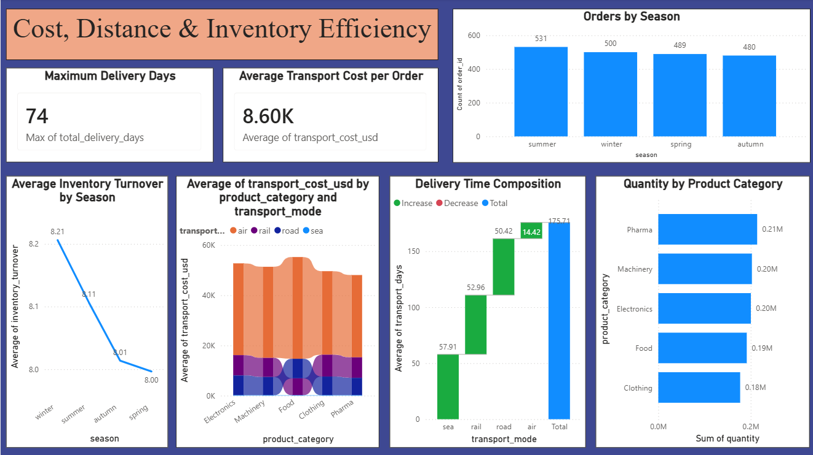
6.7-DASHBOARD 7 – COST DISTANCE & INVENTORY EFFICIENCY

Slide 15
Thank You

