Slide 1
Supply Chain Visibility System with Optimization Analytics Group1
Infosys Springboard Virtual Internship 7.0
Project Presentation
Prepared By : Sanmitha
Mentor: Nityashree

Slide 2
Project Objective
To improve end-to-end visibility across the supply chain using data analytics.
To identify operational bottlenecks affecting inventory movement and order fulfillment.
To optimize logistics, inventory management, and delivery performance.
To support data-driven decision-making through interactive dashboards and reports.
Project Modules
Data Collection & Understanding
Data Preprocessing
Data Modeling & KPI Analysis
Power BI Visualization
Insights & Reporting
PAGE 02

Slide 3
Project Execution Milestones
Milestone 1 – Data Acquisition & Cleaning
Collected and understood the supply chain dataset.
Cleaned and prepared the data for analysis.
Milestone 2 – Data Modeling
Analyzed supply chain metrics and developed key performance indicators.
Milestone 3 – Development
Created interactive Power BI dashboards to visualize supply chain performance.
Milestone 4 – Review & Optimization
Reviewed dashboard insights and refined visualizations for better understanding and reporting.

Slide 4
Challenges and Resolution
Challenges
Handling missing, duplicate, and inconsistent data.
Understanding relationships between different supply chain attributes.
Presenting complex supply chain information in a simple format.
Managing and analyzing multiple supply chain KPIs effectively.
Resolutions
Performed data cleaning, validation, and preprocessing.
Explored the dataset and analyzed relevant KPIs.
Used interactive Power BI visualizations, filters, and KPI cards.
Selected relevant KPIs and organized them into clear dashboard visualizations for easier analysis.

Slide 5
Future Enhancements & Key Insights
Future Enhancements
Integrate IoT-based real-time shipment tracking.
Apply Machine Learning for demand forecasting.
Develop predictive delivery delay analysis.
Automate supply chain alerts and recommendations.
Key Insights
Improved visibility of transportation and delivery performance.
Better monitoring of inventory and supplier performance.
Identified operational bottlenecks to support better decision-making.

Slide 6
Conclusion
The Supply Chain Visibility & Optimization project successfully transformed supply chain data into meaningful insights through data analytics and interactive Power BI dashboards.
Technical Skills
Power BI & Data Visualization
Power Query & DAX
Data Cleaning & KPI Analysis
Soft Skills
Problem Solving
Communication
Teamwork
Presentation

Slide 7
Acknowledgements & References
Acknowledgements
Infosys Springboard Virtual Internship 7.0
Project Mentor : Nityashree
Team Members
References
Kaggle – Supply Chain Dataset
Microsoft Power BI
Infosys Springboard Learning Materials
Project Dataset, Dashboard & Internship Documentation

Slide 8
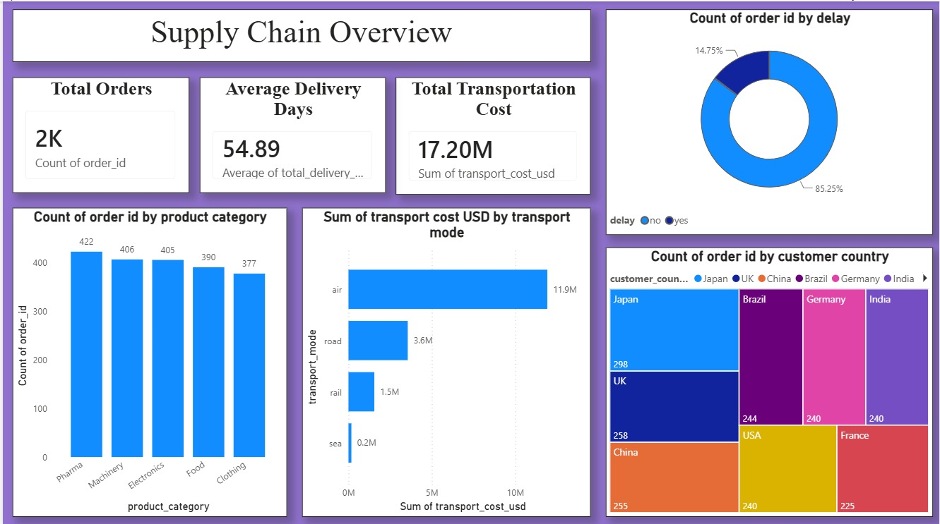
6.1 DASHBOARD 1 – SUPPLY CHAIN OVERVIEW

Slide 9
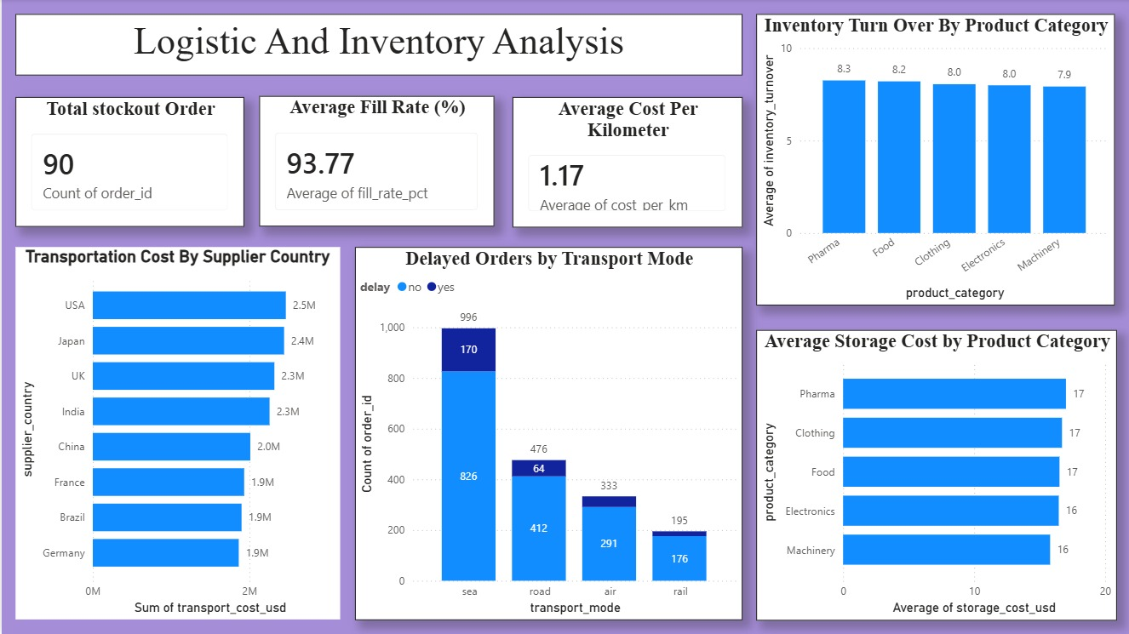
6.2 DASHBOARD 2- LOGISTIC AND INVENTORY ANALYSIS

Slide 10
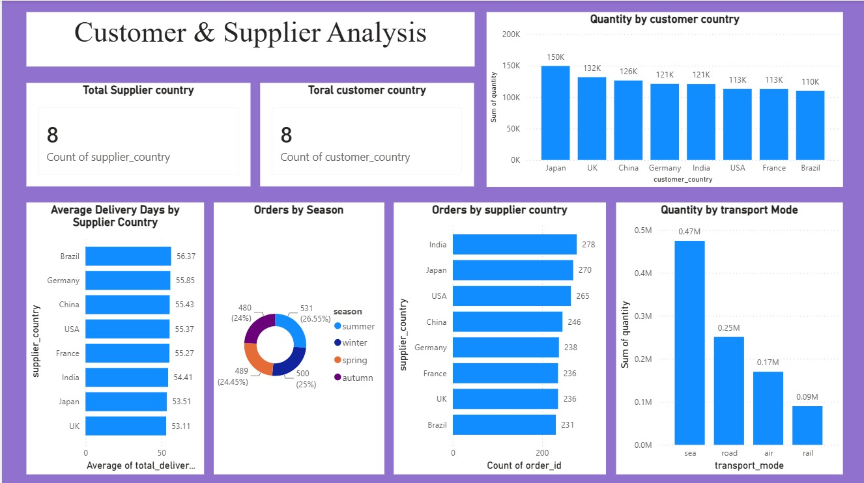
6.3 DASHBOARD 3- CUSTOMER & SUPPLIER ANALYSIS

Slide 11
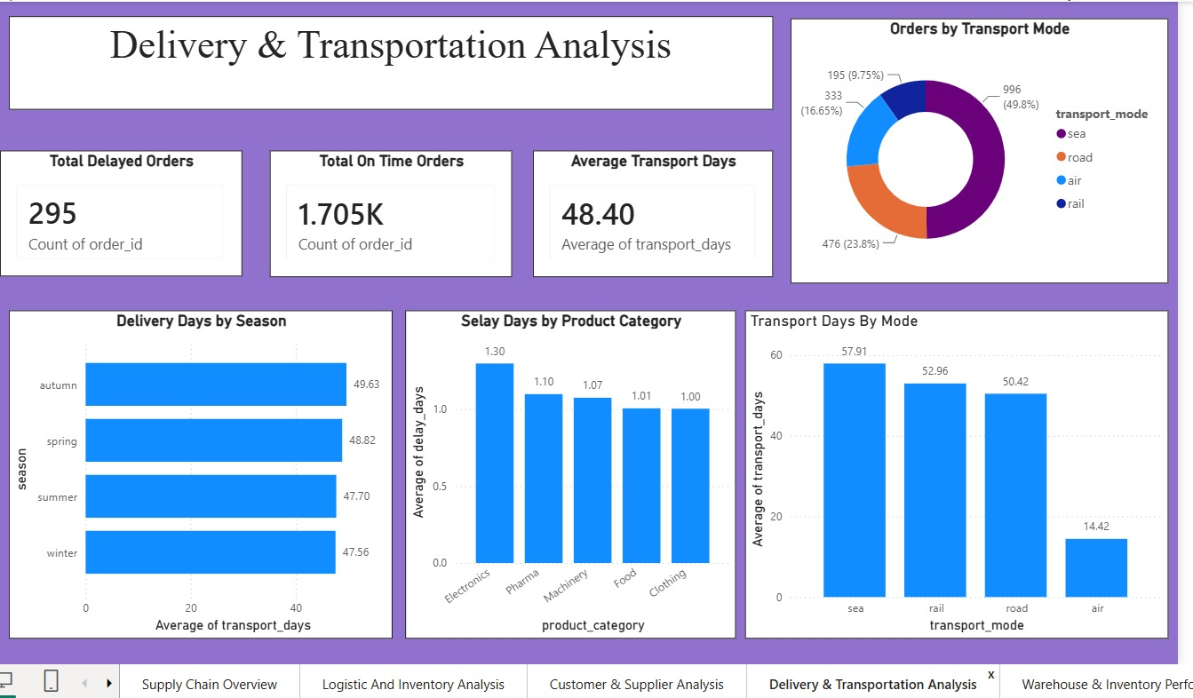
6.4 - DASHBOARD 4 – DELIVERY AND TRANSPORTATION ANALYSIS

Slide 12
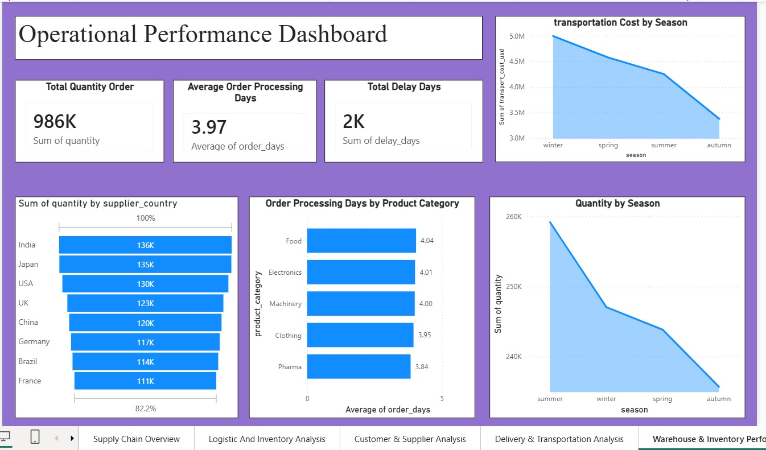
6.5 -DASHBOARD 5 – OPERATIONAL PERFORMANCE DASHBOARD

Slide 13
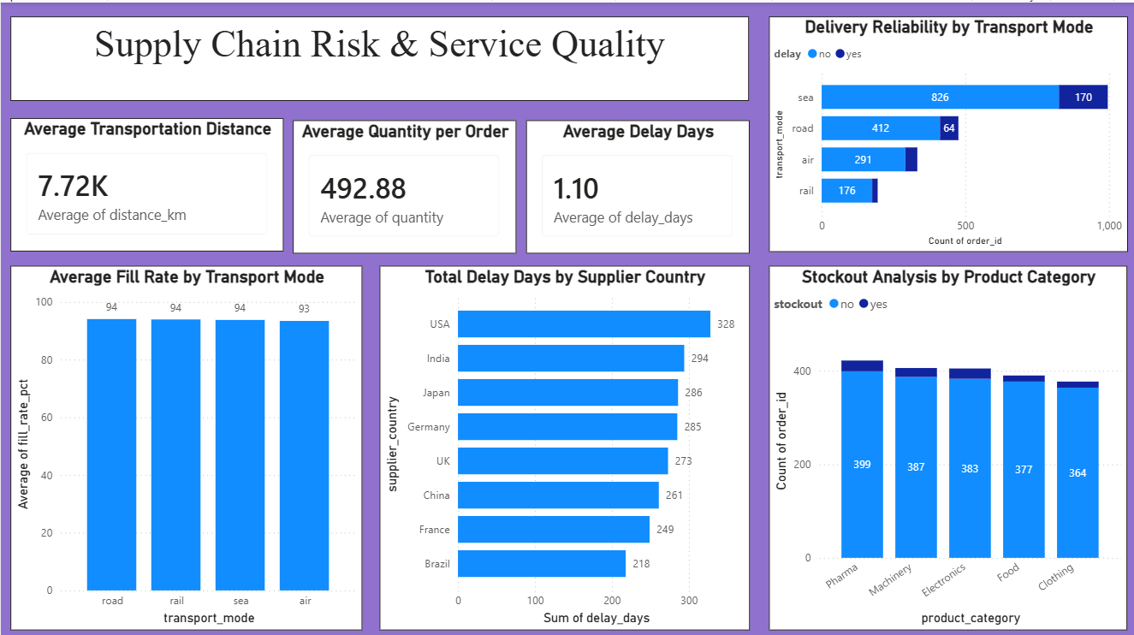
6.6-DASHBOARD 6 – SUPPLY CHAIN RISK & SERVICE QUALITY

Slide 14
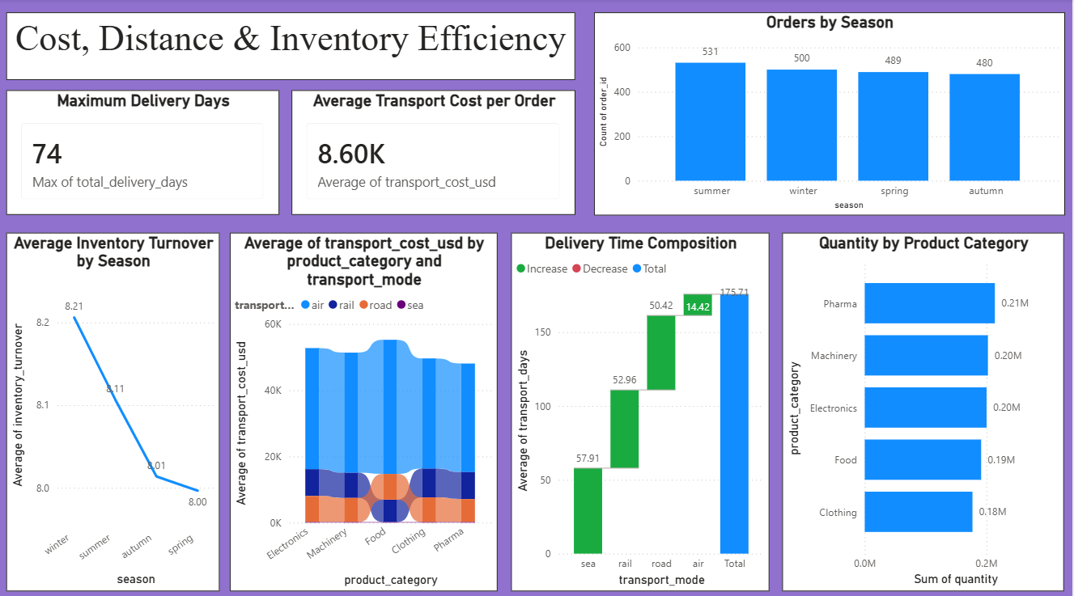
6.7-DASHBOARD 7 – COST DISTANCE & INVENTORY EFFICIENCY

Slide 15
Thank You

