Slide 1
Supply Chain Visibility System with Optimization Analytics Group1
Infosys Springboard Virtual Internship 7.0
Project Presentation
Team Members: Sanmitha
Sabari Vasan
Suryakant Upadhyay
Mentor: Nityasree

Slide 2
Project Objective
To improve end-to-end visibility across the supply chain using data analytics.
To identify operational bottlenecks affecting inventory movement and order fulfillment.
To optimize logistics, inventory management, and delivery performance.
To support data-driven decision-making through interactive dashboards and reports.
Project Modules
Data Collection & Understanding
Data Preprocessing
Data Modeling & KPI Analysis
Power BI Visualization
Insights & Reporting
PAGE 02

Slide 3
Project Execution Milestones
Milestone 1 – Data Acquisition & Cleaning
Collected and understood the supply chain dataset.
Cleaned and prepared the data for analysis.
Milestone 2 – Data Modeling
Analyzed supply chain metrics and developed key performance indicators.
Milestone 3 – Development
Created interactive Power BI dashboards to visualize supply chain performance.
Milestone 4 – Review & Optimization
Reviewed dashboard insights and refined visualizations for better understanding and reporting.

Slide 4
Challenges and Resolution
Challenges
Handling missing, duplicate, and inconsistent data.
Understanding relationships between different supply chain attributes.
Presenting complex supply chain information in a simple format.
Managing and analyzing multiple supply chain KPIs effectively.
Resolutions
Performed data cleaning, validation, and preprocessing.
Explored the dataset and analyzed relevant KPIs.
Used interactive Power BI visualizations, filters, and KPI cards.
Selected relevant KPIs and organized them into clear dashboard visualizations for easier analysis.

Slide 5
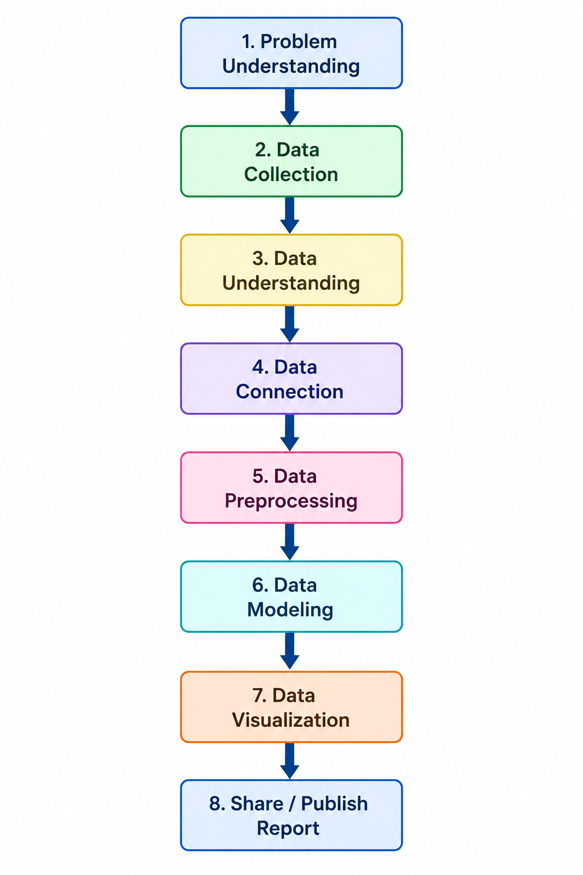
Workflow:

Slide 6
Future Enhancements & Key Insights
Future Enhancements
Integrate IoT-based real-time shipment tracking.
Apply Machine Learning for demand forecasting.
Develop predictive delivery delay analysis.
Automate supply chain alerts and recommendations.
Key Insights
Improved visibility of transportation and delivery performance.
Better monitoring of inventory and supplier performance.
Identified operational bottlenecks to support better decision-making.

Slide 7
Conclusion
The Supply Chain Visibility & Optimization project successfully transformed supply chain data into meaningful insights through data analytics and interactive Power BI dashboards.
Technical Skills
Power BI & Data Visualization
Power Query & DAX
Data Cleaning & KPI Analysis
Soft Skills
Problem Solving
Communication
Teamwork
Presentation

Slide 8
Acknowledgements & References
Acknowledgements
We would like to express our sincere gratitude to the Infosys Springboard Team for organizing this highly enriching virtual internship program and for providing a structured, industry-aligned learning platform. The well-designed modules, milestone-based framework, and practical orientation of the internship enabled us to gain meaningful exposure to real-world business intelligence applications.
We extend our heartfelt appreciation to our mentor, Ms. Nityasree, for her consistent guidance, valuable feedback, and continuous encouragement throughout the project lifecycle. Her insights and structured direction played a significant role in shaping the analytical depth and professional quality of this project. We would also like to acknowledge our team members for their strong collaboration, accountability, and shared commitment toward achieving project objectives.

Slide 9
The coordinated distribution of responsibilities, open communication, and collective problem-solving approach significantly contributed to the successful execution of this project. In addition, we extend our appreciation to the creators and maintainers of Microsoft Power BI documentation and community resources, which served as essential references during dashboard development and KPI implementation. We are also grateful to Kaggle for providing access to publicly available datasets that facilitated practical, hands-on analytical experience. The structured learning resources and practical exposure provided through this internship have significantly strengthened our analytical thinking, technical proficiency, and business interpretation skills. This experience has enhanced our ability to approach data with a strategic mindset, collaborate effectively within a team environment, and execute projects with professional discipline. Overall, this internship has been a meaningful milestone in our academic and professional journey, reinforcing the value of data-driven decision-making and structured analytical execution in modern business environments.

Slide 10
References
Kaggle – Supply Chain Dataset
Microsoft Power BI
Infosys Springboard Learning Materials
Project Dataset, Dashboard & Internship Documentation

Slide 11
Thank You

