Slide 1
Supply Chain Visibility & Optimization
Infosys Springboard Virtual Internship 7.0
Milestone 3
Domain: Data Visualization
Prepared by: Suryakant Upadhyay

Slide 2
Objective
Understand the concepts of Supply Chain Visibility and Optimization and their role in improving business operations.
Identify key challenges such as delivery delays, inventory shortages, and logistics inefficiencies.
Collect, understand, and prepare the supply chain dataset for accurate analysis and visualization.
Build a strong foundation for creating interactive dashboards and business reports in Power BI.
Support data-driven decision-making by transforming raw data into meaningful business insights.

Slide 3
Introduction
Supply chain management involves the movement of products from suppliers to customers through procurement, transportation, warehousing, and delivery.
Supply chain visibility helps organizations monitor inventory, shipments, and order status in real time to improve operational control.
Supply chain optimization focuses on reducing operational costs, improving delivery performance, and increasing overall efficiency.
Data visualization converts complex supply chain data into interactive dashboards that support faster and better business decisions.

Slide 4
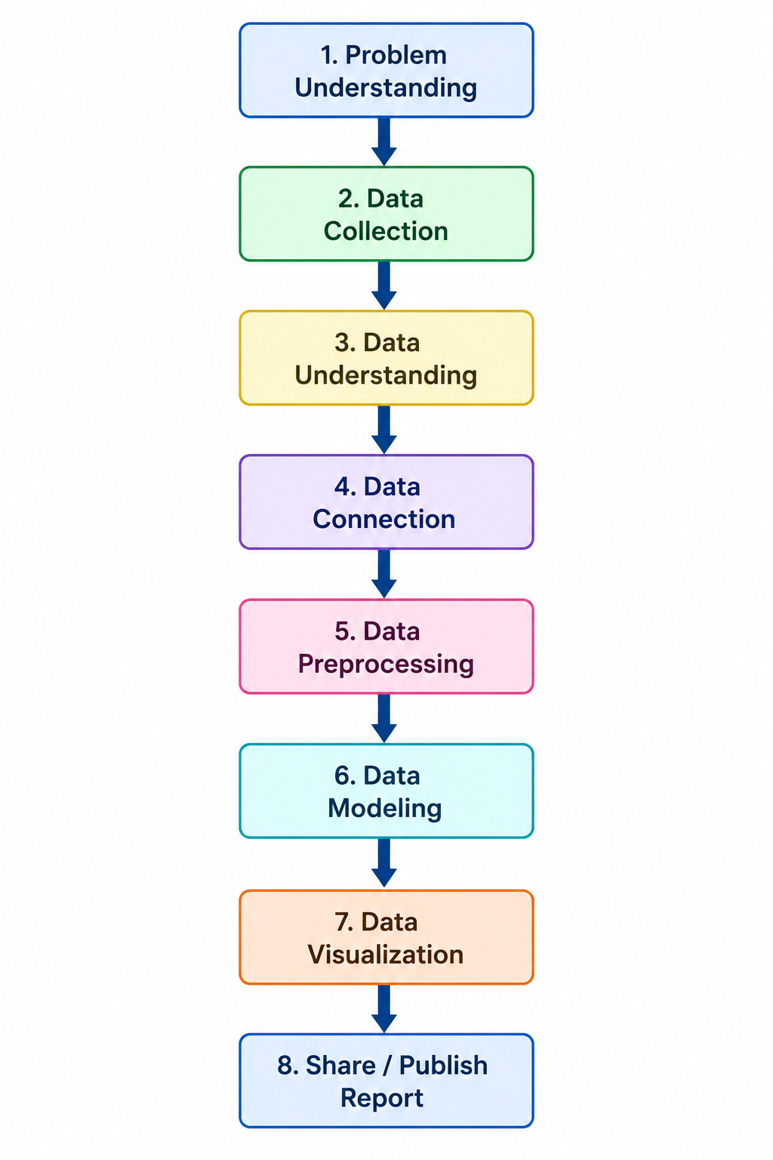
Workflow

Slide 5
Problem Understanding
Many organizations experience delayed deliveries, inventory shortages, and excess stock, affecting overall supply chain performance.
High transportation and storage costs reduce operational efficiency and increase business expenses.
Limited visibility across the supply chain makes it difficult to identify bottlenecks and respond quickly to issues.
Poor supplier performance and inefficient logistics can negatively impact customer satisfaction and service quality.
The objective of this project is to analyze these challenges and provide data-driven insights for optimization.

Slide 6
Data Collection & Understanding
Data Collection
The dataset used in this project was collected from Kaggle, a widely used platform for data science projects.
It contains 2,000 records and 21 attributes related to orders, transportation, inventory, suppliers, and logistics operations.
The dataset provides sufficient information to analyze supply chain performance and identify operational challenges.

Slide 7
Data Understanding
The dataset was explored to understand the purpose and business meaning of each column.
Data types, missing values, and duplicate records were identified before starting the analysis.
Understanding the dataset ensures accurate preprocessing and reliable business insights.

Slide 8
Data Connection
The dataset was imported into Power BI using Power Query for further analysis.
Data types for all columns were verified and corrected wherever required.
The imported data was validated to ensure consistency and completeness before preprocessing.
A proper data connection ensures reliable analysis and supports dashboard development.

Slide 9
Data Preprocessing
Missing values in transport_cost_usd and fill_rate_pct were identified and replaced using the Median method.
Duplicate records and data quality issues were checked to maintain dataset accuracy.
Numerical columns were validated, and decimal values were standardized for consistency.
Business rules were verified to ensure values such as delivery time and transportation cost were logically consistent.
The cleaned dataset is now ready for data modeling and visualization.

Slide 10
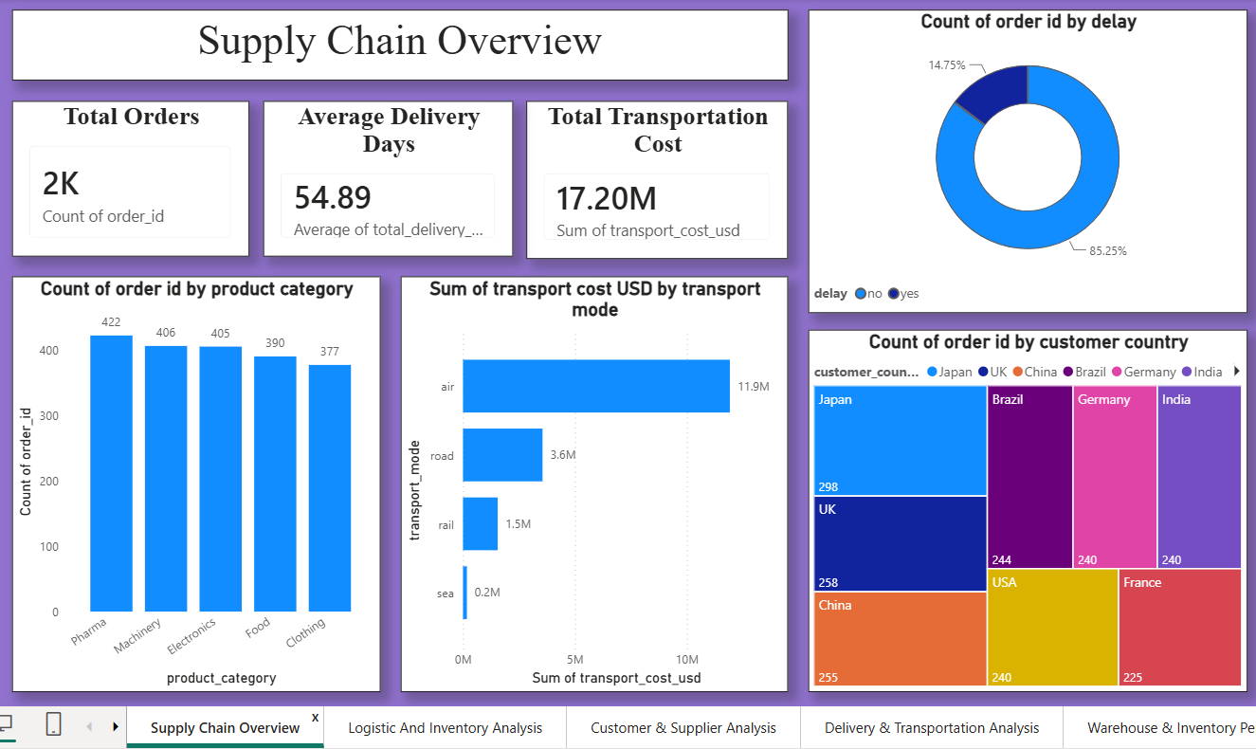
Data Visualization
Dashboard Creation

Slide 11
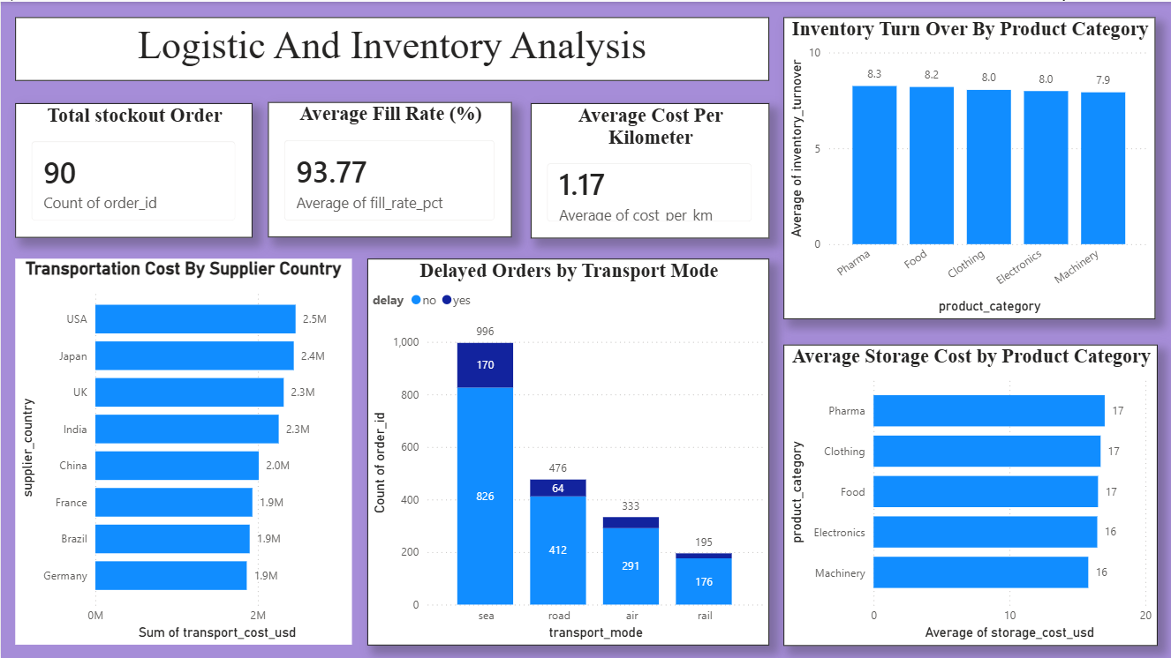

Slide 12
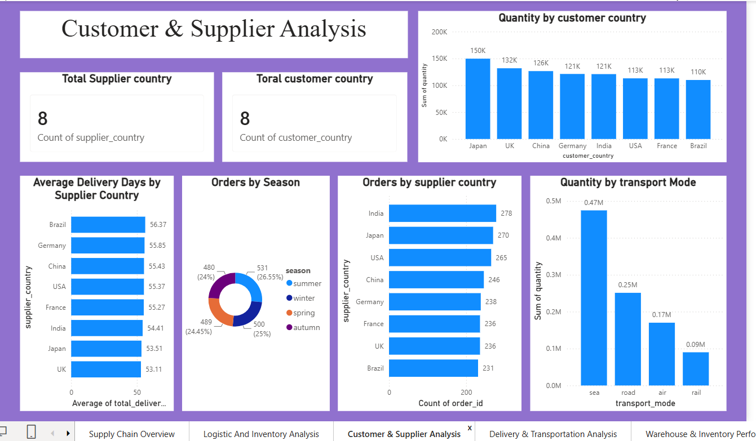

Slide 13
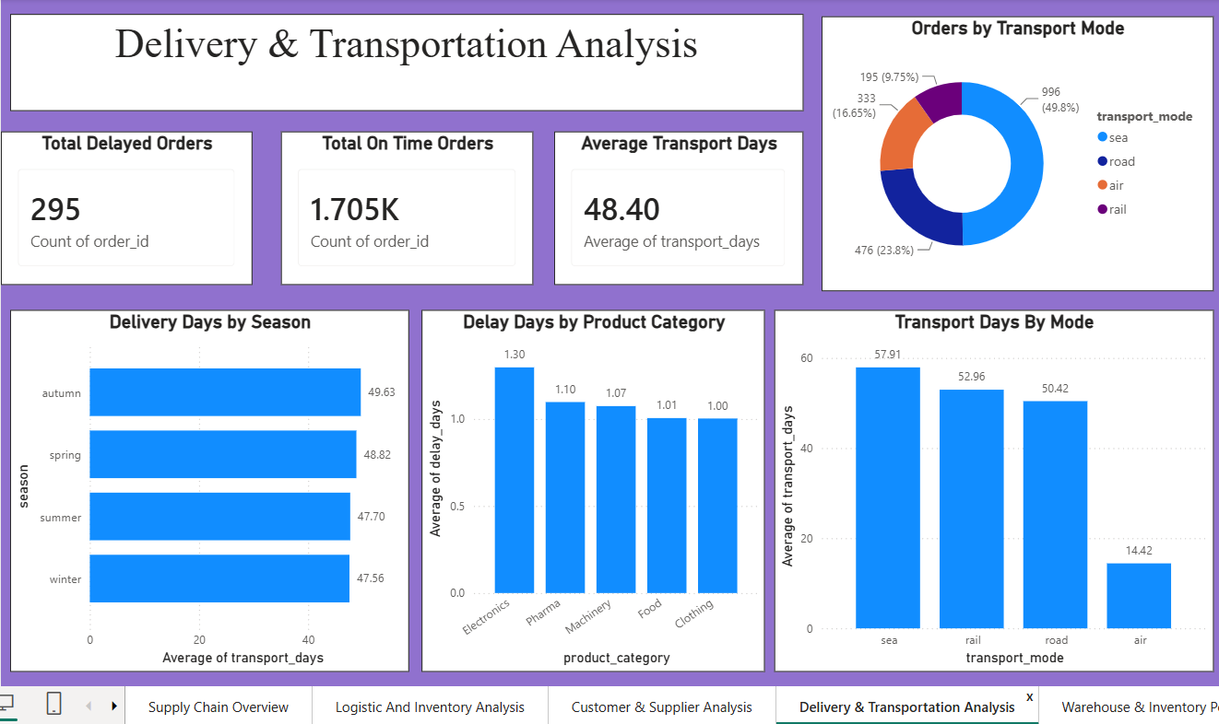

Slide 14
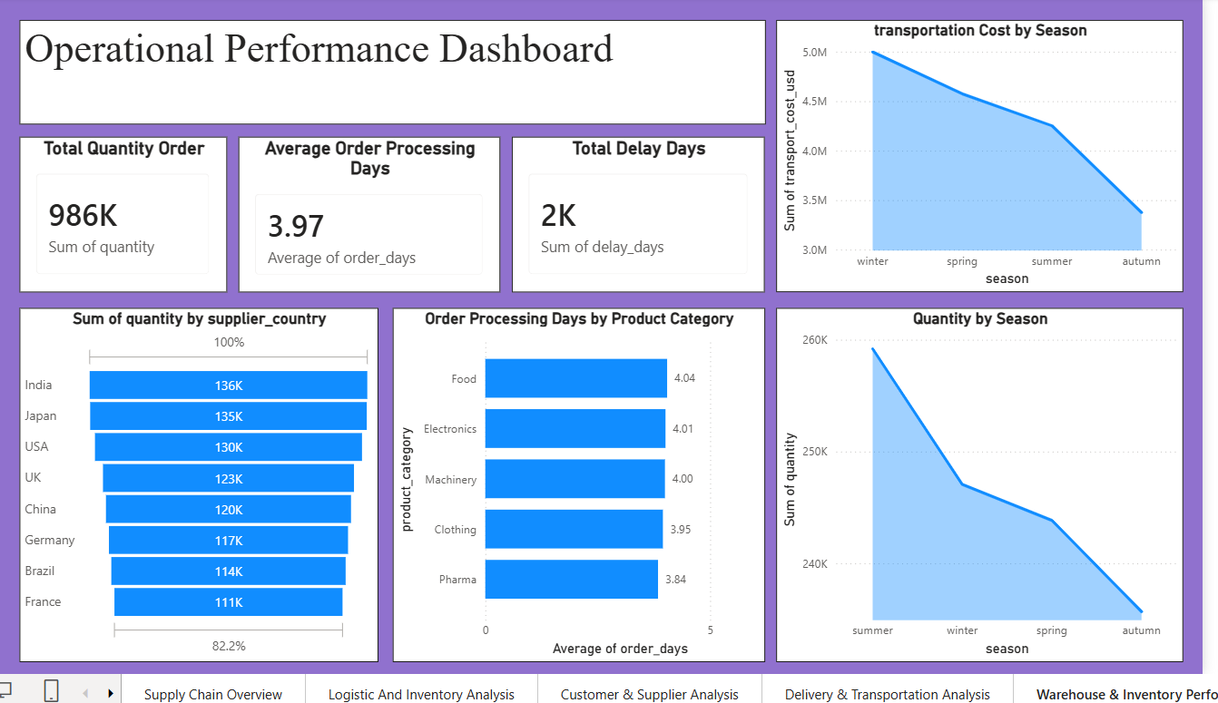

Slide 15
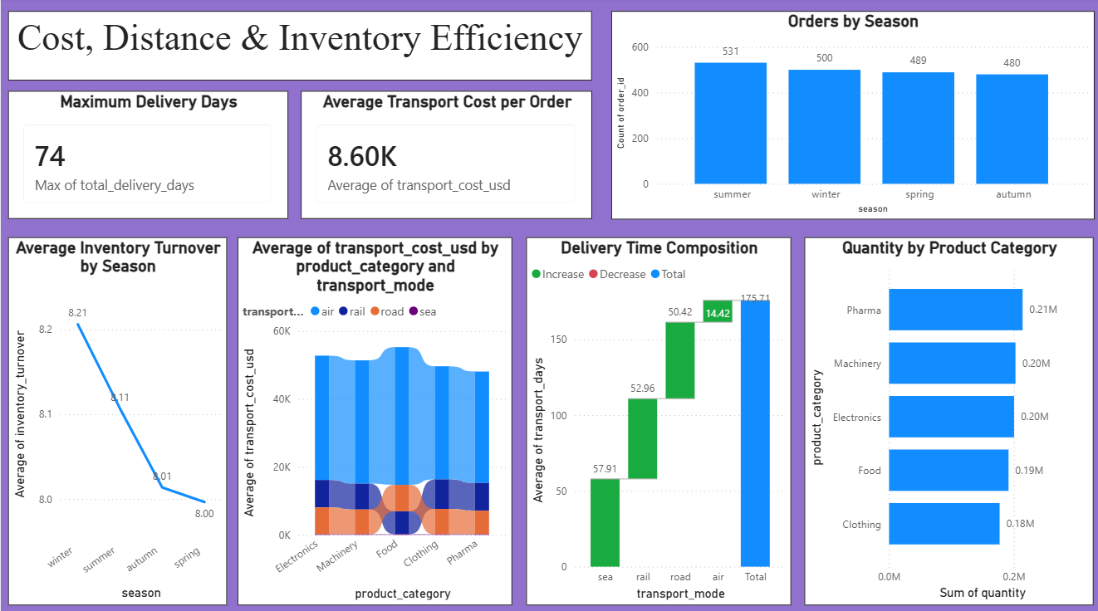

Slide 16
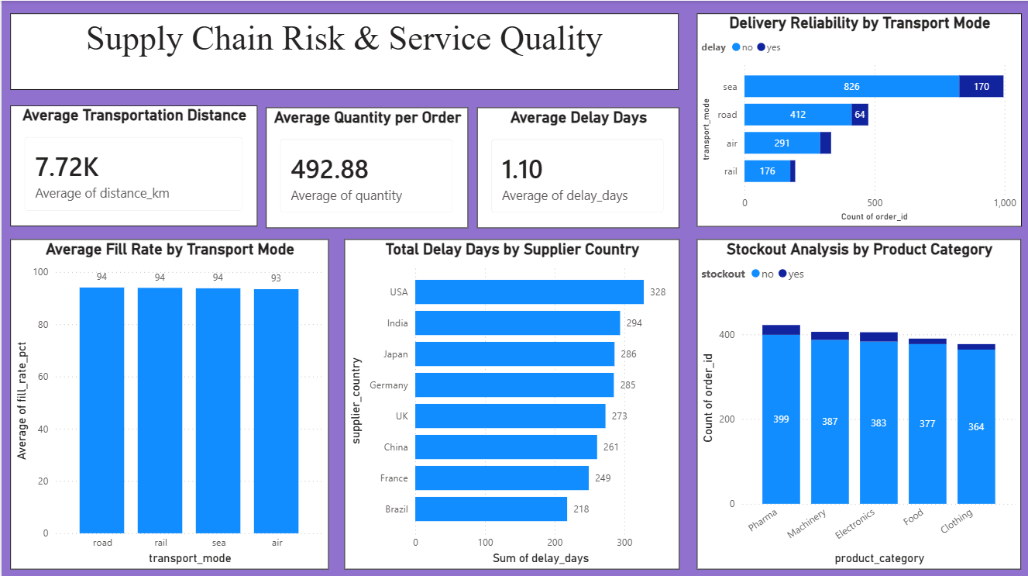

Slide 17
Page 1 – Supply Chain Overview
Total Orders (Card)
Description:
The Total Orders card displays the total number of customer orders available in the dataset. It provides a quick overview of the business volume and serves as a key performance indicator (KPI) for overall supply chain activity. This metric helps stakeholders understand the scale of operations and acts as a reference point when analyzing other performance indicators such as transportation cost, delivery time, and inventory efficiency.

Slide 18
2. Total Transportation Cost (Card)
Description:
This card displays the total transportation cost incurred across all orders. Transportation cost is one of the major expenses in any supply chain, and monitoring this value helps organizations understand overall logistics spending. By comparing transportation costs across different product categories or transport modes, businesses can identify opportunities to reduce expenses and improve operational efficiency.

Slide 19
3. Average Delivery Days (Card)
Description:
The Average Delivery Days card shows the average time required to deliver customer orders from the time they are placed until they reach the customer. This KPI helps evaluate delivery performance and operational efficiency. A lower average delivery time indicates a more efficient supply chain, while a higher value may suggest delays in transportation, order processing, or supplier performance.

Slide 20
4. Orders by Product Category (Clustered Column Chart)
Description:
This chart compares the number of customer orders across different product categories. It helps identify which categories receive the highest and lowest demand. Understanding product demand enables businesses to improve inventory planning, optimize stock levels, and allocate resources more effectively. It also supports better forecasting and purchasing decisions.

Slide 21
5. Transportation Cost by Transport Mode (Clustered Bar Chart)
Description:
This visualization compares the total transportation cost for each transport mode, such as Air, Road, Rail, or Sea. It allows businesses to identify which transportation method contributes the highest logistics cost. The insights gained from this chart can help organizations evaluate transportation strategies, improve route planning, and reduce overall logistics expenses.

Slide 22
6. Delayed vs On-Time Orders (Donut Chart)
Description:
The donut chart displays the proportion of delayed and on-time deliveries. It provides a clear overview of delivery performance and service reliability. A higher percentage of delayed orders may indicate operational bottlenecks, transportation issues, or supplier-related problems. This visualization helps organizations monitor customer service performance and identify areas that require improvement.

Slide 23
7. Average Storage Cost by Product Category (Column Chart)
Description:
This chart compares the average storage cost for different product categories. It helps identify products that require higher warehousing expenses and occupy storage space for longer periods. By analyzing storage costs, businesses can optimize warehouse utilization, improve inventory management, and reduce unnecessary storage expenses.

Slide 24
Page 2 – Logistics & Inventory Analysis
Total Stockout Orders (Card)
Description:
This KPI displays the total number of orders affected by stockouts. It helps identify inventory shortages and enables businesses to improve stock availability and reduce lost sales.

Slide 25
2. Average Fill Rate (%) (Card)
Description:
This KPI shows the average percentage of customer demand fulfilled successfully. A higher fill rate indicates better inventory management and improved customer service performance.

Slide 26
3. Average Cost per Kilometer (Card)
Description:
This card displays the average transportation cost incurred per kilometer. It helps evaluate transportation efficiency by measuring the cost of moving goods over distance. Monitoring this metric allows organizations to compare transportation performance, identify cost variations, and optimize logistics planning to reduce operational expenses.

Slide 27
4. Delayed Orders by Transport Mode (Stacked Column Chart)
Description:
This visualization compares delayed and on-time orders across different transportation modes. It helps identify which transport method experiences the highest number of delivery delays. The analysis supports better transportation planning and assists organizations in selecting more reliable shipping methods to improve delivery performance and customer satisfaction.

Slide 28
5. Inventory Turnover by Product Category (Column Chart)
Description:
This chart compares the average inventory turnover across different product categories. It highlights which categories have faster inventory movement and which products remain in storage for longer periods. The insights help businesses optimize stock levels, reduce holding costs, and improve inventory planning.

Slide 29
6. Transportation Cost by Supplier Country (Clustered Bar Chart)
Description:
This chart compares the total transportation cost across different supplier countries. It helps identify suppliers with higher logistics expenses and supports cost optimization and supplier performance analysis.

Slide 30
7. Average Storage Cost by Product Category (Clustered Bar Chart)
Description:
This chart compares the average storage cost across different product categories. It helps identify products that require higher warehousing expenses and supports better inventory planning, warehouse utilization, and storage cost optimization.

Slide 31
Page 3 – Customer & Supplier Analysis
1 – Total Supplier Country (Card)
Description
This KPI displays the total number of supplier countries available in the dataset. It provides a quick overview of the supplier network and indicates that the organization sources products from multiple countries. A diversified supplier base helps improve supply chain stability, reduce dependency on a single supplier, and minimize supply risks.

Slide 32
2 – Total Customer Country (Card)
Description
This KPI shows the total number of customer countries served by the organization. It helps understand the geographical reach of the business and reflects the diversity of the customer base. Serving customers across multiple countries indicates broader market coverage and business expansion.

Slide 33
3 – Quantity by Customer Country (Clustered Column Chart)
Description
This chart compares the total quantity ordered by customers across different countries. It helps identify countries with the highest and lowest product demand. The visualization supports demand analysis, inventory planning, and market-focused business strategies by highlighting customer purchasing patterns.

Slide 34
4 – Average Delivery Days by Supplier Country (Clustered Bar Chart)
Description
This visualization compares the average delivery time of suppliers from different countries. It helps evaluate supplier performance by identifying suppliers with faster or slower deliveries. The insights support supplier evaluation, logistics planning, and overall improvement in delivery efficiency.

Slide 35
5 – Orders by Season (Donut Chart)
Description
This donut chart displays the distribution of customer orders across different seasons. It helps identify seasonal demand patterns and shows whether customer orders remain consistent throughout the year. The visualization supports inventory planning and demand forecasting for different seasons.

Slide 36
6 – Orders by Supplier Country (Clustered Bar Chart)
Description
This chart compares the total number of orders handled by each supplier country. It helps identify supplier countries that contribute the highest order volume. The analysis supports procurement planning, supplier performance evaluation, and better supplier relationship management.

Slide 37
7 – Quantity by Transport Mode (Clustered Column Chart)
Description
This chart compares the total quantity transported through different transportation modes such as Sea, Road, Air, and Rail. It helps identify the most frequently used transportation method and supports logistics planning, transportation optimization, and efficient resource allocation.

Slide 38
Page 4 – Delivery & Transportation Analysis
1 – Total Delayed Orders (Card)
Description
This KPI displays the total number of delayed orders in the supply chain. It helps monitor delivery performance and identify the extent of shipment delays. Tracking delayed orders enables businesses to improve transportation planning, reduce operational bottlenecks, and enhance customer satisfaction.

Slide 39
2 – Total On-Time Orders (Card)
Description
This KPI shows the total number of customer orders delivered on time. It provides a quick overview of delivery reliability and service performance. A higher number of on-time deliveries reflects an efficient transportation process and improved customer experience.

Slide 40
3 – Average Transport Days (Card)
Description
This KPI represents the average number of days required to transport goods from suppliers to customers. It helps evaluate transportation efficiency and overall logistics performance. Lower transport days indicate a faster and more responsive supply chain.

Slide 41
4 – Orders by Transport Mode (Donut Chart)
Description
This donut chart illustrates the distribution of customer orders across different transportation modes such as Sea, Road, Air, and Rail. It helps identify the most frequently used transportation method and supports better logistics planning and transportation resource allocation.

Slide 42
5 – Delivery Days by Season (Clustered Bar Chart)
Description
This chart compares the average delivery days across different seasons. It helps identify whether seasonal conditions affect delivery performance. The visualization supports demand planning, logistics scheduling, and efficient supply chain operations throughout the year.

Slide 43
6 – Delay Days by Product Category (Clustered Column Chart)
Description
This chart compares the average delay days for different product categories. It highlights products that experience longer delivery delays and helps businesses identify operational challenges. The insights support inventory planning, transportation improvements, and product-specific performance analysis.

Slide 44
7 – Transport Days by Mode (Clustered Column Chart)
Description
This visualization compares the average transportation days for each transport mode. It helps evaluate the speed and efficiency of different transportation methods. Businesses can use these insights to select suitable transport options based on delivery time and operational requirements.

Slide 45
Page 5 – Operational Performance Dashboard
1 – Total Quantity Order (Card)
Description
This KPI displays the total quantity of products ordered across all customer orders. It provides an overview of the overall shipment volume handled by the supply chain. Monitoring total order quantity helps businesses understand operational workload, demand levels, and overall business performance.

Slide 46
2 – Average Order Processing Days (Card)
Description
This KPI shows the average number of days required to process customer orders before shipment. It helps evaluate the efficiency of the order processing system. Lower processing time indicates better operational performance, faster order fulfillment, and improved customer satisfaction.

Slide 47
3 – Total Delay Days (Card)
Description
This KPI represents the total number of delay days recorded across all delayed orders. It provides a clear view of the overall impact of delivery delays on supply chain operations. Monitoring this metric helps organizations identify operational inefficiencies and improve delivery performance

Slide 48
4 – Transportation Cost by Season (Area Chart)
Description
This area chart compares the total transportation cost across different seasons. It helps identify seasonal variations in logistics expenses and highlights the periods with higher transportation costs. The insights support better budgeting, transportation planning, and cost optimization throughout the year.

Slide 49
5 – Quantity by Supplier Country (Funnel Chart)
Description
This visualization compares the total quantity supplied by each supplier country. It helps identify the countries contributing the highest shipment volume and provides insights into supplier performance. The chart supports procurement planning and helps businesses maintain a balanced supplier network.

Slide 50
6 – Order Processing Days by Product Category (Clustered Bar Chart)
Description
This chart compares the average order processing time across different product categories. It helps identify products that require more processing time before shipment. The analysis supports process improvement, resource allocation, and operational efficiency by highlighting category-wise processing performance.

Slide 51
7 – Quantity by Season (Area Chart)
Description
This area chart displays the total quantity of products ordered during different seasons. It helps identify seasonal demand trends and shows how order volume changes throughout the year. These insights support demand forecasting, inventory planning, and production scheduling.

Slide 52
Page 6 - Supply Chain Risk & Service Quality
1- Average Transportation Distance
Description
This KPI shows the average distance covered for transportation, which is 7.72K km. It helps understand the overall transportation scale and the distance involved in supply chain operations. This insight can support better route planning, delivery planning, and transportation cost management.

Slide 53
2 – Average Quantity per Order
Description
This KPI shows that the average quantity per order is 492.88 units. It helps understand the typical order size handled by the supply chain. This information can support inventory planning, transportation capacity planning, and efficient order fulfillment.

Slide 54
3 – Average Delay Days
Description
This KPI shows an average delay of 1.10 days. It provides a quick view of delivery delay performance across the supply chain. Monitoring this value can help identify delivery problems and support actions to improve overall delivery reliability.

Slide 55
4 – Delivery Reliability by Transport Mode
Description
This chart compares delayed and non-delayed orders across different transport modes. Sea transport has the highest number of orders, while road, air, and rail have lower volumes. The chart helps identify which transportation modes have more delayed orders and supports better transport planning.

Slide 56
5 – Average Fill Rate by Transport Mode
Description
This chart compares the average fill rate across different transport modes. The fill rate remains around 93–94%, showing generally good order fulfillment performance. This insight helps monitor service quality and identify opportunities to maintain or improve product availability.

Slide 57
6 – Total Delay Days by Supplier Country
Description
This chart compares total delay days across supplier countries. The USA has the highest total delay days at 328, while Brazil has the lowest at 218. This analysis helps identify supplier locations that may require better coordination and improved delivery planning.

Slide 58
7 – Stockout Analysis by Product Category
Description
This chart compares stockout and non-stockout orders across product categories. It helps identify categories where inventory shortages may occur more frequently. The analysis can support better inventory planning, replenishment decisions, and stock availability management.

Slide 59
Page 7 - Cost, Distance & Inventory Efficiency
1 – Maximum Delivery Days
Description This KPI shows a maximum delivery time of 74 days. It highlights that some orders require significantly more time to reach their destination. Monitoring long delivery times can help identify inefficient routes and improve overall delivery planning.

Slide 60
2 – Average Transport Cost per Order
Description
This KPI shows an average transportation cost of 8.60K per order. It helps understand the average logistics expense associated with each order. This information can support transportation cost control and help identify opportunities for cost optimization.

Slide 61
3 – Orders by Season
Description
This chart compares the number of orders across different seasons. Summer has the highest number of orders with 531, followed by winter with 500, spring with 489, and autumn with 480. These seasonal trends can help in planning inventory and transportation capacity.

Slide 62
4 – Average Inventory Turnover by Season
Description
This chart shows inventory turnover across different seasons. The highest turnover is seen in winter at 8.21, while spring has the lowest at 8.00. The results show relatively stable inventory movement and can support better seasonal inventory planning.

Slide 63
5 – Transportation Cost by Product Category and Transport Mode
Description
This chart compares transportation costs across product categories and transport modes. It helps understand how transportation expenses vary based on the type of product and mode used. These insights can support better transport mode selection and cost optimization.

Slide 64
6 – Delivery Time Composition
Description
This chart shows the contribution of different transport modes to the overall transportation time. Sea, rail, road, and air transport together contribute to the total delivery time. It helps identify which modes have a greater impact on transportation duration and where delivery time can be improved.

Slide 65
7 – Quantity by Product Category
Description
This chart compares the total quantity across product categories. Pharma has the highest quantity at around 0.21M, while Clothing has the lowest at around 0.18M. This information can help businesses plan inventory levels, demand, and transportation requirements for different products.

Slide 66
Conclusion
Milestone 4 successfully highlights the key supply chain performance areas, including delivery reliability, transportation cost, distance, inventory efficiency, delays, and product quantity. The dashboards make it easier to identify operational issues and compare performance across transport modes, seasons, suppliers, and product categories. Overall, the analysis provides useful insights for reducing delays, controlling transportation costs, improving inventory management, and supporting better supply chain decisions.

