Slide 1
Supply Chain Visibility System with Optimization Analytics Group1
Infosys Springboard Virtual Internship 7.0
Final Project Presentation
NAME : Sabari Vasan N
INTERNSHIP DURATION – 8 WEEKS
Mentor: Ms.Nityasree

Slide 2
Project Objective
To improve end-to-end visibility across the supply chain using data analytics.
To identify operational bottlenecks affecting inventory movement and order fulfillment.
To optimize logistics, inventory management, and delivery performance.
To support data-driven decision-making through interactive dashboards and reports.
Project Modules
Data Collection & Understanding
Data Preprocessing
Data Modelling & KPI Analysis
Power BI Visualization
Insights & Reporting

Slide 3
Project Execution Milestones
Milestone 1 – Data Acquisition & Cleaning
Collected and understood the supply chain dataset.
Cleaned and prepared the data for analysis.
Milestone 2 – Data Modelling
Analysed supply chain metrics and developed key performance indicators.
Milestone 3 – Development
Created interactive Power BI dashboards to visualize supply chain performance.
Milestone 4 – Review & Optimization
Reviewed dashboard insights and refined visualizations for better understanding and reporting.

Slide 4
Challenges and Resolution
Challenges
Handling missing, duplicate, and inconsistent data in the supply chain dataset.
Identifying meaningful relationships between suppliers, products, transportation, inventory, and delivery attributes.
Presenting complex supply chain information in a simple format.
Managing multiple KPIs such as delivery time, transportation cost, inventory turnover, and order fulfillment.
Resolutions
Cleaned, validated, and preprocessed the dataset using Python, Pandas, and Power Query.
Performed exploratory data analysis to identify patterns, relationships, and important supply chain factors.
Developed interactive Power BI dashboards using suitable charts, filters, and KPI cards.
Selected and organized key KPIs into clear visualizations to support easier monitoring and decision-making.

Slide 5
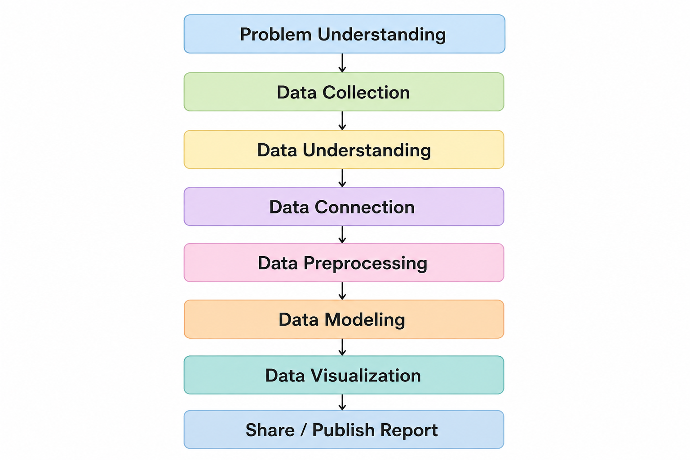
Workflow:

Slide 6
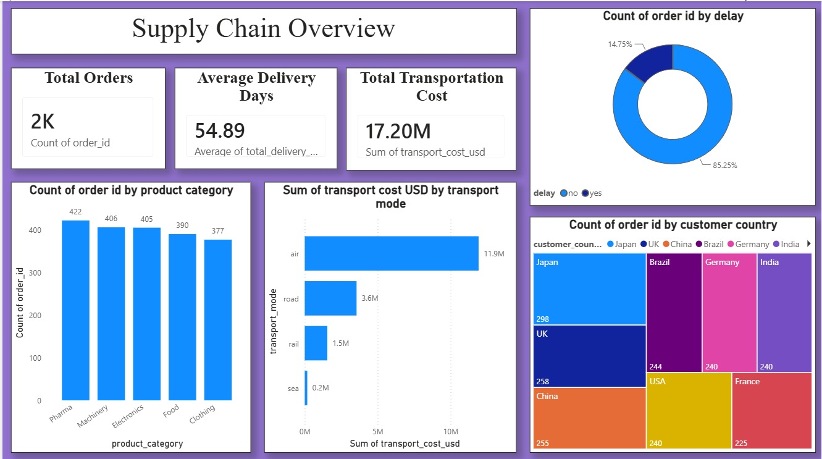
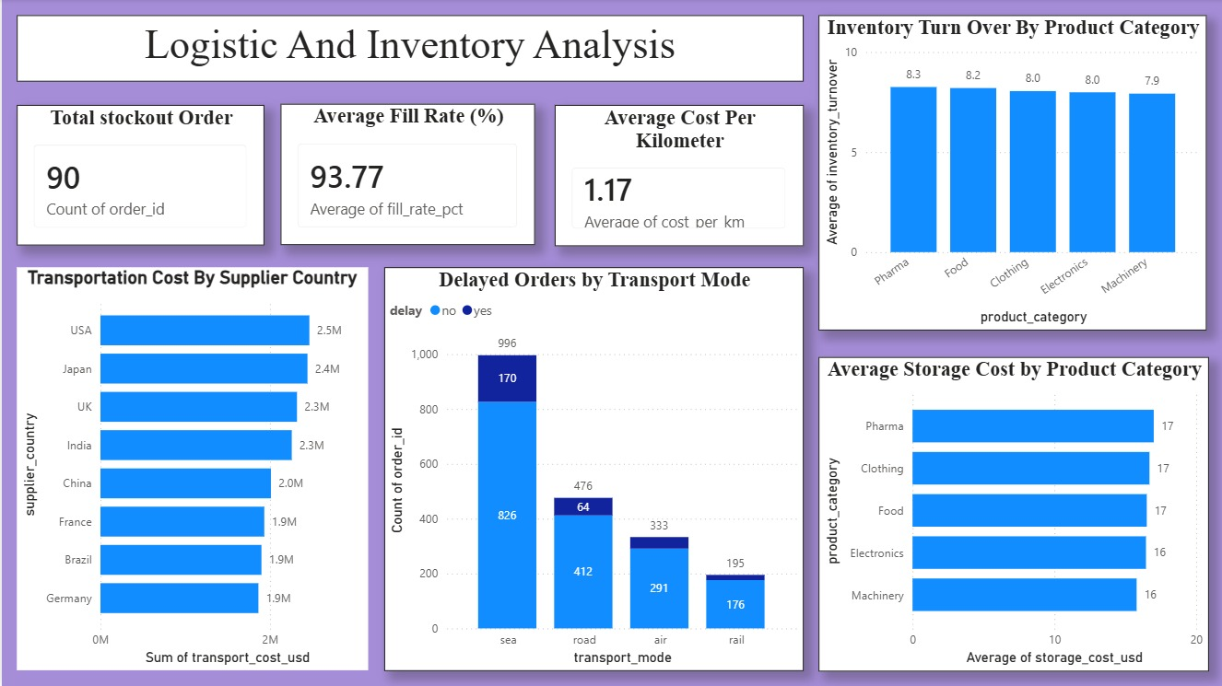
DASHBOARD

Slide 7
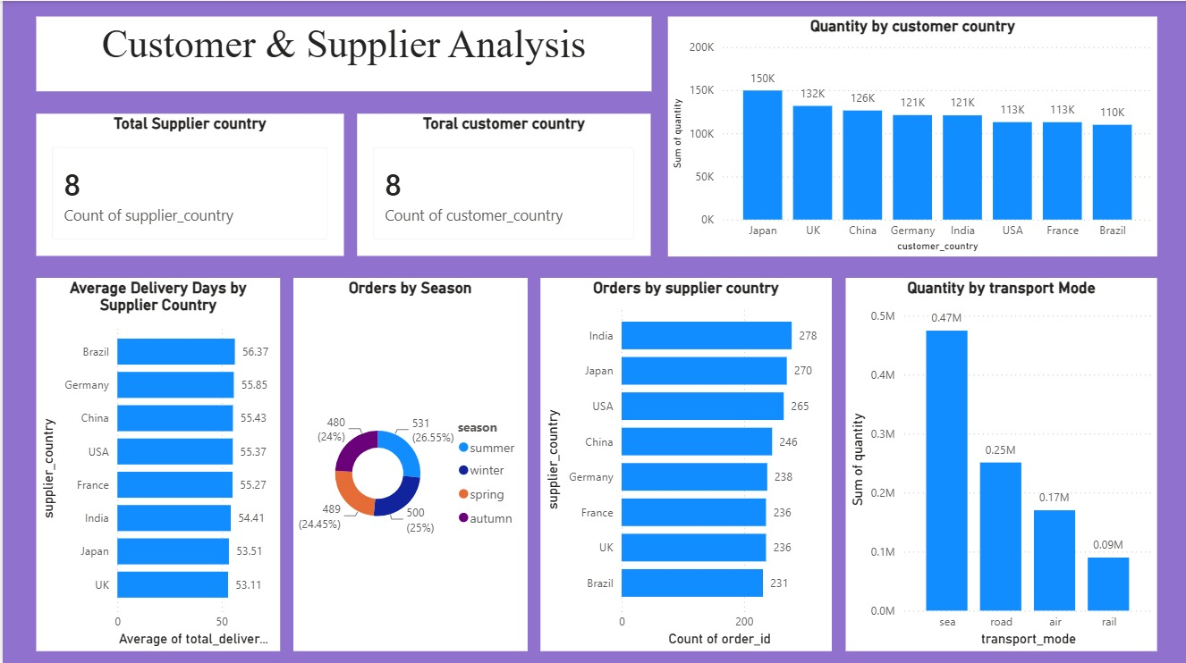
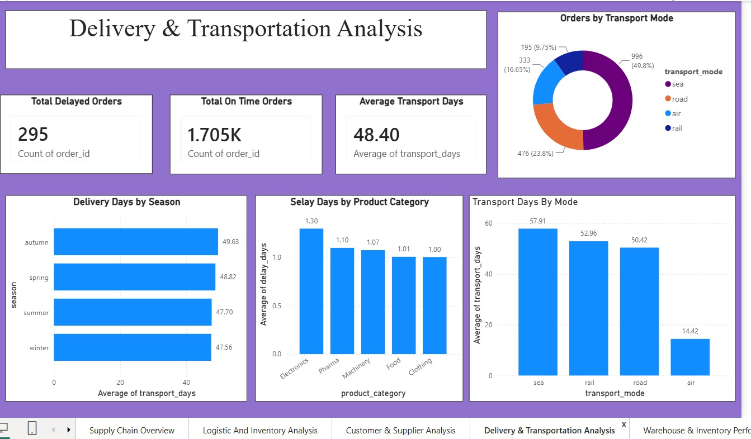
DASHBOARD

Slide 8
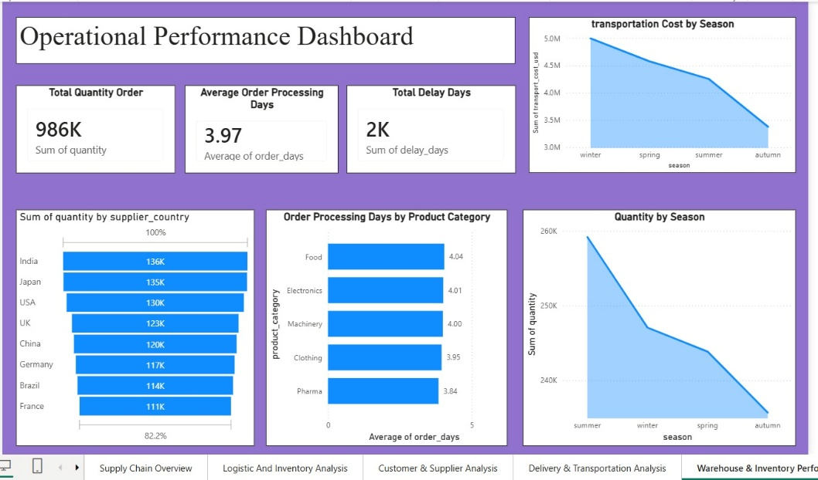
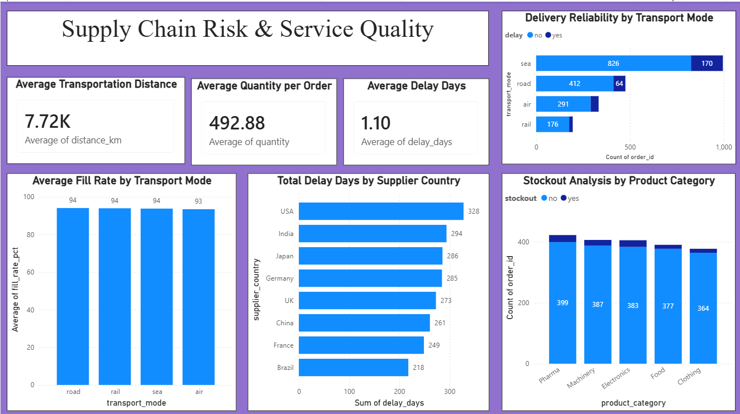
DASHBOARD

Slide 9
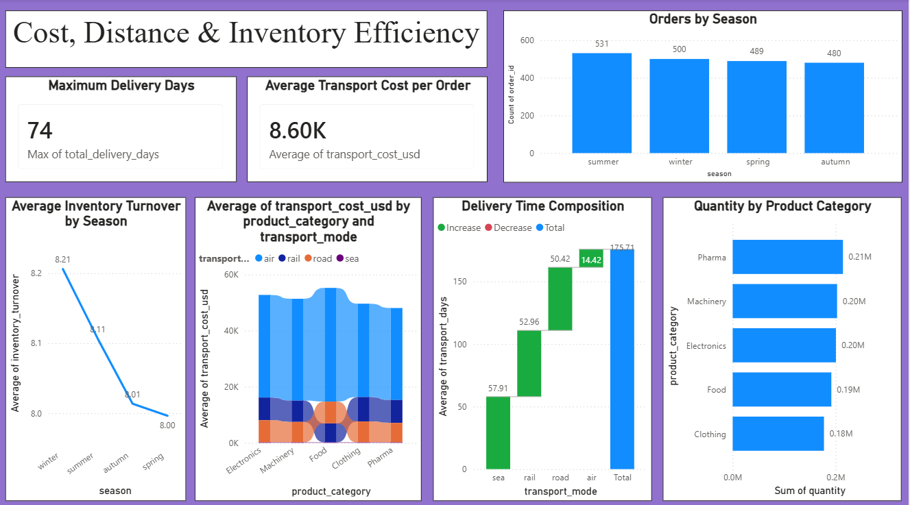
DASHBOARD

Slide 10
Future Enhancements & Key Insights
Future Enhancements
• Integrate real-time shipment tracking to improve supply chain visibility.
• Implement Machine Learning models for demand and inventory forecasting.
• Develop predictive analytics to identify potential delivery delays.
• Automate alerts and recommendations for inventory, delivery, and transportation issues.
Key Insights
• Improved visibility into transportation costs and delivery performance.
• Enabled better monitoring of inventory levels and supplier performance.
• Identified product categories and areas contributing to longer delivery cycles.
• Highlighted operational bottlenecks to support faster and more informed decision-making.

Slide 11
Conclusion
The Supply Chain Visibility & Optimization project successfully transformed supply chain data into meaningful insights through data analytics and interactive Power BI dashboards.
Technical Skills
Power BI & Data Visualization
Power Query & DAX
Data Cleaning & KPI Analysis
Soft Skills
Problem Solving
Communication
Teamwork
Presentation

Slide 12
Acknowledgements & References
Acknowledgements
We would like to express our sincere gratitude to the Infosys Springboard Team for organizing this highly enriching virtual internship program and for providing a structured, industry-aligned learning platform. The well-designed modules, milestone-based framework, and practical orientation of the internship enabled us to gain meaningful exposure to real-world business intelligence applications.
We extend our heartfelt appreciation to our mentor, Ms. Nityasree, for her consistent guidance, valuable feedback, and continuous encouragement throughout the project lifecycle. Her insights and structured direction played a significant role in shaping the analytical depth and professional quality of this project. We would also like to acknowledge our team members for their strong collaboration, accountability, and shared commitment toward achieving project objectives.

Slide 13
The coordinated distribution of responsibilities, open communication, and collective problem-solving approach significantly contributed to the successful execution of this project. In addition, we extend our appreciation to the creators and maintainers of Microsoft Power BI documentation and community resources, which served as essential references during dashboard development and KPI implementation. We are also grateful to Kaggle for providing access to publicly available datasets that facilitated practical, hands-on analytical experience. The structured learning resources and practical exposure provided through this internship have significantly strengthened our analytical thinking, technical proficiency, and business interpretation skills. This experience has enhanced our ability to approach data with a strategic mindset, collaborate effectively within a team environment, and execute projects with professional discipline. Overall, this internship has been a meaningful milestone in our academic and professional journey, reinforcing the value of data-driven decision-making and structured analytical execution in modern business environments.

Slide 14
References
Kaggle – Supply Chain Dataset
Microsoft Power BI
Infosys Springboard Learning Materials
Project Dataset, Dashboard & Internship Documentation

Slide 15
Thank You

