Slide 1

SMART INDIA HACKATHON 2026
TITLE PAGE
Problem Statement ID – 26110
Problem Statement Title- Development of a Low-Cost Light-weight Milk Chilling Can for Small-Scale Dairy Farmers
Theme- Agriculture, FoodTech & Rural Development
PS Category- Hardware
Team ID- 159400
Team Name- INVICTUS
Notes:
Template title page with details filled. PS 26110, Hardware, Agriculture FoodTech & Rural Development. Team ID and Team Name are placeholders - fill from the SIH portal.

Slide 2
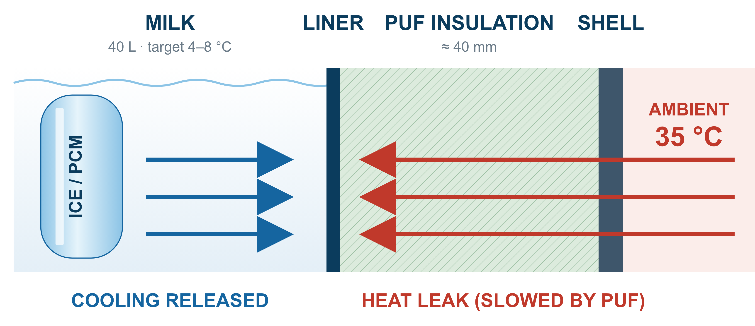
MILKSHIELD
Passive Cooling Milk Chilling Can, 30–40 L
INVICTUS
Proposed Solution
WHAT IT IS
Double-wall PUF-insulated can with a food-grade HDPE chamber
Reusable ice/PCM cartridges sit in the milk – no compressor, no mains power
HOW IT WORKS
Passive cooling stores cooling energy in reusable PCM/ice cartridges and releases it gradually around the insulated milk chamber without continuous external power.
30–40 L
capacity
4–8 °C
milk temperature
6–12 h
hold time
0 W
continuous power
WHAT IS NEW
Modular cartridges: capacity set per load
Ice inside the milk: direct, fast heat transfer
Easy to clean: smooth, wide-mouth liner
PS requirements – simulated: below 8 °C in 75 min, held 14 h at 35 °C
Optional monitoring:
Probe
ESP32
LED / phone
Notes:
Core message: passive PCM/ice cooling, no continuous power. Ice latent heat 334 kJ/kg. PUF thermal conductivity 0.022-0.035 W/m.K (Verma & Singh 2019). Monitoring layer is optional and secondary. All performance values are design targets - no prototype data yet.

Slide 3
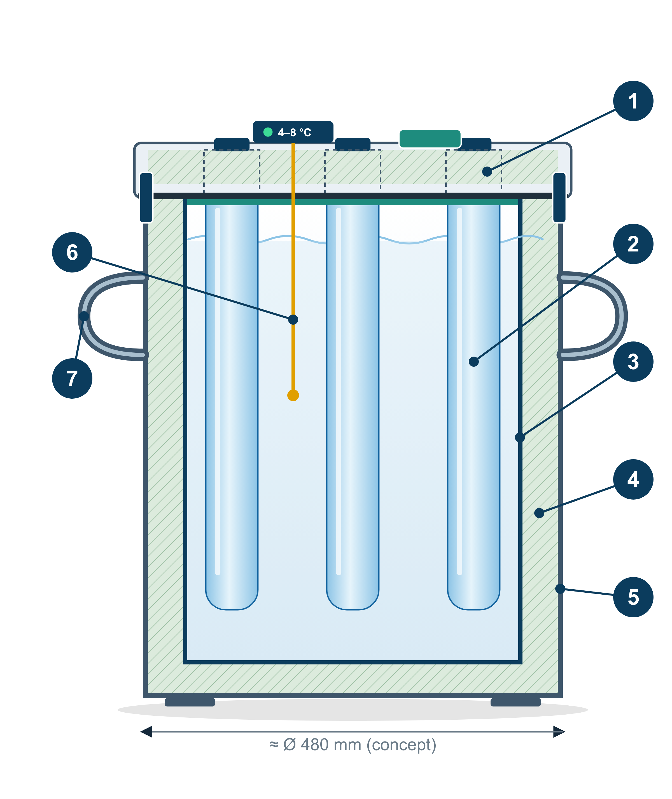
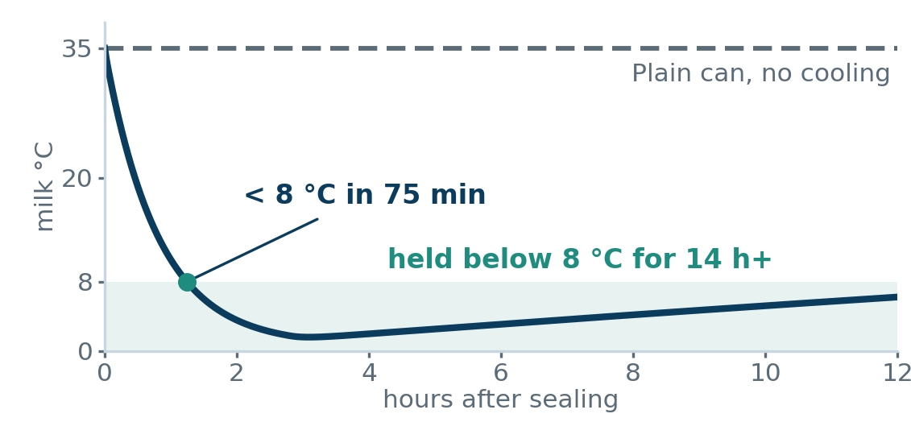
TECHNICAL APPROACH
INVICTUS
MILKING
strain milk
FILL
via strainer port
INSERT COOLING
conditioned cartridges
SEAL
gasket + latches
PASSIVE COOLING
no power
TEMP. CHECK
probe / indicator
TRANSPORT
cart · bike · vehicle
VILLAGE COLLECTION CENTRE
swap cartridges
1
Lid + gasket
Insulated PE lid, food-grade seal, cam latches
THERMAL SIMULATION 40 L · 35 °C day
2
Ice/PCM cartridge
Sealed 2 L food-grade HDPE, water/ice
3
Inner liner
Food-grade HDPE (IS 10146) [7], smooth
4
PUF insulation
≈40 mm, k ≈ 0.022–0.035 W/m·K [6]
Outer shell
UV-stabilised rotomoulded PE
CARTRIDGES NEEDED (2 L each)
5
Pre-chilled milk · 12 h | 2
Fresh 30 L · 6 h | 6
Fresh 40 L · 12 h | 8
6
Sensor (optional)
Probe → LED; ESP32 logger optional
7
Handles
Moulded-in, low centre of gravity
Fresh-milk pull-down is ≈¾ of the load, so cartridge count sets capacity.
Sized by simulation: 35 °C ambient, 40 mm PUF; milk cp, ρ [8].
Made by: rotomould shell + liner → PUF pour → assemble
Notes:
Engineering estimate, not measured. Geometry: chamber D 0.40 m x H 0.56 m (about 70 L gross), PUF 40 mm, k 0.030 W/m.K, +25% thermal-bridge allowance, mean area 1.13 m2, UA 1.06 W/K. Pull-down Q = m cp dT = 41.2 x 3.9 x 27. Ice 334 kJ/kg, 85% utilisation. Cross-check: 30 L milk 35->17 C needs 2.2 MJ = 6.5 kg ice; Torres-Toledo 2018 report 6 kg ice cooled 30 L to 17 C in <90 min. Cartridges: hold 12 h = 3, hold 6 h = 2, fresh 30 L 6 h = 8, fresh 40 L 6 h = 10, fresh 40 L 12 h = 11, hills 30 L 4 h at 25 C = 7. PCM is placed inside the milk (through a thin HDPE wall) to avoid the air-gap resistance of PCM behind the liner.

Slide 4
FEASIBILITY AND VIABILITY
INVICTUS
Analysis of the feasibility of the idea | Potential challenges and risks | Strategies for overcoming these challenges
Cooling duration Simulated: 14 h below 8 °C | Fresh milk needs ≈3× the cooling of a 12 h hold | Cartridge count sized per load by simulation (2–8)
Heat leakage ≈22 W at 35 °C (wall heat-flow model) | Lid joint is the main weak spot (≈11 % of leak) | Insulated lid, gasket, no metal through-paths
Weight Manageable | ≤16 kg of ice for a full 40 L, 12 h trip | Carry only what the load needs; swap at collection centre
Hygiene Food-grade HDPE, easy to clean | Milk residue, little cleaning water | Smooth liner, wide mouth, crown lifts out
Leakage · rough roads Robust | Bumps, tipping, cartridge or lid leaks | Rotomoulded PE, gasket + latches, welded cartridges
Cost · manufacturing Viable | Tooling cost at volume | Prototype from off-the-shelf drums; rotomould + PUF later
TECHNICALLY FEASIBLE
Simulation + prior art [1]
ECONOMICALLY FEASIBLE
Prototype ≈ ₹6–13 k (est.)
OPERATIONALLY FEASIBLE
Cartridges swapped at centre
MANUFACTURABLE
Rotomould + PUF process
SCALABLE
Cartridge count sets capacity
Notes:
Rows follow the official SIH pointers. Nothing is measured on a prototype. Prototype BOM estimate (Rs): 60-70 L food-grade HDPE drum 600-1,200 (listings Rs 310-1,030 per 50 L); ~120 L outer drum 1,000-2,000; PUF 2-part kit 1,500-3,000; lid+EPDM gasket+latches 800-1,500; crown ring 500-1,000; 12 x 2 L HDPE cartridges 1,000-2,400; handles/fasteners 300-600; optional probe+ESP32+LED+Li-ion 900-1,600. Total about Rs 6.6-13.3 k. Only drum prices come from listings; the rest are engineering estimates pending quotes. Mass-production cost is not claimed. Benchmarks from listings: 40 L Al can about Rs 2,350 (uninsulated); 50 L PU ice box Rs 1,700-10,200.

Slide 5
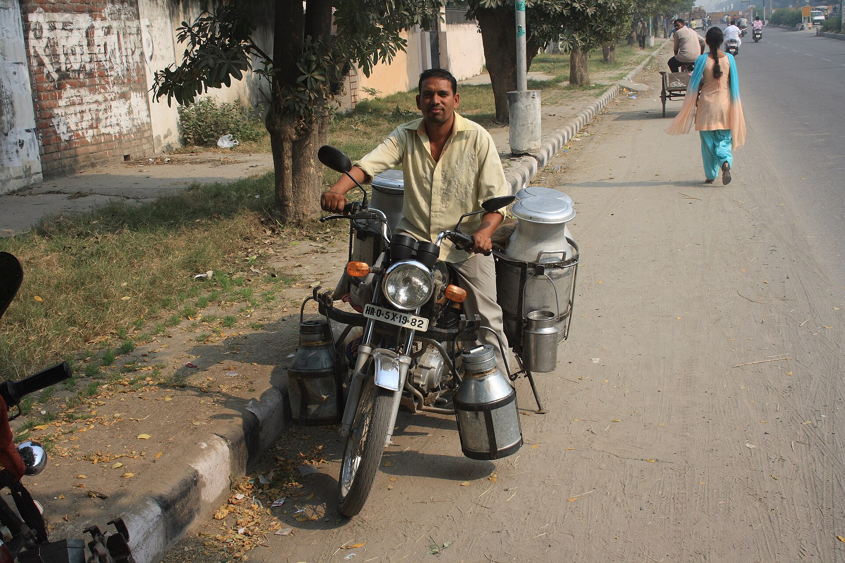
IMPACT AND BENEFITS
INVICTUS
TARGET USERS
BENEFITS
1
Small & marginal dairy farmers
SOCIAL
Safe milk without electricity
Suits hilly & NE villages
ECONOMIC
Reusable ice/PCM, no power bill
Fewer rejected milk lots
2
Village milk collection centres
3
Dairy cooperatives
4
Rural milk transporters
OPERATIONAL
Easy to clean, moulded handles
Cartridges sized per trip
ENVIRONMENTAL
No refrigerant, no diesel
Reusable cartridges, recyclable HDPE
Today: uninsulated cans. Karnal, Haryana. Photo: Arne Hückelheim, CC BY-SA 3.0, Wikimedia Commons
5
Remote / hilly / NE dairy networks
Codex: cool to ≤6 °C (≤4 °C if not collected daily) when not collected within 2 h [4]
MILK JOURNEY
FARMER
≈35 °C at milking
MILKSHIELD
cartridges in, sealed
RURAL TRANSPORT
passive hold, 6–12 h
COLLECTION CENTRE
check, swap cartridges
DAIRY COLD CHAIN
BMC / plant chilling
Scales later with the same design: 30–40 L → 50–100 L modular → cooperative fleets
Notes:
No quantified spoilage reduction is claimed. Codex CAC/RCP 57-2004: milk not collected or used within 2 h of milking is cooled to <=6 C (daily collection) or <=4 C (not daily). IGNOU/eGyanKosh Dairy Technology Unit 1: chill below 4 C within 4 h; head-load 3-25 L over 3-8 km especially in hilly areas. Photo: File:MilkMan.JPG, Arne Hueckelheim, CC BY-SA 3.0, Wikimedia Commons.

Slide 6
RESEARCH AND REFERENCES
INVICTUS
 | Conventional can [5] | Ice-in-can prototype [1] | PCM pail, ICAR-NDRI [2,3,9] | MilkShield (proposed)
Cooling | None | Ice compartment | Nano-PCM jacket | Ice/PCM cartridges in milk
Power | None | None in use | None in use | None in use
Reported result | No cooling | 30 L → 17 °C in <90 min; 20 L <13 °C for 12 h | 37 → <10 °C in 30–40 min (reported) | Simulated: below 8 °C in 75 min; held 14 h at 35 °C
Modular | No | No | No | Yes: 2–8 cartridges
Cost | ≈ ₹2,350 (40 L Al) | Not reported | ≈ ₹1,500–2,000 | Prototype ≈ ₹6–13 k (est.)
REFERENCES
[1] Torres-Toledo et al., Int. J. Refrigeration 90 (2018) 22–31. doi:10.1016/j.ijrefrig.2018.04.001
[2] Prakash et al., Innov. Food Sci. Emerg. Technol. 81 (2022) 103112. doi:10.1016/j.ifset.2022.103112
[3] Prakash & Ravindra, J. Food Eng. 337 (2023) 111223. doi:10.1016/j.jfoodeng.2022.111223
[4] FAO/WHO Codex, Code of Hygienic Practice for Milk and Milk Products, CAC/RCP 57-2004
[5] IGNOU / eGyanKosh, Dairy Technology Unit 1: Milk Collection & Transportation
[6] Verma & Singh, Energy Procedia 161 (2019) 232–241. doi:10.1016/j.egypro.2019.02.086
[7] FSSAI Packaging Regulations 2018 (IS 10146); BIS IS 1825:1983
[8] Minim et al., J. Chem. Eng. Data 47 (2002) 1488. doi:10.1021/je025546a
[9] DST, Govt. of India: affordable milk chilling at point of harvest
Simulation study: thermal model · wall heat-flow model · 2D CFD (milk cools evenly, top to bottom within 2.5 °C). Next: prototype field trial.
Notes:
Comparison uses only cited or listed facts. NDRI pail figures (37 to <10 C in 30-40 min) are as reported in a KrishiKosh thesis abstract surfaced by search; full text not retrieved. Pail cost from DST article. 40 L Al can price from trade listings. Papers verified by DOI via Crossref. Minim et al. gives milk cp 3.4-4.1 kJ/kg.K and density 1012-1050 kg/m3 (design uses 3.9 and 1.03). No IEEE paper cited: none directly relevant identified.

