Slide 1

SMART INDIA HACKATHON 2026
Problem Statement ID – SIH26232
Problem Statement Title- Low-Cost loT Block chain Nodes for Farm-to-Fork Traceability
Theme- Agriculture, FoodTech & Rural Development
PS Category- Hardware
Team ID- 159400
Team Name: INVICTUS

Slide 2

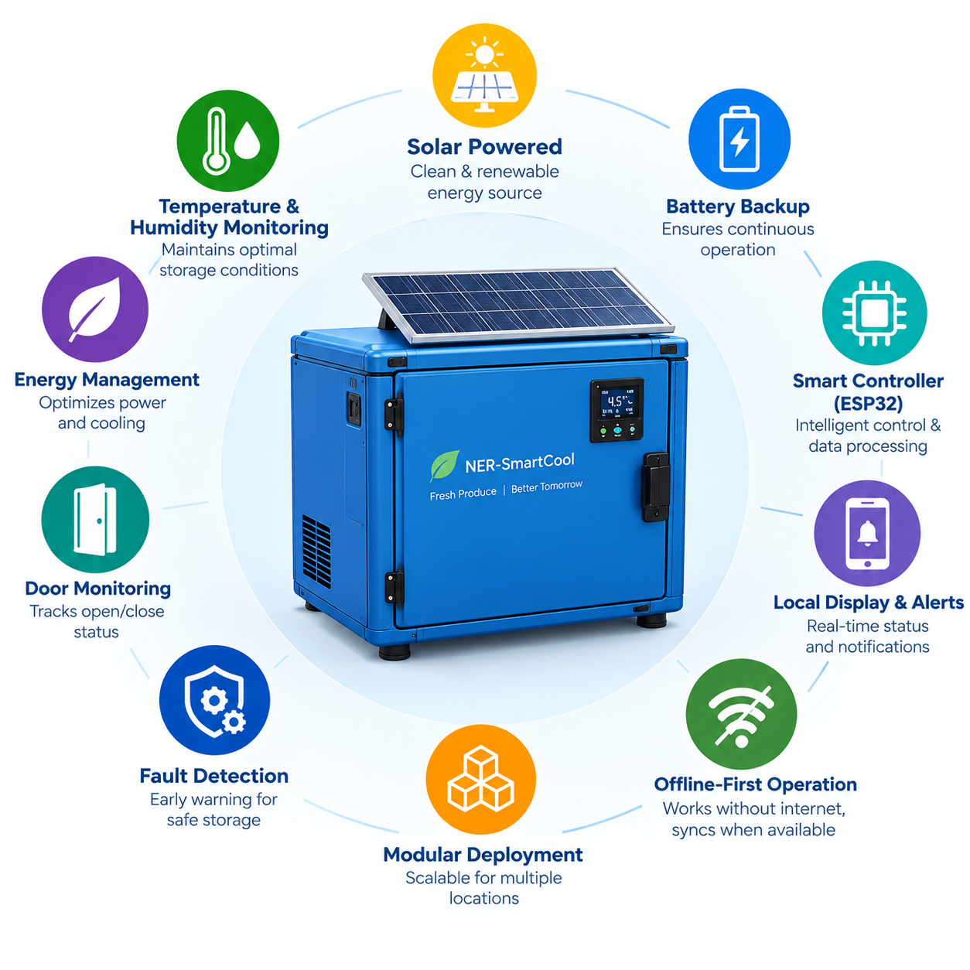
INVICTUS
SmartCool: Solar-Powered Smart Mini Cold Storage
SMART INDIA
HACKATHON
2026
Proposed Solution
A decentralized, solar-powered mini cold-storage unit for farm-gate, village collection centres and FPOs : a temporary storage buffer between harvest and transport.
Insulated chamber + DC compressor refrigeration + forced-air circulation, fed by Solar PV → MPPT → Battery → DC bus for unreliable-grid and off-grid sites.
ESP32 closed-loop control with hysteresis holds crop-specific temperature and humidity; energy-aware modes (Normal / Energy-Aware / Critical) protect produce on low battery.
Fault detection for high temperature, door-open, low battery, solar-charging and cooling failure, with local buzzer / LED / display alerts that need no internet.
Offline-first: RTC + MicroSD logging with store-and-forward sync (Wi-Fi / GSM) and a simple crop-select interface; set-points validated on the prototype.
Blockchain traceability: every sensor record is SHA-256 hashed and anchored to a blockchain ledger, giving a tamper-proof farm-to-fork audit trail.
Physical cold storage is the product; IoT is the supporting layer.
Low-Cost IoT Blockchain Node for Tamper-Proof Farm-to-Fork Cold-Chain Traceability with Offline Data Logging and Secure Environmental Monitoring
2

Slide 3
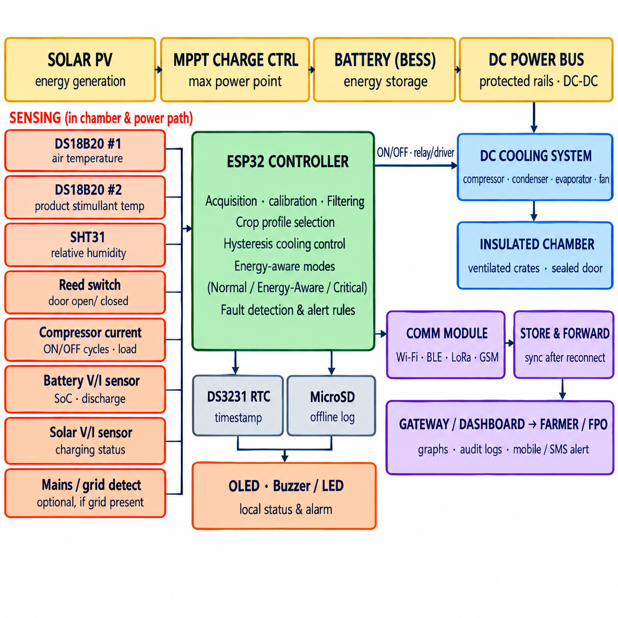
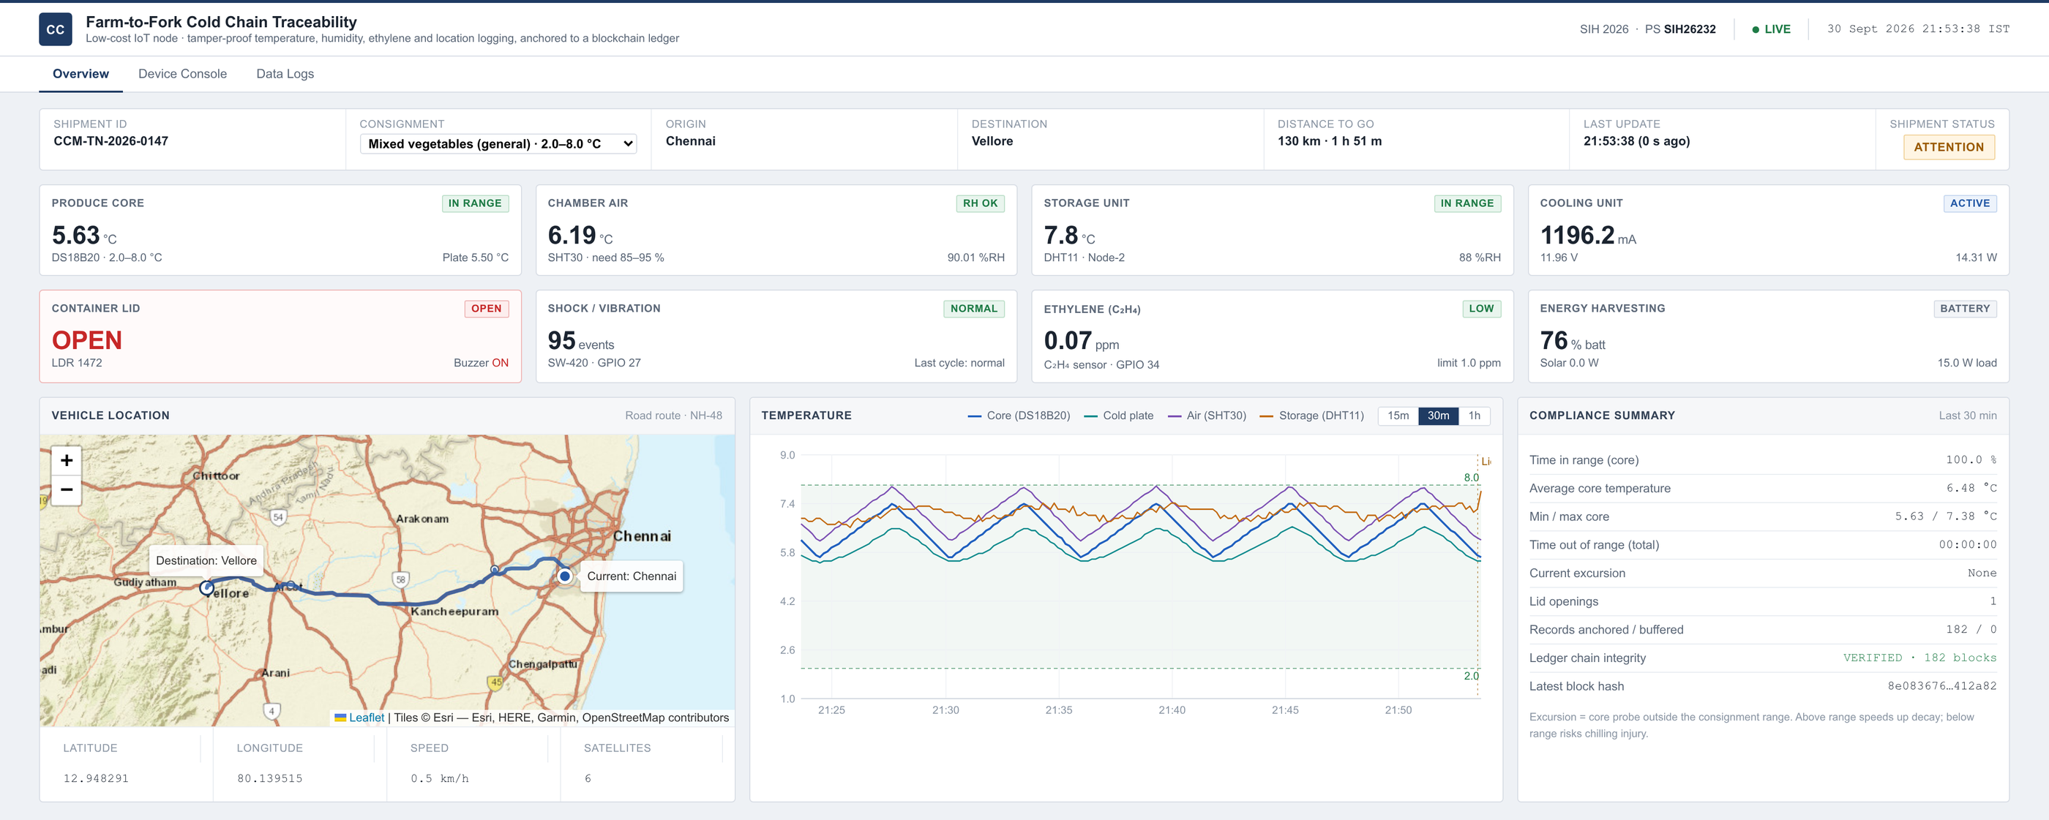
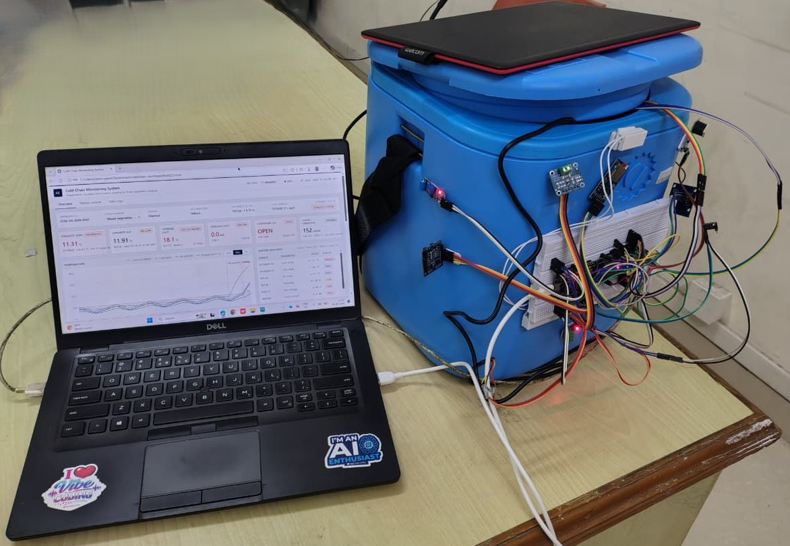
TECHNICAL APPROACH
SMART INDIA
HACKATHON
2026
INVICTUS
Dashboard
Techstack Used:
Solar PV + MPPT controller
Battery (BESS) + DC protection
DC compressor refrigeration
PU/PIR insulated chamber
ESP32 (Arduino / ESP-IDF C++)
6. Digital temp + RH sensors
7. Reed switch, V/I sensors
8. RTC + MicroSD, OLED/LCD
9. Wi-Fi / GSM / LoRa (optional)
10. Web dashboard (optional)
Prototype
3
Low-Cost IoT Blockchain Node for Tamper-Proof Farm-to-Fork Cold-Chain Traceability with Offline Data Logging and Secure Environmental Monitoring

Slide 4
INVICTUS
FEASIBILITY AND VIABILITY
SMART INDIA
HACKATHON
2026
Analysis of the feasibility of the idea | Potential challenges and risks | Strategies for overcoming these challenges
Technical – Achievable | Sizing solar, battery and cooling load for NER climate | Cooling-load and energy calculations before hardware selection; proven DC refrigeration, MPPT and standard sensors; ratings validated on the prototype.
Reliability – Resilient | Cloudy / rainy days, night, grid outages, no network | Solar + battery with energy-aware / critical modes; offline-first control, alerts and logging; fault detection for cooling, door and solar failure.
Operational – Practical | Unreliable power & connectivity; limited cold-storage access; limited technical support | Local data storage + cloud synchronization, Safe Holdover Time Prediction, intelligent alerts, farmer-friendly crop selection, local status display, offline-first operation, weather-resistant modular unit.
Given that feasibility and viability are our top priority we will ensure to keep everything
Technically viable – uses existing solar, DC refrigeration and ESP32 technology; one or two crops validated first.
Economically feasible – small modular units for FPO / collection-centre deployment; cost to be worked out after design.
Environmentally sound – renewable solar energy, energy-efficient cooling, designed to cut post-harvest and transport losses.
4
Low-Cost IoT Blockchain Node for Tamper-Proof Farm-to-Fork Cold-Chain Traceability with Offline Data Logging and Secure Environmental Monitoring

Slide 5
INVICTUS
IMPACT AND BENEFITS
SMART INDIA
HACKATHON
2026
Potential Impact on Target Audience
Benefits of the solution
1. Farmers
Reduces forced immediate sale and spoilage; flexible transport timing.
2. FPOs & Cooperatives
Shared, monitored local storage at aggregation points.
3. Village collection centres / traders
Better produce handling before transport to markets.
4. Remote NER communities
Cold-chain access without depending on grid supply.
5. Government / MDoNER
Scalable decentralized horticulture cold-chain model.
1. Social
Improves farmer bargaining flexibility; supports cooperatives.
2. Economic
Improves income opportunity by cutting post-harvest losses.
3. Environmental
Renewable solar energy; less wasted produce and transport.
4. Technological
Energy-aware, offline-first rural embedded system.
5. Strategic
Replicable modular units across horticultural clusters.
Validated on the working prototype:
Temperature stability
Cooling response
Solar charging
Battery backup
Safe Holdover Time Prediction
Alert response
Offline log retention
Vegetable quality check
Low-Cost IoT Blockchain Node for Tamper-Proof Farm-to-Fork Cold-Chain Traceability with Offline Data Logging and Secure Environmental Monitoring
5

Slide 6
INVICTUS
RESEARCH AND REFERENCES
SMART INDIA
HACKATHON
2026
Research Survey
Aspect | Conventional Systems | Proposed System
Location | Large centralized cold rooms, far from farms | Decentralized farm-gate / village mini units
Power | Grid-dependent | Solar + battery, energy-aware operation
Control | Basic thermostat | Closed-loop, crop-specific profiles
Monitoring | Manual checks, network-dependent | Offline-first logging + local alerts
Faults | Found after damage | Cooling / door / solar fault detection
Traceability | Paper records, easily altered | Blockchain-anchored, tamper-proof sensor logs
Reference
[1] FAO, “Global Food Losses and Food Waste – Extent, Causes and Prevention”, Rome (2011).
[2] ICAR-CIPHET, “Assessment of Quantitative Harvest and Post-Harvest Losses of Major Crops and Commodities in India”, Ludhiana (2015).
[3] National Centre for Cold-chain Development (NCCD) and National Horticulture Board (NHB): cold-chain infrastructure and horticulture data.
[4] MNRE / NABARD: solar-powered cold storage and agri-infrastructure guidelines.
[5] Peer-reviewed literature on solar PV–battery DC refrigeration and small-scale vegetable cold storage (to be shortlisted).
GitHub Repository (code, firmware, dashboard)
github.com/Sanmugavel1/SIH2026-FarmToFork-ColdChain
Solution Video
youtu.be/o2jbTQCLLzo
6
Low-Cost IoT Blockchain Node for Tamper-Proof Farm-to-Fork Cold-Chain Traceability with Offline Data Logging and Secure Environmental Monitoring

