Slide 1


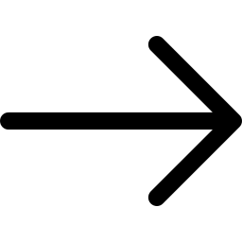
Text-to-Speech, Text Summarizer
UX Machine Learning SS/19 Susanne Clara

Slide 2
Frame the ML Problem
The ideal is creating audio files and books from PDF
An additional feature is the ability to summarize text and predict the genre

Slide 3
Prepare the Data
Data Format needs to be txt
PDF files must be transformed into txt
Data comes from free Data-Sets from Internet and Communities
https://cseweb.ucsd.edu/~jmcauley/datasets.html#goodreads
http://u.cs.biu.ac.il/~koppel/BlogCorpus.htm
https://blog.cambridgespark.com/50-free-machine-learning-
datasets-natural-language-processing-d88fb9c5c8da
Etc.
Aroud 0.5 million to 1 million available

Slide 4
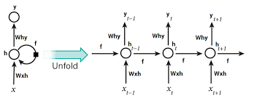
Train the ML Model
RNN - Recurrant neural network
“A recurrent neural network model is born with the capability to process long sequential data”
the network takes time into account

Slide 5
Predict using the Model
Car, Cleaning, physical work
→ Mobile, Smart Watch, MP3-Player etc.
Needs a big data Set!
The model probably doesn't need to be trained very often, because summarizing texts has often been done with machine learning and the community is very extended and this task has been done often.

Slide 6

Examples …

Slide 7
1984
big brother is watching you it was a bright cold day in april and the clocks were striking thirteen winston smith hurried home to victory mansions with his enormous the face of a handsome man of about fortyfive with a large black moustache the man s eyes seemed to follow

