Slide 1
FingerPrint Introduction
Wei Deng

Slide 2
Agenda
Background
Patterns & Minutiae features
Fingerprint sensors & working principle
Fingerprint recognition / Pattern Matching with algorithms
业界已有的指纹识别解决方案 (include vendor introduction)
SPI basic introduction
FPC1140 (Fingerprint Cards AB) introduction
Open & QA

Slide 3
Background
The analysis of fingerprints for matching purposes generally requires the comparison of several features of the print pattern. These include patterns, which are aggregate characteristics of ridges, and minutia points, which are unique features found within the patterns.^{[1]} It is also necessary to know the structure and properties of human skin in order to successfully employ some of the imaging technologies.
Ridge -- 背脊，峰，隆起线; 山脊
Minutia point -- 细节点, 特征点
fingerprint matching: imaging technology (for Pre-processing), pattern comparison (Pattern-based algorithms).

Slide 4
Patterns -- ridges
The three basic patterns of fingerprint ridges are the arch, loop, and whorl:
arch: (拱门;弓形;拱形物;) The ridges enter from one side of the finger, rise in the center forming an arc, and then exit the other side of the finger.
Loop (回路;圈，环;): The ridges enter from one side of a finger, form a curve, and then exit on that same side.
whorl: (螺纹;涡;轮生体;螺旋环) Ridges form circularly around a central point on the finger.

Slide 5
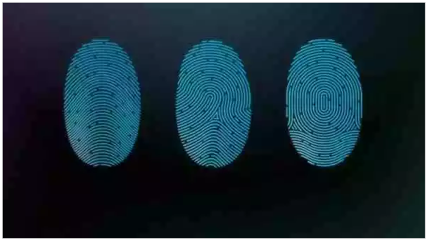
Patterns -- ridges

Slide 6
Patterns -- Minutiae features
The major minutia features of fingerprint ridges are ridge ending, bifurcation, and short ridge (or dot).
The ridge ending is the point at which a ridge terminates.
Bifurcations (分岔;分叉;) are points at which a single ridge splits into two ridges.
Short ridges (or dots) are ridges which are significantly shorter than the average ridge length on the fingerprint.

Slide 7
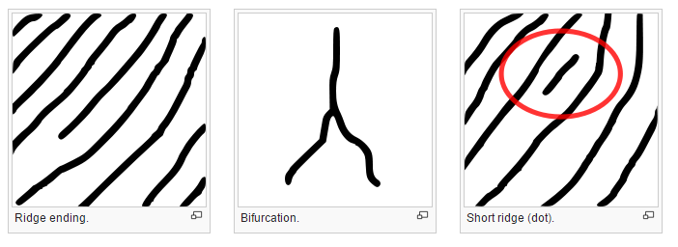
Patterns -- Minutiae features

Slide 8
Fingerprint sensors
A fingerprint sensor is an electronic device used to capture a digital image of the fingerprint pattern.
The captured image is called a live scan. This live scan is digitally pre-processed to create a biometric template (a collection of extracted features) which is stored and used for matching.
Many technologies have been used, including: optical, Capacitance, ultrasonic, etc.

Slide 9
Optical
Optical fingerprint imaging involves capturing a digital image of the print using visible light.
This type of sensor is, in essence, a specialized digital camera. The top layer of the sensor, where the finger is placed, is known as the touch surface. Beneath this layer is a light-emitting phosphor layer which illuminates the surface of the finger.
The light reflected from the finger passes through the phosphor layer to an array of pixels which captures a visual image of the fingerprint.
A scratched or dirty touch surface can cause a bad image of the fingerprint. A disadvantage of this type of sensor is the fact that the imaging capabilities are affected by the quality of skin on the finger. For instance, a dirty or marked finger is difficult to image properly.
Fingerprints can be read from a distance.

Slide 10
Ultrasonic
Ultrasonic sensors make use of the principles of medical ultrasonography in order to create visual images of the fingerprint.
Unlike optical imaging, ultrasonic sensors use very high frequency sound waves to penetrate the epidermal layer of skin.
The sound waves are generated using piezoelectric transducers and reflected energy is also measured using piezoelectric materials. Since the dermal skin layer exhibits the same characteristic pattern of the fingerprint, the reflected wave measurements can be used to form an image of the fingerprint.
This eliminates the need for clean, undamaged epidermal skin and a clean sensing surface.
Qualcomm introduced Ultrasonic sensor in smartphone chipset.^{[3]} LeEco became the first company to introduce this in Smartphone.^{[4]}

Slide 11
Capacitance
Capacitance sensors use principles associated with capacitance in order to form fingerprint images.
In this method of imaging, the sensor array pixels each act as one plate of a parallel-plate capacitor, the dermal layer (which is electrically conductive) acts as the other plate, and the non-conductive epidermal layer acts as a dielectric.
Each sensor pixel is used to measure the capacitance at that point of the array.
The capacitance varies between the ridges and valleys of the fingerprint due to the fact that the volume between the dermal layer and sensing element in valleys contains an air gap.
The dielectric constant of the epidermis and the area of the sensing element are known values. The measured capacitance values are then used to distinguish between fingerprint ridges and valleys.
The iPhone 6 uses a capacitance fingerprint sensor.

Slide 12
Fingerprint recognition with Pattern-based algorithms
Matching algorithms are used to compare previously stored templates of fingerprints against candidate fingerprints for authentication purposes. In order to do this, either the original image must be directly compared with the candidate image or certain features must be compared.
Pre-processing
Pattern-based algorithms

Slide 13
Pre-processing
Pre-processing helped enhancing the quality of an image by filtering and removing unnecessary noises.
The minutiae based algorithm only worked effectively in 8-bit gray scale fingerprint image. A reason was that an 8-bit gray fingerprint image was a fundamental base to convert the image to 1-bit image with value 0 for ridges and value 1 for furrows.
As a result, the ridges were highlighted with black color while the furrows were highlighted with white color. This process partly removed some noises in an image and helped enhance the edge detection.
Furthermore, there are two more steps to improve the best quality for the input image: minutiae extraction and false minutiae removal.
The minutiae extraction was carried out by applying ridge thinning algorithm which was to remove redundant pixels of ridges. As a result, the thinned ridges of the fingerprint image are marked with a unique ID so that further operation can be conducted.
After the minutiae extraction step, the false minutiae removal was also necessary.The lack of the amount of ink and the cross link among the ridges could cause false minutiae that led to inaccuracy in fingerprint recognition process.

Slide 14
Pattern-based algorithms
Pattern based algorithms compare the basic fingerprint patterns (arch, whorl, and loop) between a previously stored template and a candidate fingerprint.
This requires that the images can be aligned in the same orientation. To do this, the algorithm finds a central point in the fingerprint image and centers on that.
In a pattern-based algorithm, the template contains the type, size, and orientation of patterns within the aligned fingerprint image. The candidate fingerprint image is graphically compared with the template to determine the degree to which they match.
There are several techniques to match fingerprints such as correlation-based matching, minutiae-based matching, ridge feature-based matching and minutiae-based algorithm. However, the most popular algorithm was minutiae based matching algorithm due to its efficiency and accuracy.

Slide 15
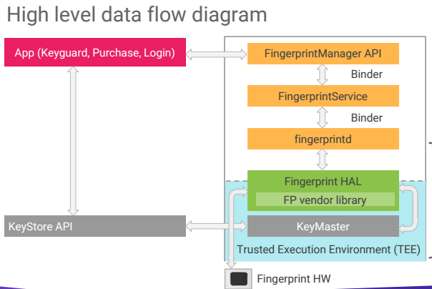
FP HAL API: enroll() & authenticate()

Slide 16
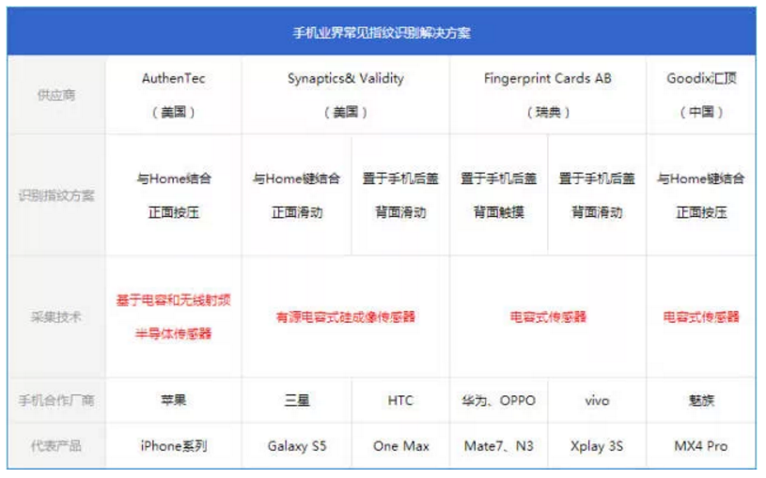
手机业界常见的指纹识别解决方案

Slide 17
AuthenTec(美国)
AuthenTec 是世界领先的PC、无线设备以及访问控制市场指纹认证传感器和解决方案的提供商。而在2012年7月27日，苹果以3.56亿美元收购了该公司。从此AuthenTec隶属于苹果。
其研发的指纹识别传感器是基于电容和无线射频的半导体，传感器是与iPhone和iPad的Home键相结合，最上层为蓝宝石盖板。该传感器是由台积电完成晶圆代工，台湾精材、晶方科技完成晶圆级封装，日月光负责后续封装与测试以及SiP模组制作。
面向对象：只对苹果旗下的手机以及平板产品开放，不向同行业厂商提供任何产品以及技术，但是对银行安全以及管理业务可以提供（笔者感觉是为Apple Pay做铺垫）。

Slide 18
新思Synaptics Validity（美国）
简介：Synaptics是全球领先的移动计算、通信和娱乐设备人机界面交互开发解决方案设计制造公司。其成立于1986年，总部在美国。2013年10月17日时，以2.55亿美元的价格收购了生物ID识别公司Validity，正式进军指纹识别领域。
面向对象：三星Galaxy S5以及去年发布的HTC One Max都是采用的Synaptics的设计方案，不过稍显不同的是，S5采用正面与Home键结合，而HTC One Max则采用背部识别方案，虽说在指纹识别位置上有所不同，但是方案确实一样的。

Slide 19
Fingerprint Cards AB (FPC)
简介：FPC致力于开发、生产和销售生物识别元件和技术，帮助通过分析和比对个人独特的指纹确认用户的身份，总部在瑞典哥德堡，并在纳斯达克上市。其推出全球首个使用Android智能手机和平板的电容式触摸指纹传感器—FPC1020。
面向对象：其面向的对象有很多，大家所熟知的就是vivo Xplay 3S、华为Mate7以及OPPO N3，三个都是将传感器置于背部，不过解锁方式稍微有所不同。
GLV should use FPC1150.

Slide 20
Goodix汇顶科技（中国）
简介：汇顶科技成立于2002年，于2006年开始进军触控行业。汇顶科技立足于全球领先的人机交互技术研发及芯片设计，汇顶科技现作为MTK唯一战略合作伙伴，具有丰富的电容触摸芯片的量产经验并拥有完善的触控测试系统和测试标准，已经拥有电容触控技术专利超过30项。
面向对象：目前手机市场上只有魅族MX4 Pro，这也是国内手机厂商首创正面按压式指纹识别方案.

Slide 21
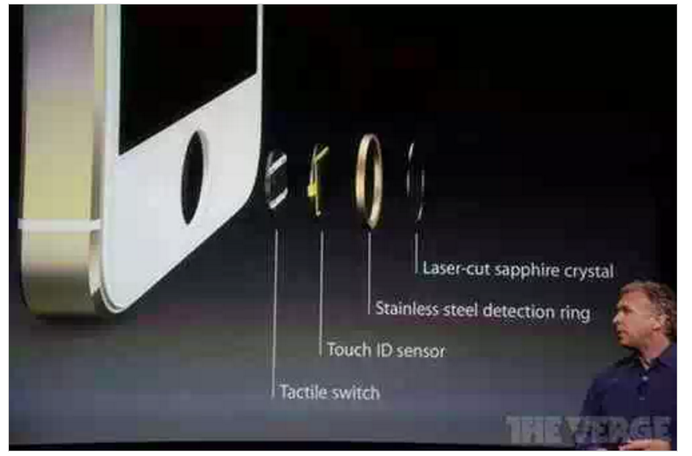
iPhone 5S/6指纹识别原理：

Slide 22
iPhone 5S/6指纹识别原理：
iPhone 5S/6的Touch ID指纹传感器被放置在Home键中，Home键传感器表面由激光切割的蓝宝石水晶制成，能够实现精确聚焦手指，保护传感器的作用，并且传感器会在此时进行指纹信息的纪录与识别，而传感器按钮周围则是不锈钢环，用于监测手指，激活传感器和改善信噪比。随后，软件将读取指纹信息，查找匹配指纹来解锁手机。
其中指纹传感器部分在开始表格中提到的基于电容和无线射频的半导体传感器，这位指纹读取做了两层验证。第一层是借助了一个指纹电容传感识别器来识别整个接触面的指纹图像。第二层则是利用无线射频技术并通过蓝宝石片下面的感应组件读取从真皮层反射回来的信号，形成一幅指纹图像。

Slide 23
iPhone 5S/6指纹识别原理：
无线射频识别：将一个低频的射频信号发射到真皮层。由于人体细胞液是导电的，通过读取真皮层的电场分布从而获得整个真皮层最精确的图像，而Touch ID外面有一个驱动环,由它将射频信号发射出来。
经过对指纹图像的纪录，将数据录入到数据库中，然后Touch ID在指纹验证过程中，获得指纹扫描图像之后，其能够对指纹进行360度全方位扫描并且与数据库指纹数据进行比对判断。当新的指纹图像与数据库样本指纹互相匹配成功，该指纹图像就能够用于加强和完善数据库的样本信息，这样能够使得更多的样本信息被纪录了，提高指纹识别的成功率以及能够在各种角度成功的识别指纹。

Slide 24
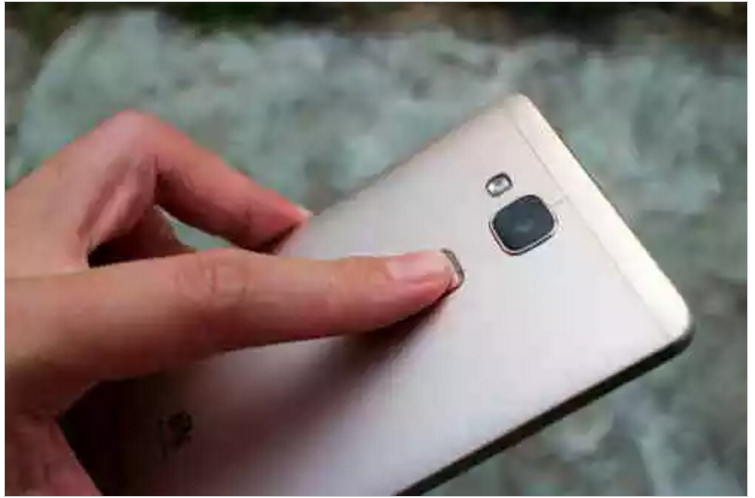
华为Mate 7指纹识别原理
华为Mate 7 采用瑞典FPC公司的FPC1020指纹识别方案 ，该方案是将传感器置于手机后盖中，虽说是按压式指纹识别技术，但是它应该属于接触式。只需要将手机轻轻放在解锁区域，就能够进行解锁。

Slide 25
华为Mate 7指纹识别原理
华为Mate7指纹传感器上覆盖一层银色镀膜，指纹识别区域和后壳之间还有一圈环形金属状，类似于包裹住iphone5s指纹感应区的不锈钢探测环（Stainless steel detection ring），这个金属环除了充当指纹触发器感觉还可以有很多功能。此外成熟的FPC1020的面积是现阶段其他手机的面积中最大的。

Slide 26
Mate 7指纹识别安全性
华为是基于芯片硬件的安全解决方案。指纹加密，存储，校验的程序是运行在海思芯片里物理隔离的安全OS中，安卓环境下的程序无法直接访问，即使手机被root后，这部分仍然不能被访问和篡改。
手机并不会保存指纹图像，只会去保存提取后的模板信息，当然通过指纹模板是不能还原出指纹图像的。在所录入的所有指纹模板信息在手机中是手机本身利用AES256算法进行加密的，每个芯片都有独一无二的密钥，这个密钥在芯片出厂时就是被一次性熔断写入的，根本无法从外部读取和修改。指纹模板数据只能写入和删除，无法读取和修改，自然也不会上传任何服务器，更不会被任何第三方程序读取。

Slide 27
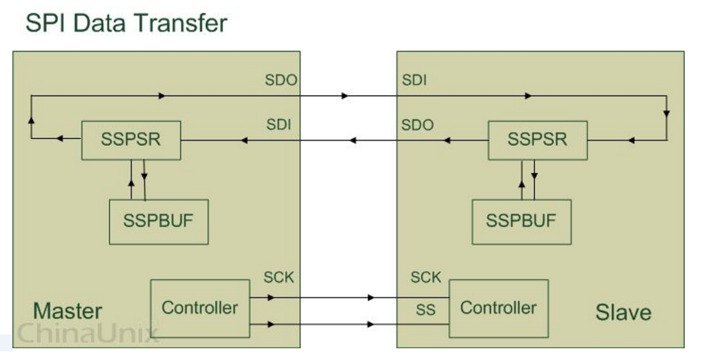
SPI: Serial Perripheral Interface
Notes:
同步串行接口技术

Slide 28
FPC1140
A capacitive touch fingerprint sensor with low power consumption. The FPC1140 sensor includes the following features: • Fingerprint area sensor • Superior 3D image quality • 508 dpi resolution • 56 x 196 pixels with 8-bit depth (with 256 greyscale values in each pixel ) • High-speed SPI interface • Ultra-low power consumption • 1.8 Volt operation • Extended ESD range 30kV • Wake-up functionality

Slide 29
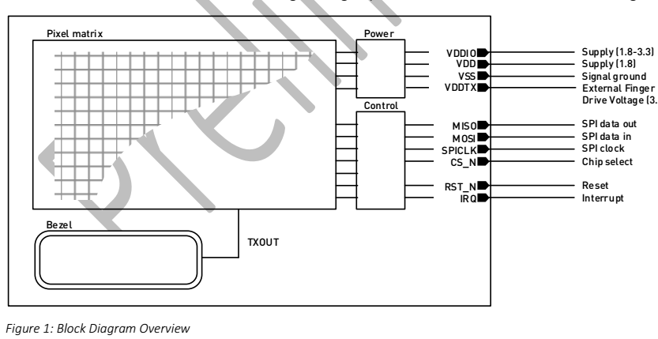
Block Diagram

Slide 30
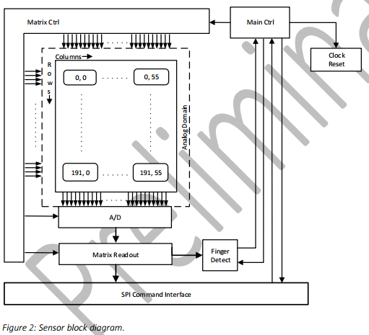
Principal Block Diagram

Slide 31
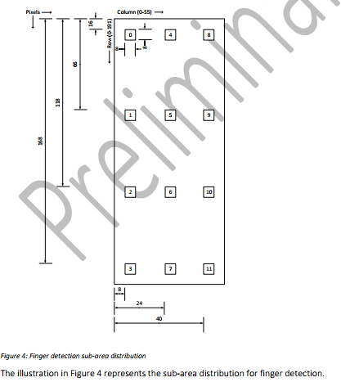
Finger Detection
Notes:
Reduced size sub-area sets are captured to detect if and where a finger is placed on the sensor, without doing a full image capture. This decreases capture response time and improves performance. The sensor uses 12 pre-defined sub-areas of 8x8 pixels each. These sub-areas are arranged in four evenly distributed rows. Each of the four rows has three sub-areas, which are evenly distributed, horizontally.

Slide 32
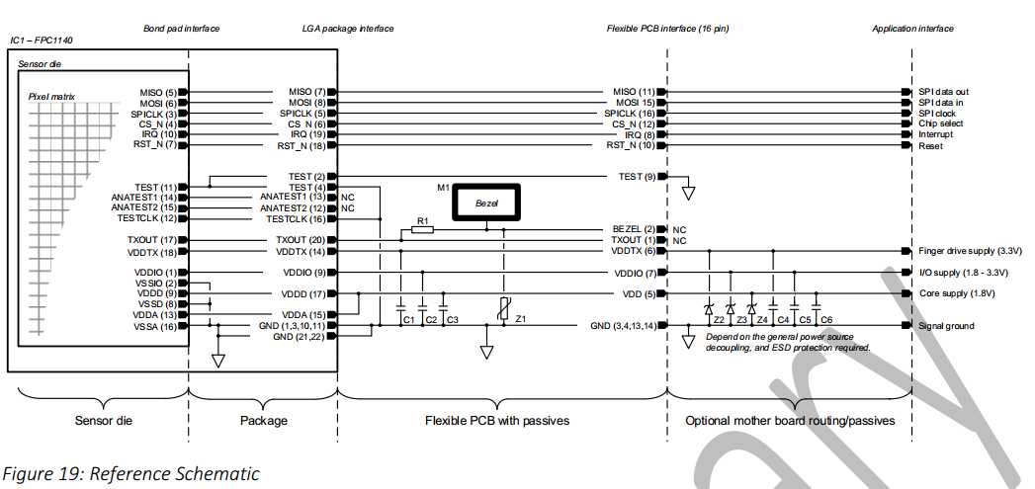
Reference Schematic

Slide 33
Open
Authenticate(): who will provide the lib/functionality for pattern-based algorithms for template comparison.
Where to find vendor lib? How to use it?

Slide 34
Q & A
THANK YOU.

