Slide 1
Power system fault detection and classification using machine learning
CAPSTONE PROJECT
Presented By:
Krishna Pranab Chatterjee – Narula Institute of Technology - CSE

Slide 2
OUTLINE
Problem Statement
Proposed System/Solution
System Development Approach (Technology Used)
Algorithm & Deployment
Result (Output Image)
Conclusion
Future Scope
References

Slide 3
Problem Statement
The challenge is to design a machine learning model capable of detecting and classifying various faults in a power distribution system. Using electrical measurement data such as voltage and current phasors, the model should accurately differentiate between normal operating conditions and multiple fault types, including line-to-ground, line-to-line, and three-phase faults. The primary objective is to achieve rapid and precise fault identification to ensure the stability and reliability of the power grid.

Slide 4
Proposed Solution
Develop a machine learning model that classifies power system faults using the dataset provided. The model will process electrical measurements to identify the type of fault rapidly and accurately. This classification will help automate fault detection and assist in quicker recovery actions, ensuring system reliability.
Key components:
Data Collection: Use the Kaggle dataset on power system faults.
Preprocessing: Clean and normalize the dataset.
Model Training: Train a classification model (e.g., Decision Tree, Random Forest, or SVM).
Evaluation: Validate the model using accuracy, precision, recall, and F1-score.

Slide 5
System Approach
The "System Approach" section outlines the overall strategy and methodology for developing and implementing the power system fault detection and classification. Here's a suggested structure for this section:
System requirements:
IBM Cloud(mandatory)
IBM Watson studio for model development and deployment
IBM cloud object storage for dataset handling

Slide 6
Algorithm & Deployment
Algorithm Selection:
Random Forest Classifier (or SVM based on performance)
Data Input:
Voltage, current, and phasor measurements from the dataset.
Training Process:
Supervised learning using labelled fault types.
Prediction Process:
Model deployed on IBM Watson Studio with API endpoint for real-time predictions.

Slide 7
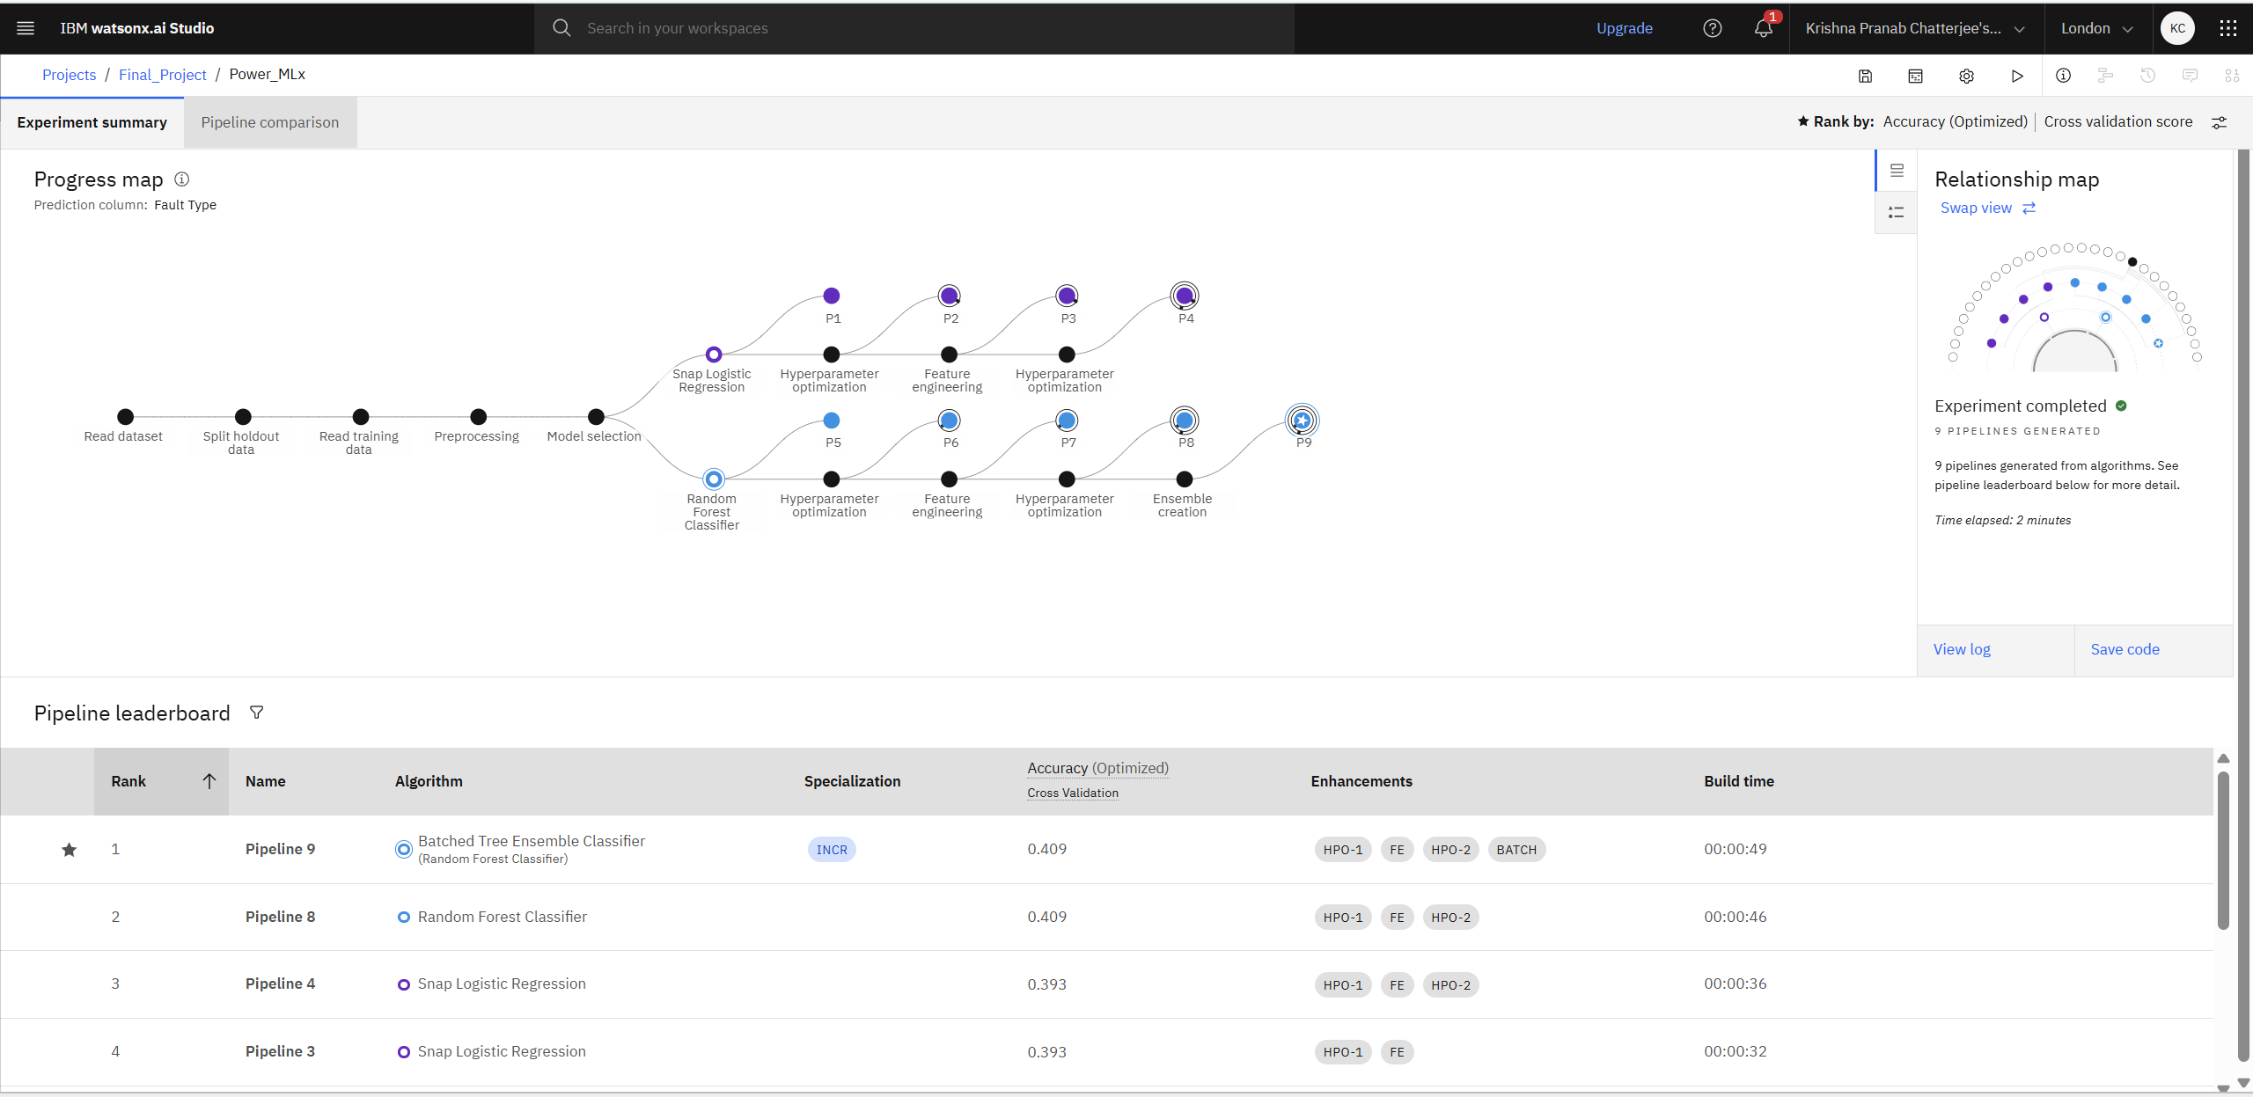
Result

Slide 8
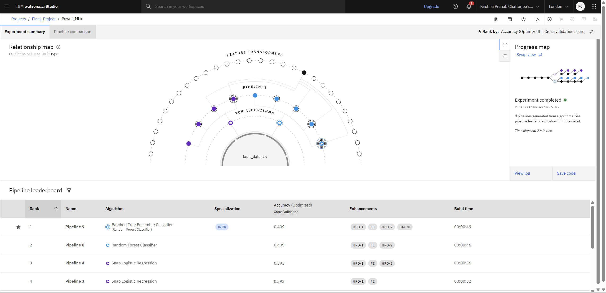
Result

Slide 9
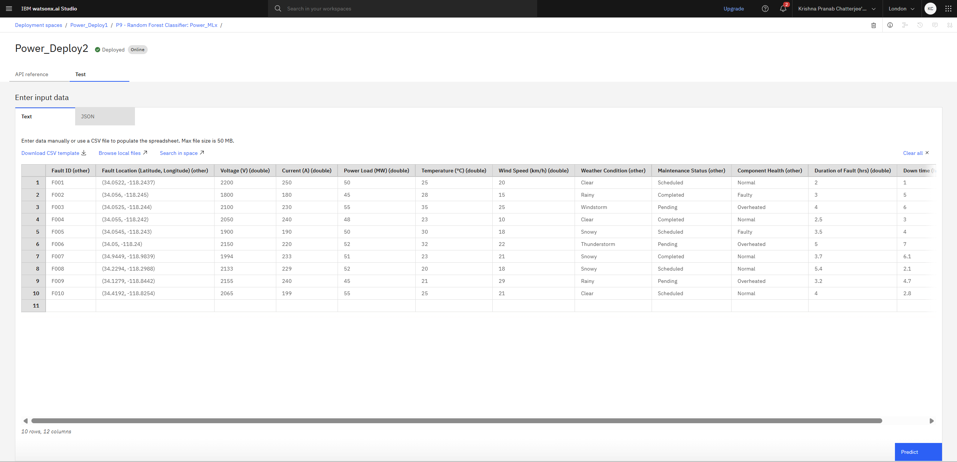
Result

Slide 10
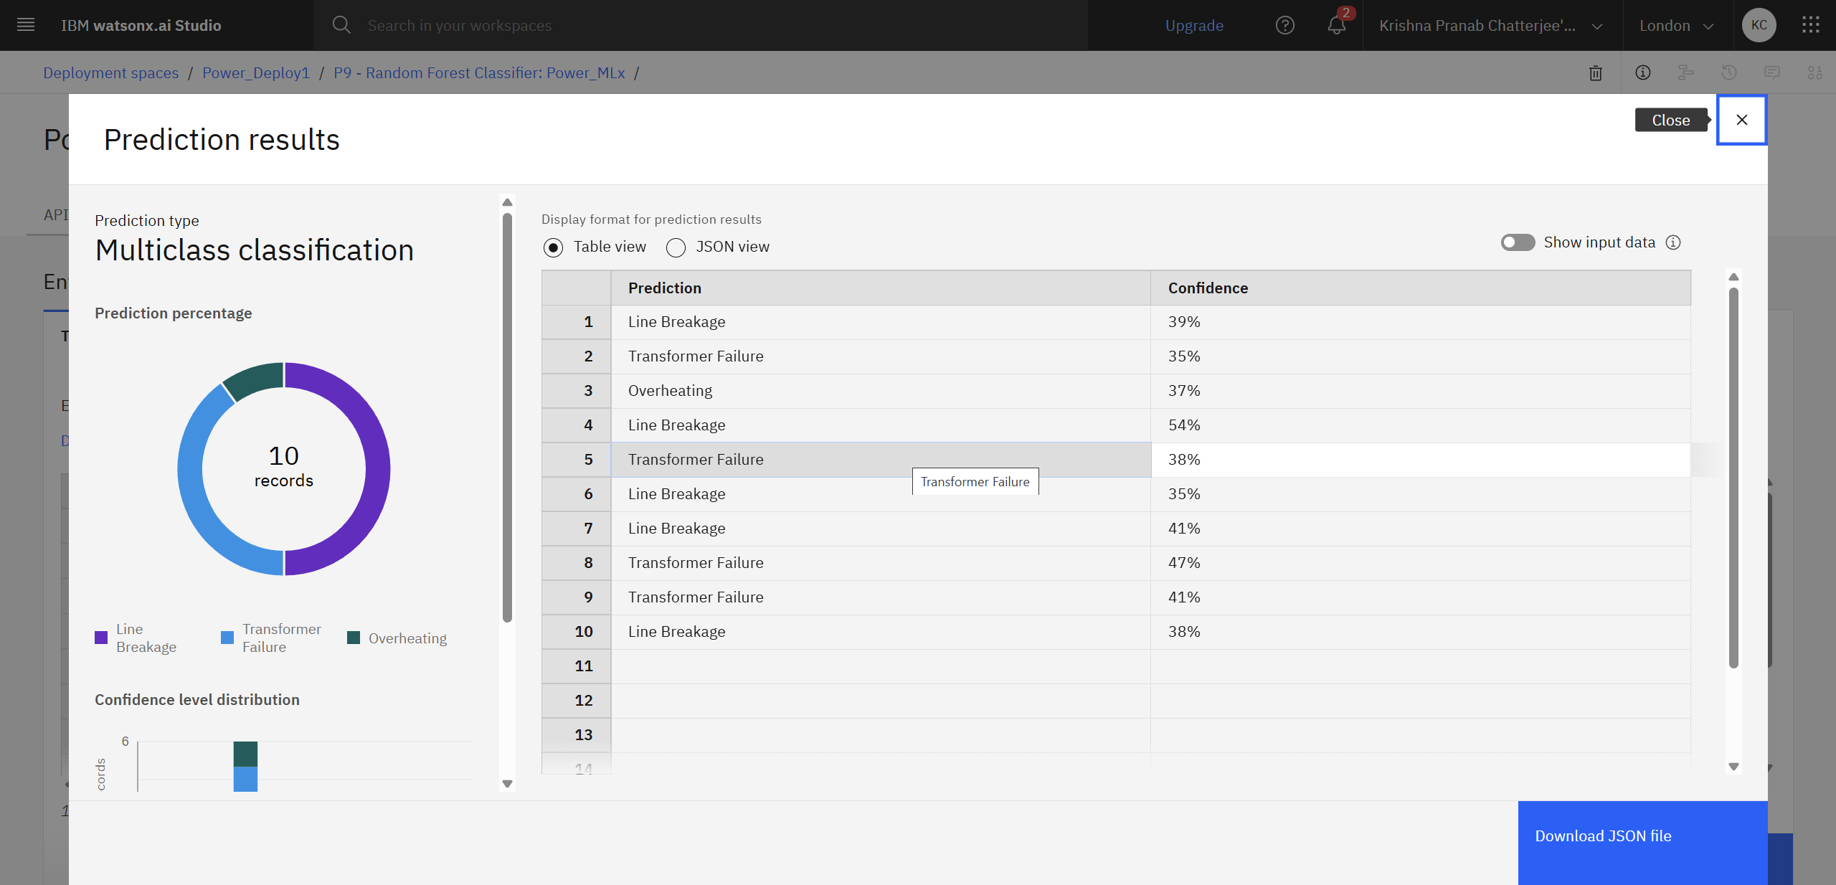
Result

Slide 11
Conclusion
The proposed machine learning model successfully detects and classifies various power system faults using voltage and current phasor data. It accurately distinguishes between normal and fault conditions, enabling rapid identification of line-to-ground, line-to-line, and three-phase faults. This approach enhances fault response speed, improves grid reliability, and supports stable power system operation.

Slide 12
Future scope
The proposed machine learning-based fault detection and classification model can be extended for real-time deployment in power grid monitoring systems to ensure faster and more reliable fault management. Future developments may include scalability to larger transmission networks, integration with renewable energy systems, and implementation on IoT or edge devices for low-latency detection. The model can also be enhanced to locate faults accurately, adapt through continuous learning, and incorporate multi-source data such as environmental and weather conditions, ultimately improving the stability, resilience, and security of modern power systems.

Slide 13
References
This project leverages IBM Cloud’s Condition Monitoring framework in Cloud Pak for Data and watsonx.ai Studio to design and train machine learning models—such as Random Forest, Support Vector Machine (SVM), and Deep Neural Networks—for detecting and classifying faults in a power distribution system. It builds on IBM’s anomaly detection methodologies to distinguish between normal and fault conditions using voltage and current phasor data. The approach also draws from IBM Cloud Pak for AIOps, which processes telemetry for real-time anomaly alerts, and IBM Research’s deep learning techniques for large-scale time-series anomaly detection, ensuring rapid and accurate fault identification for grid stability.

Slide 14
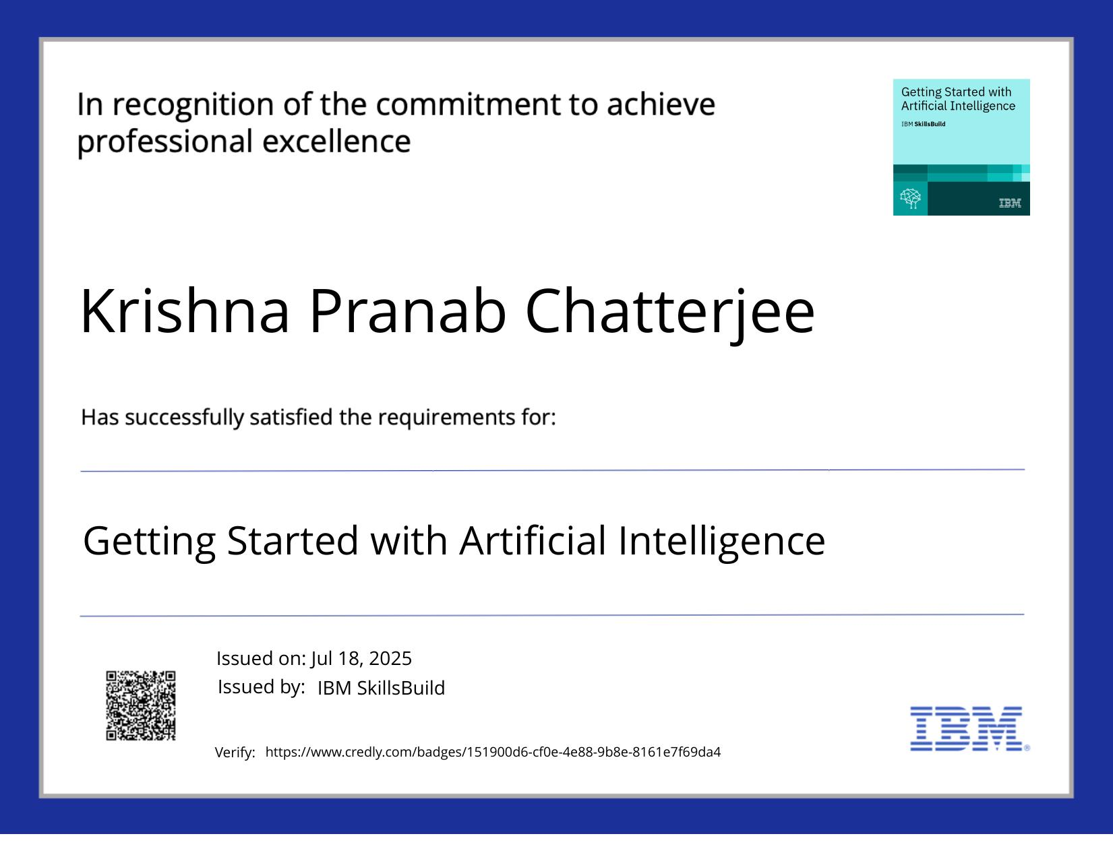
IBM Certifications
Getting Started with Artificial Intelligence:

Slide 15
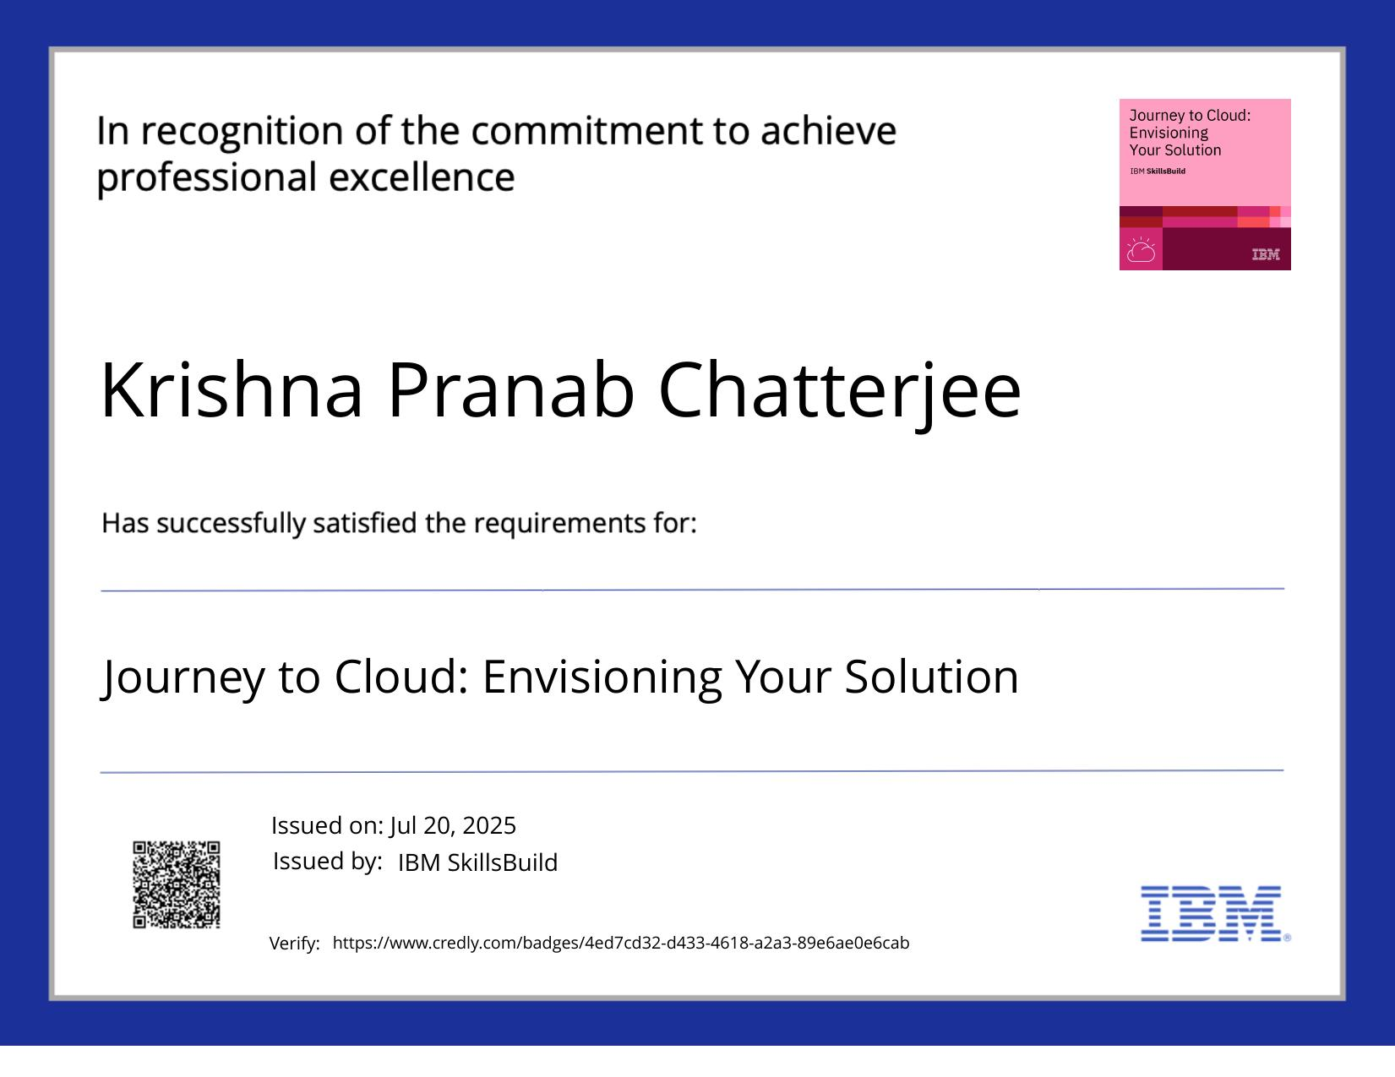
IBM Certifications
Journey to Cloud: Envisioning Your Solution

Slide 16
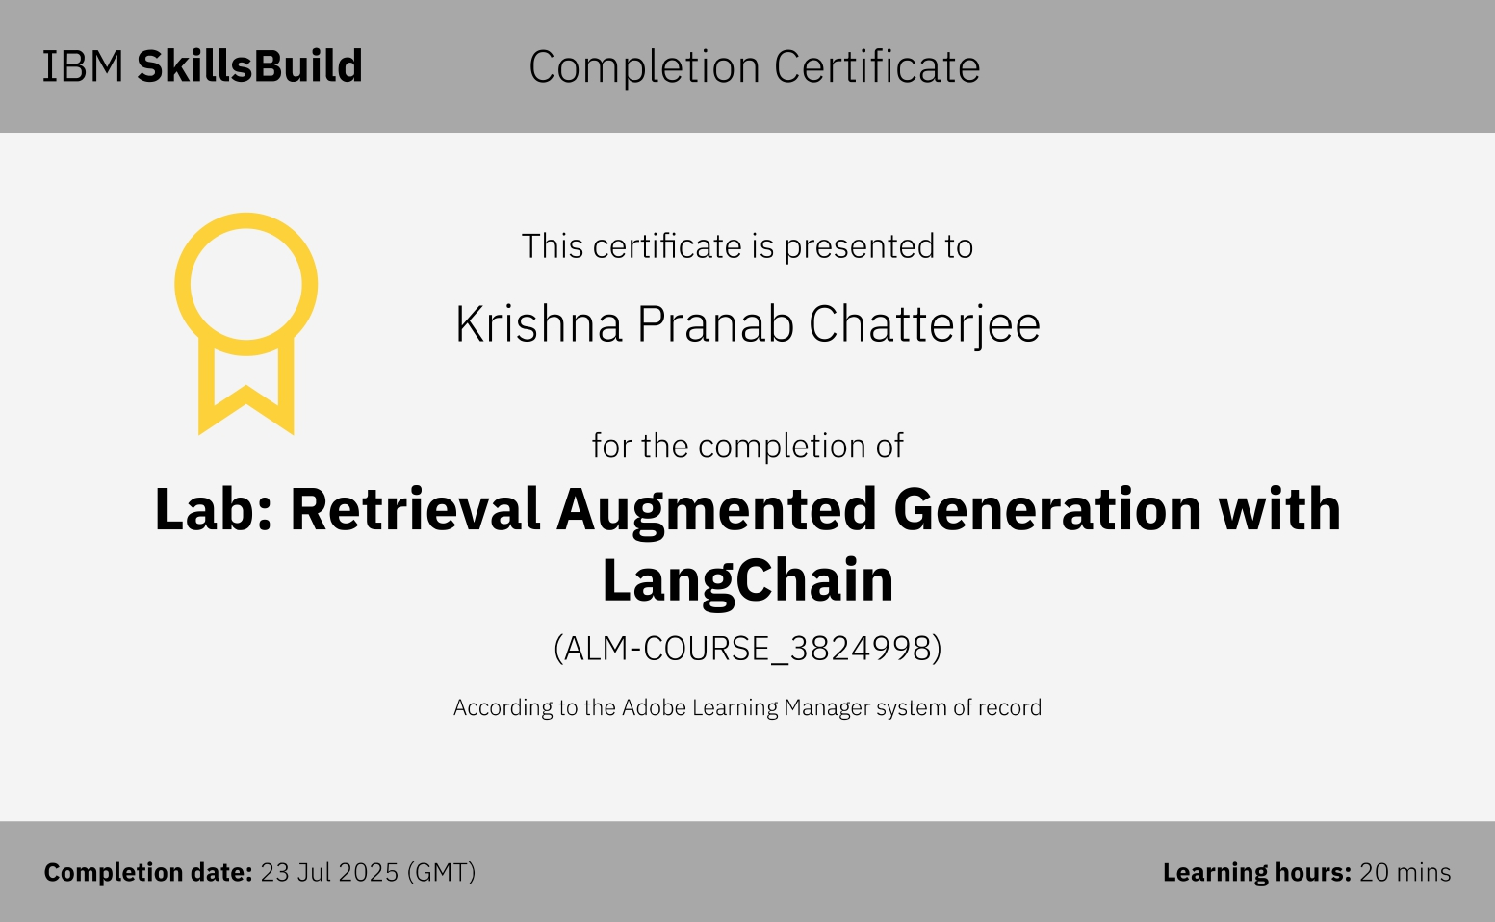
IBM Certifications
Lab: Retrieval Augmented Generation with LangChain

Slide 17
THANK YOU

