Slide 1
Custom Conjugate Gradient Optimization for Stock Price Prediction
An Application Of CG & Fibonacci Method in Finance Domain
By Group 6: Sannidhya Das(419), Siddhartha Sen(423), Soumyadeep Roy(430), Suchibrata Patra(403), Dipanjan Chakraborty(437), Peyasi Mondal(420)

Slide 2
Introduction:
In today’s dynamic financial markets, accurate stock price prediction has become essential for data-driven investment strategies. With increasing volatility and complex market behavior, developing robust predictive models that generalize across varying conditions is both a challenge and a necessity.
This project focuses on weight optimization for stock price prediction, aiming to determine the optimal weight vector for a linear regression model that predicts normalized stock closing prices of companies such as MSFT, AAPL, NFLX etc. By optimizing model parameters, we seek to minimize prediction error and enhance forecasting accuracy.
To achieve this, we employ numerical optimization techniques the Fibonacci Search Method and Conjugate Direction Method to efficiently minimize the Mean Squared Error (MSE) and compare their performance in convergence and accuracy.

Slide 3
Problem Statement
Objective
Accurately predicting stock prices is a complex task that requires efficient and reliable optimization techniques. Traditional linear regression methods, while conceptually simple, can differ significantly in performance and accuracy depending on the optimization strategy used to estimate model parameters. In the context of financial modeling, it becomes essential to evaluate how different optimization algorithms; both analytical and iterative behave when applied to real stock data. There exists a need for a systematic framework that not only implements these methods but also provides a comparative understanding of their computational efficiency, convergence behavior, and predictive capability.
The primary objective of this study is to develop and analyze the StockPriceOptimizer class, a Python-based framework designed to fit linear regression models to historical stock price data using three distinct optimization approaches: the analytical Least Squares method, Scipy’s Conjugate Gradient (CG) implementation, and a custom-built Conjugate Gradient algorithm. By implementing and comparing these methods, the framework aims to validate algorithmic correctness, highlight the mathematical principles behind each approach, and empirically assess their performance across diverse financial datasets. Ultimately, the goal is to provide deeper insights into the trade-offs between different optimization strategies in linear regression for financial modeling.

Slide 4
Scope and Significance
The scope of this report extends beyond the mere implementation of regression algorithms it encompasses the full analytical lifecycle of evaluating optimization methods in a financial context. The StockPriceOptimizer class is designed to process real-world stock price data, construct linear models, and measure the performance of three optimization techniques under consistent experimental conditions. The analysis includes examining convergence behavior, computational efficiency, and model accuracy across multiple financial tickers.
The significance of this work lies in its ability to bridge theoretical understanding with practical application. By comparing both built-in and custom optimization routines, the study provides valuable insights into the strengths and limitations of different regression solvers. This not only aids in selecting the most suitable optimization approach for stock price modeling but also contributes to a deeper comprehension of how algorithmic design choices impact predictive performance in quantitative finance.

Slide 5
About The Dataset
The dataset contains 25,160 records of daily stock market data collected through web scraping from NASDAQ.
It covers 10 major companies i.e, Apple (AAPL), Microsoft (MSFT), Tesla (TSLA), Amazon (AMZN), Meta, Netflix (NFLX), Qualcomm (QCOM), Cisco (CSCO), Starbucks (SBUX), and AMD each contributing 2,516 records, ensuring a balanced dataset across firms.
Each record represents a company’s trading activity for a specific date, including Open, High, Low, Close/Last, and Volume, forming a time-series dataset ideal for stock trend modeling and optimization.
Dataset link: Stock Market: Historical Data of Top 10 Companies

Slide 6
Ticker-Level Filtering
We subset the dataset to the chosen ticker symbol, which prevents cross-company mixing and ensures all model signals represent only the asset under study.
Numeric Normalization of OHLCV + Target
Price and volume fields often arrive as formatted text (e.g., $123.45, 1,200,000). We remove currency symbols and commas convert values to numeric using coercion This ensures no string artifacts corrupt the computation.
Date Standardization
The date column is parsed into a proper datetime type. Which enabled sorting, slicing, and temporal computation with full consistency.
Missing-Value Enforcement
Rows with missing required values (features or target) are dropped. Since regression cannot rely on incomplete observations, this avoids hidden distortions and preserves data integrity.
Data Cleaning & Preprocessing
1
2
3
4

Slide 7
(data cleaning & preprocessing continued……)
5
Time-Index Feature Creation
We engineer Days_Since_Start by measuring the number of days since the first trading date in the ticker’s history.This numeric time feature allows a linear model to interpret long-term price evolution even though raw date values aren’t directly meaningful.
Time-Based Train/Test Split
Data is divided strictly by date:
Training uses only remote/historical observations and Testing uses future observations
This avoids information leakage and ensures performance reflects a true forward-looking environment.
Feature Standardization (Z-Score)
Feature columns are standardized using mean and standard deviation calculated only from the training period.
Which ensured
features share a comparable scale
numerical optimization (e.g., CG) remains stable
test data is transformed consistently without leaking future information
A safety guard handles zero-variance features to avoid divide-by-zero errors.
Bias Term Augmentation
A column of ones is added to the feature matrix to support an intercept term inside the linear model.
This gives the model the ability to learn baseline price levels rather than forcing predictions to pass through zero.
6
7
8

Slide 8
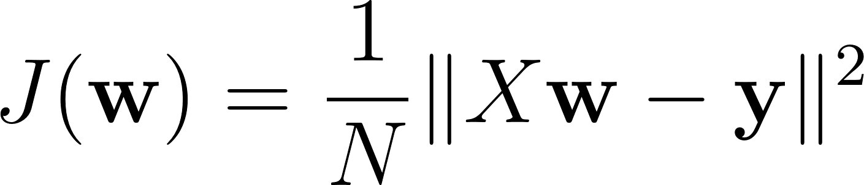
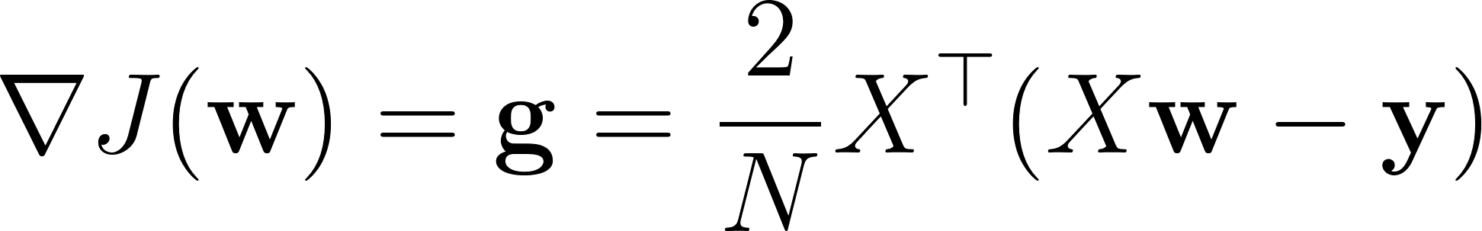
Methodology:
In this project we aim to determine the optimal weight vector w for a linear regression model that predicts normalized stock closing prices (e.g., MSFT, AAPL, NFLX).
Objective Function: Mean Squared Error (MSE)
The optimization objective is the Mean Squared Error (MSE), which is quadratic and convex, ensuring stable convergence during optimization.
Analytical Gradient Function
The gradient defines the direction of steepest ascent and plays a crucial role in initializing the Conjugate Gradient (CG) method and updating residuals.

Slide 9
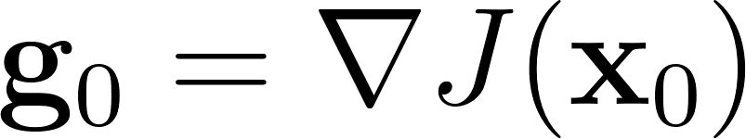


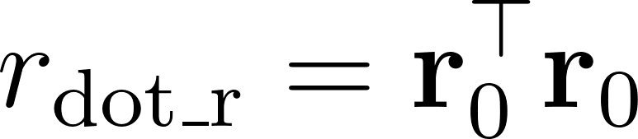
Custom Conjugate Gradient Initialization: (methodology continued……)
The custom CG implementation (_conjugate_gradient_custom) iteratively updates the weights with tolerance tol = 10^{-6} and max_iter = 1000.
Step 0: Initialization (i = 0)
1. Initial Weights:
2. Initial Gradient:
3. Initial Residual (Negative Gradient):
4. Initial Search Direction:
5. Pre-calculation:

Slide 10
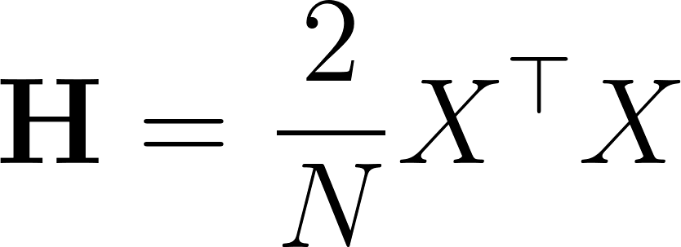
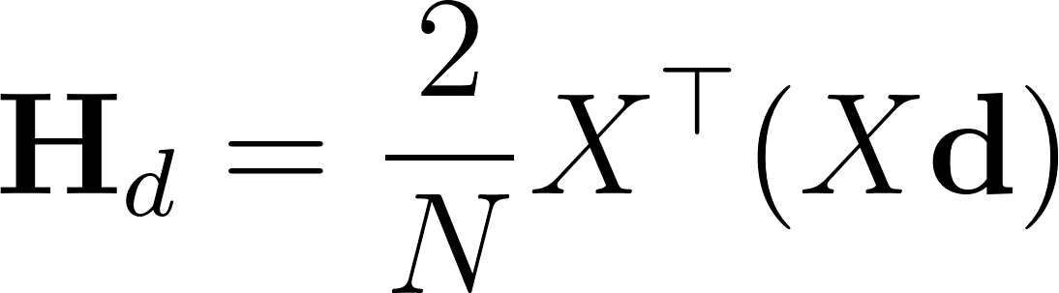
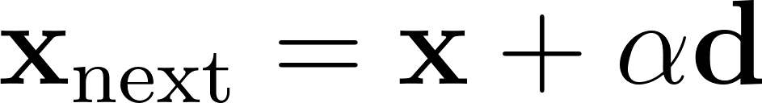
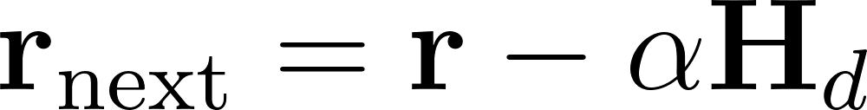
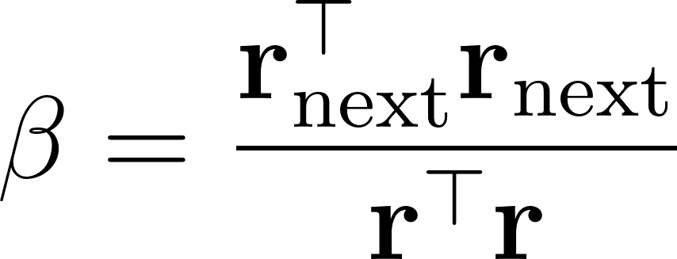
Custom CG Iterative Calculations: (methodology continued……)
For each iteration i, the algorithm computes the optimal step size (α) and updates the conjugate direction (d_next).
1. Hessian–Direction Product (H_d)
The product H_d is required to compute the optimal step size.
For the MSE objective, the Hessian is given by:
Then:
2. Analytical Step Size (α)
After that we applied Fibonacci line search on quadratic objective func, to calculate the exact analytical step size.
3. Update Weights and Residual:
4. Conjugacy Parameter (β)
Using the Fletcher–Reeves update rule to maintain conjugacy between directions:

Slide 11

Results & Discussions:
5. Update Search Direction
The next direction combines the new residual and the previous direction scaled by β:
Key Finding: All Methods Show High Accuracy. The implementations were validated when all three optimisation techniques; Analytical Least Squares, Scipy CG, and Custom CG converged to nearly identical high-accuracy solutions.
Core Linear Model (Example of AAPL)With an extremely low Mean SquaredError (MSE) of roughly 0.363, the model forecasting Apple's (AAPL) closing price showed a nearly perfect fit.
Close Price = -0.659 Open + 0.852 High+ 0.807 Low
Insights into Finance (Feature Weights):
The best positive predictor is high price (≈ 0.852). The final close is significantly impacted by the day's peak price.A strong positive predictor is low price (≈ 0.807). A solid support level for

Slide 12
Comparison Of Optimization Method:
(results & discussions continued……)
the close is established by the day's floor price.Open Price (≈ -0.659): The negative weight indicates that intraday movements (high/low) are a better predictor of the closing price than the opening price.
Method | Runtime(Seconds) | Final Mse | Iterations/Steps
Least Squares (Analytical) | 0.005986 | 0.362631 | N/A
Scipy's Conjugate Gradient (CG) | 0.089793 | 0.3626 | 50
Custom Conjugate Gradient (CG) | 0.2999 | 0.362625 | 150

Slide 13
Conjugate Gradient The Scalable Solution:
(results & discussions continued……)
Why Financial Modelling Uses Conjugate Gradient (CG) Excels For extensive financial analysis,
CG approaches offer the best possible balance between scalability and efficiency.
Scalability for Large Datasets: CG circumvents the need to compute and invert the Hessian matrix explicitly. Because of this, it is particularly well-suited for high-dimensional financial data (such as millions of observations or thousands of features), where analytical techniques become computationally prohibitive.
Memory Efficiency: By using matrix-vector products instead of storing entire matrices, CG uses a lot less memory. This is perfect for real-time trading systems with limited memory.
Adaptive & Robust Convergence: CG avoids redundant searches by using conjugate search directions, which guarantees faster convergence than steepest descent. It provides strong convergence even on ill-conditioned problems by dynamically adjusting to the structure of the data.

Slide 14
Performance and Practicality:
(results & discussions continued……)
Scipy CG: Its practicality for the majority of financial applications was demonstrated by the industry-standard implementation, which converged in just 50 iterations.
Custom CG: Although it took longer (150 iterations), it achieved similar accuracy and validated the mathematical framework.
Training Efficiency: Studies reveal that CG techniques, such as SCG, can finish training in minutes as opposed to hours for second-order techniques, such as Levenberg-Marquardt. This is a significant benefit for real-time applications.
Generalisation: By lowering the chance of overfitting, neural networks trained with CG optimisation achieve exceptional generalisation (R-values of 0.99+) on unseen stock data.

Slide 15
Conclusion:
The best option for developing production-grade, scalable stock price prediction systems is the Conjugate Gradient approach. The scalability and efficiency of Conjugate Gradient are crucial for real-world financial applications that involve large datasets and real-time predictions, whereas the Analytical Least Squares method works well for smaller datasets.

Slide 17
Citation:
Deliverables:
Code and Plots: https://github.com/SannidhyaDas/StockPriceOptimizer-CG-Fibonacci
Research methodology for applying Fibonacci numbers in financial markets: https://patents.google.com/patent/US6877094B1/en
Step-by-step Python implementation and explanation on Towards Data Science: https://towardsdatascience.com/complete-step-by-step-conjugate-gradient-algorithm-from-scratch-and-its-implementation-for-solving-3a4f9d1b4aa1
ScienceDirect article summarizing the origins and details of the method: https://www.sciencedirect.com/topics/mathematics/conjugate-gradient-method
NASDAQ official site for historical stock data: https://www.nasdaq.com/market-activity/historical-data

