Slide 1
Automatic Detection of Hard Exudates in Retinal Fundus Images
Jennifer Mento Clemens - 19BCE1673
Prithika Shakthi A -19BCE1820
Sanjana Reddy - 19BCE1581

Slide 2
Aim
To detect the presence of Hard Exudates in retinal images as an early sign of retinopathy.
Software Requirements
Matlab

Slide 3
Purpose / Scope of the project
The main purpose or scope of this work is to automate and detect Diabetic Retinopathy (DR) at an early stage in patients.
When a patient has DR, the blood vessels develop sacks and eventually break. The blood leaks from these broken sacks into the eyes and forms a yellowish patch. These patches are the Hard Exudates.
Nowadays, there is a lack in the number of Ophthalmologists, considering the growing number of DR patients.
Hence, the purpose of this project is to automate the detection of Hard exudates in fundus images of the retina.

Slide 4
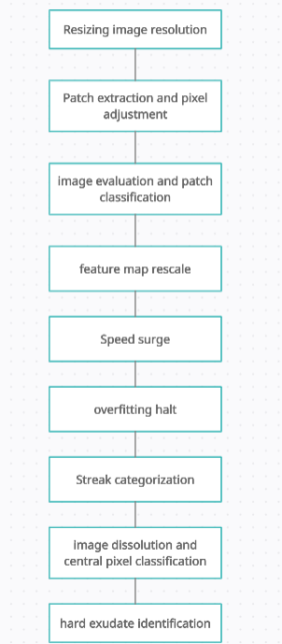
Architectural Diagram

Slide 5
Algorithm
Hard Exudates presented in the DR affected fundus image have been detected using a deep learning model. Assumptions: In all the fundus images of the retina, the hard exudates of an intensity of 1 and the background has an intensity of 0.
Step 1:
Resize all the fundus images to 256x256 resolution.
Step 2:
Extract image patches of size 32x32 from the ground truth images, in which the pixel of interest is located at position (17, 17). Since no padding was used on the ground truth images, all the pixels are not evaluated. The original images are evaluated from (16, 16) to (240,240).
Step 3:
The image patches are evaluated on an 8 layer convolution neural network using a kernel of size 2x2. The neural network classifies whether the central pixel of each image patch belongs to a hard exudate or background.
Step 4:
After every second convolution layer, Maxpool is used to half the size of the feature map.

Slide 6
Step 5:
Batch normalization is also used in each convolution layer to increase the speed of the training.
Step 6:
Overfitting is prevented by making use of Drop out.
Step 7:
Out of 200000 image patches, 5 sets of 40000 were each trained for 500 epochs one by one. When the network trained all 40000 image patches of one set for 500 epochs, it is called a streak. The current network is trained for 3 complete streaks which means the network is trained for 1500 epochs.
Step 8:
After training, the images are dissolved into 50176 patches which is then predicted by the network whether the central pixel belongs to a hard exudate or background.
Step 9:
These image patches are then reshaped into images of size 224x224 since padding was not initially used. Hence, images with hard exudates are detected.

Slide 7
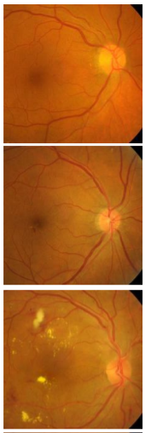
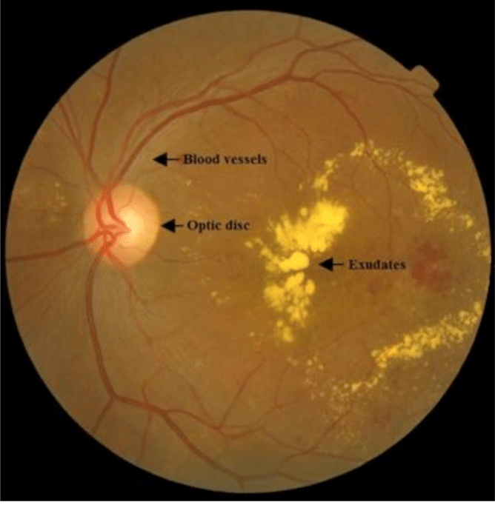
Fig. Full capture of retina containing hard exudates near the edges.
Fig. Cropping the retinal images to only the evaluated pixels.
Notes:
Identifying the edge HE, means a higher probability for hard exudates to be identified in a retinal image. Which in turn can increase the accuracy of the model.

Slide 8
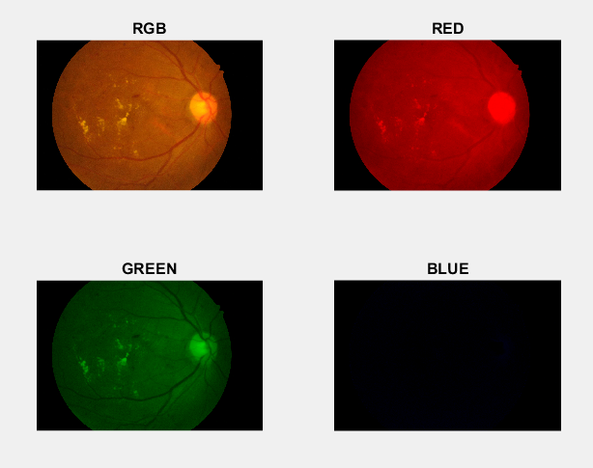
Drawbacks/Flaws:
Outer 16 pixels are ignored.
Hard exudates in those regions are not identified.
Our Solution:
Pad the original images of size 256x256 with 16px width border.
Apply the convolution layers to any one of the RGB planes since the hard exudates may be more intense in those planes.
Test to see if accuracy can be increased by this method.
Notes:
Deep random forest, domain knowledge

Slide 9
Dataset Information
Dataset used is INDIAN DIABETIC RETINOPATHY IMAGE DATASET (IDRiD).
URL: https://www.kaggle.com/aaryapatel98/indian-diabetic-retinopathy-image-dataset

Slide 10
References
1. He, Xueqin, et al. "Automatic Detection of Hard Exudates in Retinal Fundus Images." (2021).
2. Benzamin, Avula, and Chandan Chakraborty. "Detection of hard exudates in retinal fundus images using deep learning." 2018 Joint 7th International Conference on Informatics, Electronics & Vision (ICIEV) and 2018 2nd International Conference on Imaging, Vision & Pattern Recognition (icIVPR). IEEE, 2018.
2. Sánchez, Clara I., et al. "A novel automatic image processing algorithm for detection of hard exudates based on retinal image analysis." Medical engineering & physics 30.3 (2008): 350-357.

