Slide 1
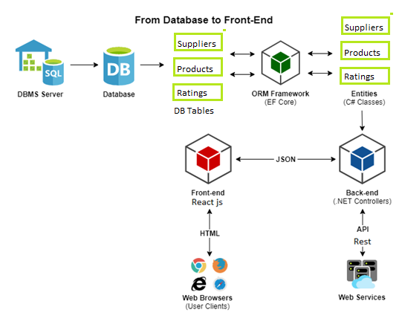
FEATURE 1

Slide 2
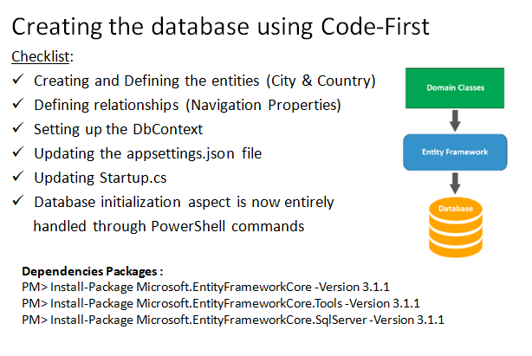

Slide 3
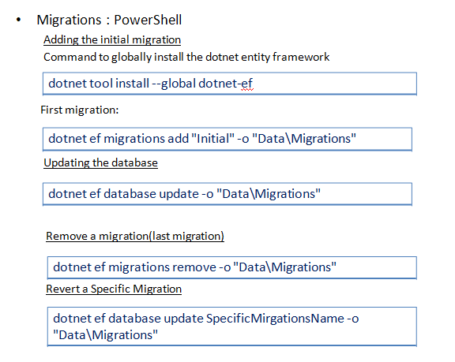

Slide 4
Generate SQL scripts Migrations :
Basic Usage
dotnet ef migrations script
With From (to implied)
dotnet ef migrations script ThisMigrationtoLatestMigrations
With From and To
dotnet ef migrations script <First: Exclusive> <Second: Inclusive>
Drops the database.
dotnet ef database drop

Slide 5
